Slide 1
From Chemist to Software Engineer in 5 months
Kelly Lin
28 Mar 2019

Slide 2
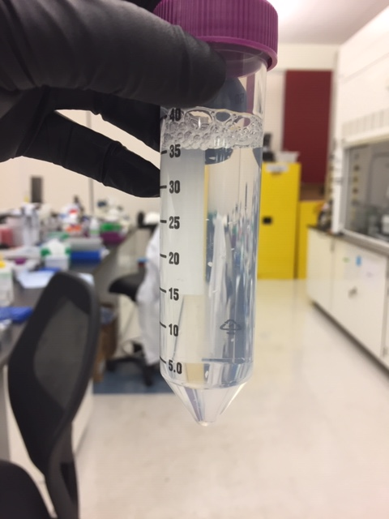
Where I Came From
Bachelor’s in Chemistry
Worked in Pharma for 4 years
Analytical and Formulation Chemistry
Lab work

Slide 3
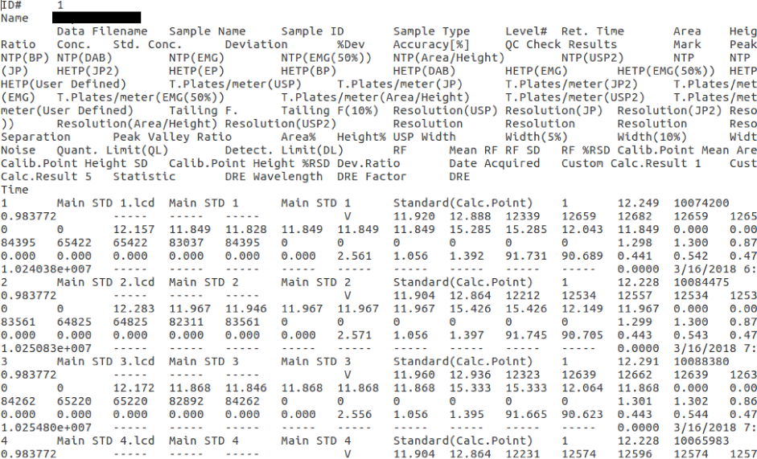
The Catalyst

Slide 4
Initial Steps
Learned some Python to automate some of my work in June 2018
Along the way, took free courses online
  Harvard CS50
  MIT 6.001x, MIT 6.002x
Made some crappy personal projects and really enjoyed it.

Slide 5
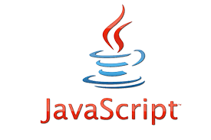

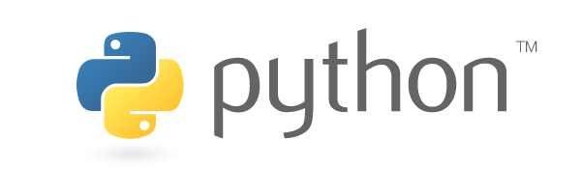
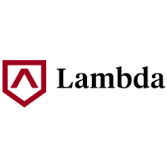
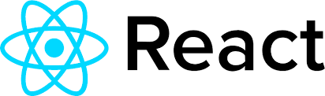
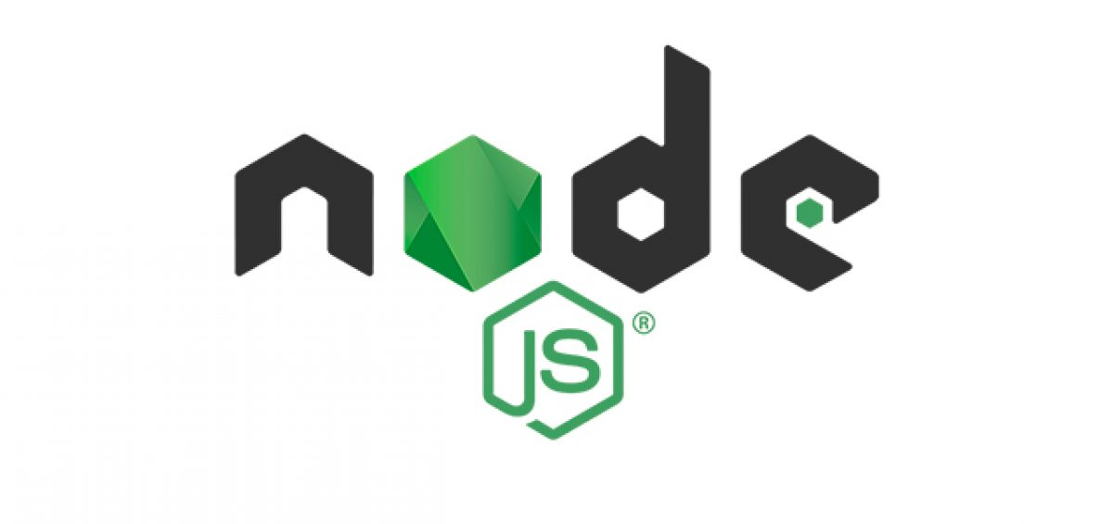

Serendipity
Laid off in Oct 2018
Seemed like a sign!
Enrolled at a remote coding academy (Lambda School) in Nov 2018
Continued self-teaching outside of it

Slide 6
Interview Prep Cycle
Not getting responses? Improve resume, network, coffee chats.
Not hearing back after phone screen? Practice phone interviews with friend.
Not hearing back after coding challenges? Algorithms/DS practice.
Not hearing back from onsites? Behavioral or whiteboarding practice.

Slide 7

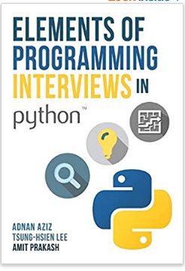
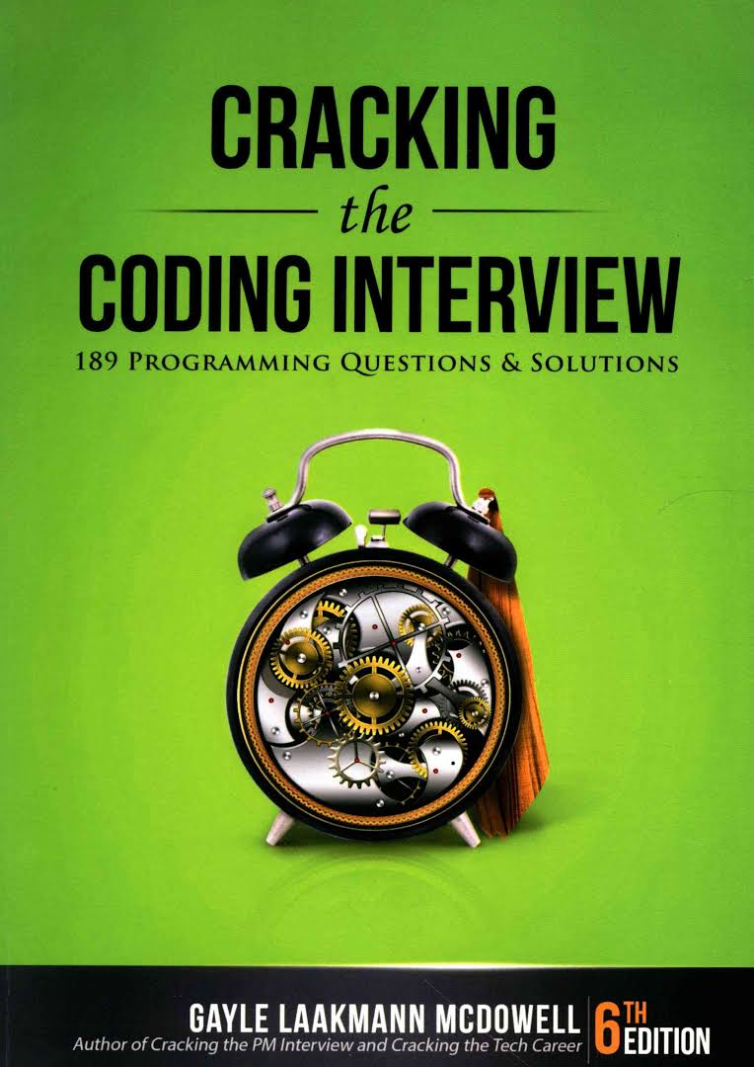
Resources I Used
Elements of Programming Interviews
LeetCode
Cracking the Coding Interview
HackerRank/CodeWars

Slide 8
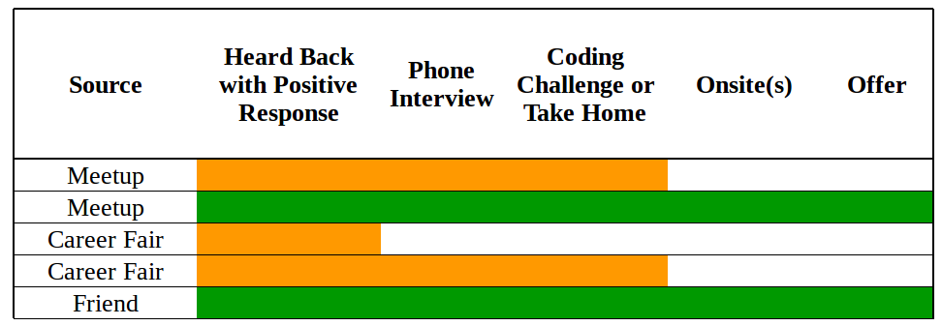
Interview Stats
Applied to 21 places
Positive responses from 5
0% success rate with cold applications
February 2019, received two offers!

Slide 9
Thanks
San Diego Python User Group for the awesome Saturday meetups
Lambda School for the structure and classmate emotional support
Chris Bui, Samira Kiani, David Osuna, Jeff Szielenski from the CTCI meetup for whiteboard coding practice with me

