Slide 1

Facebook: BognorRegisJam
Twitter: @BognorRegisJam #rjam

Slide 2
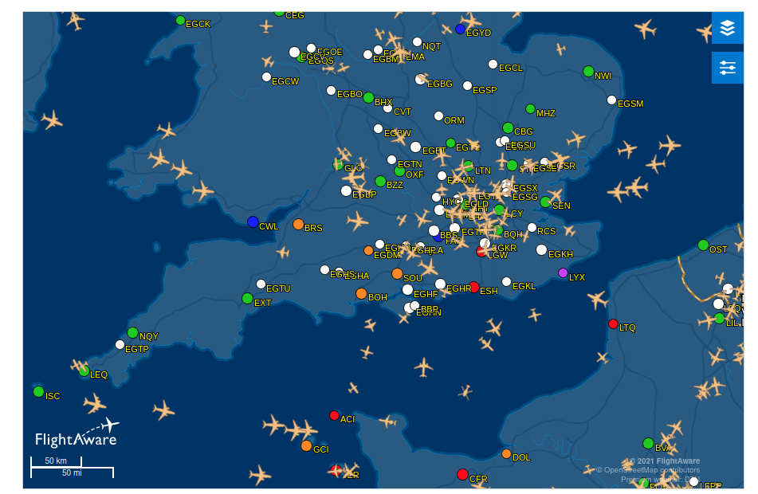
Aircraft Tracking on the Raspberry Pi
Notes:
<number>

Slide 3
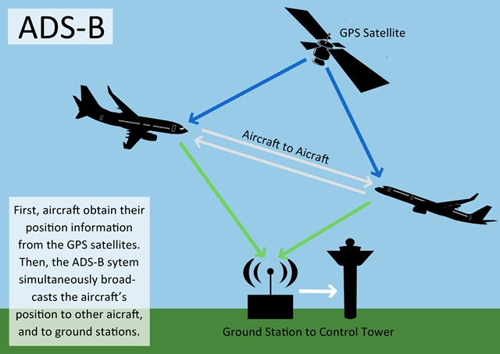
Aircraft Tracking on the Raspberry Pi
What’s it all About?
Almost all aircraft transmit position information using a system called ADS-B.
The signal can be picked up and then transferred to a Raspberry Pi for decoding and displaying on your computer.
Q: What does ADS-B stand for!?
Facebook: BognorRegisJam
Twitter: @BognorRegisJam #rjam
Notes:
<number>

Slide 4
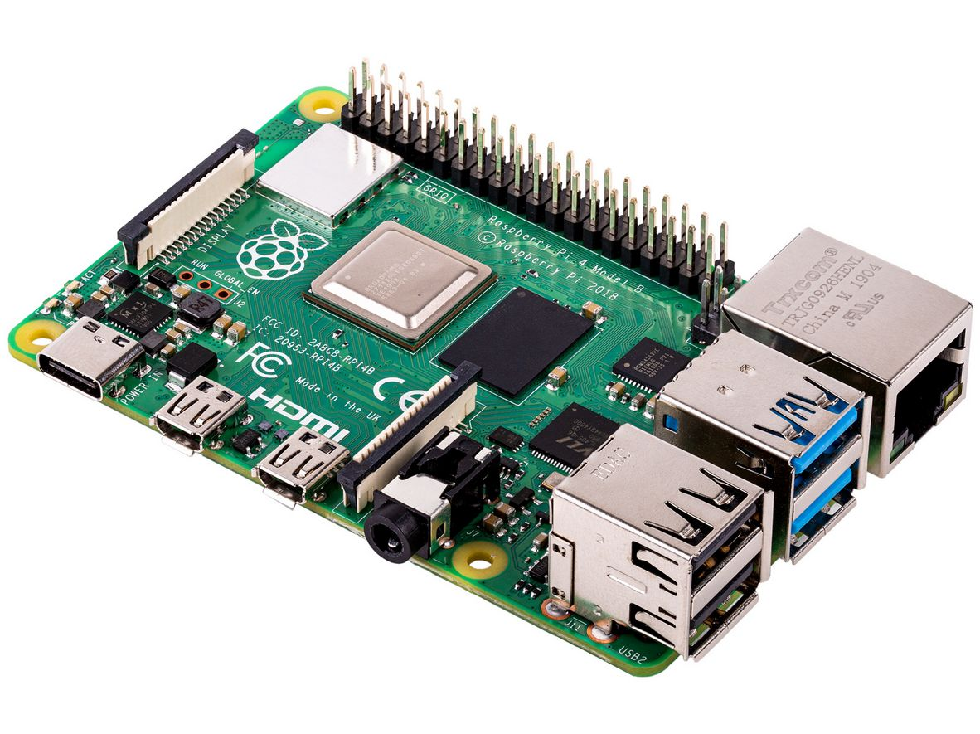
Aircraft Tracking on the Raspberry Pi
You will need...
A Raspberry Pi 2 / 3 / 4 (B or B+) with power supply.
An Internet connection (cable or wifi).
A micro SD card (8GB+) with operating system.
Facebook: BognorRegisJam
Twitter: @BognorRegisJam #rjam
Notes:
<number>

Slide 5
Aircraft Tracking on the Raspberry Pi
You will also need...
USB SDR (Software Defined Radio) adapter (aka ‘dongle’ or ‘stick’).
Antenna.
FlightAware software package.
FlightAware account (free).
Facebook: BognorRegisJam
Twitter: @BognorRegisJam #rjam
Notes:
<number>

Slide 6
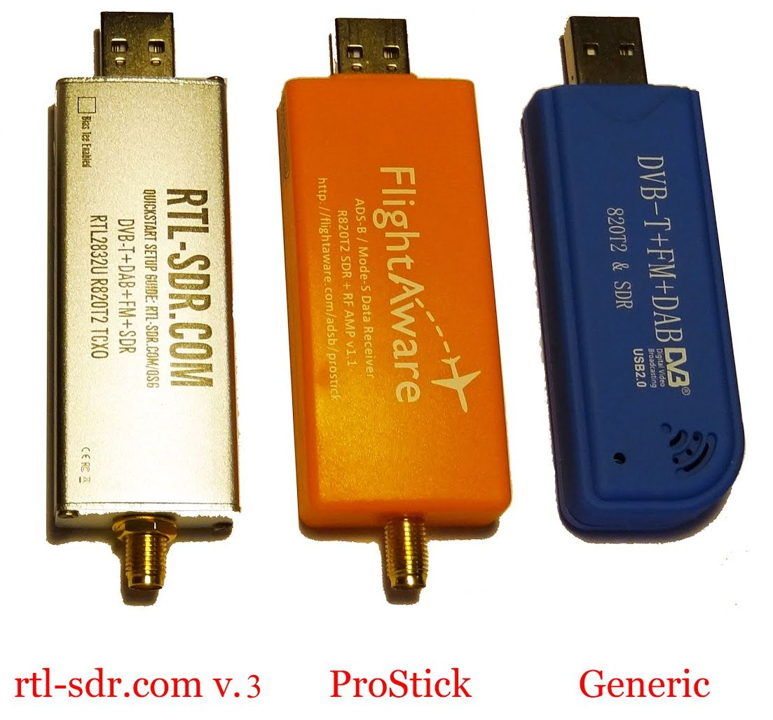
Aircraft Tracking on the Raspberry Pi
You’ll need an SDR Dongle
Generic – approx. £16
Rtl-sdr v.3 - approx. £25
ProStick (Pi Hut, Moonraker) - £21-£25
Make sure the dongle uses the RTL2832U chip
Facebook: BognorRegisJam
Twitter: @BognorRegisJam #rjam
Notes:
<number>

Slide 7
Aircraft Tracking on the Raspberry Pi
Buy a dongle...
Available from:
Amazon
Ebay
Specialist shops
RTL-SDR and FlightAware stores: https://www.rtl-sdr.com/buy-rtl-sdr-dvb-t-dongles/
https://flightaware.com/adsb/prostick/
Search for “RTL-SDR”
See the additional notes at the end of this presentation
Facebook: BognorRegisJam
Twitter: @BognorRegisJam #rjam
Notes:
<number>

Slide 8
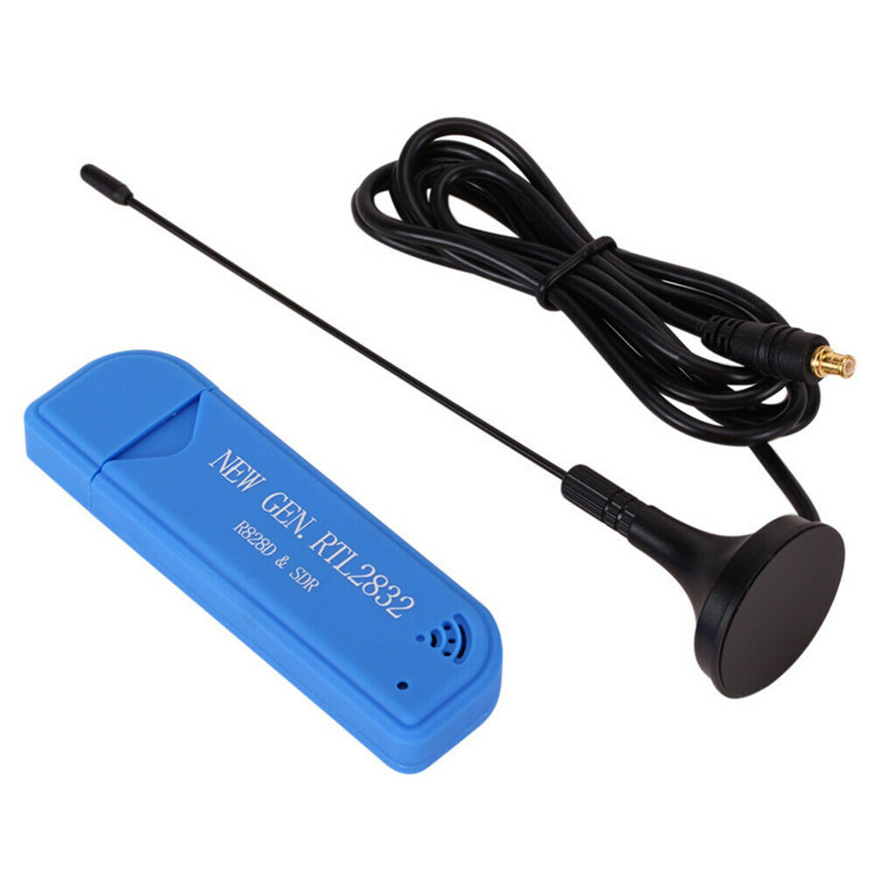
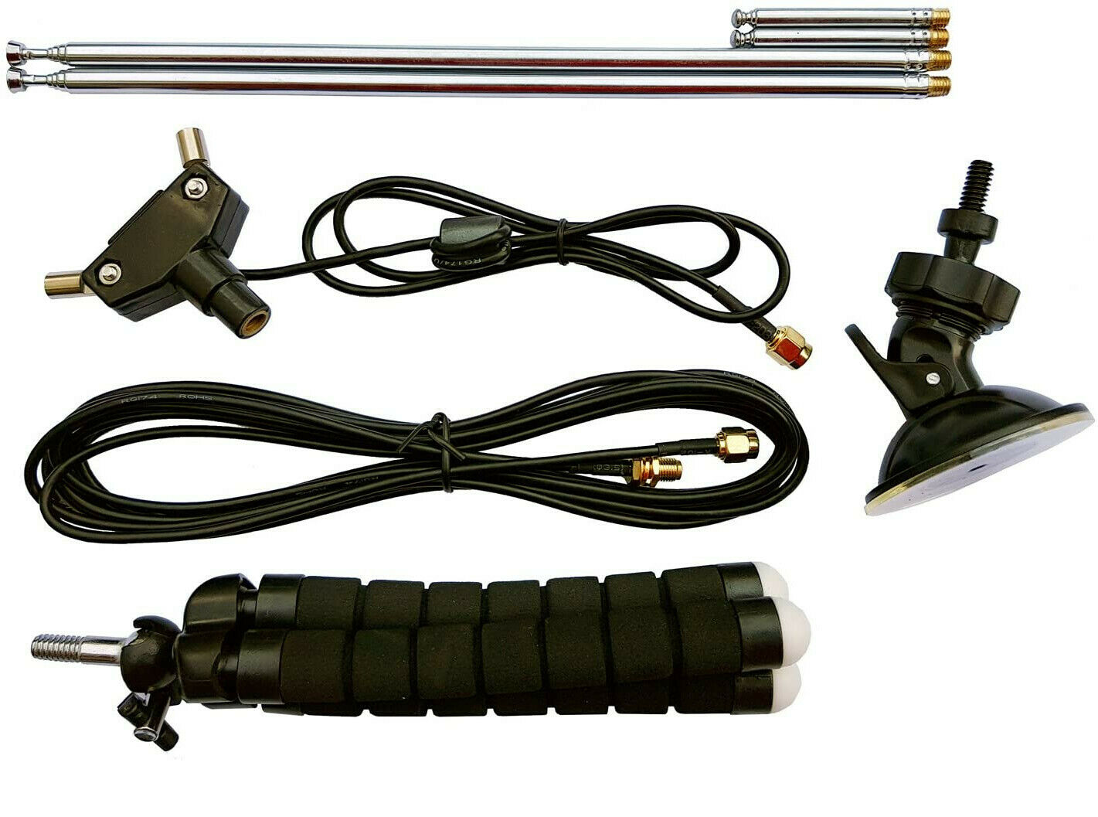
Aircraft Tracking on the Raspberry Pi
You’ll need an antenna
Generic SDR sticks often come with an antenna. – but it’s the wrong length for ADS-B. - we can fix that! – see Appendix.
You can buy a basic antenna kit (“RTL-SDR antenna kit”) for about £18.
Facebook: BognorRegisJam
Twitter: @BognorRegisJam #rjam
Notes:
<number>

Slide 9
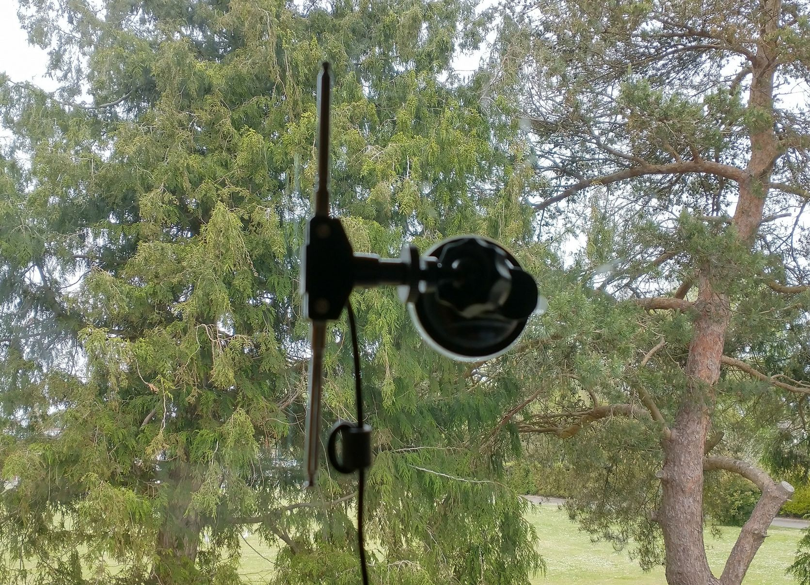
Aircraft Tracking on the Raspberry Pi
Antenna Kit in Use
Short telescopic parts used fully closed – this makes them ~68mm long.
Trees!
Facebook: BognorRegisJam
Twitter: @BognorRegisJam #rjam
Notes:
<number>

Slide 10
Aircraft Tracking on the Raspberry Pi
Wavelength
Wavelength = Speed of light / frequency
Speed of light = 299,792,458m/s
ADS-B frequency = 1090MHz = 1090,000,000Hz
ADS-B Wavelength = 299792458/1090000000 = 0.275m = 27.5cm = 275mm
½ wavelength = 137.5mm ¼ wavelength = 68.75mm
Idea: Write a program to calculate wavelengths from given frequency!
Facebook: BognorRegisJam
Twitter: @BognorRegisJam #rjam
Notes:
<number>

Slide 11
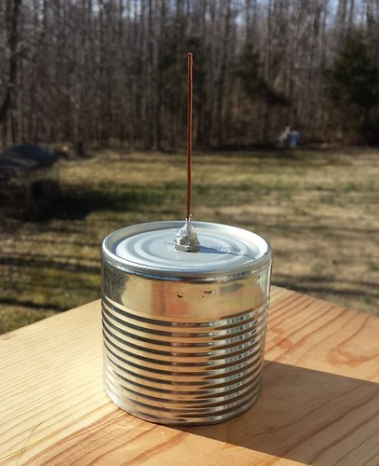
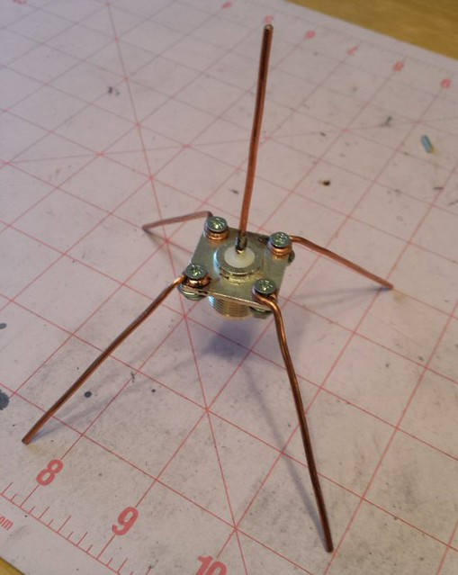
Aircraft Tracking on the Raspberry Pi
You’ll need an antenna – make your own...
Cantenna
Cantenna
Spider
Facebook: BognorRegisJam
Twitter: @BognorRegisJam #rjam
Notes:
<number>

Slide 12
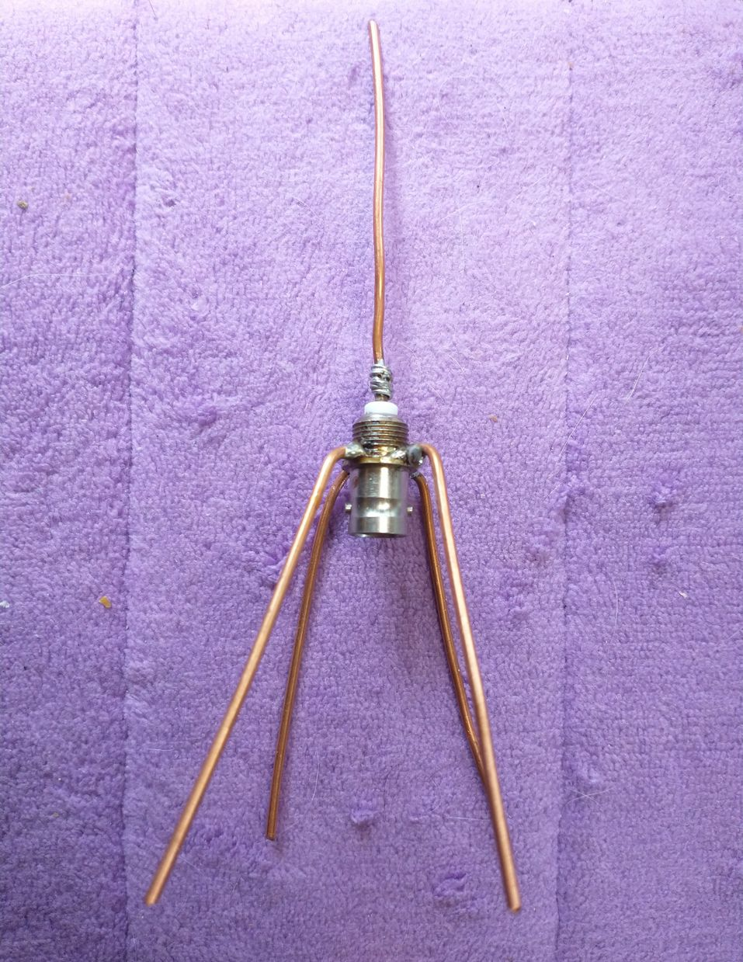
Aircraft Tracking on the Raspberry Pi
Make your own...
Spider
Facebook: BognorRegisJam
Twitter: @BognorRegisJam #rjam
Notes:
<number>

Slide 13
Aircraft Tracking on the Raspberry Pi
FlightAware Software
Follow the instructions at:
https://uk.flightaware.com/adsb/piaware/build
Or see the third-party instructions at:
https://discussions.flightaware.com/t/install-piaware-5-0-on-x86-64-machines-and-rpi-armv7l-aarch64/74699
You can also use a full Raspberry Pi OS image with PiAware preinstalled (requires a blank microSD card) – see the Appendix.
Facebook: BognorRegisJam
Twitter: @BognorRegisJam #rjam
Notes:
<number>

Slide 14
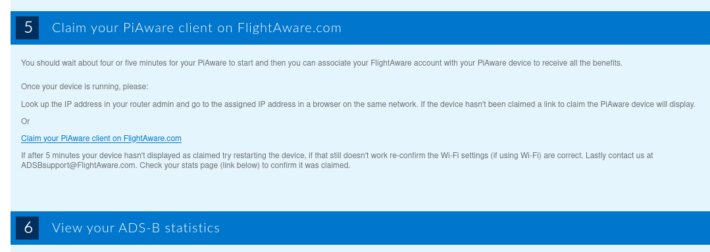
Aircraft Tracking on the Raspberry Pi
FlightAware Account
Instructions are on the PiAware setup Web page.
Facebook: BognorRegisJam
Twitter: @BognorRegisJam #rjam
Notes:
<number>

Slide 15
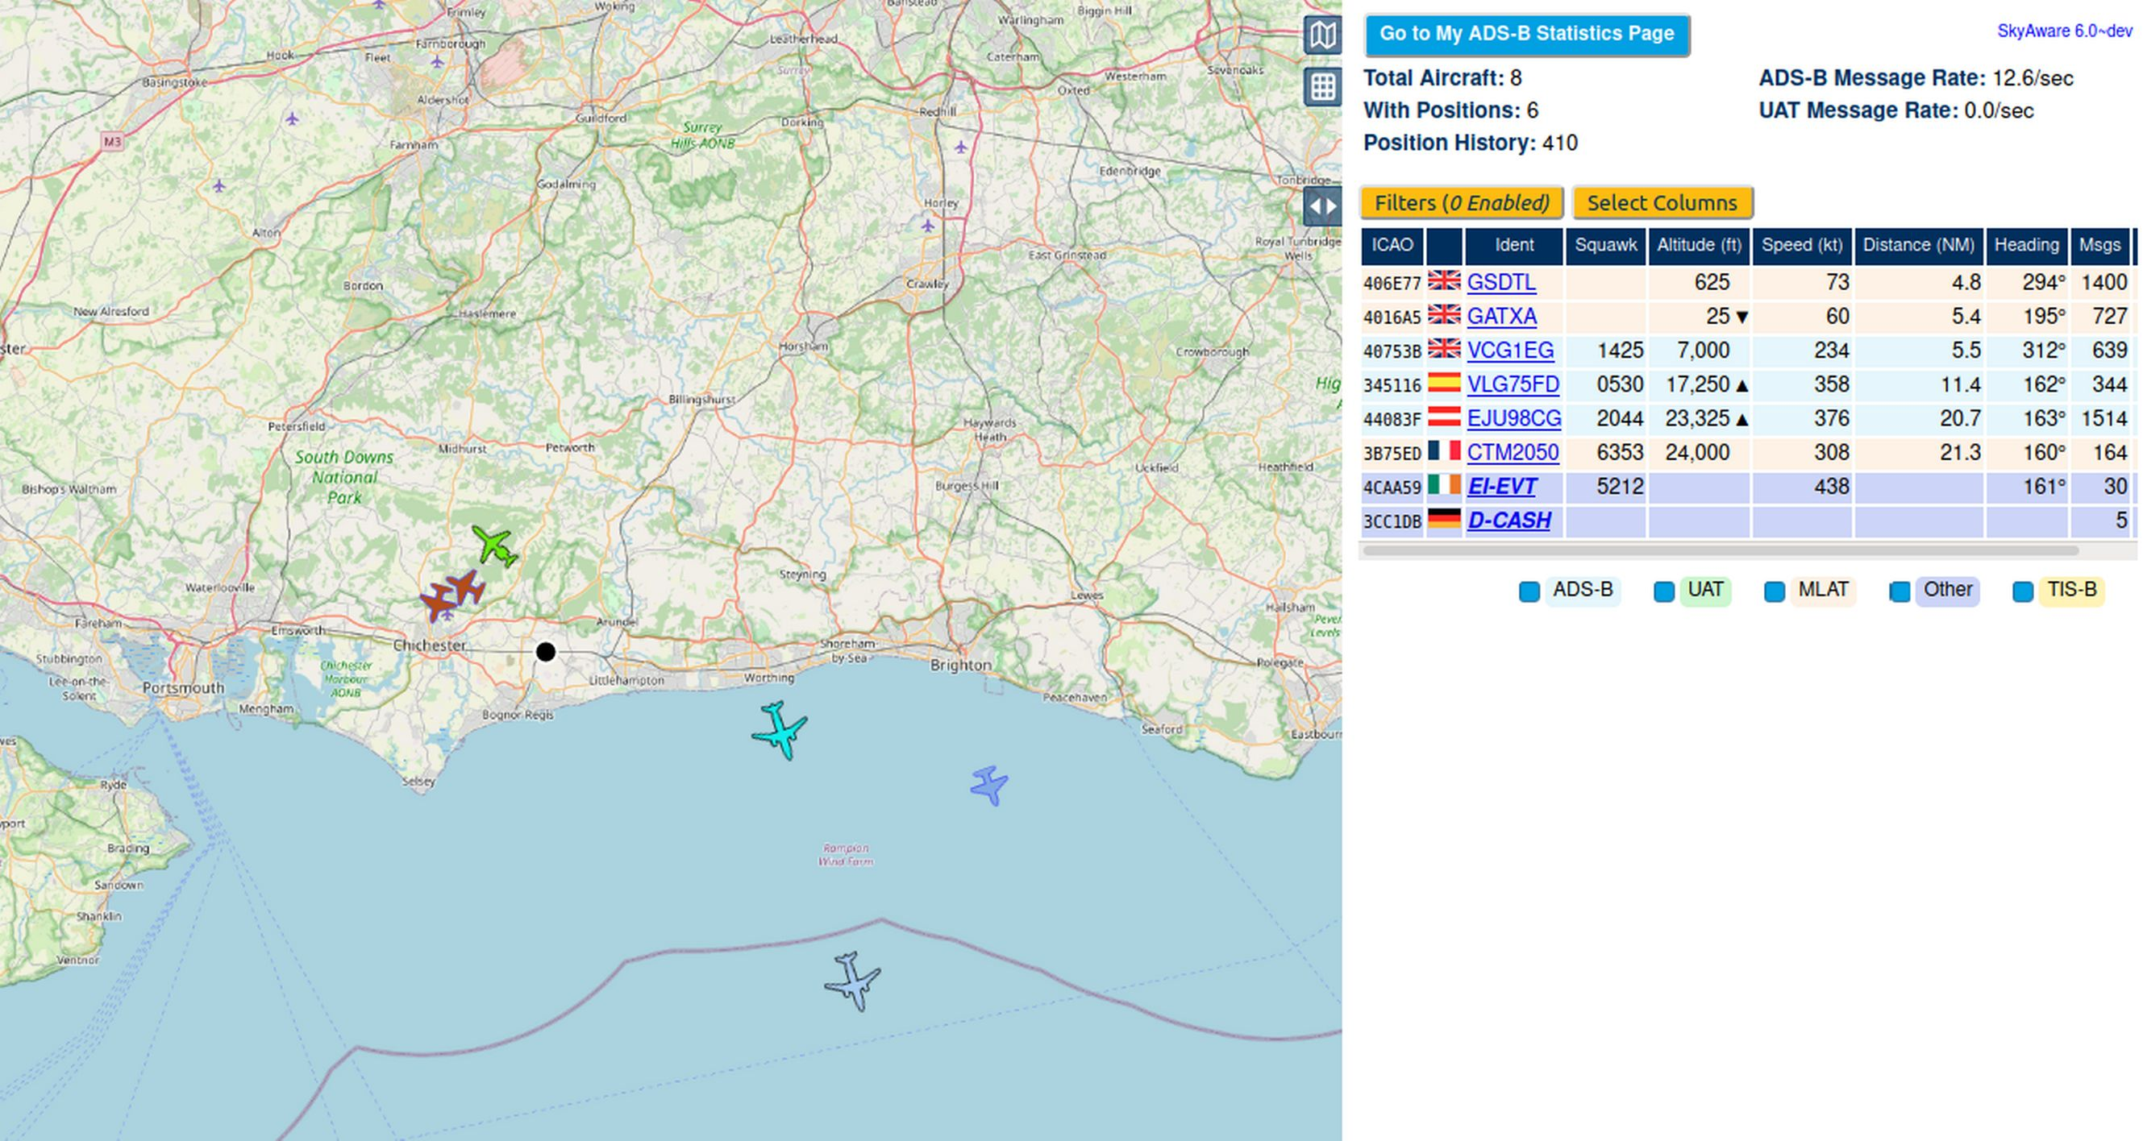
Aircraft Tracking on the Raspberry Pi
Facebook: BognorRegisJam
Twitter: @BognorRegisJam #rjam
Notes:
<number>

Slide 16
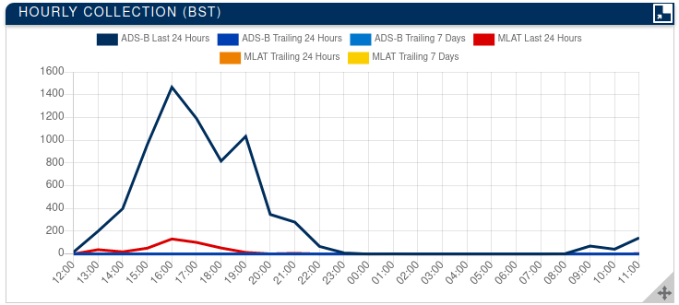
Aircraft Tracking on the Raspberry Pi
FlightAware Account
Facebook: BognorRegisJam
Twitter: @BognorRegisJam #rjam
Notes:
<number>

Slide 17
Aircraft Tracking on the Raspberry Pi
Any Questions?
Facebook: BognorRegisJam
Twitter: @BognorRegisJam #rjam
Notes:
<number>

Slide 18
Aircraft Tracking on the Raspberry Pi
Thank you!
Nigel Kendrick (Twitter: @linker3000)
You’ll find a copy of this presentation at:
https://github.com/linker3000/Raspberry-Pi-Jams
Facebook: BognorRegisJam
Twitter: @BognorRegisJam #rjam
Notes:
<number>

Slide 19
Aircraft Tracking on the Raspberry Pi
Appendix
Things to help you get started!
Modifying a DVB-T antenna
Making your own antenna
Antenna connector adapter
Additional resources
ADS-B = Automatic Dependent Surveillance–Broadcast
Facebook: BognorRegisJam
Twitter: @BognorRegisJam #rjam
Notes:
<number>

Slide 20
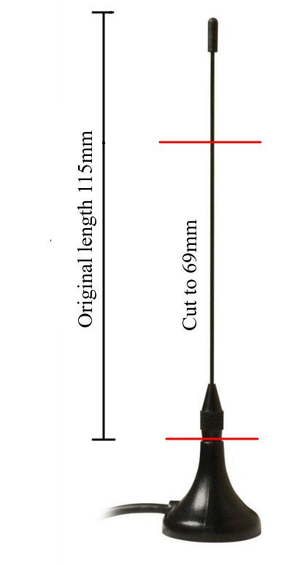
Aircraft Tracking on the Raspberry Pi
Modifying a DVB-T antenna
Antenna length is optimised for Digital TV (DVB-T).
ADS-B is transmitted at a different frequency.
Cut antenna to 69mm.
Take care when cutting the antenna:
The metal is sharp and quite hard.
If using snips, the bit being removed can fly off.
Ask an adult to perform the operation ...or just buy an antenna kit!
After the antenna is cut, it’s no longer the right length for digital TV!
Facebook: BognorRegisJam
Twitter: @BognorRegisJam #rjam
Notes:
<number>

Slide 21
Aircraft Tracking on the Raspberry Pi
Making your own antenna...
Check out some handy sites:
https://lucsmall.com/2017/02/06/making-antennas-for-1090mhz-ads-b-aircraft-tracking/
https://discussions.flightaware.com/t/three-easy-diy-antennas-for-beginners/16348/3
Radio frequency connectors come in many sizes and are not easy to fit onto cable – you may require assistance.
The UK ADS-B system operates at 1090MHz. You might see references to 978MHz, but that frequency is not used in the UK, so you don’t need to follow any instructions to enable support for it.
Facebook: BognorRegisJam
Twitter: @BognorRegisJam #rjam
Notes:
<number>

Slide 22
Aircraft Tracking on the Raspberry Pi
You might need a connector adapter
Most generic DVB-T SDR dongles (blue dongle on the far right) are fitted with a connector type called MCX
Most antenna kits come with SMA connectors (like the first two dongles in the picture)
For dongles with MCX connectors you need an adapter!
Search eBay (or your favourite store site) for:
“sma female mcx male”
Facebook: BognorRegisJam
Twitter: @BognorRegisJam #rjam
Notes:
<number>

Slide 23
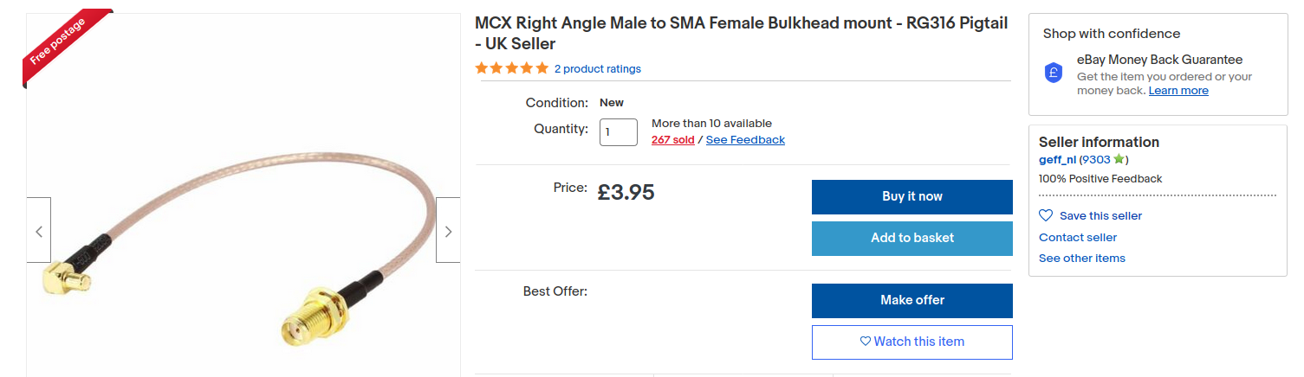
Aircraft Tracking on the Raspberry Pi
You might need a connector adapter
Example (below). A pigtail lead puts less stress on the dongle’s MCX connector….
MCX
SMA
Facebook: BognorRegisJam
Twitter: @BognorRegisJam #rjam
Notes:
<number>

Slide 24
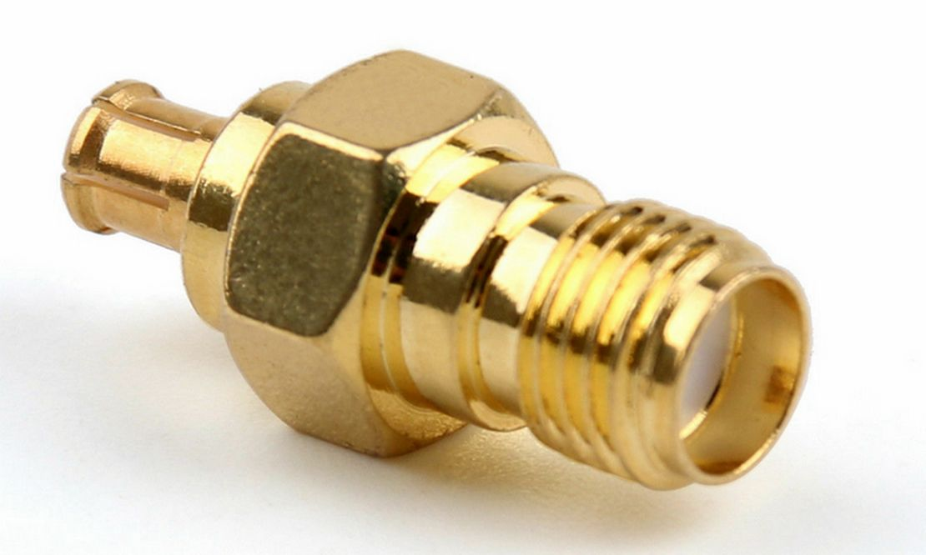
Aircraft Tracking on the Raspberry Pi
You might need a connector adapter
...but you can get a straight adapter if you wish...
MCX
SMA
Facebook: BognorRegisJam
Twitter: @BognorRegisJam #rjam
Notes:
<number>

Slide 25
Aircraft Tracking on the Raspberry Pi
PiAware Image
A complete Raspberry Pi OS installation image with PiAware preinstalled.
Follow instructions at:
https://discussions.flightaware.com/t/how-to-install-and-configure-piaware-5-0-sd-card-image-quickstart-guide/48262
Facebook: BognorRegisJam
Twitter: @BognorRegisJam #rjam
Notes:
<number>

