Slide 1

前端综合练习
Powerd by LinkKnown
作者:周锐

Slide 2

练习-模态对话框

Slide 3
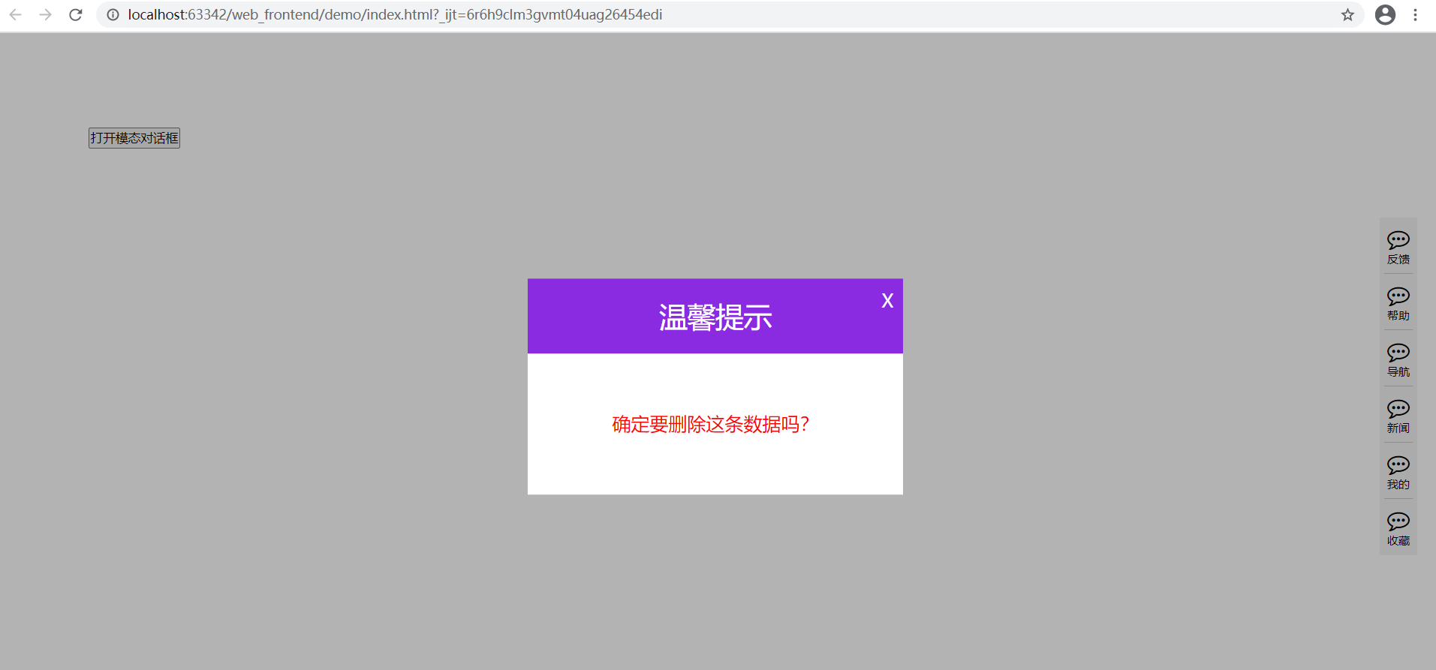
练习-模态对话框

Slide 4
.hide {
display: none;
}
.show {
display: block;
}
/* 模态对话框 */
.modalShade {
position: fixed;
left: 0;
right: 0;
top: 0;
bottom: 0;
width: 100%;
height: 100%;
background-color: black;
opacity: 0.3;
z-index: 100;
}
.modalDialog {
width: 400px;
height: 230px;
position: fixed;
background-color: white;
top: 50%;
left: 50%;
transform: translate(-50%, -50%);
z-index: 101;
}
.dialogHeader {
height: 80px;
line-height: 80px;
background-color: blueviolet;
color: white;
text-align: center;
font-size: 30px;
}
.dialogContent {
height: 150px;
text-align: center;
line-height: 150px;
font-size: 20px;
color: red;
}
.dialogClose {
position: absolute;
right: 10px;
top: 10px;
color: white;
font-size: 20px;
cursor: pointer;
transition: transform 0.2s ease-in-out;
}
.dialogClose:hover {
transform: rotateZ(180deg);
}
<!-- 模态对话框练习 -->
<div class="modalDiv">
<button>打开模态对话框</button>
<div class="modalShade hide"></div>
<div class="modalDialog hide">
<div class="dialogClose">X</div>
<div class="dialogHeader">温馨提示</div>
<div class="dialogContent">确定要删除这条数据吗？</div>
</div>
</div>
$(".modalDiv > button").click(function () {
$(".modalShade").show();
$(".modalDialog").show();
// 打开模态对话框后禁用滚动条
$("body").css("overflow", "hidden");
});
$(".dialogClose").click(function () {
$(".modalShade").hide(1);
$(".modalDialog").hide(1);
$("body").css("overflow", "visible");
});
模态对话框

Slide 5
练习-简易轮播图

Slide 6

练习-简易轮播图

Slide 7
<!-- 轮播图实现 -->
<div class="swiperBox">
<ul class="swiperList">
<li class="swiperItem">
<a href="javascript:;">
<img src="./img/img01.jpg" alt="">
</a>
</li>
<li class="swiperItem">
<a href="javascript:;">
<img src="./img/img02.jpg" alt="">
</a>
</li>
<li class="swiperItem">
<a href="javascript:;">
<img src="./img/img03.jpg" alt="">
</a>
</li>
<li class="swiperItem">
<a href="javascript:;">
<img src="./img/img04.jpg" alt="">
</a>
</li>
<li class="swiperItem">
<a href="javascript:;">
<img src="./img/img05.jpg" alt="">
</a>
</li>
</ul>
<ul class="swiperPage"></ul>
</div>
/* 轮播图 */
.swiperBox {
position: relative;
margin: 0 auto;
width: 800px;
height: 400px;
overflow: hidden;
}
.swiperList {
list-style: none;
}
.swiperItem {
width: 800px;
height: 400px;
float: left;
line-height: 400px;
}
.swiperItem img {
width: 100%;
height: 100%;
}
.swiperPage {
position: absolute;
right: 10px;
bottom: 10px;
list-style: none;
}
.swiperPage > li {
float: left;
color: white;
width: 18px;
height: 18px;
line-height: 18px;
border: 1px solid #e8e8e8;
background-color: transparent;
border-radius: 50%;
text-align: center;
font-size: 14px;
margin: 0 2px;
cursor: pointer;
}
.swiperPage > li.active {
color: darkorange;
border: 1px solid darkorange;
}

Slide 8
// 当前选中的索引
var index = 0;
// 除第一张其余的图片全部隐藏
$(".swiperList > li:not(:eq(0))").hide();
// 定义页码
var totalNum = $(".swiperList > li").length;
var html_page = "";
for (var i=1; i<= totalNum; i++) {
if (i === 1) {
html_page += "<li class='active'>" + i + "</li>";
} else {
html_page += "<li>" + i + "</li>";
}
}
$(".swiperPage").html(html_page);
$(".swiperPage > li").click(function () {
index = $(this).index();
showPic(index);
});
function showPic (index) {
$(".swiperList > li:eq(" + index + ")").show().siblings("li").hide();
$(".swiperPage > li:eq(" + index + ")").addClass("active").siblings("li").removeClass("active");
}
// .hover( handlerIn, handlerOut )
$(".swiperList").hover(function () {
clearInterval(window.swiper_timer);
}, function () {
window.swiper_timer = setInterval(function () {
showPic(index);
index ++;
if (index === totalNum) {
index = 0;
}
}, 2000);
}).trigger("mouseleave"); // 触发离开使其能自动播放

Slide 9


