Slide 1

前端综合练习
Powerd by LinkKnown
作者:周锐

Slide 2

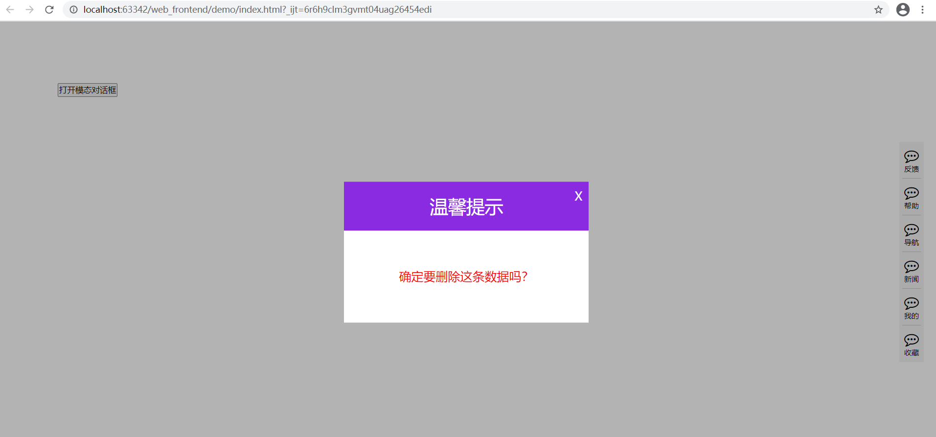
综合练习-模态对话框

Slide 3
/* 模态对话框 */
.modalShade {
position: fixed;
left: 0;
right: 0;
top: 0;
bottom: 0;
width: 100%;
height: 100%;
background-color: black;
opacity: 0.3;
z-index: 100;
}
.modalDialog {
width: 400px;
height: 230px;
position: fixed;
background-color: white;
top: 50%;
left: 50%;
transform: translate(-50%, -50%);
z-index: 101;
}
.dialogHeader {
height: 80px;
line-height: 80px;
background-color: blueviolet;
color: white;
text-align: center;
font-size: 30px;
}
.dialogContent {
height: 150px;
text-align: center;
line-height: 150px;
font-size: 20px;
color: red;
}
.dialogClose {
position: absolute;
right: 10px;
top: 10px;
color: white;
font-size: 20px;
cursor: pointer;
transition: transform 0.2s ease-in-out;
}
.dialogClose:hover {
transform: rotateZ(180deg);
}
<!-- 模态对话框练习 -->
<div class="modalDiv">
<button>打开模态对话框</button>
<div class="modalShade hide"></div>
<div class="modalDialog hide">
<div class="dialogClose">X</div>
<div class="dialogHeader">温馨提示</div>
<div class="dialogContent">确定要删除这条数据吗？</div>
</div>
</div>
$(".modalDiv > button").click(function () {
$(".modalShade").show();
$(".modalDialog").show();
// 打开模态对话框后禁用滚动条
$("body").css("overflow", "hidden");
});
$(".dialogClose").click(function () {
$(".modalShade").hide(1);
$(".modalDialog").hide(1);
$("body").css("overflow", "visible");
});
模态对话框
.hide {
display: none;
}
.show {
display: block;
}

Slide 4


