Slide 1

Views in MS-SQL Server
Soyeb Ghachi
Technical Trainer | Mentor |SME

Slide 2
Views in MS-SQL Server
Advantages of Views
Creating a View
Modifying a View
Removing a View
Overview

Slide 3
Views in MS-SQL Server

Slide 4
In MS-SQL Server, views are virtual database objects that represent the result of a pre-defined query.
They are used to simplify complex queries, provide a layer of abstraction, and offer a way to encapsulate frequently used queries into a reusable structure.
CREATE VIEW [OR ALTER] view_name [(column_list)]
AS
select_statement;

Slide 5
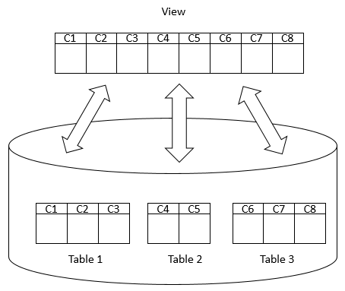
A view may consist of columns from multiple tables using joins or just a subset of columns of a single table. This makes views useful for abstracting or hiding complex queries.

Slide 6
Advantages of views

Slide 7
Advantages of views:
Security
You can restrict users to access directly to a table and allow them to access a subset of data via views.
For example, you can allow users to access customer name, phone, email via a view but restrict them to access the bank account and other sensitive information.
Simplicity
A relational database may have many tables with complex relationships e.g., one-to-one and one-to-many that make it difficult to navigate.
However, you can simplify the complex queries with joins and conditions using a set of views.

Slide 8
Consistency
Sometimes, you need to write a complex formula or logic in every query.
To make it consistent, you can hide the complex queries logic and calculations in views.

Slide 9
Creating View

Slide 10
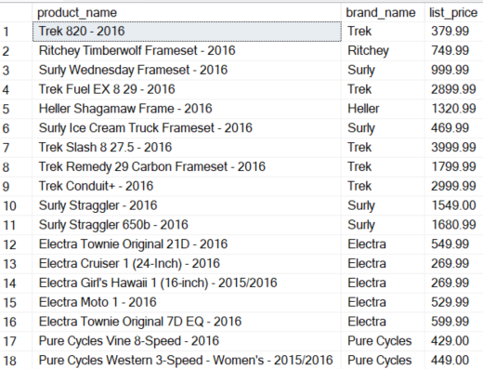
Creating View
CREATE VIEW Select_Products_With_Brand
AS
SELECT
product_name,
brand_name,
list_price
FROM
products p
INNER JOIN brands b
ON b.brand_id = p.brand_id;
Executing a View
SELECT * FROM Select_Products_With_Brand

Slide 11
Modifying a View

Slide 12
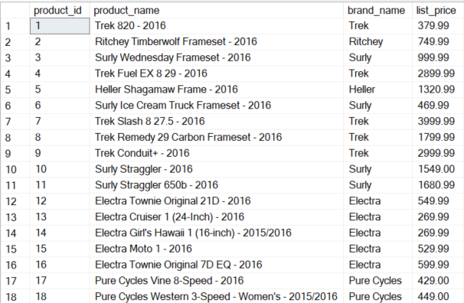
Alter a View
ALTER VIEW Select_Products_With_Brand
AS
SELECT
product_id,
product_name,
brand_name,
list_price
FROM
products p
INNER JOIN brands b
ON b.brand_id = p.brand_id;
Executing a View
SELECT * FROM Select_Products_With_Brand

Slide 13
Removing a View

Slide 14
SQL Server drop view using Transact-SQL:
To remove a view from a database, you use the DROP VIEW statement as follows:
DROP VIEW Select_Products_With_Brand

Slide 15
https://www.w3schools.com/sql/sql_view.asp
References
https://learn.microsoft.com/en-us/sql/relational-databases/views/views
https://www.sqlshack.com/sql-view-a-complete-introduction-and-walk-through/
https://www.tutorialsteacher.com/sqlserver/views
https://www.javatpoint.com/view-in-sql-server
https://www.c-sharpcorner.com/UploadFile/f0b2ed/views-in-sql-server/
https://www.sqlservertutorial.net/sql-server-views/

