Slide 1
WPT sprint2
Lexiao Lin
linkola@bu.edu

Slide 2
sprint1 goal
Get the math model done

Slide 3
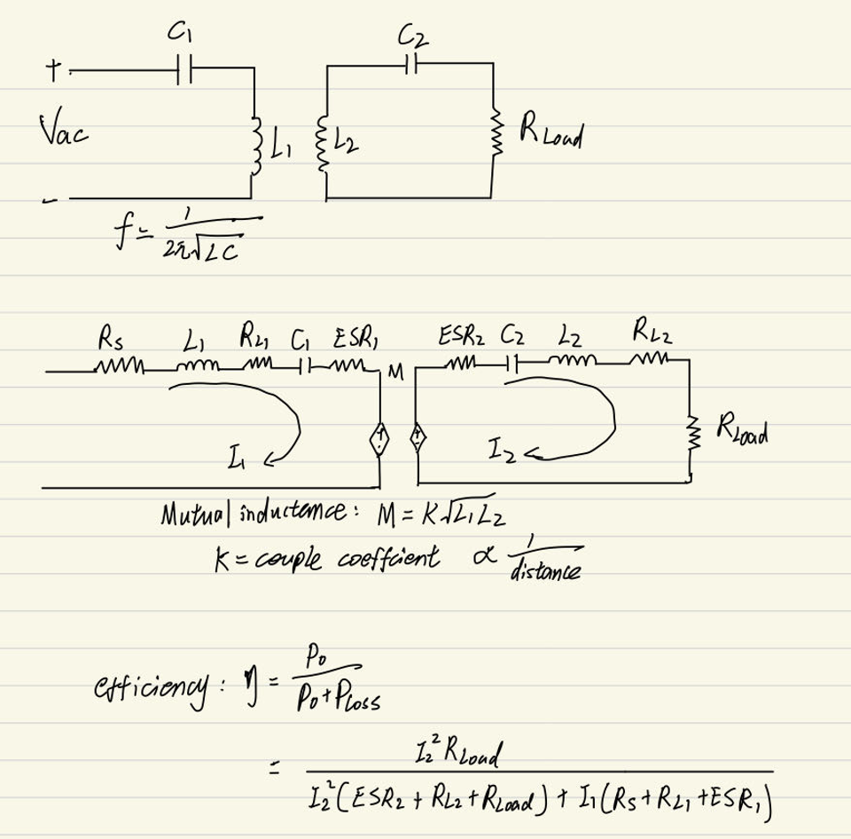
Math Model

Slide 4
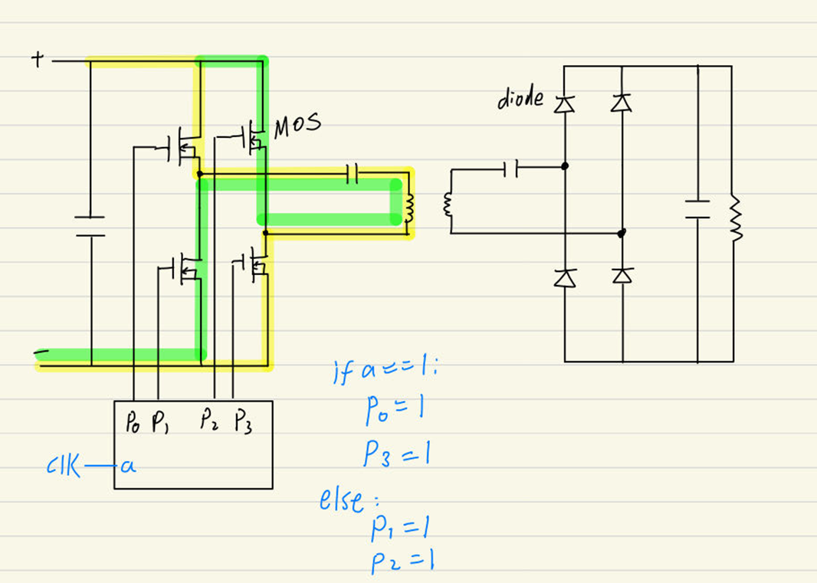
Math Model

Slide 5
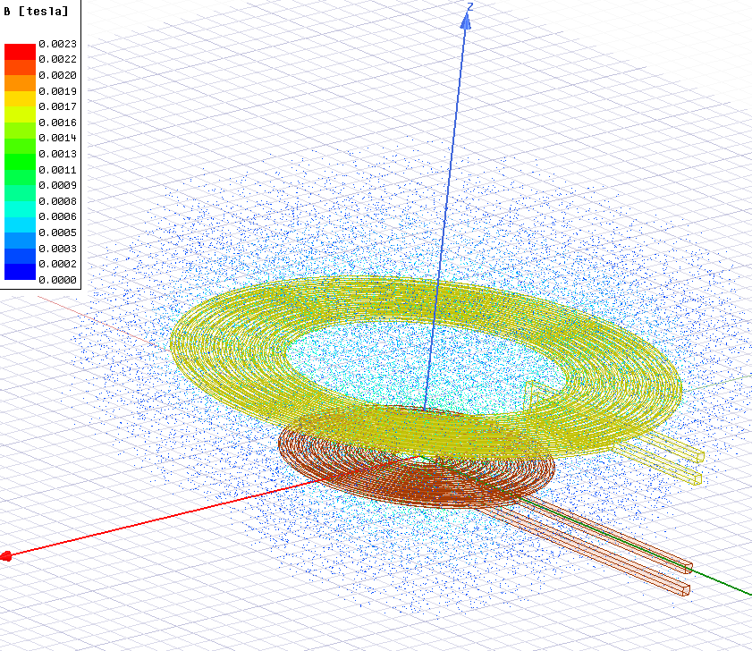
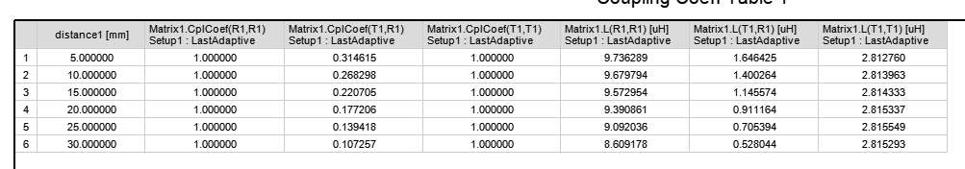
N1=10,N2=10, r1=30mm,r2=5mm

Slide 6
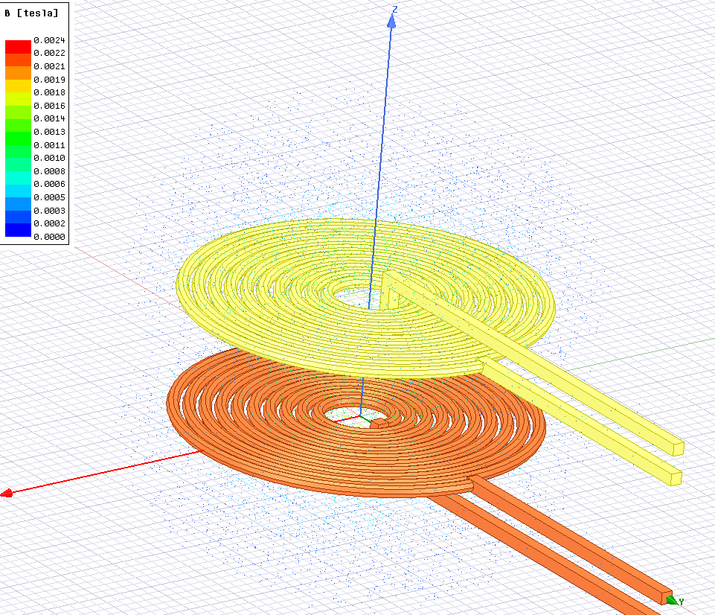
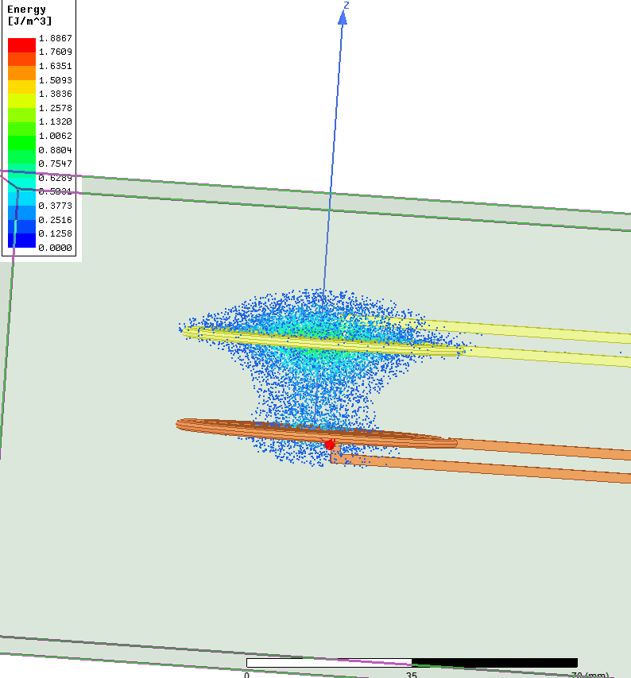
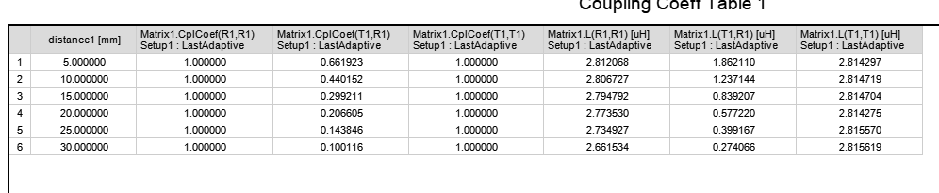
N1=10,N2=10,r1=5mm,r2=5mm

Slide 7
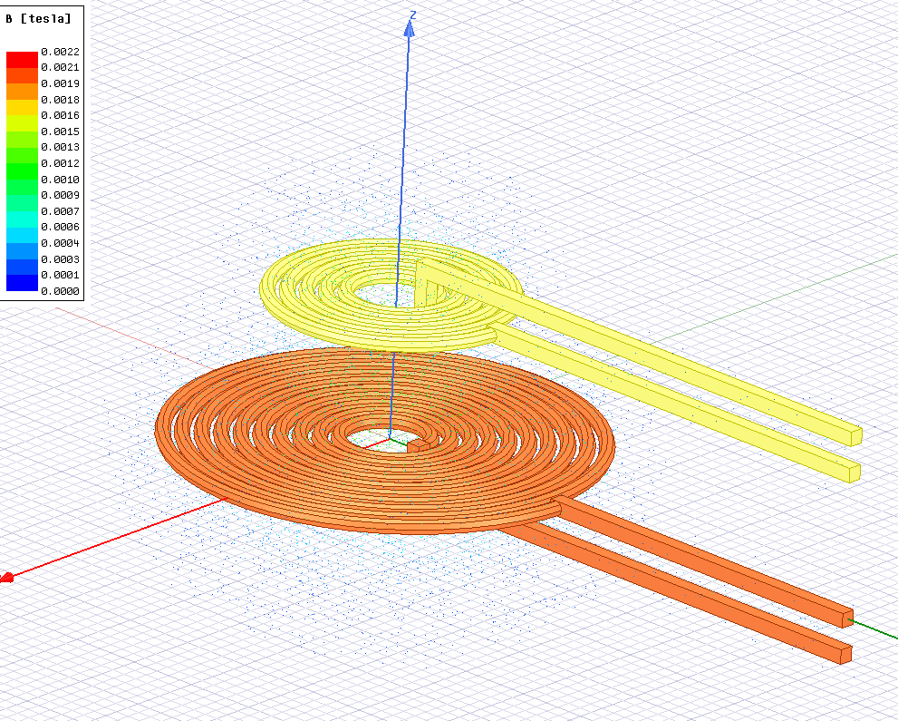
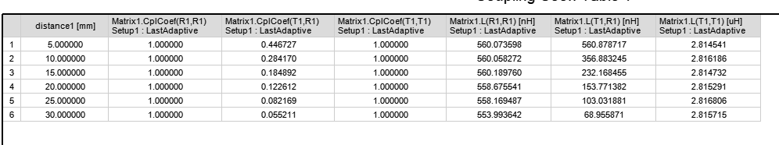
N1=10,N2=5,r1=5mm,r2=5mm

Slide 8
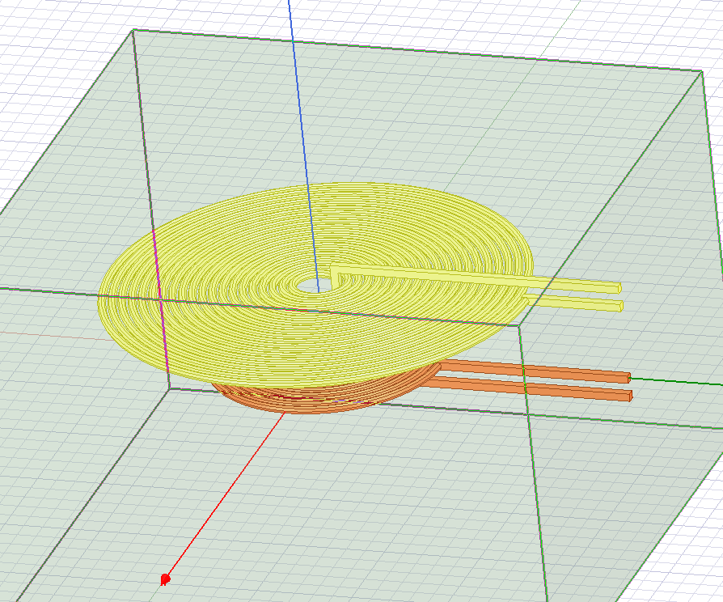
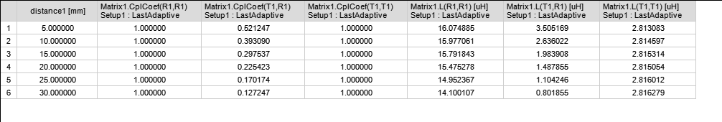
N1=10,N2=20,r1=5mm,r2=5mm

Slide 9
Conclusion
The N of coils has a little influence on K
The best design is the two coils have the same shape
Problem unfixed: The T-distance is still limited

Slide 10
Next goals
Design a WPT system for city power supply
Learn radioactive technology

