Slide 1
Wireless power transfer
Lexiao Lin
linkola@bu.edu

Slide 2
User Stories
People in poor areas & mountain areas: I want to use power as people in cities.
Patients with artificial organs: I don’t want my organs die by accident because of battery aging
People using E-vehicles: I don’t want to charge my car frequently

Slide 3
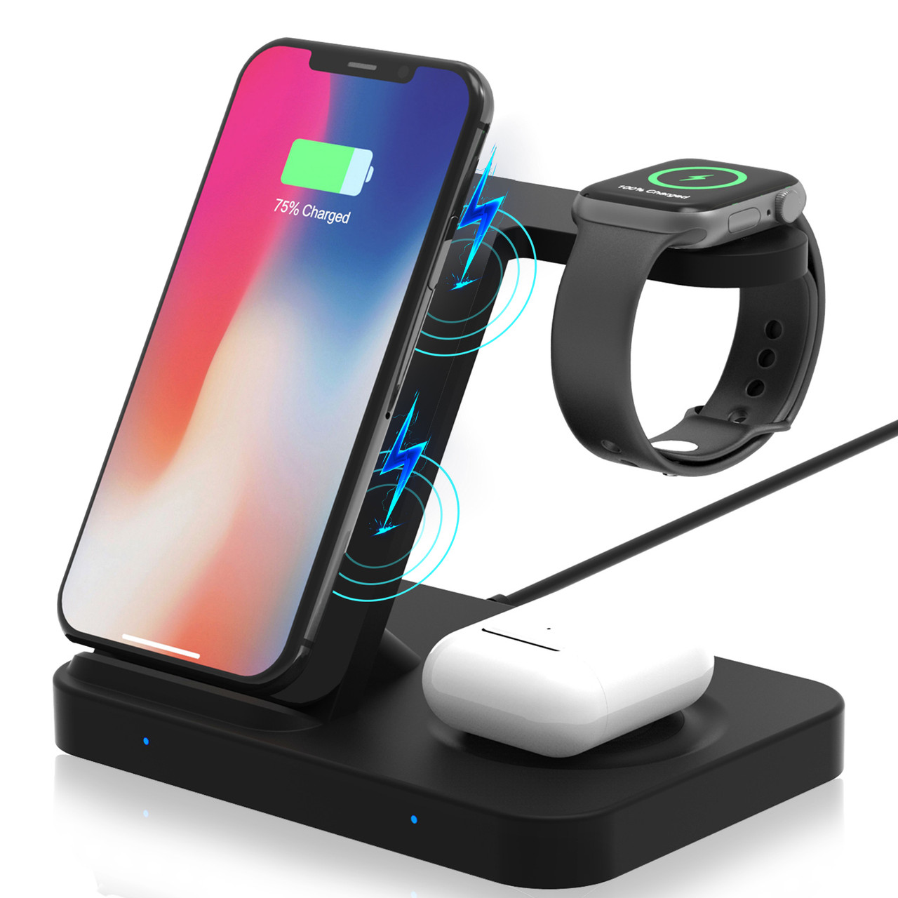
MVP
Close range wireless devices charging (Phones)
Wireless Charger, 3 in 1 Qi 15W Fast Charging Station Fit for iWatch Series 5/4/3/2/1, AirPods Pro/2, Wireless Charging Stand Dock Fit for iPhone 12 Pro Max/XS MAX/Samsung Note20 Ultra/S20+/S20 FE

Slide 4
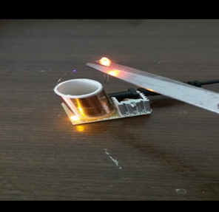
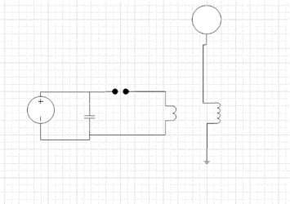
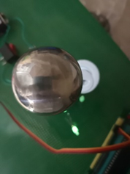
Inductive coupling

Slide 5


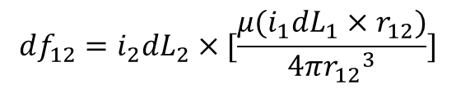
Problem of coupling
$$df_{12}=i_{2}dL_{2}×[\frac{μ(i_{1}dL_{1}×r_{12})}{4π{r_{12}}^{3}}]$$
Ampere's law
$$dB=\frac{μ(i_{1}dL_{1}×r_{12})}{4π{r_{12}}^{3}}$$
Faraday's law
https://www.youtube.com/watch?v=_TFGXC_paeA&t=2s

Slide 6
literature review
N Tesla, “The transmission of electrical energy without wires”, Electrical World and Engineer, 5 March 1904
Sun, Tianjia; Xie, Xiang; Wang, Zhihua (2013). Wireless Power Transfer for Medical Microsystems. Springer Science and Business Media.
Erfani, Reza; Marefat, Fatemeh; Sodagar, Amir M.; Mohseni, Pedram (May 2018). "Modeling and Characterization of Capacitive Elements With Tissue as Dielectric Material for Wireless Powering of Neural Implants". IEEE Transactions on Neural Systems and Rehabilitation Engineering. 26 (5): 1093–1099.

Slide 7
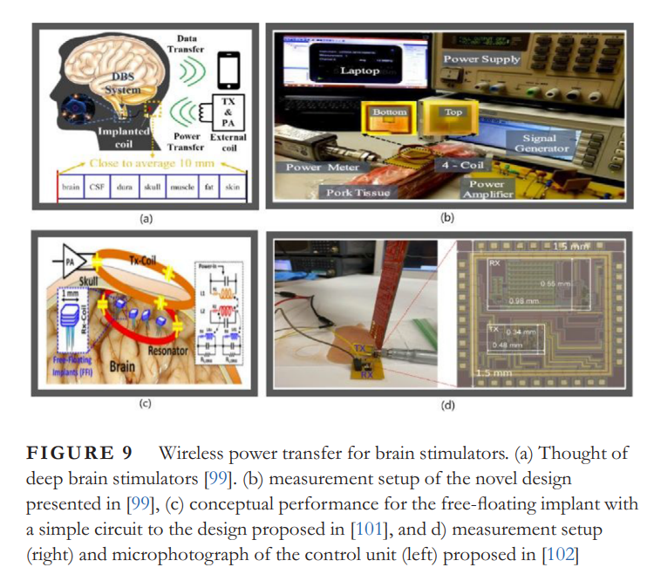
literature review
IET Power Electronics - 2022 - Mahmood - Near‐field wireless power transfer used in biomedical implants A comprehensive review

Slide 8
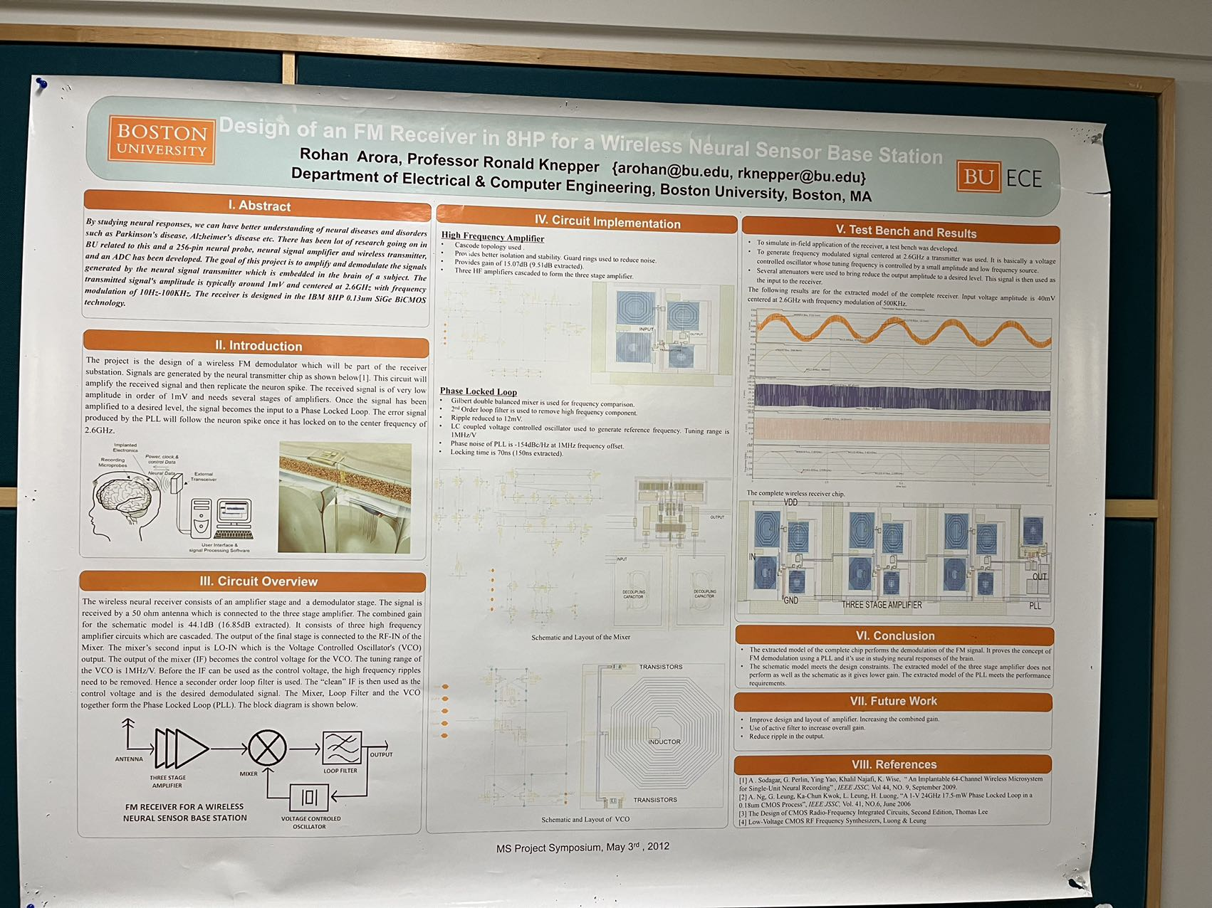
Literature review

Slide 9
Mission
First step: Build a math model for long distance wireless power transfer system
Second step: Build a physical model for a city wireless power transfer system
Final step: The global one

Slide 10
Develop environment and tools
MATLAB: for math calculation
Fusion 360：for anime simulation to show you how will the world be like

Slide 11
Next sprint goal
Get the math model done

