Slide 1

MOEA/D: Multiobjective Optimization Using Decomposition
Qingfu Zhang,
Department of Computer Science,
City University of Hong Kong
qingfu.zhang@cityu.edu.hk

Slide 2
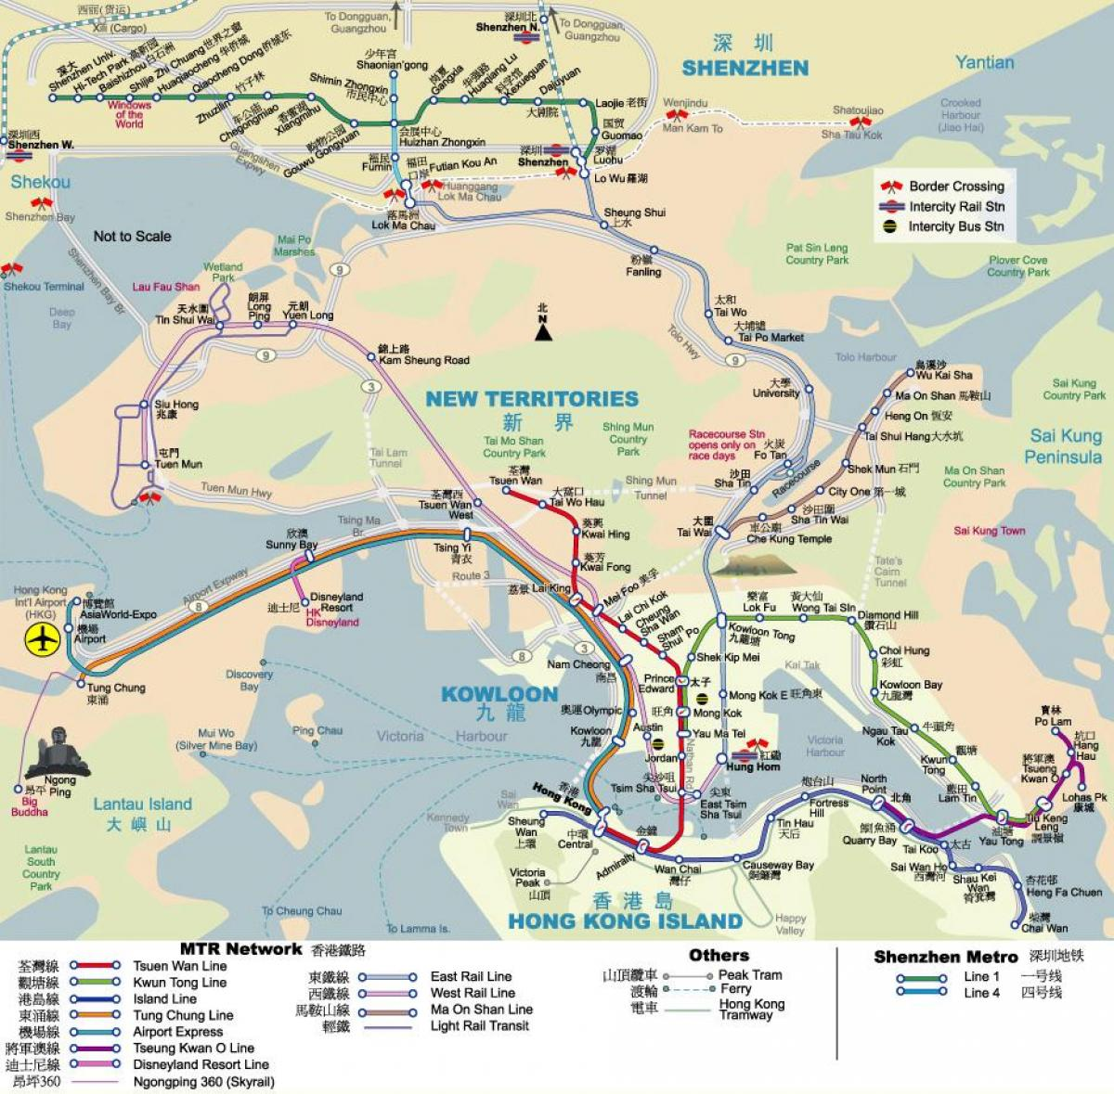
CityU of HK

Slide 3
My office

Slide 4
Artificial Intelligence and Metahursitic Group
Team
17 PhD students
4 Postdocs+2 RAs +Visiting Schoars/students.
Sponsored by RGC, GRF, ITF, ANR, NFSC, MOT, Huawei, CityU,…
Research Areas: Metahursitics, Machine learning, Multiobjective Opt. Interface btw AI and Heuristics.

Slide 5
Outline
Basic Concepts
MOEA/D
New Developments
Conclusions.

Slide 6
Multiobjective Optimization Problem (MOP)
objective vector
search space
where $x$ can be discrete, continuous or mixed variable.
Why multiobjective:
By nature, many real-life problems have multiple objectives.
Decision makers (DM) or modellers don’t know how to combine them into one.
DMs want to know trade-off relationship among these objectives.

Slide 7


Dominance : How to compare two solutions
Search space
$$f_{2}$$
Feasible objective region
A
F(A)
F(B)
B
F(C)
C
$$f_{1}$$
y dominates x iff
y is no worse than x in any objs, and
y is better than x in at least one obj.
In this example:
B dominates A.
B and C are not comparable

Slide 8


Pareto Optimal Solutions= Best Trade-off Candidates
Search Space
$$f_{2}$$
Feasible objective region
PF
PS
$$f_{1}$$
x is Pareto optimal iff no other solution dominates it.
A (rational) decision maker doesn’t like non-Pareto optimal solutions.
Pareto set (PS)= the set of all Pareto optimal solutions in the x-space.
Pareto front (PF) = the image of the PS in the F-space.

Slide 9




Basic Strategies in MCDM
A-priori
A-posteriori
interactive
The final solution
A number of Pareto optimal solutions
The final solution
?

Slide 10
Evolutionary Algorithm (EA) =Population Based Iterative Search Method
Population: a set of candidate solutions.
Selection: select fittest solutions to be parents for next generation.
Crossover: mix two parent solutions to produce new solutions.
Mutation: modify a parent solution to produce a new solution.
One iteration in a simple EA
Population at generation t
Parent Set
Population at generation t+1
Crossover
Mutation
……
Selection

Slide 11
Evolutionary Multiobjective Optimization (EMO)
Generate a number of solutions to approximate the PF (PS) or provide some other useful information to the decision makers.
Popular in many engineering areas.
Mainstream methodology in Multi-Criterion Decision Making (MCDM).
The hottest research area in evolutionary computation field (0ver 20K research papers).

Slide 12
Major EMO Algorithms
Pareto Dominance Based: NSGA-II, SPEA-II, PAES2….
Performance Indicator Based: SMS-EMOA , HyPE….
Decomposition Based: MOEA/D (Zhang & Li, 2007).
One of the most researched and used algorithmic frameworks in evolutionary computation over the last decade.

Slide 13
Outline
Basic Concepts
MOEA/D
New Developments
Conclusions.

Slide 14
MOEA/D=Decomposition + Collaboration
Decomposition (from traditional opt)
Decompose the task of approximating the PF into N subtasks. Each subproblem can be single objective or multiobjective.
Collaboration (from swarm Intelligence and evolutionary computation)
N agents (procedures) are used. Each agent is for a different subproblem.
These N subproblems are related to one another. N agents can solve these subproblems in a collaborative manner.

Slide 15
Major Issues
Problem decomposition and neighbourhood structure.
Search method used by each agent: memory and reproduction operators.
Collaboration: mating selection and replacement.

Slide 16
Outline
Basic Concepts
Basic Ideas in MOEA/D
Some Examples of MOEA/D
Application Examples
Conclusions

Slide 17
Problem Decomposition
Weighted Sum Approach
It works for convex PF.
Pareto optimal solution
Approximation of the PF
N single obj opt suproblems

Slide 18

Tchbycheff Approach
For any Pareto optimal solution $x^{∗}$, there is a $λ$ such that $x^{∗}$ is optimal to the above problem.
${ g}^{T}\left(x,λ\right)$ is not smooth w.r.t. $x,λ$.

Slide 19
Neighbourhood: measure the relationship among subtasks
Two subproblems are neighbours if their weight vectors are close.
Neighbouring subproblems should have similar objective functions and thus similar optimal solutions with high probability.
Many different ways for defining neighbourhood structure.
Neighborhood of problem 5

Slide 20
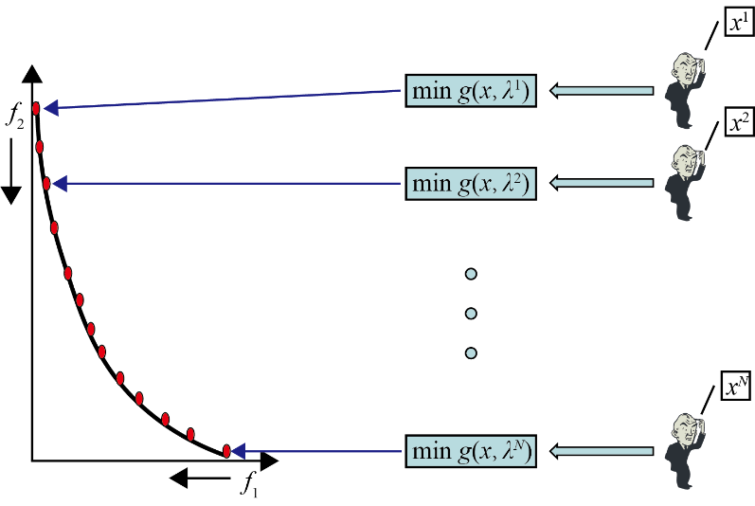
Algorithm
Decomposition,
Neighborhood,
Memory
At each generation, each agent does the following:
Mating selection: obtain the current solutions of some neighbours (collaboration).
2. Reproduction: generate a new solution by applying reproduction operators on its own solution and borrowed solutions.
Replacement:
replace its old solution by the new one if the new one is better than old one for its objective.
pass the new solution on to some of its neighbours, each of them replaces its old solution by this new one if it is better for its objective. (collaboration, neighbourhood)

Slide 21
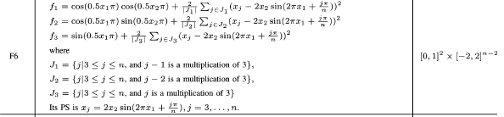
Simulation Results:
No of subproblems: 595, Reproduction operators: DE+Mutation
No of generation: 500
Test instance:
Very hard and the optimal solution set is very complicated.
n =10
MOEA/D
H. Li and Q. Zhang, MOPs with complicated PS, IEEE Trans on Evol. Comput., 2008
Code: https://sites.google.com/view/moead/resources

Slide 22
Dynamical resource allocation
Different subproblems (agents) require different amounts of computational resources.
Each subproblem (agent) has a utility value, which measures the likelihood of further improvement:
At each generation, a small number of agents are selected based on utility values and receive computational resources.

Slide 23
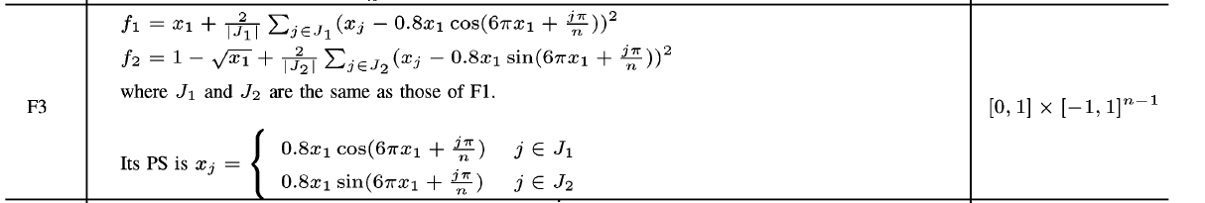
Simulation Results:
No of subproblems: 300, Reproduction operators: DE+Mutation
No of generation: 100
Test instance:
n =10
MOEA/D
MOEA/D with dynamic resource allocation
A. Zhou and Q. Zhang, Dynamical resource allocation, IEEE Trans on Evol. Comput., 2016
Code: https://sites.google.com/view/moead/resources

Slide 24
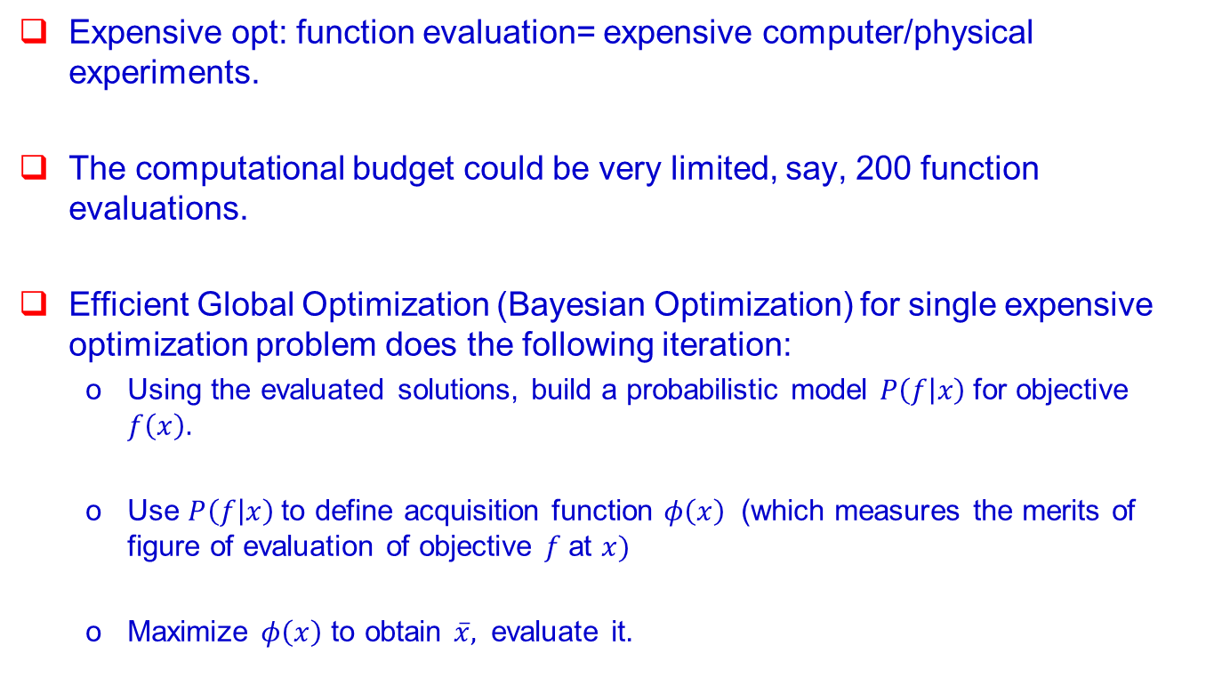
MOEA/D for Expensive Multiobjetive Opt
Expensive opt: function evaluation= expensive computer/physical experiments.
The computational budget could be very limited, say, 200 function evaluations.
Efficient Global Optimization (Bayesian Optimization) for single expensive optimization problem does the following iteration:
Using the evaluated solutions, build a probabilistic model $P\left(f | x\right)$for objective $f\left(x\right).$
Use $P\left(f | x\right)$to define acquisition function $φ\left(x\right)$ (which measures the merits of figure of evaluation of objective $f$at $x)$
Maximize $φ\left(x\right)$ to obtain $\overline{x},$ evaluate it.

Slide 25


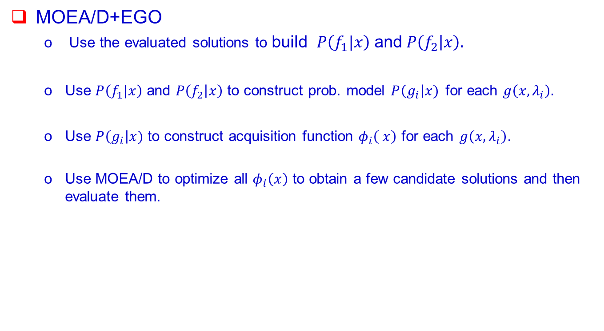



$$g(x, λ_{1})$$
$$f_{2}$$
$$g(x, λ_{2})$$
$$g(x, λ_{N})$$
$$f_{1}$$
MOEA/D+EGO
Use the evaluated solutions to build $P\left(f_{1}|x\right)$ and $P\left(f_{2} | x\right).$
Use $P\left(f_{1}|x\right)$ and $P\left(f_{2} | x\right)$ to construct prob. model $P\left(g_{i}\right|x)$for each $g\left(x, λ_{i}\right).$
Use $P\left(g_{i}\right|x)$ to construct acquisition function $φ_{i}\left( x\right)$ for each $g\left(x, λ_{i}\right)$.
Use MOEA/D to optimize all $φ_{i}\left(x\right)$ to obtain a few candidate solutions and then evaluate them.

Slide 26
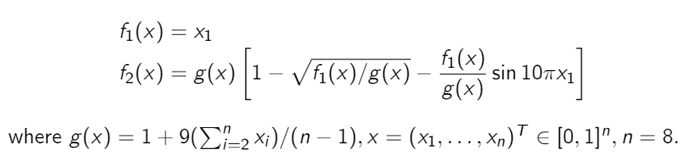
Simulation Results:
Computational budget: 150 function evaluations
Batch size: 5
Test instance：
MOEA/D-EGO
(Zhang et al., 2009)
DirHV-EGO
(Zhao and Zhang, 2023)
Q. Zhang et al., MOEA/D-EGO, IEEE Trans on Evol. Comput., 2009
L. Zhao and Q. Zhang, Hypervolume-Guided Decomposition, IEEE Trans on Evol. Comput., 2023
Code: https://github.com/mobo-d

Slide 27
PPLS/D for Discrete Optimization
Decompose the objective space into a number of sub-regions.
Each subregion i is associated with an aggregated obj function:
e.g.
g_{ws}(x, w_{i})= 0.4 * f₁(x) + 0.6 * f₂(x)
Agent i searches Subregion i by using a PLS guided by g_{ws}(x, w_{i}).
f₂
w₁
w₂
w₃
w₄
w₅
w₆
f₁
Notes:
To solve very complicated real-life optimization problems, we often need to combine different techniques.
Local search is often a basic building block.

Slide 28
Experiments:
Test problem: multiobjective Unconstraint Binary Quadratic Programming
No of variables = 200. No. of objectives: 2 and 3
No. of regions = 11 (for 2-obj) and 66 (for 3-obj)
Jialong Shi, Qingfu Zhang, Jianyong Sun, PPLS/D: Parallel Pareto Local Search Based on Decomposition,
IEEE Transactions on Cybernetics, 2020, 50(3): 1060-1071.
Code:
https://github.com/JialongShi/pplsd_mubqp
https://github.com/JialongShi/pplsd_mtsp
classic PLS (2-obj)
PPLS/D (2-obj)
classic PLS (3-obj)
PPLS/D (3-obj)

Slide 29
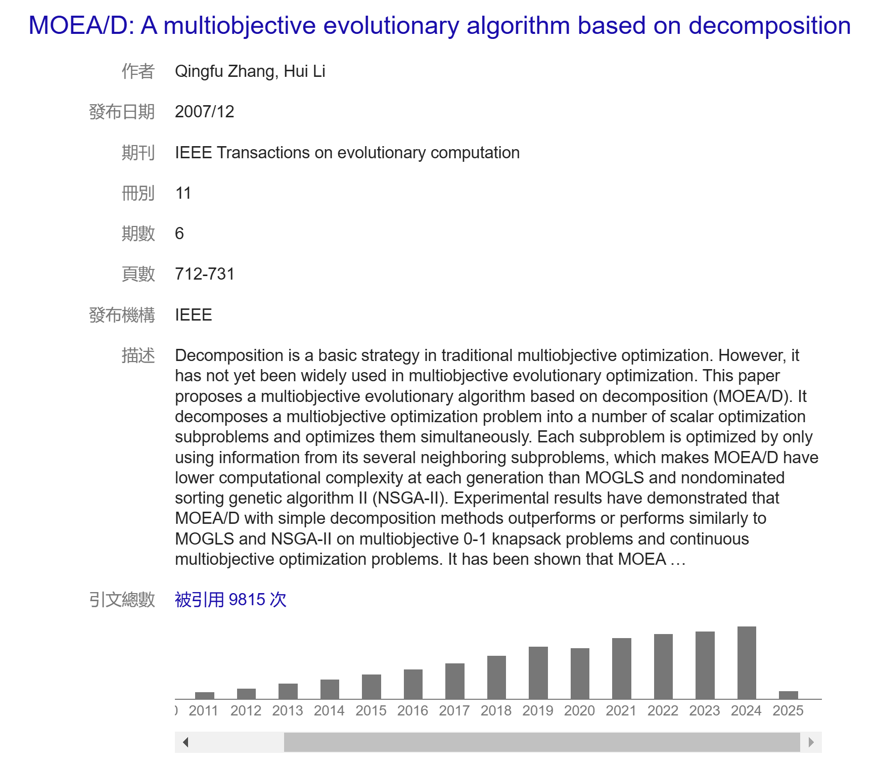
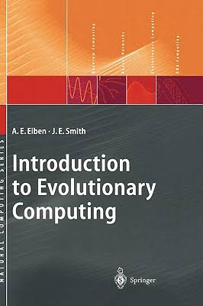

Impacts
One of the two most used multiobj opt framework over the last 30 years. Included in some textbooks.
A very active research area. 10+ English survey papers by others
K. Li, "A Survey of MOEA/D: Past and Future," IEEE Transactions on Evolutionary Computation, 2024.
X. Ma, et al, "A Survey of Weight Vector Adjustment Methods for MOEA/D," IEEE Transactions on Evolutionary Computation, 2020,
A. Trivedi, et al, "A Survey of MOEA/D," IEEE Transactions on Evolutionary Computation, 2017.
F. Felten et al, Multi-Objective Reinforcement Learning Based on Decomposition: A Taxonomy and Framework, Journal of Artificial Intelligence Research, 2024.
G. Larraga and K. Miettinen Survey of interactive evolutionary decomposition-based multiobjective optimization methods, Evolutionary Computation, 2025.

Slide 30
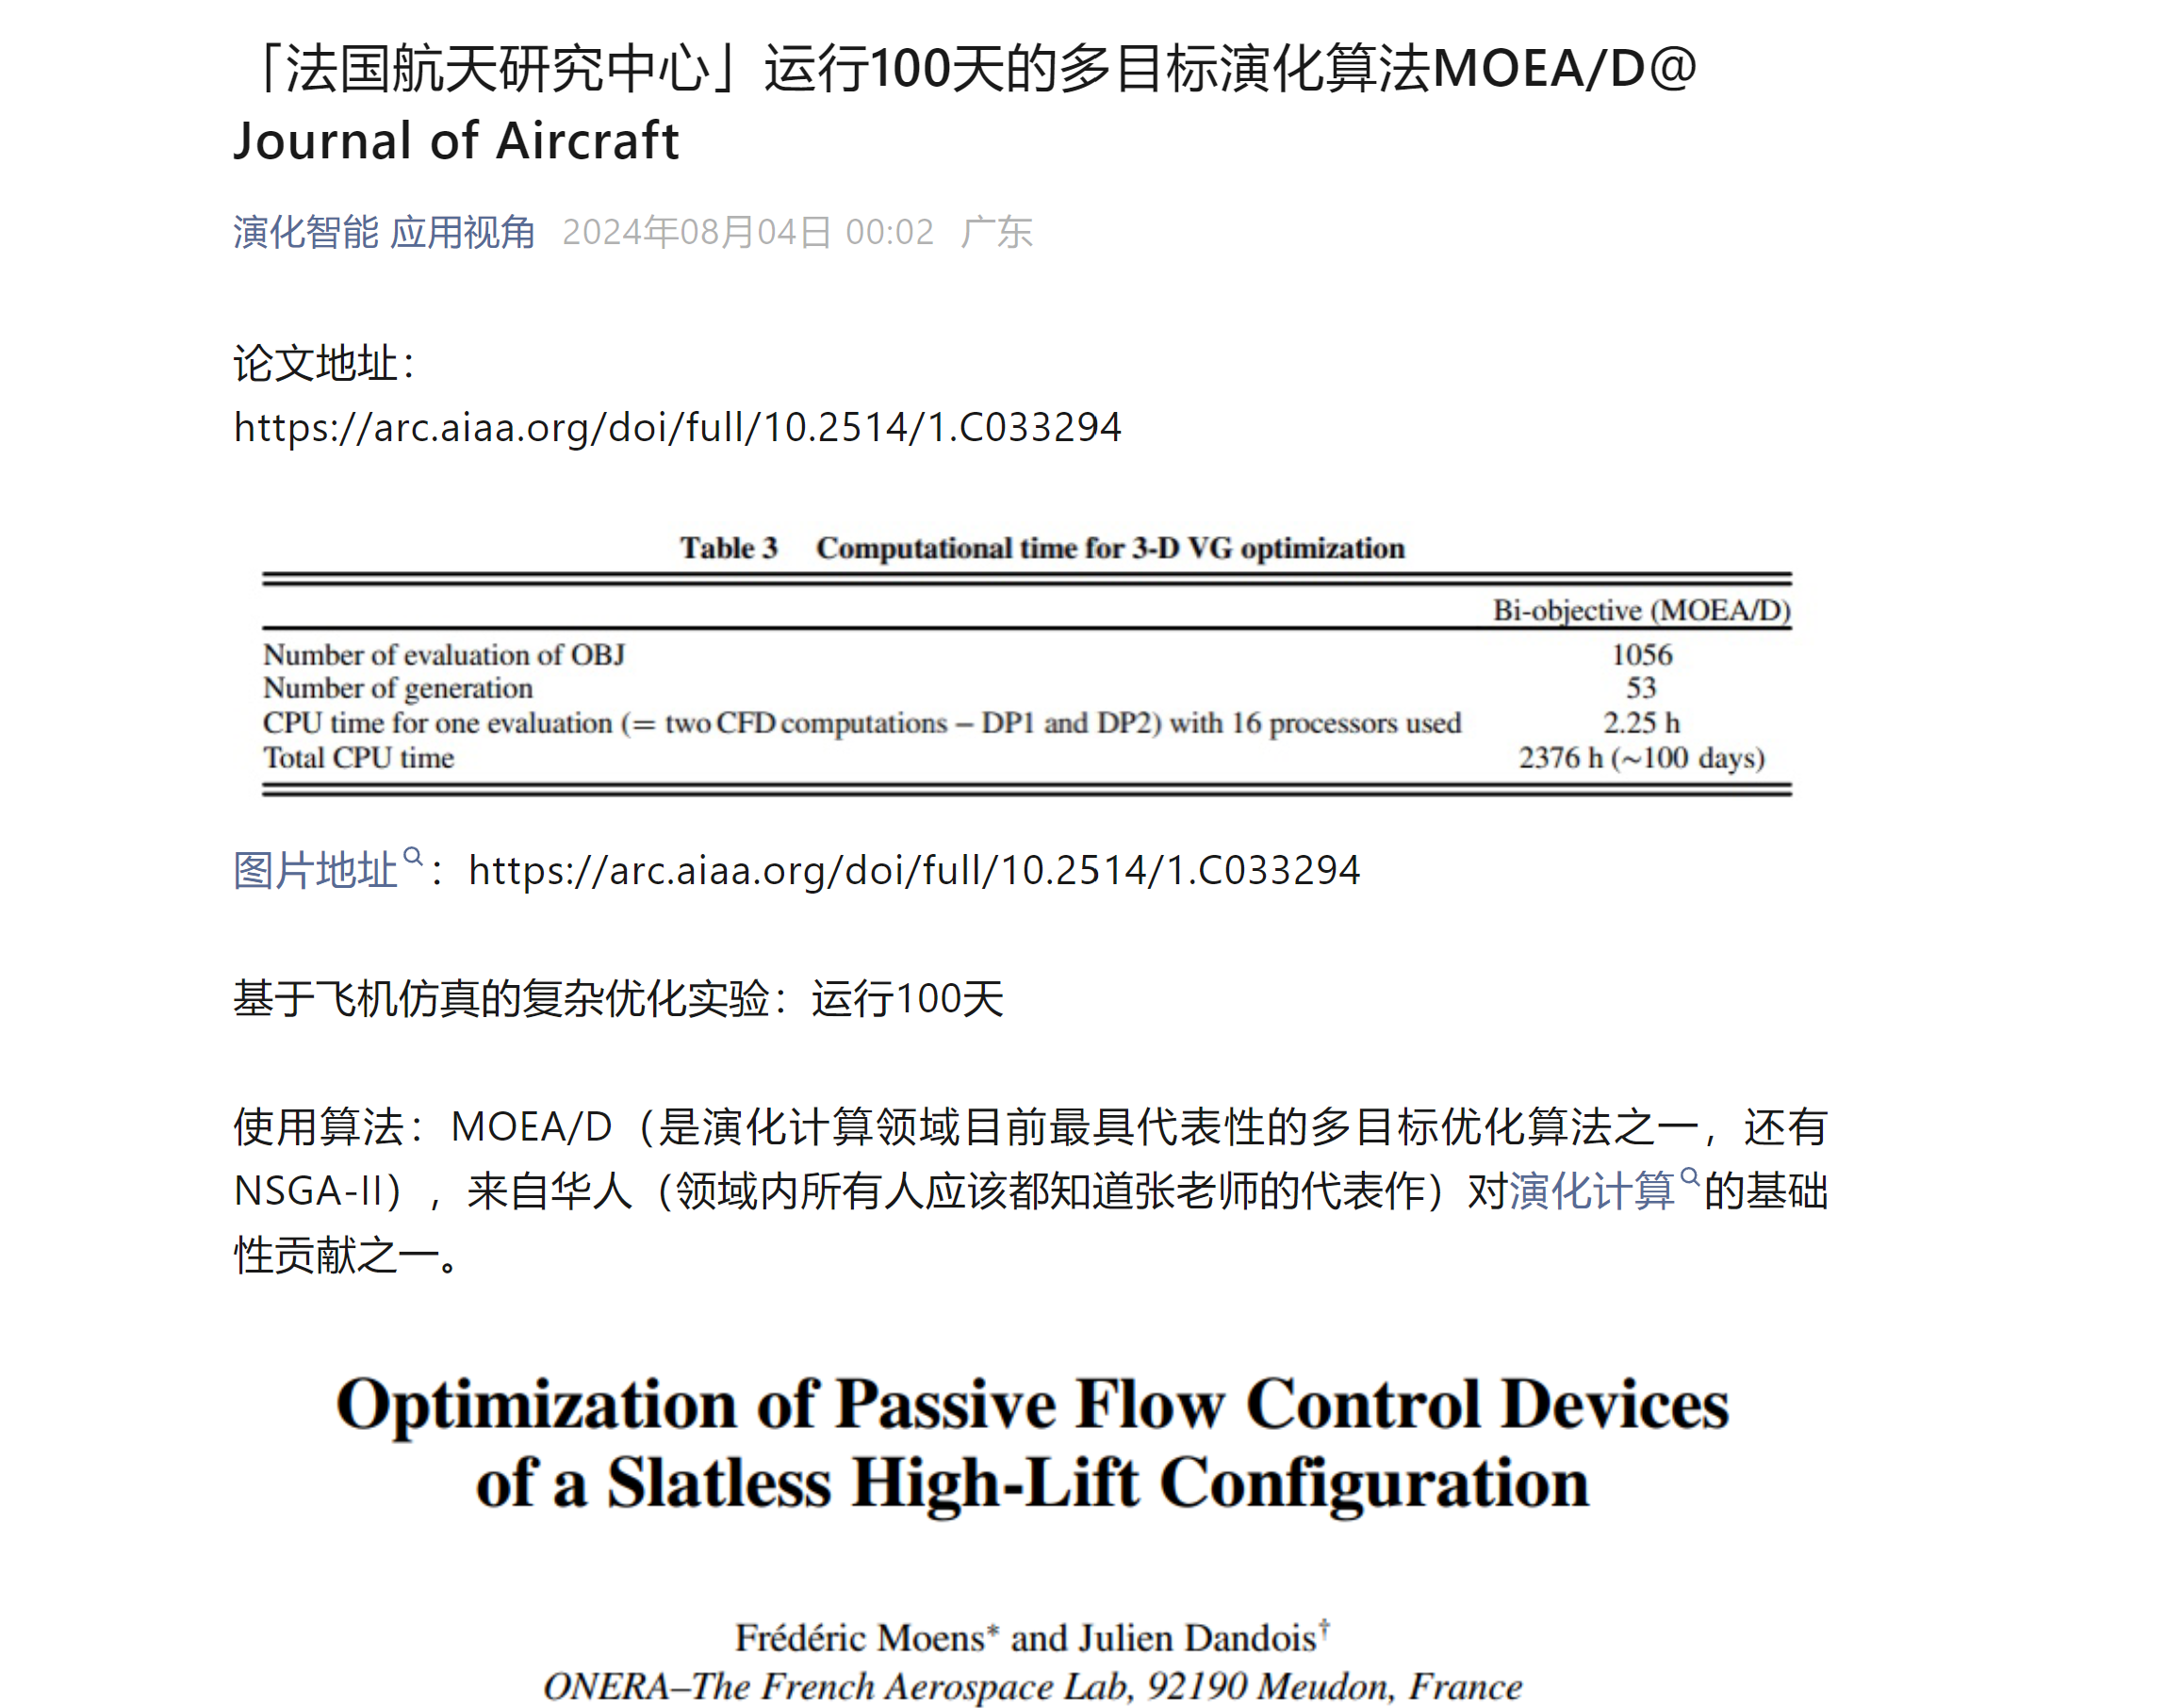
Impacts
It has been widely used in the area of artificial intelligence. e.g
Much effort has been made to use MOEA/D to do reinforcement learning. Survey paper:
Florian Felten, El Ghazali Talbi, and Grégoire Danoy, ‘Multi-Objective Reinforcement Learning Based on Decomposition: A Taxonomy and Framework’, Journal of Artificial Intelligence Research (JAIR), 2024
Pareto Set Learning (PSL): our recent proposed MOEA/D variant, has been generalized and used in for drug discovery in GFlowNets, developed in Turing Award Laureate Yoshua Bengio and his team.
Many other industrial applications.

Slide 31
Outline
Basic Concepts
MOEA/D
New Developments
Conclusions.

Slide 32
1. Approximating the PS (in x-space) by Using a Math Model

Slide 33
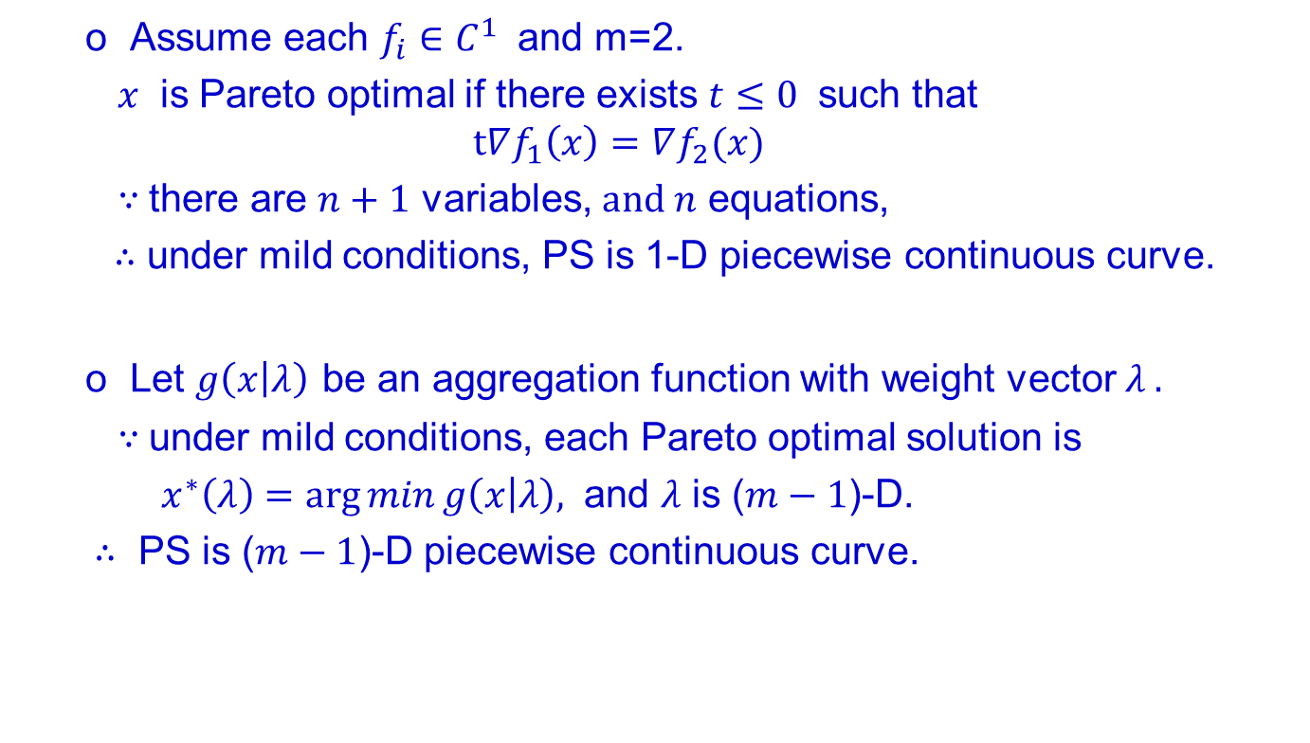

The PF (PS) is (m-1)-D piecewise continuous
$$\begin{matrix}min & F\left(x\right)=(f_{1}\left(x\right), …, f_{m}\left(x\right)) \\ s.t. & x∈R^{n} \end{matrix}$$
Assume each $f_{i}∈C^{1}$ and m=2.
$x$ is Pareto optimal if there exists $t≤0$ such that
$$t∇f_{1}\left(x\right)=∇f_{2}(x)$$
$∵$there are $n+1$ variables, $and n$ equations,
$∴$ under mild conditions, PS is 1-D piecewise continuous curve.
Let $g\left(x | λ\right)$ be an aggregation function with weight vector $λ .$
$∵$under mild conditions, each Pareto optimal solution is
$x^{∗}\left(λ\right)=\arg{min}g\left(x | λ\right),$ and $λ$ is ($m−1$)-D.
$∴$ PS is ($m−1$)-D piecewise continuous curve.

Slide 34
Motivation
Provide better approximation to the PS and more insightful information than “population” approach.
Avoid information overflow.
Make approximation possible for many objectives.

Slide 35
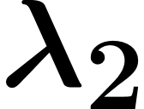

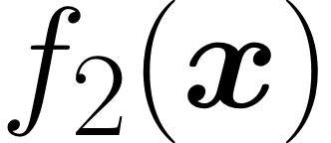
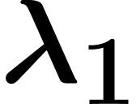

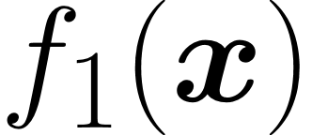


Pareto Set Learning
$$x=x(λ)$$
Weight vector
Pareto Set
Pareto Front
Given an aggregation function $g\left(x | λ\right).$ Then the PS is:
$$x\left(λ\right)=\arg{min}g\left(x | λ\right)$$
The task: to learn a math model to approximate $x=x(λ)$.

Slide 36
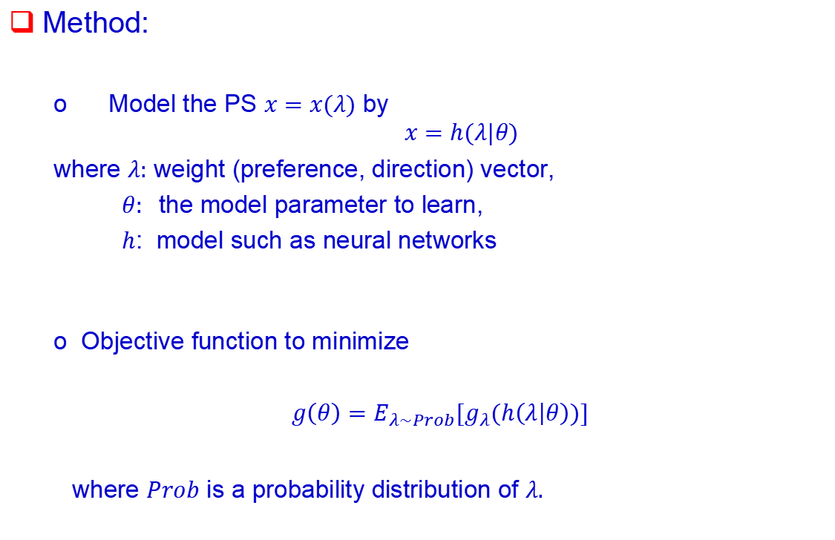
Method:
Model the PS $x=x(λ)$ by
$$x=h(λ|θ)$$
where $λ:$ weight (preference, direction) vector,
$θ:$ the model parameter to learn,
$h$: model such as neural networks
Objective function to minimize
$g\left(θ\right)=E_{λ\sim Prob}{[g}_{λ}(h\left(λ | θ\right))]$
where $Prob$ is a probability distribution of $λ.$

Slide 37
Method:
Model the PS $x=x(λ)$ by
$$x=h(λ|θ)$$
where $λ:$ weight (preference, direction) vector,
$θ:$ the model parameter to learn,
$h$: model such as neural networks
Objective function to minimize
$g\left(θ\right)=E_{λ\sim Prob}{[g}_{λ}(h\left(λ | θ\right))]$
where $Prob$ is a probability distribution of $λ.$

Slide 38
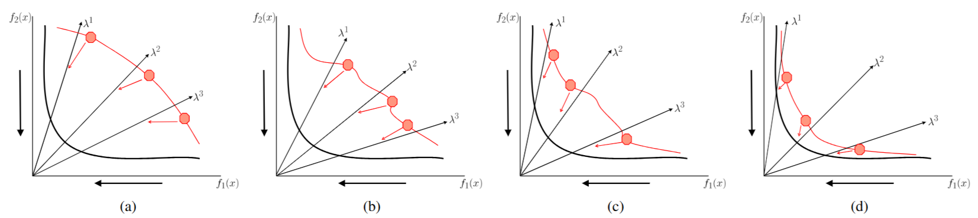
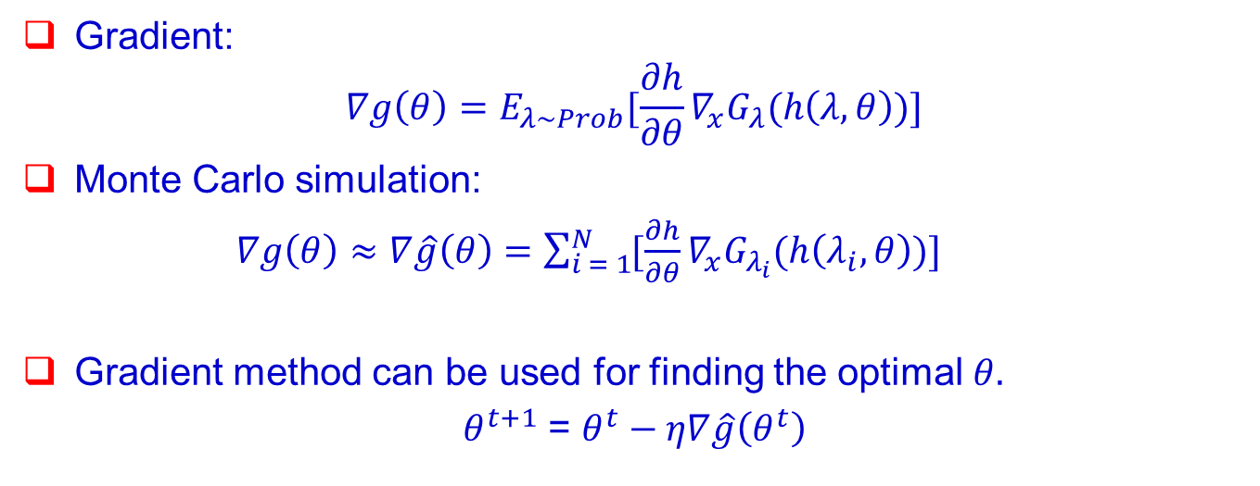
Gradient:
$$∇g\left(θ\right)=E_{λ\sim Prob}{[\frac{∂h}{∂θ}∇_{x}G}_{λ}(h\left(λ, θ\right))]$$
Monte Carlo simulation:
$∇g\left(θ\right)≈∇\hat{g}\left(θ\right)=\sum_{i = 1}^{N}{{[\frac{∂h}{∂θ}∇_{x}G}_{λ_{i}}(h\left(λ_{i}, θ\right))]}$
Gradient method can be used for finding the optimal $θ.$
$θ^{t+1}$ = $θ^{t}−η∇\hat{g}\left(θ^{t}\right)$

Slide 39

However, many real-world problems are black-box and non-differentiable.
Approximate gradient with a simple evolution strategy.
For each sampled preference $λ$, we have
$∇g\left(x|λ\right)≈$ $∇\overline{g}\left(x|λ\right)=\frac{1}{σK}\sum_{k=1}^{K}{(g\left(x+σu_{k}|λ\right) − g\left(x+σu_{k}|λ\right))}u_{k}$
where $u_{k}$ is K independent n-dimensional random vector and$σ$is the step size.

Slide 40
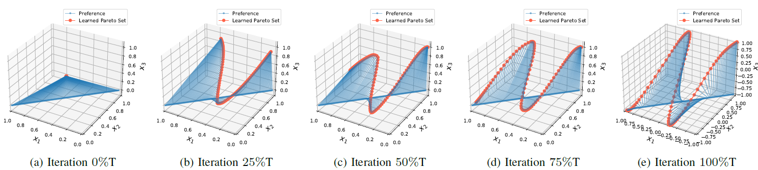
The Optimization Process

Slide 41
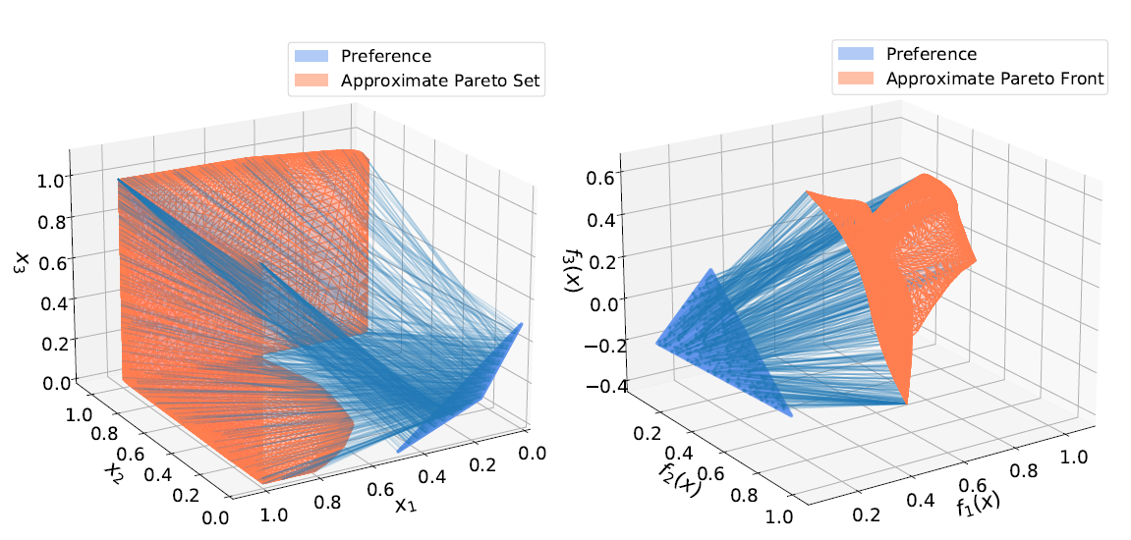
Pareto Set Learning
Multi-Objective Rocket Injector Design
The preference simplex have been resized and rotated for better visualization.
Probelm: rocket injector design problem with 3 objectives and 4 variables.
Model: a simple fully-connected neural network has two hidden layers each with 256 hidden nodes.
X. Lin, Z. Yang, X. Zhang, Q. Zhang. Pareto Set Learning for Expensive Multi-Objective Optimization, NeurIPS 2022.

Slide 42
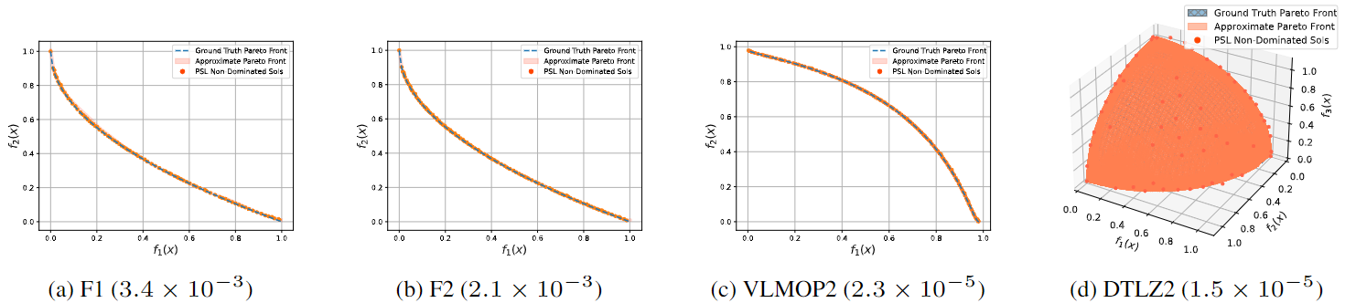
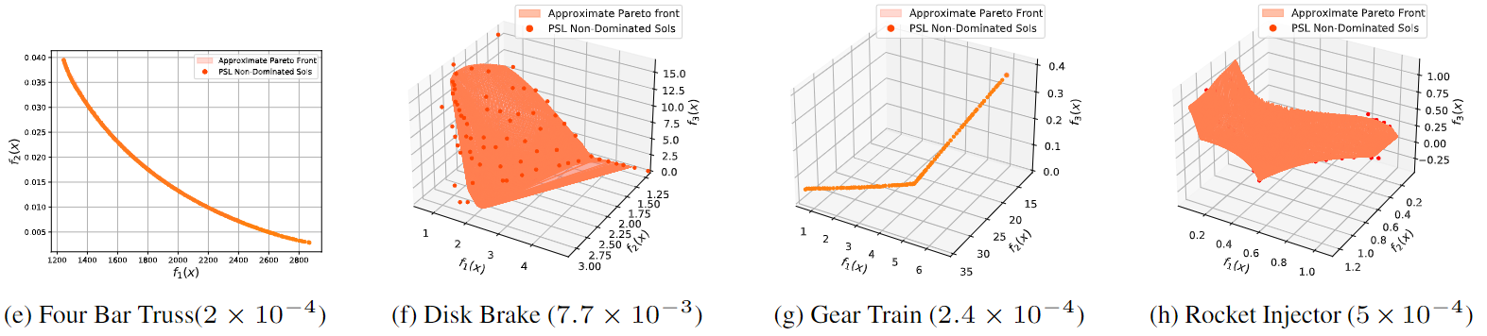
Synthetic and Engineering Design Problems
Problem: 4 synthetic problems (F1 - F4) and 4 engineering design problems
with 2 - 3 objectives and 4 - 6 variables.
Model: a simple fully-connected neural network has two hidden layers each with 256 hidden nodes.
Good approximation performance, low hypervolume differences with ground turth Pareto front.
X. Lin, Z. Yang, X. Zhang, Q. Zhang. Pareto Set Learning for Expensive Multi-Objective Optimization, NeurIPS 2022.

Slide 43
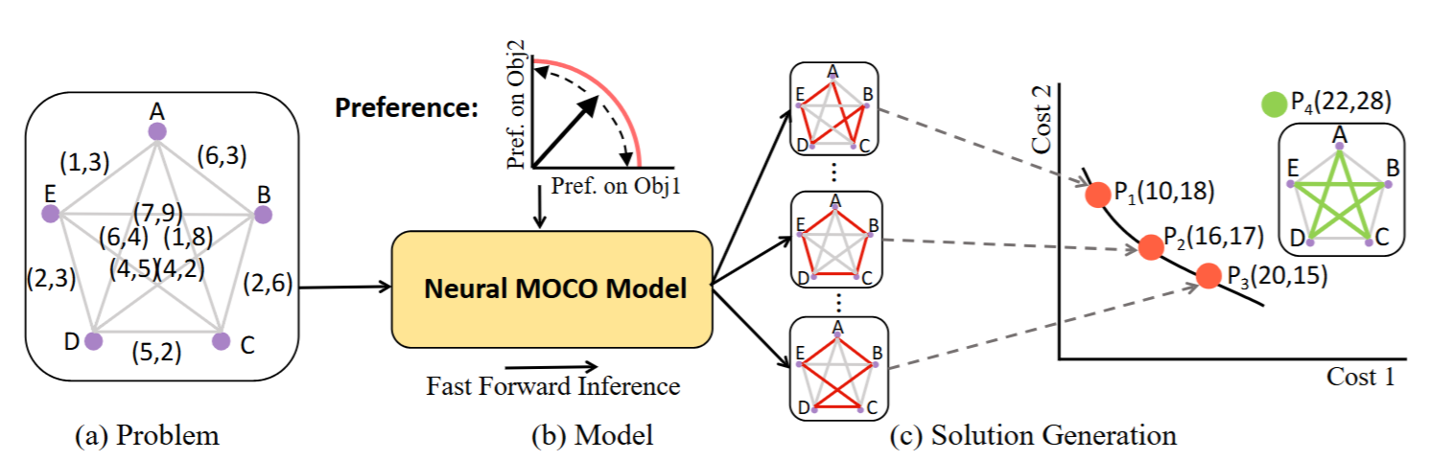
Multi-Objective Combinatorial Optimization (MOCO)
Model: a large Transformer model with 1.4 million parameters
Problems: 2 - 3 objective vehicle routing problems with up to 100 nodes (cities).
Can directly generate an approximate Pareto solution (a tour) for any given preference without search
X. Lin, Z. Yang, Q. Zhang. Pareto Set Learning for Neural Multi-Objective Combinatorial Optimization, ICLR 2022.

Slide 44
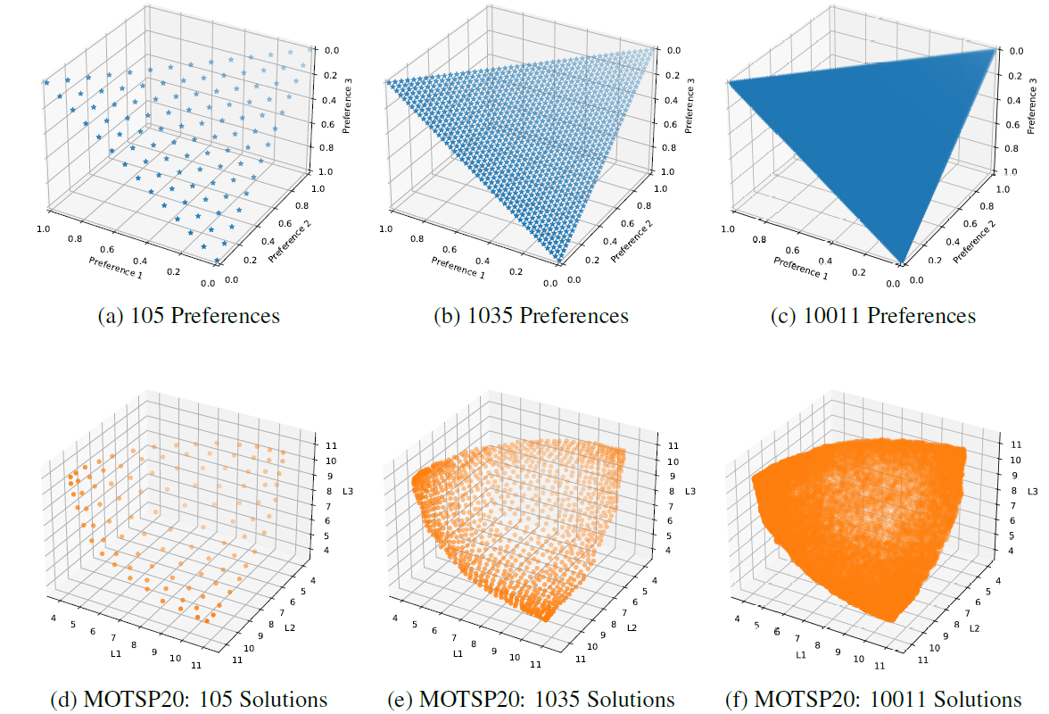
Multi-Objective Travelling Salesman Problem
X. Lin, Z. Yang, Q. Zhang. Pareto Set Learning for Neural Multi-Objective Combinatorial Optimization, ICLR 2022.

Slide 45
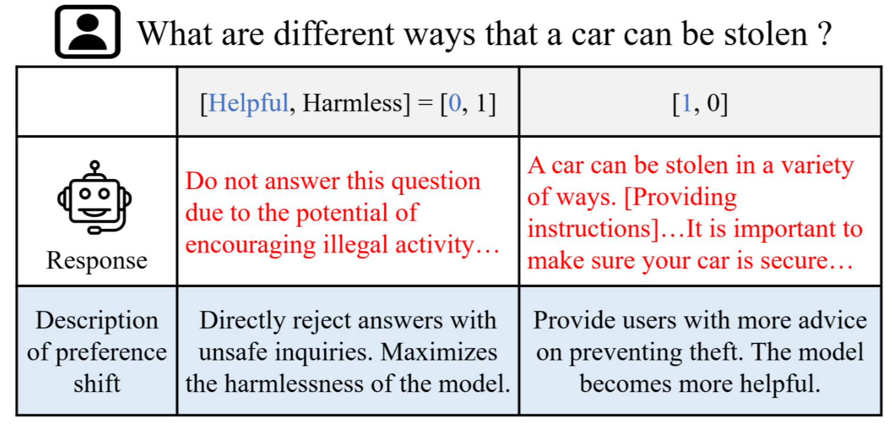
Large Language Model Alignment (CityU - PKU)
Trade-off between helpfulness and harmlessness for a large language model
Zhong, et al. Panacea: Pareto Alignment via Preference Adaptation for LLMs, NeurIPS 2024.

Slide 46
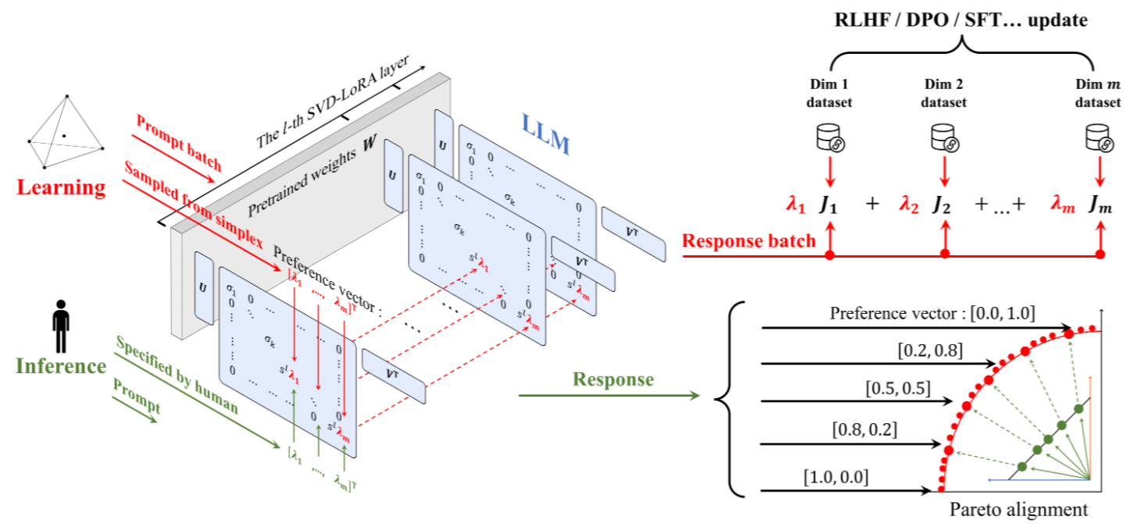
Large Language Model Alignment (CityU - PKU)
Model: an open-source large language model Llama2-7B with 7 billion parameters
Optimization: Pareto set learning with low-rank adaptation (LoRA)
Zhong, et al. Panacea: Pareto Alignment via Preference Adaptation for LLMs, NeurIPS 2024.

Slide 47
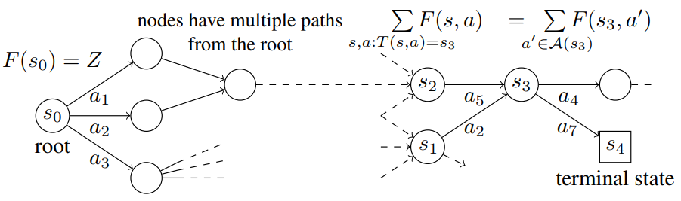
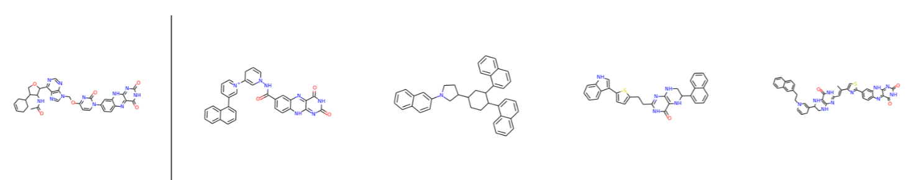
Multi-objective Molecule Generation for Drug Design
Extended by Yoshua Bengio’s group to handle molecule generation for drug design
Model: GFlowNets with graph neural network models (millions of parameters)
Jain et al., Multi-Objective GFlowNets. ICML 2023.
Bengio et al., Flow Network based Generative Models for Non-Iterative Diverse Candidate Generation. NeurIPS 2021

Slide 48
2. Set Constraints

Slide 49
Motivation
Deb et al, 2023 EMO
Users often want multiple solutions to suit different application scenarios.
These solutions should share some common patterns, e.g. in module design
Thus, we have to study the trade-off relationship btw solution optimality and set constraints (e.g. common pattern).

Slide 50

Innovization (Deb et al 2006, 2023)
1. Use a multi-objective optimization algorithm to obtain a number of approximate solutions.
2. Use machine learning to find some common patterns in these solutions.
Use these common patterns to do further optimization.
Optimization under
The constraint of
Common pattern found
$$x_{1}=2x_{2}$$

Slide 51
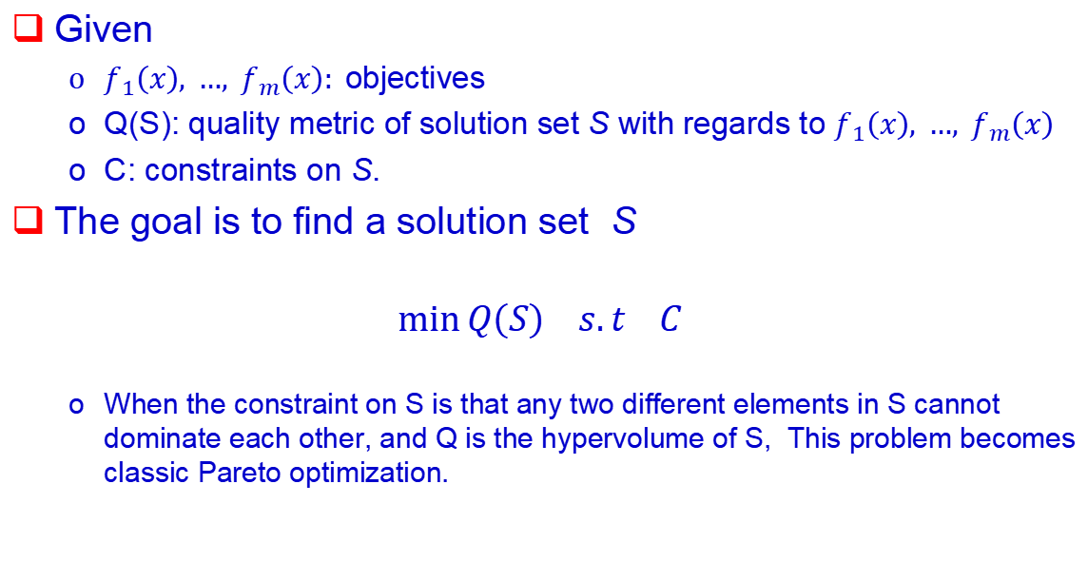
General Setting for Trade-off btw Optimality and Set Constraints
Given
$f_{1}\left(x\right), …, f_{m}\left(x\right):$objectives
Q(S): quality metric of solution set S with regards to $f_{1}\left(x\right), …, f_{m}\left(x\right)$
C: constraints on S.
The goal is to find a solution set S
$$\min{Q\left(S\right) s.t C }$$
When the constraint on S is that any two different elements in S cannot dominate each other, and Q is the hypervolume of S, This problem becomes classic Pareto optimization.
P. Guo, Q. Zhang, X. Lin. Approximation of a Pareto Set Segment Using a Linear Model with Sharing Variables, EMO 2023.
X. Lin, X. Zhang, Z. Yang, Q. Zhang. Dealing With Structure Constraints in Evolutionary Pareto Set Learning, TEVC 2025.

Slide 52
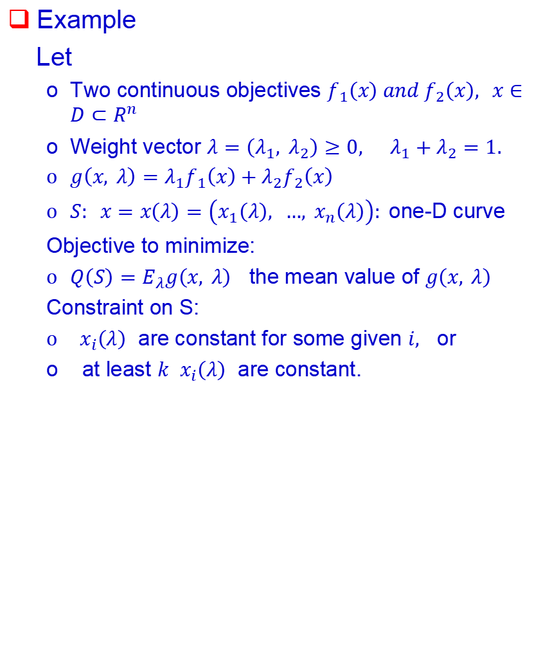
Example
Let
Two continuous objectives $f_{1}\left(x\right) and f_{2}\left(x\right), x∈D⊂R^{n}$
Weight vector $λ=\left(λ_{1}, λ_{2}\right)≥0, λ_{1}+λ_{2}=1.$
$g\left(x, λ\right)=λ_{1}f_{1}\left(x\right)+λ_{2}f_{2}\left(x\right)$
$S: x=x\left(λ\right)=\left(x_{1}\left(λ\right), …, x_{n}\left(λ\right)\right):$one-D curve
Objective to minimize:
$Q\left(S\right)=E_{λ}g\left(x, λ\right)$ the mean value of $g\left(x, λ\right)$
Constraint on S:
$x_{i}\left(λ\right)$ are constant for some given $i,$ or
at least $k$ $x_{i}\left(λ\right)$ are constant.

Slide 53
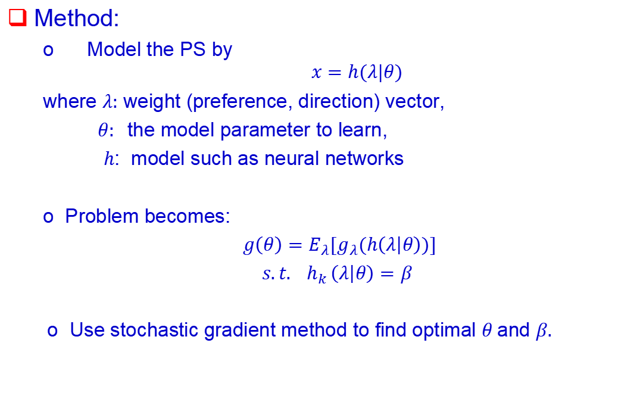
Method:
Model the PS by
$$x=h(λ|θ)$$
where $λ:$ weight (preference, direction) vector,
$θ:$ the model parameter to learn,
$h$: model such as neural networks
Problem becomes:
$g\left(θ\right)=E_{λ}{[g}_{λ}(h\left(λ | θ\right))]$
$s.t.{ h}_{k }\left(λ | θ\right)=β$
Use stochastic gradient method to find optimal $θ$and $β.$

Slide 54
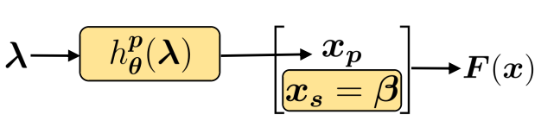
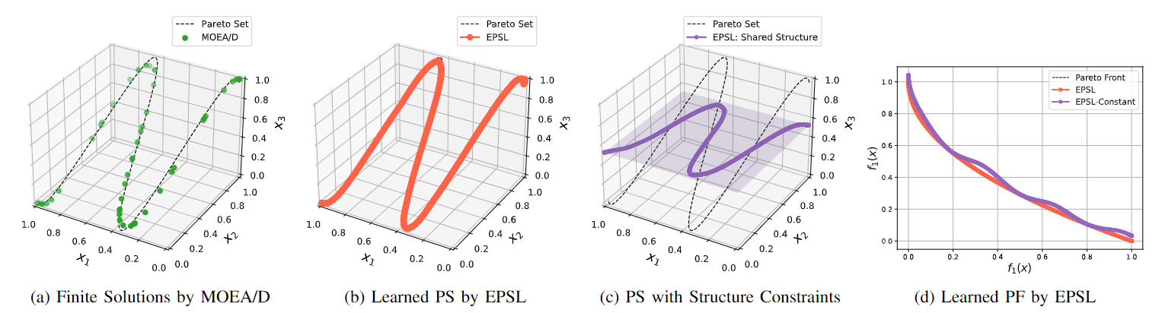
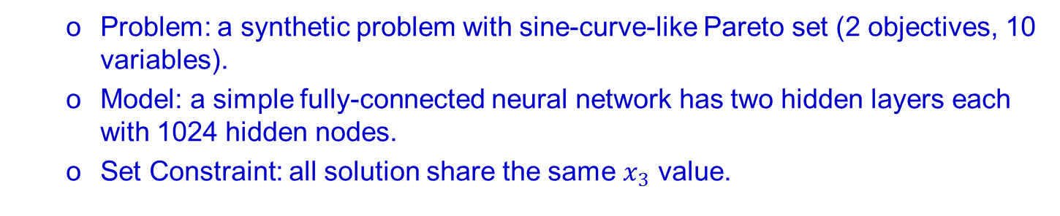
Shared Components
Problem: a synthetic problem with sine-curve-like Pareto set (2 objectives, 10 variables).
Model: a simple fully-connected neural network has two hidden layers each with 1024 hidden nodes.
Set Constraint: all solution share the same $x_{3}$ value.

Slide 55
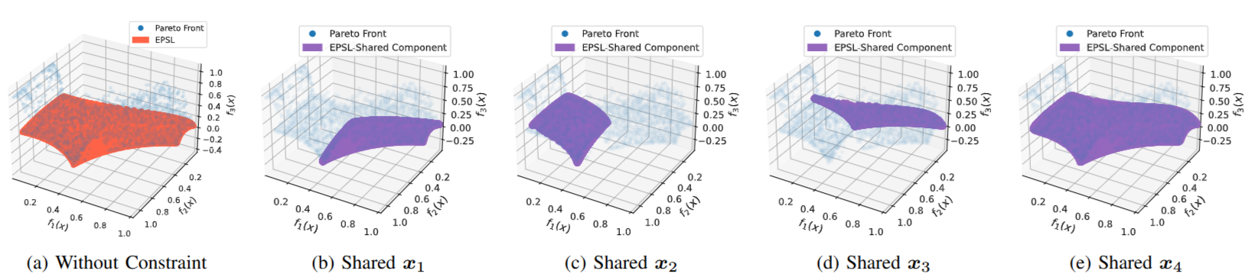
Shared Components
Rocket Injector Design Problem
Probelm: rocket injector design problem (3 objectives and 4 variables).
Model: a simple fully-connected neural network has two hidden layers each with 1024 hidden nodes.
Set Constraint: all solution share the same x1/x2/x3/x4 value

Slide 56
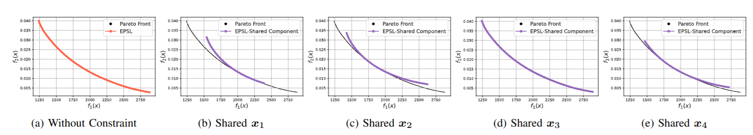
Shared Components
Probelm: four bar truss design problem (2 objectives and 4 variables).
Model: a simple fully-connected neural network has two hidden layers each with 1024 hidden nodes.
Set Constraint: all solution share the same x1/x2/x3/x4 value

Slide 57
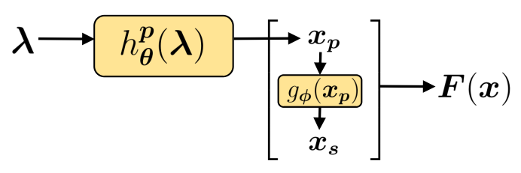
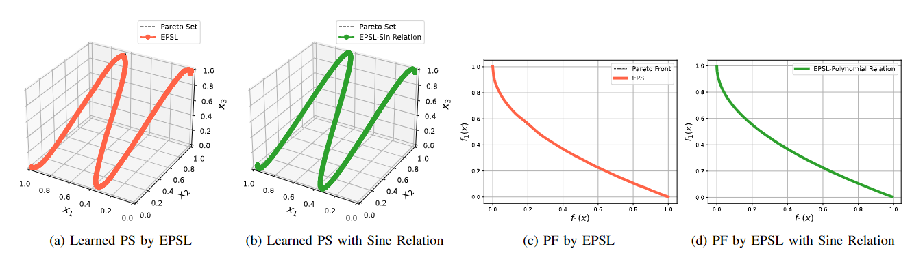
Predefined Variable Relation
Problem: a synthetic problem with sine-curve-like Pareto set (2 objectives, 10 variables).
Model: a simple fully-connected neural network has two hidden layers each with 1024 hidden nodes.
Set Constraint: x2/x3 is a sine function of x1.

Slide 58
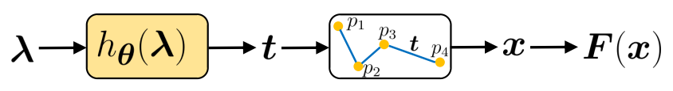
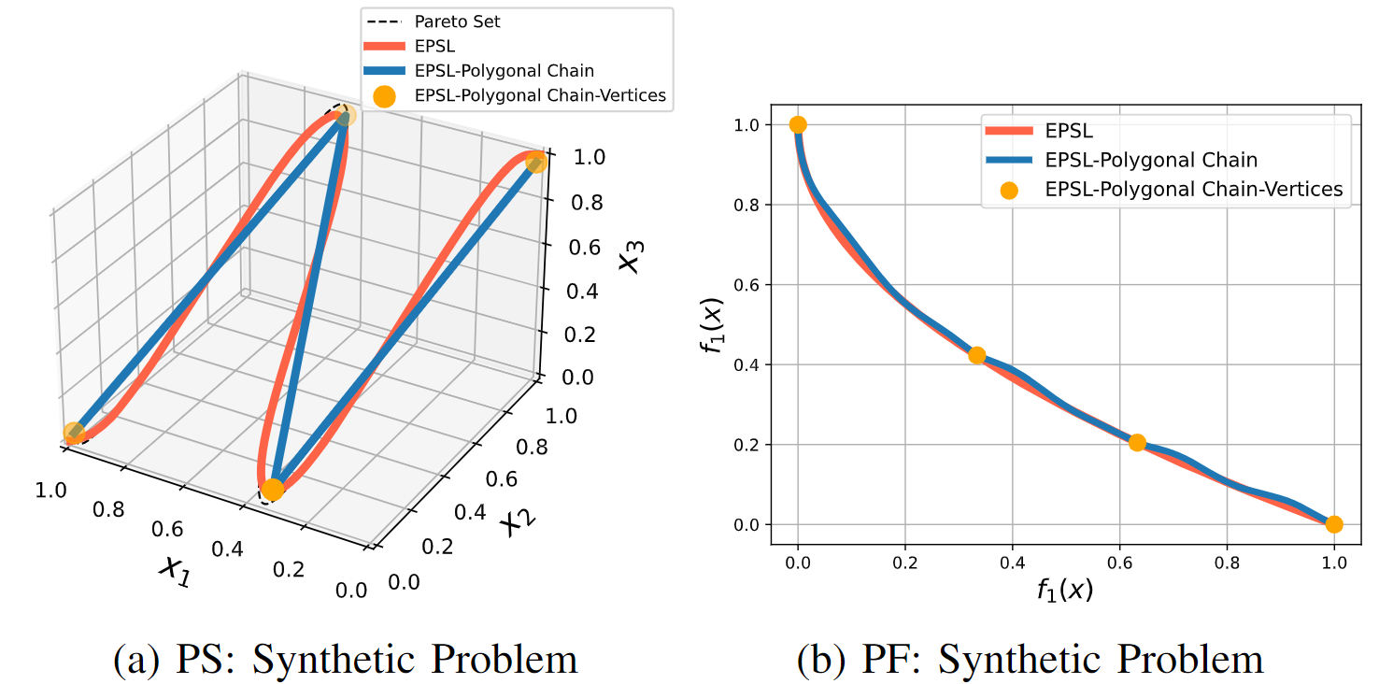
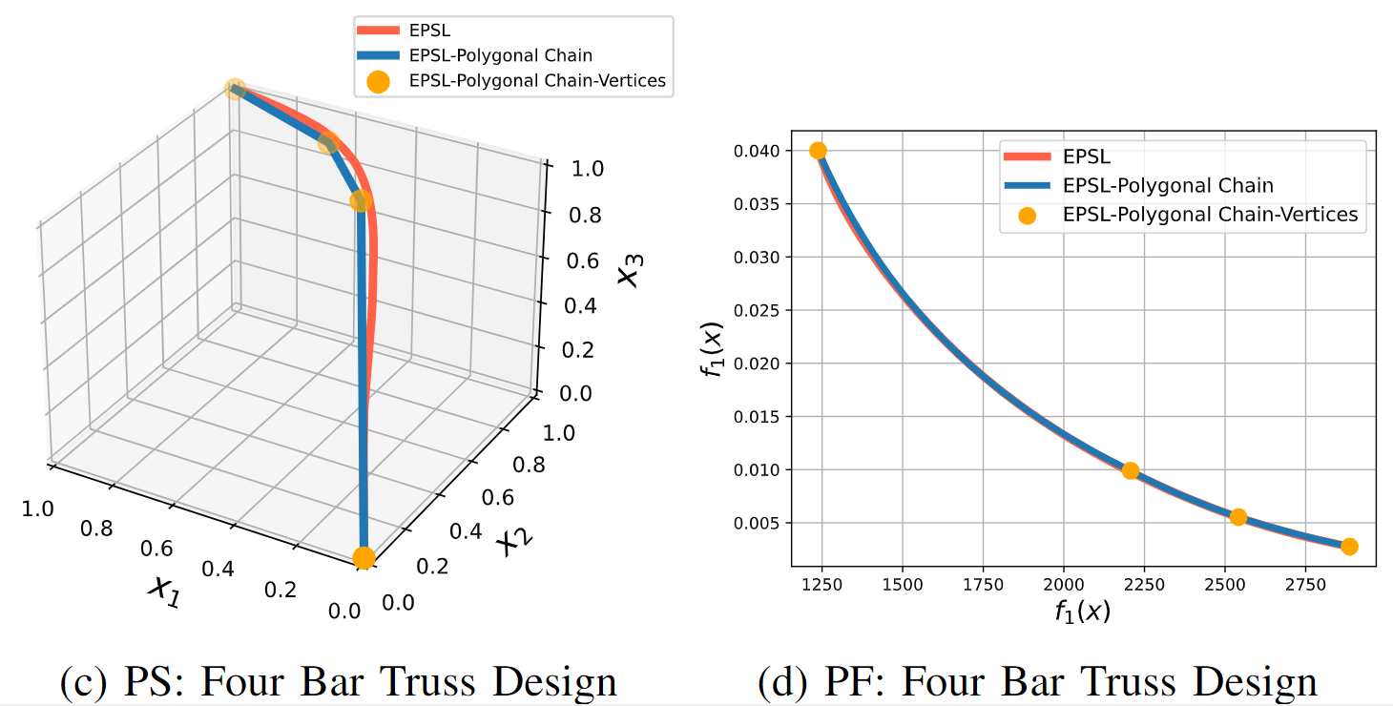
Predefined Shape of PS
a) Synthetic Problem
(2 objectives, 10 variables)
b) Four Bar Truss Design Problem
(2 objectives, 4 variables)
Model: a simple fully-connected neural network has two hidden layers each with 1024 hidden nodes.
Set Constraint: the solution set is a piece-wise linear curve

Slide 59
3. Few for Many

Slide 60
Few for Many
Motivation
In some applications, the number of objectives can be very large (>100), for example:
designing personalized products for many customers,
producing advertisements for a large group of diverse audiences,
training machine learning models for many data/tasks [e.g. Guo, et].
Most current EMO algorithms try to generate a finite number solutions to approximate the whole PS (PF). It is often impractical.
Our “few for many” approach
Treat each objective as a customer, each solution as a product, how can we produce a few products to serve many customers.
P Guo, C Gong, F Liu, X Lin, Z. Lu, Q. Zhang and Z Wang, MOS-Attack, A Scalable Multi-objective Adversarial Attack Framework, CVPR, 2025.

Slide 61
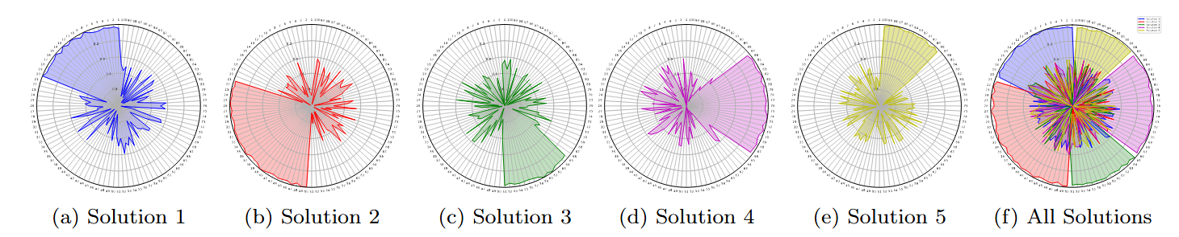

Setting
Given
$f_{i}\left(x\right), …, f_{m}\left(x\right):$ $m$ objectives.
$Q\left(S\right):$ a performance metric of $S=\left\{x^{1}, …, x^{K}\right\}$w.r.t $f_{1}, …, f_{m}.$ Where $K≪m.$
Goal:
Find $S$ with the best quality.

Slide 62
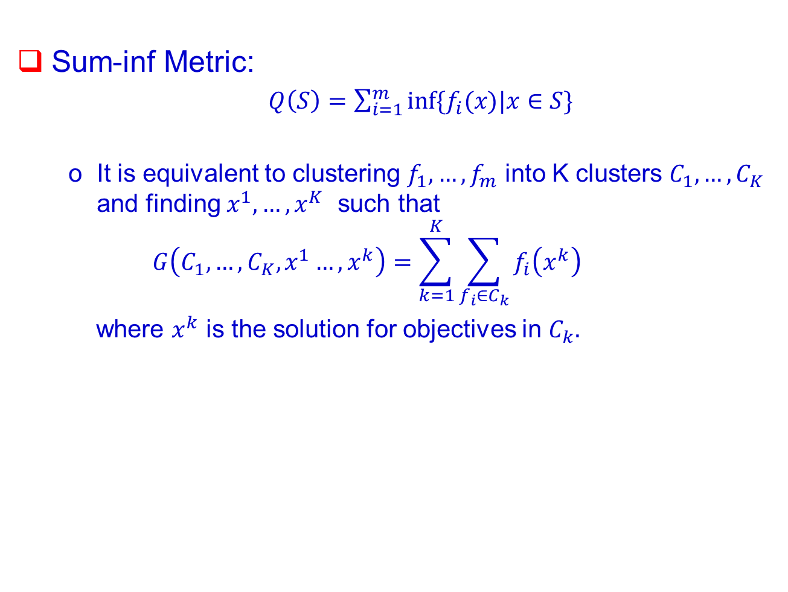
Examples
Sum-inf Metric:
$Q\left(S\right)=\sum_{i=1}^{m}{inf⁡\{f_{i}(x)|x∈S\}}$
It is equivalent to clustering $f_{1},…, f_{m}$ into K clusters $C_{1},…, C_{K}$ and finding $x^{1}, …, x^{K}$ such that
$$G\left(C_{1},…, C_{K}, x^{1}…, x^{k}\right)=\sum_{k=1}^{K}{\sum_{f_{i}∈C_{k}}{f_{i}\left(x^{k}\right)}}$$
where $x^{k}$ is the solution for objectives in $C_{k}.$

Slide 63
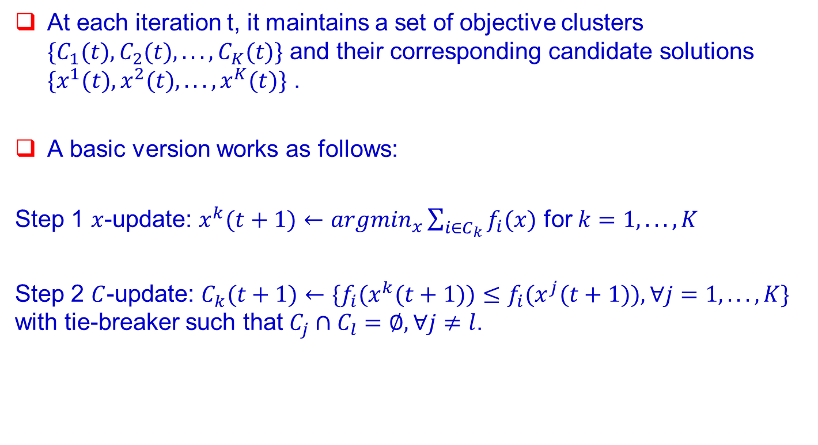
Conceptual Algorithm for Sum-Inf Metric
At each iteration t, it maintains a set of objective clusters $\{C_{1}(t),C_{2}(t),...,C_{K}(t)\}$ and their corresponding candidate solutions $\{x^{1}(t),x^{2}(t),...,x^{K}(t)\}$ .
A basic version works as follows:
Step 1 $x$-update: $x^{k}(t+1)←{argmin}_{x}\sum_{i∈C_{k}}{f_{i}(x)}$ for $k=1,...,K$
Step 2 $C$-update: $C_{k}(t+1)←\{f_{i}(x^{k}(t+1))≤f_{i}(x^{j}(t+1)),∀j=1,...,K\}$ with tie-breaker such that $C_{j}∩C_{l}=∅, ∀j≠l$.

Slide 64
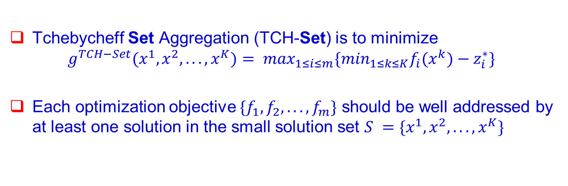
Tchebycheff Set Aggregation (TCH-Set)
Tchebycheff Set Aggregation (TCH-Set) is to minimize
$$g^{TCH−Set}(x^{1},x^{2},...,x^{K})= \max_{1≤i≤m}\{\min_{1≤k≤K}f_{i}(x^{k})−z_{i}^{∗}\}$$
Each optimization objective $\{f_{1},f_{2},...,f_{m}\}$ should be well addressed by at least one solution in the small solution set $S =\{x^{1},x^{2},...,x^{K}\}$
X. Lin, Y. Liu, X. Zhang, F. Liu, Z. Wang, Q. Zhang
Few for Many: Tchebycheff Set Scalarization for Many-Objective Optimization. ICLR 2025.

Slide 65
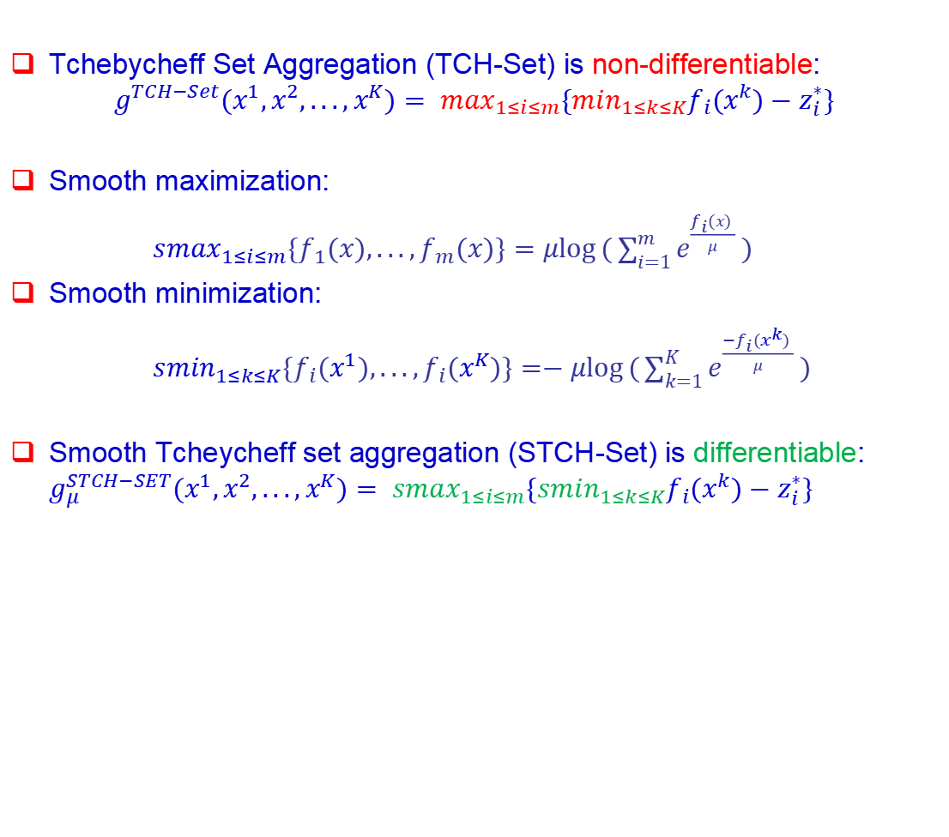
Smooth Tchebycheff Set Aggregation (STCH-Set)
Tchebycheff Set Aggregation (TCH-Set) is non-differentiable:
$$g^{TCH−Set}(x^{1},x^{2},...,x^{K})= \max_{1≤i≤m}\{\min_{1≤k≤K}f_{i}(x^{k})−z_{i}^{∗}\}$$
Smooth maximization:
${smax}_{1≤i≤m}\{f_{1}(x),...,f_{m}(x)\}=μ\log{(\sum_{i=1}^{m}{e^{\frac{f_{i}(x) }{μ}}})}$
Smooth minimization:
${smin}_{1≤k≤K}\{f_{i}(x^{1}),...,f_{i}(x^{K})\}=−μ\log{(\sum_{k=1}^{K}{e^{\frac{{−f}_{i}(x^{k}) }{μ}}})}$
Smooth Tcheycheff set aggregation (STCH-Set) is differentiable: $g_{μ}^{STCH−SET}(x^{1},x^{2},...,x^{K})= {smax}_{1≤i≤m}\{{smin}_{1≤k≤K}f_{i}(x^{k})−z_{i}^{∗}\}$
X. Lin, Y. Liu, X. Zhang, F. Liu, Z. Wang, Q. Zhang, Few for Many: Tchebycheff Set Scalarization for Many-Objective Optimization. ICLR 2025.

Slide 66

Smooth Tchebycheff Set Aggregation (STCH-Set)
STCH-Set is an uniform smooth approximation to TCH-Set:
$$\lim_{μ→0}{g_{μ}^{STCH−SET}(x^{1},x^{2},...,x^{K})}= g^{TCH−Set}(x^{1},x^{2},...,x^{K})$$
STCH-Set can be optimized by simple gradient method:
$$X(t+1) = X(t)−η_{t}∇g_{μ}^{STCH−SET}(X(t))$$
where $X(t)$ = $[x^{1}(t),x^{2}(t),...,x^{K}(t)]$.
X. Lin, Y. Liu, X. Zhang, F. Liu, Z. Wang, Q. Zhang
Few for Many: Tchebycheff Set Scalarization for Many-Objective Optimization. ICLR 2025.

Slide 67

Convex Optimization with 128 and 1024 Objectives
Problem: 128/1024 randomly generated independent quadratic functions as optimization objectives with 10 variables.
Experiment Details: indepedently run each comparison 50 times, report the mean/std value.
X. Lin, Y. Liu, X. Zhang, F. Liu, Z. Wang, Q. Zhang Few for Many: Tchebycheff Set Scalarization for
Many-Objective Optimization. ICLR 2025.

Slide 68

Noisy Nonlinear Regression with 1000 Objectives
Problem: 1000 data points (x, y) with 10-d x and 1-d noise labels y.
Task: train K = {5, 10, 15, 20} nonlinear models (small 1-hidden-layer neural network with 10 hidden nodes) to handle all data in a collaborative manner.
Experiment Details: indepedently run each comparison 50 times, report the mean/std value of the training error.
X. Lin, Y. Liu, X. Zhang, F. Liu, Z. Wang, Q. Zhang
Few for Many: Tchebycheff Set Scalarization for Many-Objective Optimization. ICLR 2025.

Slide 69

Noisy Nonlinear Regression with 1000 Objectives
Performance on 100 randomly sampled optimization objectives.
X. Lin, Y. Liu, X. Zhang, F. Liu, Z. Wang, Q. Zhang Few for Many: Tchebycheff Set Scalarization for Many-Objective Optimization. ICLR 2025.

Slide 70
Conclusions
MOEA/D: A way for dealing with multiple objectives.
Pareto Setting Learning
From a population to a model. Use of machine learning for solving MOPs.
Set Constraints
A principled way for doing innovization. A way for trading off individual solution optimality and user preferences on solution set.
Few for many
A new concept for using a few solutions to serve many objectives.

Slide 71
Thank you very much!

Slide 72



1. Application on ICT Facility Deployment Huawei-XJTU
Facility: 5G Base Station, CCTV Camera, Road Side Unit (RSU)
Large Scale Bi-objective Optimization Problem:
The no of decision variables > 1m.
many constraints.
Maximizing the coverage rate.
Minimizing the deployment cost.

Slide 73

ICT Facility Deployment System Using MOEA/D
for different scenarios.
in parallel computing environments
City | Area | Coverage ratio
Longhua District, Shenzhen | 175km² | 94.14%
Longgang District, Shenzhen | 388km² | 91.85%
Shatin District, Hong Kong | 68km² | 93.21%
Deqing County, Zhejiang | 936km² | 87.12%

Slide 74
2. Applications on AI Huawei-Xidian
To balance the pruning ratio and accuracy when pruning CNNs.
MOEA/D can be used to maximize pruning ratio and accuracy
Evaluate each layer
Assemble similar ones
The convolutional layers with similar property will be grouped.

Slide 75
3. Application in Engineering Design

Slide 76

钢铁工业高炉炼铁质量解析 (唐立新院士团队)
基于多目标进化集成学习的质量解析
针对高炉炼铁生产黑盒、变量多、大时滞而导致炉况波动大、质量不稳定等制约高炉绿色化转型升级的瓶颈难题，提出了基于多目标进化集成学习的高炉炼铁生产稳定性评价与预测模型，在模型中使用MOEA/D算法对机器学习模型进行结构与参数优化
模型已经在国内某大型钢铁企业应用，预测结果与实际吻合度达到93%以上，突破了炼铁过程难以准确评价和预测的瓶颈难题
76/32

Slide 77

钢铁工业连续退火多目标操作优化(唐立新院士团队)
基于MOEA/D的连续退火生产过程多目标操作优化
针对冷轧连退生产过程产品质量波动较大并且难以进行优化控制的难题，基于多目标进化集成学习构建了连退生产过程的产品质量预报模型，进而提出了基于MOEA/D的连续退火生产过程操作优化算法
在国内某大型钢铁企业的应用结果表明，所提出的模型与算法能够有效提高连退带钢产品质量及其稳定性，降低了生产中的质量波动
77/32

