Slide 1
Require
The Module loader for JavaScript

Slide 2
Why use require.js
JavaScript has an inherent lack of a module system
Till ECMA-5 didn’t had syntax to create modules
JavaScript does not have a way to load the modules nor defining.
Programmers had to waste time with tedious script tag ordering and rely on global references.

Slide 3
Example without require.js
Lets take a look at how this problem typically plays out. Assume that we have a very simple application that has color palette widget. Moving the selector in the color palette changes the page color.

Slide 4
Problems we endup with
The utils.js file ALWAYS has to be referenced first because it creates the APP variable that all of the modules live on.
There are 2 files already, and this is a dead simple page. Imagine how many files you might have in a full on enterprise application.
You could use a build tool like ASP.NET MVC Bundling, but as your application grows you are still going to have modules that depend on other modules. You can try to keep that all straight in your head, but as your app grows, you are going to find that it starts getting messed up.

Slide 5
Require.js
RequireJS was developed by David Mark and its initial version v1.0.0 was released in 2009
The core idea behind RequireJS is to allow you to specify in a JavaScript file which files it depends on so that you can be sure that when your code executes, the dependencies are satisfied.
It also helps to improve the speed and quality of the code.
It is an open source and version 2.3.3 is its recent stable release.

Slide 6
Features of Require.js
It manages the dependencies between JavaScript files and improves the speed and quality of the code.
It combines and minifies the modules into one script for an optimized experience.
It reduces code complexity in large applications.
It gathers different JavaScript files from different modules at the time of compilation.
It allows for easy debugging as it loads the files from plain script tags.

Slide 7
Environment Setup
Download Require.js
http://requirejs.org/docs/download.html

Slide 8
What is AMD
Asynchronous module definition (AMD) is a specification for the programming language that defines code modules and their dependencies, and loads them asynchronously if desired.
Its a proposal for defining modules where both the module and dependencies can be asynchronously loaded
It is asynchronous and highly flexible by nature which removes the tight coupling.
Used by Dojo and Require.js

Slide 9
AMD Format & Syntax
define ( id ? , dependencies ? , factory);
id : Identification to module/resource name
dependencies : [ dependency modules ]
factory : function with dependencies as args with returning

Slide 10
Configuration Options
When using require() in the top-level HTML page a configuration object can be passed as the first option.
Configuration Options
Base Url : the root path to use for all module lookups.
Eg. require.config({ baseUrl: "./js" });
By default, the base url is whatever directory contains the bootstrap file

Slide 11
Paths
Paths
Sometimes you won't want to put the full module path in your dependancy arrays.
Eg. require.config({
baseUrl: '/another/path',
paths: {
'myModule': 'a/b/c/d/myModule'
'templates': '../templates',
'text': 'libs/text',
'jQuery': "https://ajax.googleapis.com/ajax/libs/jquery/1.6.2/jquery.min"
}
});
Paths are really just shortcuts.

Slide 12
Shim
Shim
Primary use of shim is with libraries that don't support AMD, but you need to manage their dependencies.
E.g Backbone requires Underscore
require(['underscore', 'backbone'], function( Underscore, Backbone ) {
// do something with Backbone
})
RequireJS will kick off asynchronous requests for both Underscore and Backbone, but you don't know which one will come back first so it's possible that Backbone would try to do something with Underscore before it's loaded.

Slide 13
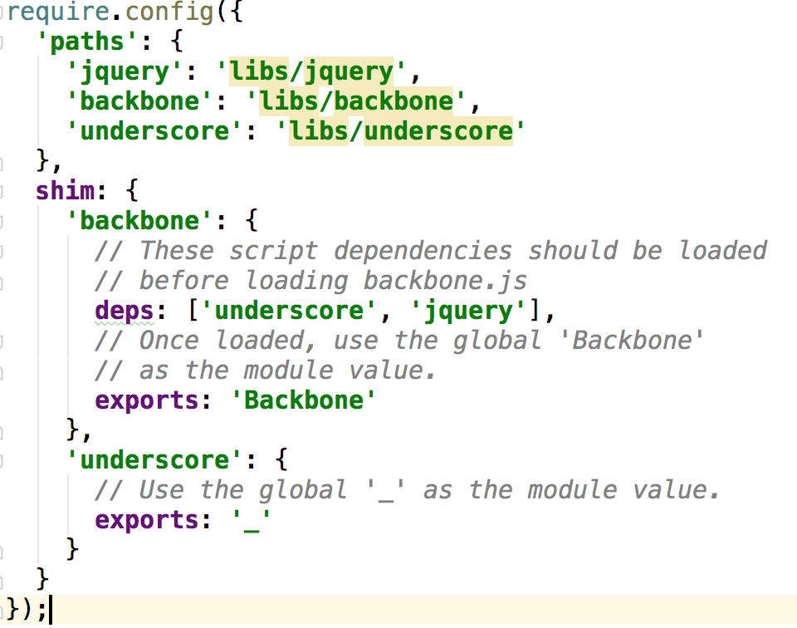
Loading Backbone

Slide 14
Config Option
Config
Config option is used to pass intial configuration into the module.
Modules can then read that info by asking for the special dependency "module" and calling module.config()

Slide 15
Wait & Deps
waitSeconds
The number of seconds to wait before giving up on loading a script. Setting it to 0 disables the timeout. The default is 7 second.
Deps
An array of dependencies to load.
Useful when you want to load dependencies as soon as require() is defined.
Using deps is just like doing a require([]) call, but done as soon as the loader has processed the configuration

Slide 16
Configuration options
Callback
A function to execute after deps have been loaded. Useful when require is defined as a config object before require.js is loaded, and you want to specify a function to require after the configuration's deps array has been loaded.
UrlArgs
Extra query string arguments appended to URLs that RequireJS uses to fetch resources. Most useful to cache bust when the browser or server is not configured correctly

Slide 17
Optimizer
The Optimizer in RequireJS has the following characteristics :
-- Combines script files together with the help of UglifyJS for default usage or Closure Compiler for Java usage
-- Combines CSS files together.
The optimizer is a component of the r.js adapter for Node. It is developed to be a part of a build process and not for the development process.

Slide 18
Setting up optimizer
Install Node.js
npm install -g requirejs
Download r.js
http://requirejs.org/docs/download.html#rjs

Slide 19
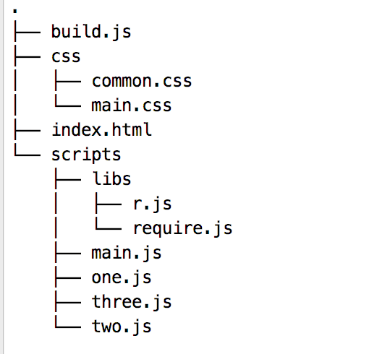
Example Project Structure

Slide 20
Build Options
https://github.com/jrburke/r.js/blob/master/build/example.build.js

Slide 21
Plugins
Sometime we need to include non-js resources.
RequireJS allows to write loader plugins that can load different types of resources as dependencies.
Examples of loader plugins are the text! and i18n! Plugins
List of Offical Plugins

Slide 22
Using the text plugin
The text plugin allows you to load files that aren't JavaScript files (but are text files, i.e., no images); this will probably be HTML or CS.
This is great for using templating systems like Mustache.js or Underscore.js: instead of putting the template in <script type=”text/template>, or right inside your JavaScript, just put it in a separate file and use the text plugin
Download Text Plugin
https://raw.githubusercontent.com/requirejs/text/master/text.js

Slide 23
Jasmine
Behaviour-Driven Javascript

Slide 24
BDD
Behavior Driven Development is an Agile development process that comprises aspects of
Acceptance Test Driven Planning
Domain Driven Design
Test Driven Development

Slide 25
BDD
BDD puts focus on Behavior rather than structure
Examples
User inputting values
Awaiting for feedback
Calculations/logic
It’s all behavior

Slide 26
Jasmine
It’s a BDD Framework for testing JavaScript
Does not depends on another framework
Clean & Obvious syntax
Does not require DOM
Available as standalone can be used with Node.js too

Slide 27
Terminologies
Specs
describe
It
Expect
Matchers
Mock
Spies

Slide 28
Testing Modules with Jasmine
download jasmine
https://github.com/jasmine/jasmine/releases

