Slide 1
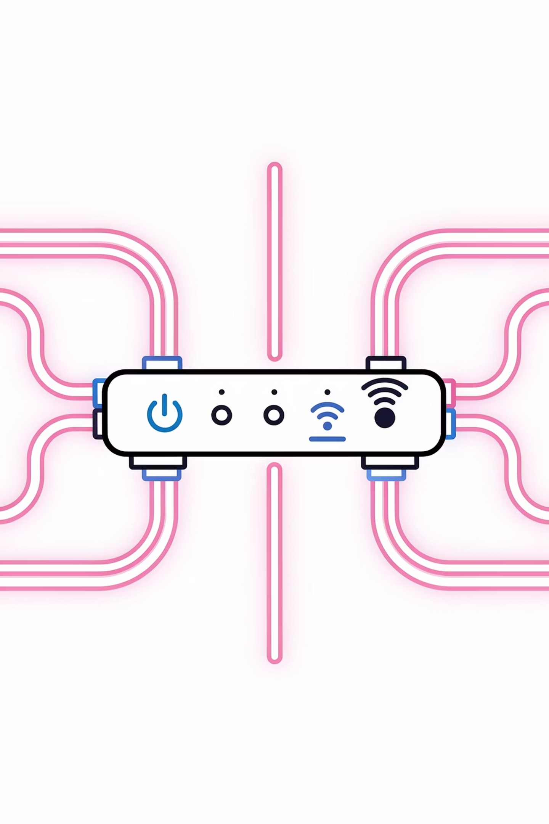
USP-Driven UI Architecture
Technical Presentation for Architects

Slide 2
TECHNICAL OVERVIEW
USP-Driven UI Architecture
A Standards-Based, Open Source-Friendly Approach for OpenWRT Routers
01
Design Drivers
Why this architecture?
02
USP Standard Compliance
TR-369 adherence
03
UI-Side Architecture
Rust client, code generation
04
Router-Side Components
lighttpd, USP Bridge, Auth CGI, OBUSPA
05
Dual Transport
HTTP/SSE + Turbo Channel
06
Package Isolation
8 independent packages
07
AI Powered Management
Dynamic calls, LLM integration
08
Key Takeaways
Summary and next steps

Slide 3





FOUNDATION
Design Drivers
Why This Architecture?
Open Source Compatible
OpenWRT-Oriented
UI layer is replaceable; Flutter today, any framework tomorrow. Developer-friendly approach hides TR-181 complexity and works with typed abstractions.
Minimal footprint designed specifically for resource-constrained embedded devices, ensuring optimal performance.
USP Standard (TR-369)
Turbo Channel
No vendor lock-in; industry-standard device management protocol ensures interoperability and future-proofing.
High-bandwidth streaming capability without blocking normal operations, enabling advanced use cases.

Slide 4

TR-369
USP Standard Compliance (TR-369)
What is USP?
User Services Platform — Broadband Forum TR-369
Successor to TR-069 (CWMP)
Protocol for device management: Get, Set, Add, Delete, Operate, Notify
Our Compliance Strategy
Standard Wire Format
Vendor Extensions
UDS MTP (Primary)
Protobuf-encoded USP Records
Architecture allows extending the data model when needed
Unix Domain Socket for USP Bridge ↔ OBUSPA communication
WebSocket MTP
Standard Subscriptions
UI ↔ lighttpd (wstunnel proxy) ↔ OBUSPA (:8443 localhost) for high-bandwidth streaming
TimeToLive, NotifType, ReferenceList per spec
Result: Any USP-compliant agent (not just OBUSPA) can be used.

Slide 5
CLIENT ARCHITECTURE
UI-Side Architecture
Application Layer
(UI screens, business logic, state management)
Definition files
(YAML files)
Definition Driven Layer
(generated from YAML files)
usp-codegen
usp-client plugins
usp-client plugins
USP client Layer (Rust)
Protobug encoding | HTTP/SSE | WebSocket | JWT refresh
Design Goals:
Developers never work with TR-181 paths or protobuf directly.
UI can be replaced with another language if needed without losing the USP connectivity.

Slide 6
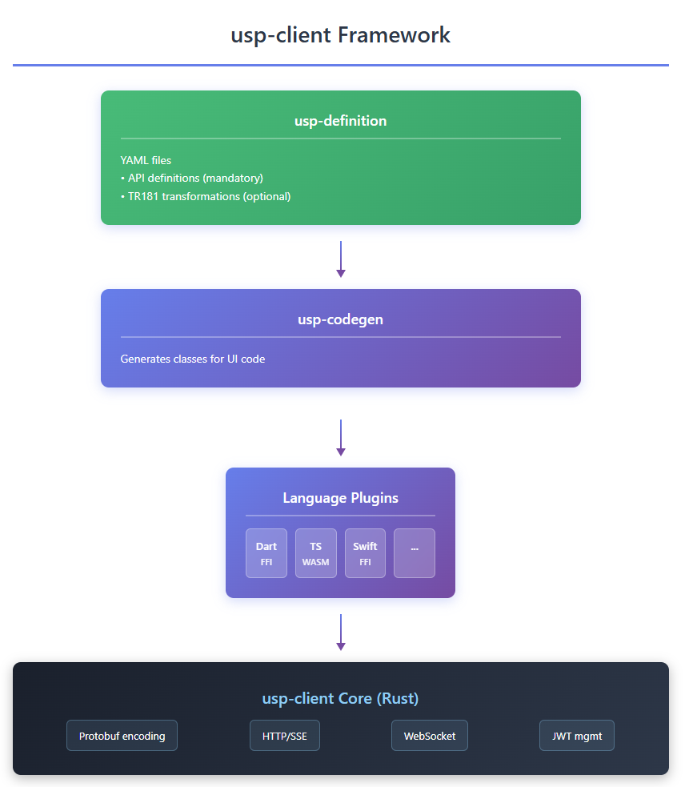
FRAMEWORK
The usp-client Framework
Not Just a Library — A Complete Framework
Core Components
usp-codegen: YAML → Code definitions
Language Plugins: Dart FFI, TypeScript WASM, Swift FFI, and more
usp-client Core (Rust): Protobuf encoding, HTTP/SSE, WebSocket, JWT management
Framework Benefits
Today: Dart plugin for Flutter provides complete integration
Tomorrow: TypeScript, Swift, or any other language — the framework architecture supports extensibility

Slide 7

CODE GENERATION
Definition-Driven Development
YAML Definition Example
Generated Dart Code
name: hardwareInfo
description: Basic hardware identification
type: get
parameters:
- path: Device.DeviceInfo.ModelName
field: modelName
type: string
- path: Device.DeviceInfo.ModelNumber
field: modelNumber
type: string
class HardwareInfo {
final String modelName;
final String serialNumber;
static Future<HardwareInfo> fetch(
UspClient client
) async {
final response = await client.get([
'Device.DeviceInfo.ModelName',
'Device.DeviceInfo.SerialNumber',
]);
return HardwareInfo._fromResponse(
response
);
}
}
Benefit: API layer is defined declaratively in YAML — no manual protobuf or TR-181 path handling. JSON definitions can be created by AI or non-experts; UI development focuses purely on presentation.

Slide 8

BENEFITS
Code Generation Benefits
Security
Developer Experience
Build Integration
TR-181 paths baked into compiled binary
Type safety: Compile-time checking, IDE autocomplete
# Generate API classes from definitions
flutter pub run build_runner build
No runtime YAML files that attackers could modify
No TR-181 knowledge required: Call WifiSettings.fetch(), not Device.WiFi.SSID.1.
Behavior is immutable without replacing signed binary
Multi-language: Same YAML definitions generate Dart, TypeScript, etc.
Output: lib/api/generated/core.dart, lib/api/generated/extensions.dart

Slide 9

EMBEDDED
OpenWRT-Oriented Design
Constraints We Design For
Limited RAM/Flash
Protobuf Offloaded to UI
Minimal daemon footprint optimized for embedded devices
USP Bridge is a thin proxy (~50KB); all protobuf encoding done by usp-client (Rust)
No Persistent State / stateless components
UCI Configuration
OBUSPA is source of truth; bridge maintains no state
Standard OpenWRT config files for system integration
lighttpd Web Server
C for Router Daemons
Lightweight, proven web server for embedded systems
Native performance with small binary sizes
Package Integration
/etc/config/usp-bridge # UCI configuration
/etc/config/usp-auth # JWT settings
/usr/sbin/usp-bridge # ~50KB daemon
/usr/lib/cgi-bin/usp-auth # ~30KB CGI
All packages follow OpenWRT packaging conventions (Makefile, init.d scripts).

Slide 10

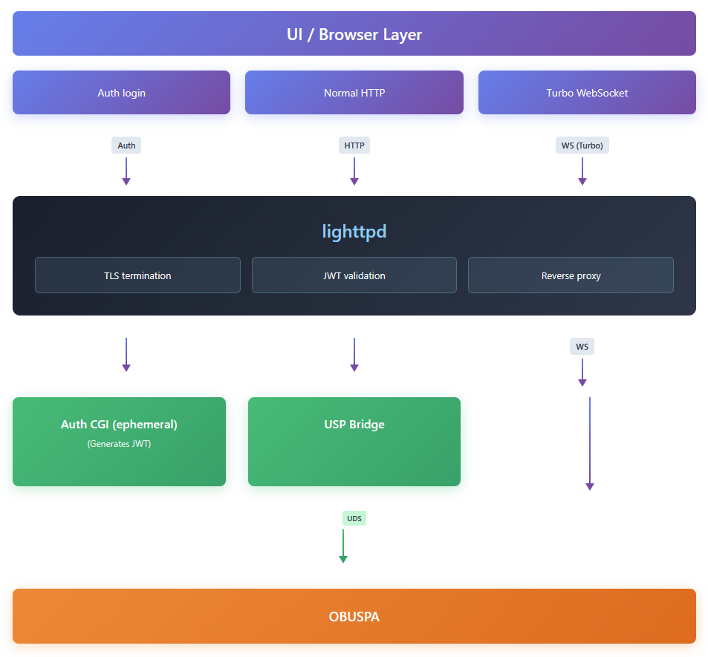
SYSTEM DESIGN
High-Level Architecture
Why This Split?
Separation of concerns: Each component does one thing well
Security: Auth CGI is ephemeral; no long-running auth state
Testability: Each component can be tested in isolation
Replaceability: Swap OBUSPA for another USP agent if needed
The architecture separates concerns with clear boundaries: the UI layer handles presentation, lighttpd manages security and routing, and backend services process USP operations. Communication flows through HTTPS and WSS protocols, with JWT-based authentication ensuring secure access.

Slide 11


BRIDGE LAYER
USP Bridge
Endpoints Exposed
Endpoint
Method
Purpose
/api/usp
POST
USP Request/Response (protobuf)
/api/events
GET
SSE notification stream
/api/subscribe
POST
Register subscription→session mapping
/api/turbo/start
POST
Acquire turbo channel
/api/turbo/heartbeat
POST
Keep turbo channel alive
/api/turbo/release
POST
Release turbo channel
Internal State (In-Memory Only)
Session → SSE connections (fan-out)
Request correlation (msg_id)
Subscription → Session mapping
Turbo channel ownership
No persistent state — survives restart by re-registration.

Slide 12


TRANSPORT
Dual Transport Strategy
Why Two Transports?
Transport
Use Case
Characteristics
HTTP/SSE (Normal)
Get, Set, Add, Delete, subscriptions
Multi-client, via USP Bridge
WebSocket (Turbo)
Packet capture, log streaming
Single-client, via usp-client
Normal Transport Flow
Turbo Channel Flow
UI → usp-client → HTTP POST /api/usp → USP Bridge → UDS → OBUSPA
UI → usp-client → POST /api/turbo/start → USP Bridge (reserves channel)
SSE /api/events ← notifications (fan-out to all tabs)
usp-client → WebSocket /usp-ws → lighttpd → OBUSPA (streaming)
Key: WebSocket is managed by usp-client (Rust), not the UI directly.

Slide 13

MODULARITY
Package Architecture (8 Packages)
#
Package
Language
Purpose
1
usp-bridge
C
HTTP/SSE ↔ UDS bridge daemon
2
usp-auth-cgi
C
JWT authentication CGI
3
usp-lighttpd-config
Config
Routing, TLS, proxy rules
4
usp-client
Rust
Client library (FFI + WASM)
5
usp-definitions
YAML
API + transforms definition files
6
usp-codegen
C
YAML → Dart/TS generator
7
usp-llm-proxy
C
AI chat validation + retry
8
usp-ui-flutter
Flutter
Cross-platform UI app
Isolation Benefits
Independent versioning and testing
Clear dependency graph
Replace any package without affecting others

Slide 14


ROADMAP
AI Powered router management
Data Path | Use Case | Characteristics
Static (Generated) | 99% of operations | Type-safe, compile-time checked
Dynamic (AI) | Natural language queries | Runtime YAML, router-validated
Why AI on the router?
Browser cannot connect directly to LLM: requires authentication
Security: Router validates all AI-generated YAML before execution
LLM in Cloud
Privacy: Customer controls cloud vs local LLM via settings
Retry Logic: Validation failures sent back to LLM without UI involvement
What channel
is Wifi using?
Sequence
UI
lighttpd
usp-llm-proxy
Local micro LLM
USP query
On 2.4GHz, you are on channel 8, and on 5GHz …
usp-bridge
usp-agent
USP response

Slide 15

ROADMAP
Future: Dynamic Module Extensibility
Goal: Replace LuCI with Modular Architecture
Like LuCI, allow OpenWRT packages to install their own UI modules on the fly.
Main Flutter UI
Core features
(pre built APIs)
Module Frame / App Launcher
Reads from a local Db (can be a file)
Embeds dynamic modules
Module A
(opkg)
Module B
(opkg)
Module C
(opkg)
Build time | Module developer creates YAML definitions → usp-codegen → typed APIs
Package | Module web app + postinst script (registers in `app_db.json`)
Install | `opkg install module-x` → module available in UI immediately
Key insight: Each module runs usp-codegen at its own build time — no TR-181 burden for module developers, no rebuild of main UI required.

Slide 16






SUMMARY
Key Takeaways
Open Source Friendly
UI is replaceable (Flutter, TypeScript, or future frameworks)
Single Rust client serves all platforms (native + WASM)
YAML definitions are language-agnostic
Standards-Based
Pure USP (TR-369) on the wire — vendor extensions supported when needed
OBUSPA (or any USP agent) is the source of truth
WebSocket MTP compliant for turbo channel
OpenWRT-Optimized
Minimal memory footprint (~50KB daemons)
UCI configuration files
Developer Experience
Hide TR-181 complexity behind typed APIs
Code generation from YAML definitions
Multi-tab/multi-device handled transparently
Future-Ready
Architecture supports dynamic module loading (LuCI replacement)
Modules built independently with their own YAML definitions
AI ready for dev and users

Slide 17
REFERENCES
Appendix: References
Standards & Specifications
Specification Documents
TR-369: Broadband Forum USP specification
router-side-spec.md — Full router architecture details
TR-181: Device:2 Data Model
ui-side-spec.md — Full UI architecture details
OBUSPA: https://github.com/BroadbandForum/obuspa
components-isolation.md — Package boundaries and interfaces
Protobuf: USP wire encoding format
Thank You
Questions & Discussion

