Slide 1

Safest place to open a restaurant
And be profitable
By Nguyen tran

Slide 2
Safest area / most profit
The Greater London area is a highly popular area to live in, being densely populated (https://www.researchgate.net/figure/Gridded-UK-population-density-based-on-the-UK-census-at-the-5-km-5-km-grid-spatial_fig8_281137363)
High population means higher chance of foot traffic into businesses opened in the area, such as restaurants.
However, being highly populated, it is also subject to the most crime.
Restaurants key crimes are burglary, theft and robberies (https://www.msra.org/uploads/2/2/5/4/22540394/restaurant20security.pdf). Main threat is robbery as that directly threatens lives.
There are two steps to be taken:
Locate safest borough within the Greater London
Use Data Science methods (K-means nearest neighbor) to predict best area to open a restaurant. Use of Foursquare to retrieve venue data

Slide 3
Data acquisition & cleaning
Crime Data to be taken from https://data.police.uk/data/
Crime Data to be taken for City of London Police and Metropolitan Police. Together they cover most - if not all - of Greater London
Data is provided in CSV files and split by month. Data needs to be merged manually before loading
Main data fields are Longitude, Latitude, LSOA name, Crime type
Safest borough in Greater London will have its postal codes returned
Postal codes to be scraped from Wikipedia page
Data needs to be filtered by the Local Authority Area that has the boroughs’ name

Slide 4
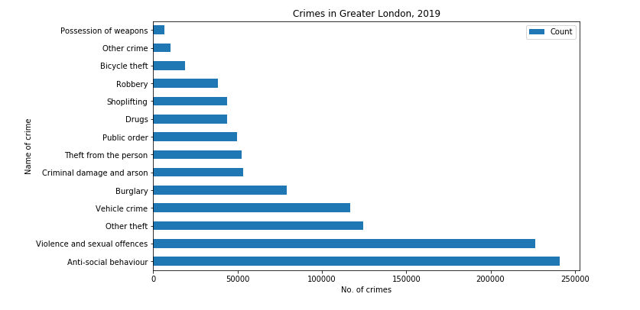
Crime Distribution, 2019

Slide 5
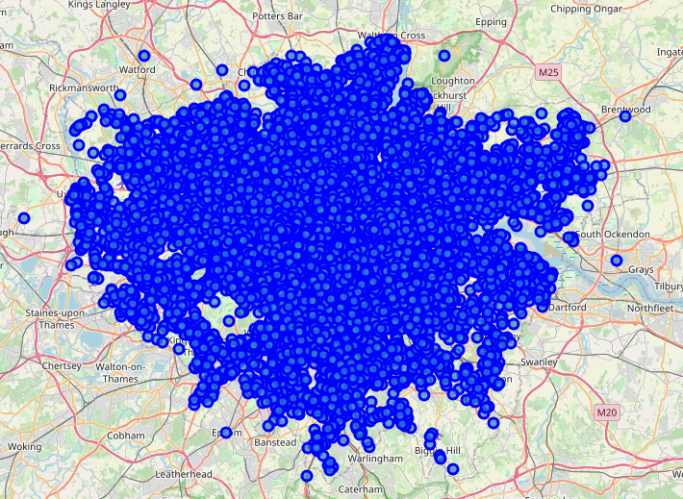
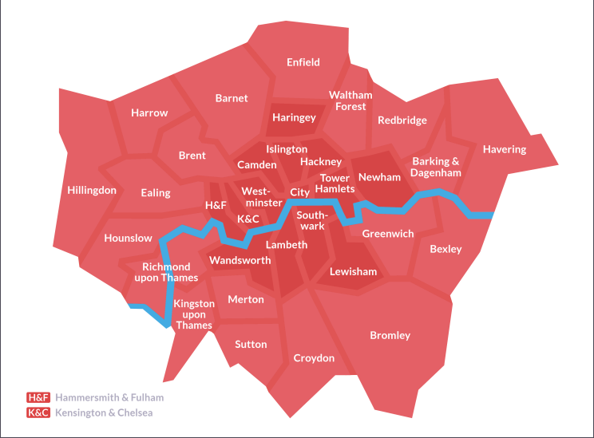
Crime distribution cont.
The crime points are all robberies that have occurred over Greater London in 2019
Clear spot of no to low robberies located in the Richmond upon Thames area
Safest place from robberies will be the borough of Richmond upon Thames

Slide 6
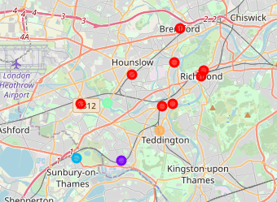
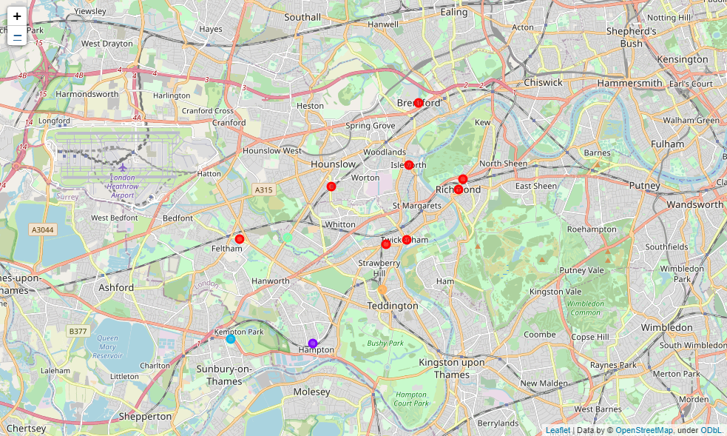
K-means Clustering venues
Richmond upon Thames selected, postal codes retrieved and parsed for venues
Most of the clusters are coloured red and are around the Hounslow, Brentford and Richmond areas
Small clusters around Teddington, Hampton and Sunbury-on-Thames

Slide 7
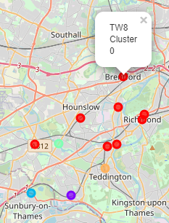
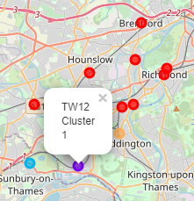
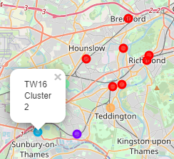
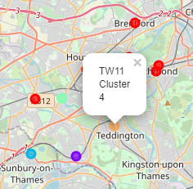
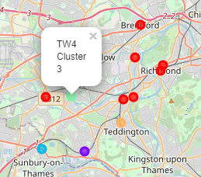
Cluster NAMES
Largest cluster is red
Red cluster is called “Cluster 0”
Explore the venues in each cluster

Slide 8
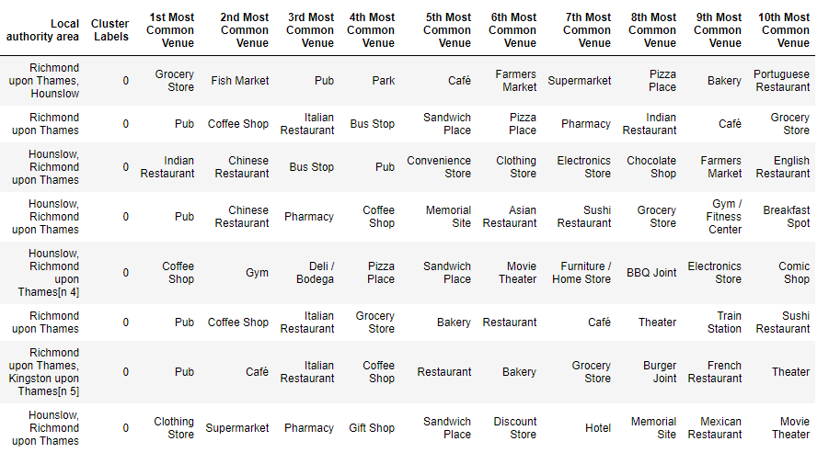
Cluster 0 Venues

Slide 9
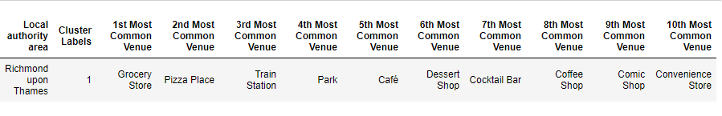
Cluster 1 Venues

Slide 10
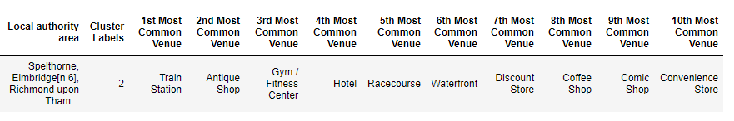
Cluster 2 Venues

Slide 11
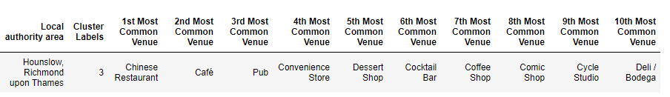
Cluster 3 Venues

Slide 12
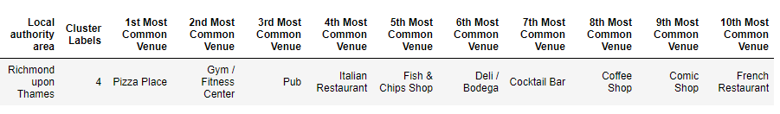
Cluster 4 Venues

Slide 13
Conclusion
Richmond upon Thames is the safest place in Greater London for robberies based on crime data from 2019
K-means clustering with venues for Richmond upon Thames postal codes has most of the nodes clustered around the Hounslow, Brentford and Richmond areas (cluster 0)
The other clusters only have 1 node each
It may seem counter-intuitive, but the restaurant should be opened around the area for cluster 0. The many nodes clustered together means higher foot traffic so potentially more customers
Restaurant just needs to serve a cuisine not around in the top 10 frequent venues for best results. Vietnamese restaurant for instance

