Slide 1
APP store monetization experiment design
Leiwen Lin

Slide 2
Goal
VP of Product has set up the goal to increase entire store’s revenue by 5% in 2018

Slide 3
How?
1. Understand business objectives
2. exploratory data analysis
3. Make hypothesis
4. Design run experiments
5. Make recommendations

Slide 4
1. Business Objectives
Increase App store revenue by 5%
Revenue = Price * volume * conversion rate
Price
Volume
Conversion rate

Slide 5
2. Exploratory data analysis (EDA)
Variable introduction
Deal with missing value and extreme value
Descriptive Analysis and Visualization

Slide 6
2. Exploratory data analysis (EDA)
User
user_id
country
Revenue
spend_next_14_days
user behavior
visit_before
saw_cart_before
clicked_buy_before
made_purchase_before
is_existing_buyer
buyer_week_before
Payment
credit_card
DCB
FOP
gift_card
paypal
initial_fop_set

Slide 7
Deal with missing value and extreme value
In 566,699 rows
columns | Number of missing value
country | 12524
user_added_credit_card | 396102
user_added_dcb | 396102
user_added_gift_card | 396102
user_added_paypal | 396102
spend_usd_next_14_days | 477667
saw_cart_before | 71059
clicked_buy_before | 71059
made_purchase_before | 71059

Slide 8
Deal with missing value and extreme value
In 566,699 rows
columns | Number of missing value
country | 12524
user_added_credit_card | 396102
user_added_dcb | 396102
user_added_gift_card | 396102
user_added_paypal | 396102
spend_usd_next_14_days | 477667
saw_cart_before | 71059
clicked_buy_before | 71059
made_purchase_before | 71059
user_added_fop
initial_fop_set
visit_before

Slide 9
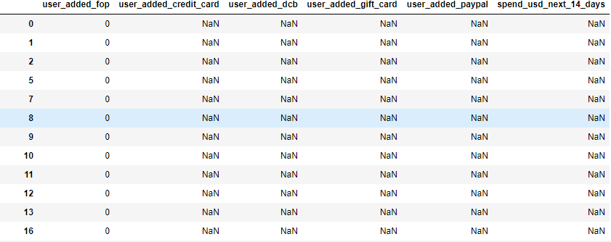
Deal with missing value and extreme value
In 566,699 rows
columns | Number of missing value
country | 12524
user_added_credit_card | 396102
user_added_dcb | 396102
user_added_gift_card | 396102
user_added_paypal | 396102
spend_usd_next_14_days | 477667
saw_cart_before | 71059
clicked_buy_before | 71059
made_purchase_before | 71059
user_added_fop
initial_fop_set
visit_before

Slide 10
Deal with missing value and extreme value

Slide 11
Deal with missing value and extreme value
Define spend more than $500 in next two weeks as extreme value

Slide 12
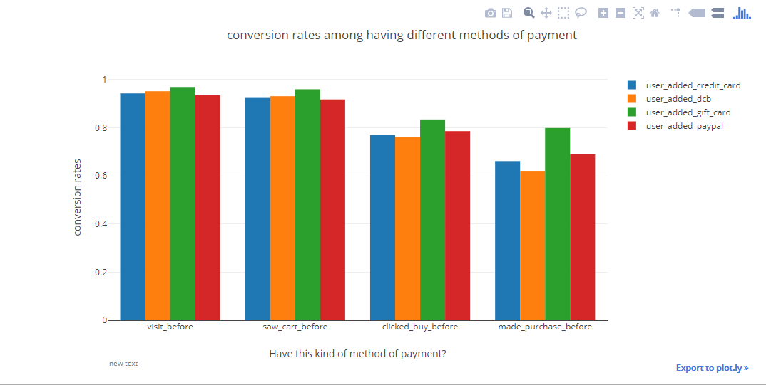
Descriptive Analysis and Visualization

Slide 13
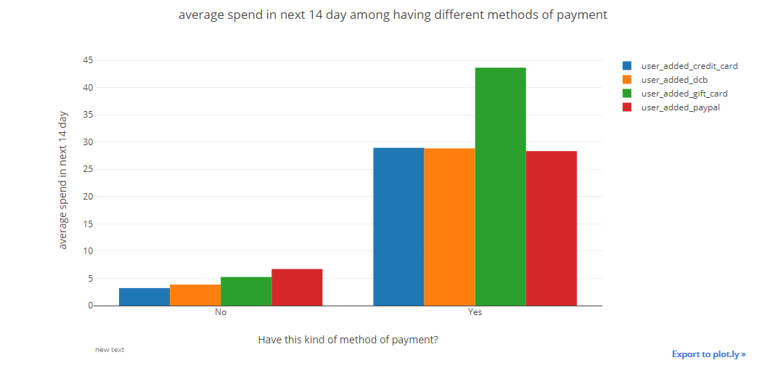
Descriptive Analysis and Visualization

Slide 14
3. Make hypothesis
Conversion rate is positively influenced by gift card payment
The amount of each customer spending is positively influenced by gift card payment

Slide 15
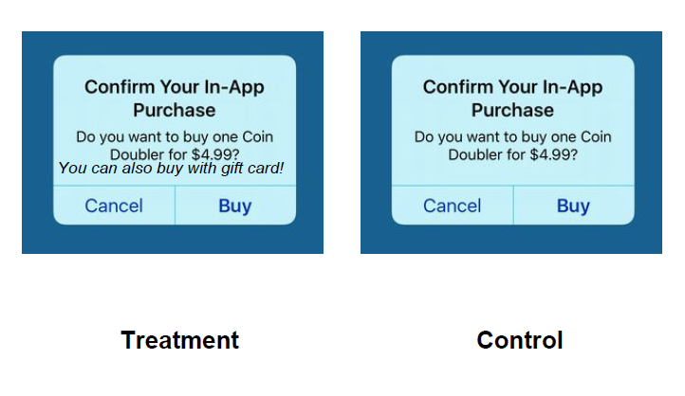
4. Design run experiments
“north star” metric: average spend of each customer
1. average spend of treatment group is significantly higher than that of control group under 95% confidence
2. average spend of treatment group is significantly more than 5% higher than that of control group under 95% confidence

Slide 16
Result of One tail t test
1. average spend of treatment group is significantly higher than that of control group (P value = 0.002)
2. average spend of treatment group is significantly more than 4.36% higher than that of control group (P value = 0.05)
3.we cannot reasonably sure that average spend of treatment group is significantly more than 5% higher than that of control group under 95% confidence

Slide 17
Result (Assume)
4. Three more days have passed by, now assume your result shows +0.8% uplift on revenue but no stat-sig uplift (Assume)

Slide 18
Recommendation
Possible reasons
Seasonal effect
Novelty effect
Sample size is small (non-stat-significant)
Recommendation
Give additional two weeks to collect larger sample

Slide 19
Code and ppt
https://github.com/linleiwen/store-monetization-experiment-design-Project

