Slide 1
Credit card Fraud Detection
By leiwen

Slide 2
Overview
credit cards transactions in September 2013 by European cardholders.
Data cleaning, Data manipulate and Data exploration
Modeling
Result

Slide 3
DATA
1. 285,299 transactions with 30 columns (PCA transformation)
2. Highly unbalanced data (only 0.172% are fraud)

Slide 4
DATA manipulation
Split data set into training set and test set 70:30
SMOTE training data

Slide 5
modeling
Logistic Regression
Random Forest classification
Bagging Tree Classification
Extreme Gradient Boost
Kernel SVM

Slide 6
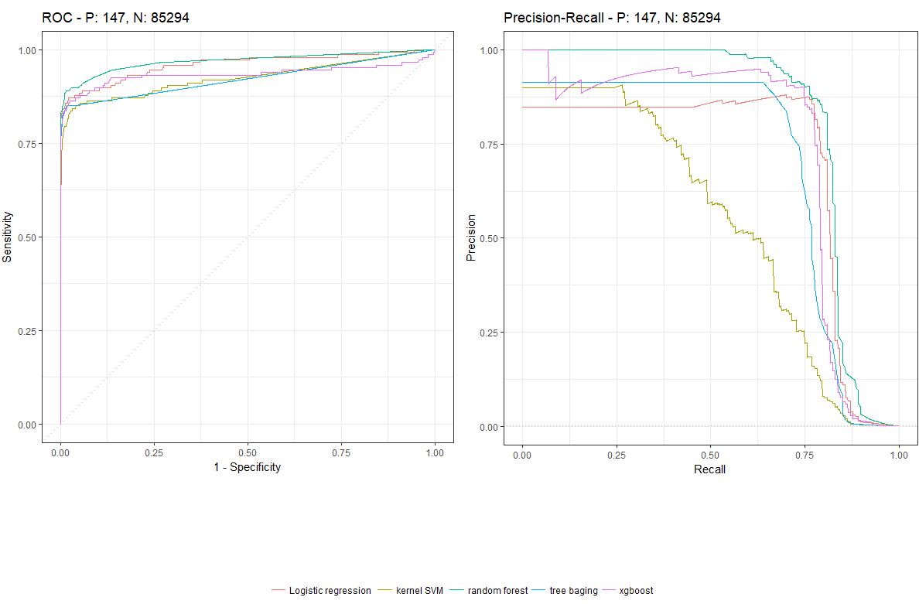
Result

Slide 7
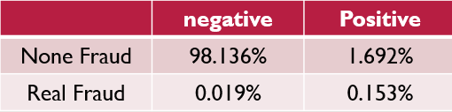
Impact
Set cutoff rate = 5%
Suppose unable to detect a real fraud is 19 times expensive as mistakenly detect a fraud
Overall accuracy: 98.3%
Precision : 8.3%
Recall :89.1%

Slide 8
Code and PPT
Code and PPT: https://github.com/linleiwen/Credit-Card-Fraud-Detection
data source: https://www.kaggle.com/dalpozz/creditcardfraud

