Slide 1

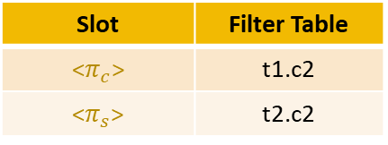
Schema-based Instantiation
Schema & Pre-state
② Slot filling (Table)
t1
c1 (PK) | c2
1 | 10
2 | 20
Grammar-guided structure generation
Slot | Filter Table
<T> | t1
<R> | t2
①Build Slot
FK Const
Abstract Skeleton
t2
c1 (FK) | c2
1 | 30
2 | 40
UPDATE <T>
INNER JOIN <R>
ON <pred_slot>
SET <$π_{c}$> = <$π_{s}$>
③ Slot filling(Column)
Slot | Filter Table
<$π_{c}$> | t1.c2
<$π_{s}$> | t2.c2
Original DML
UPDATE t1
INNER JOIN t2
ON t1.c1=t2.c1
SET t1.c2=t2.c2
④ Slot filling(Predicate)
<pred_slot>
t1.c1=t2.c1

