Slide 1
空白演示
单击输入您的封面副标题

Slide 2
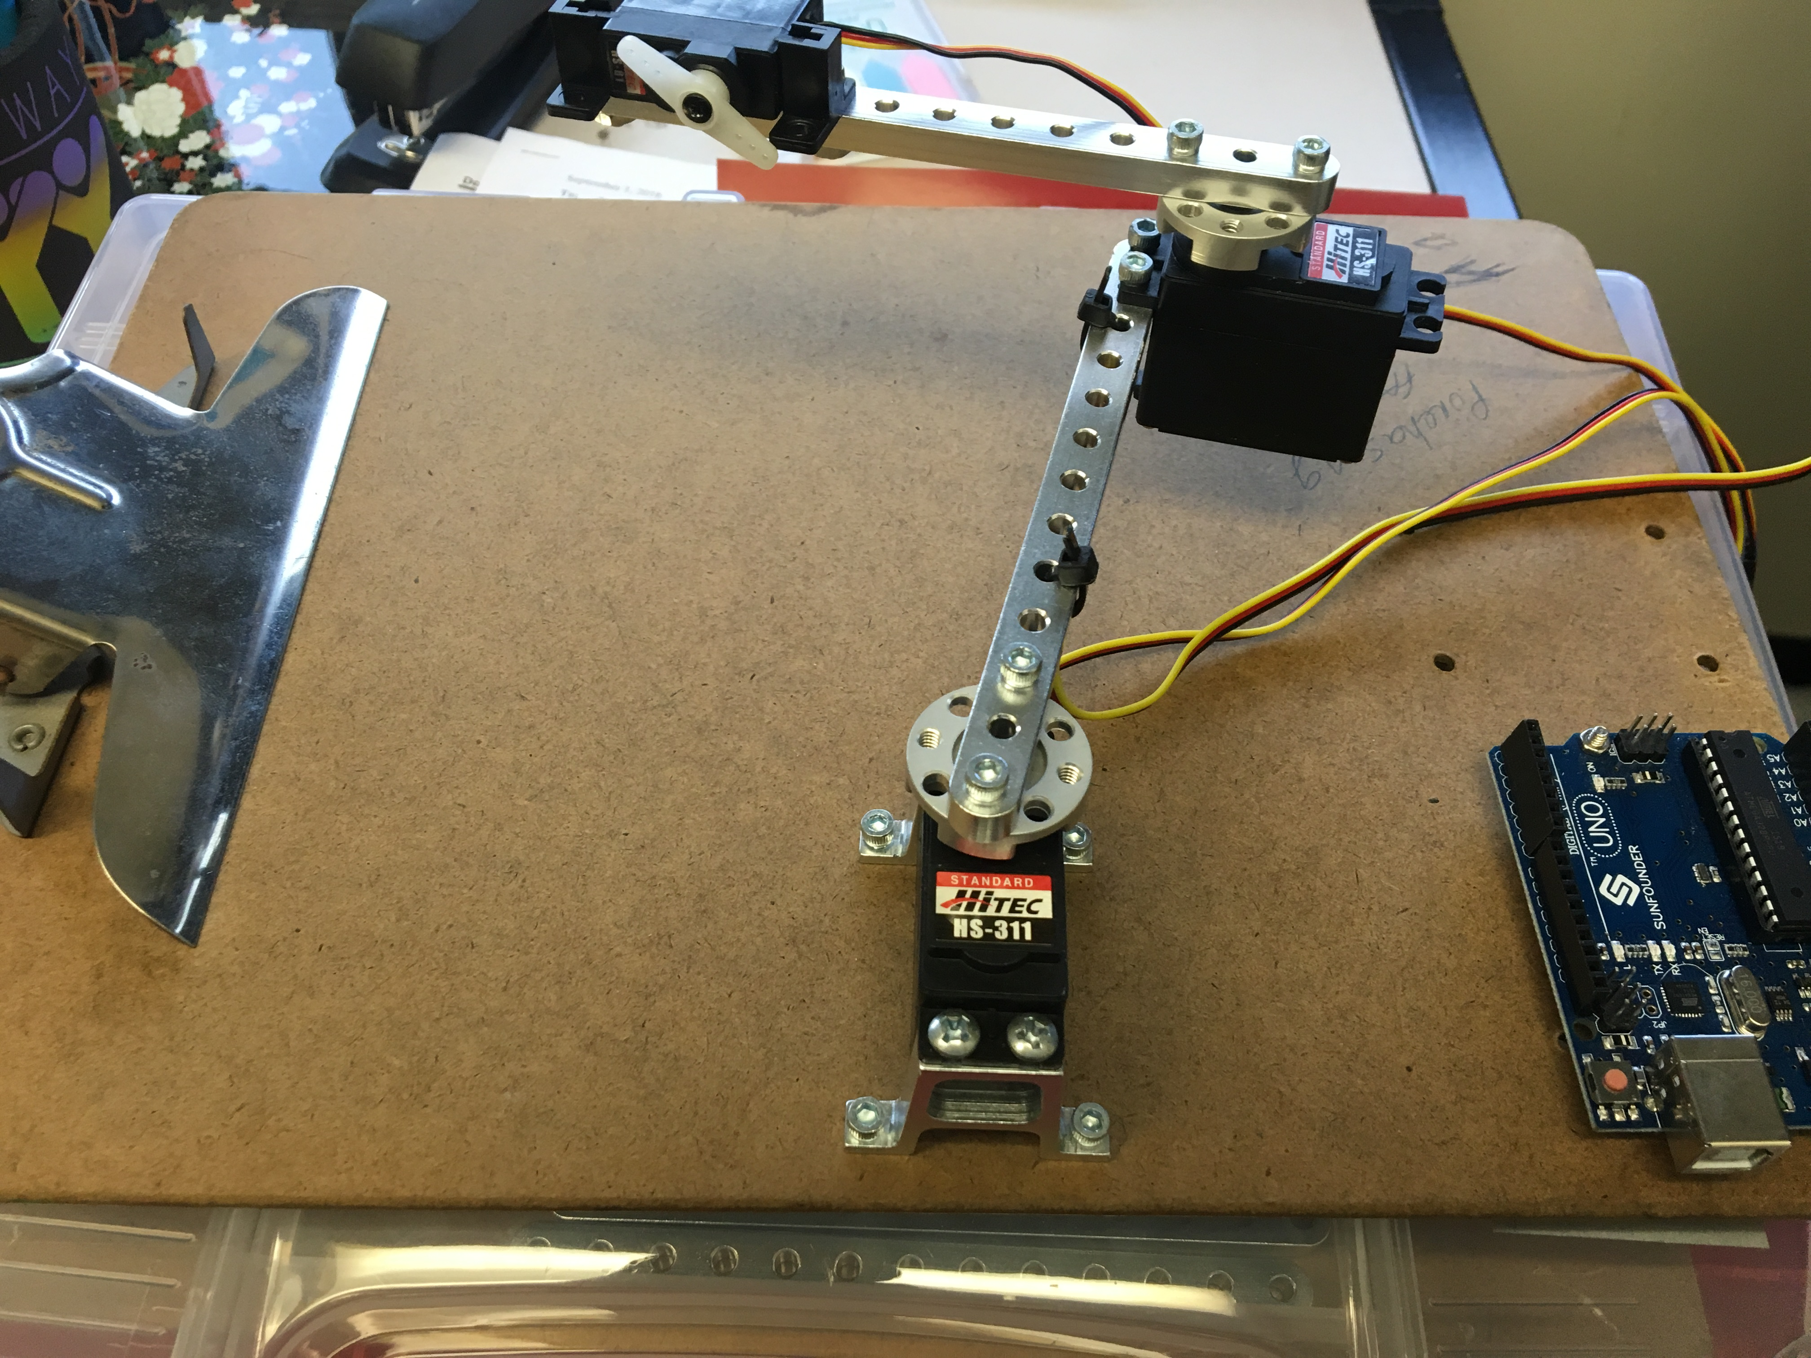

Slide 3
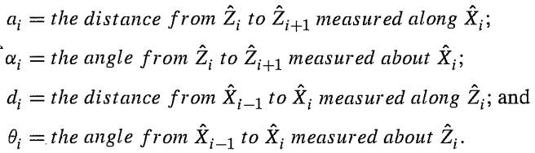

Slide 4
Z2
X3
{T}
a2
X2
Z3
L3
L2
{C}: clipboard frame
{B}: base frame
{T}: Tool frame
Y3
Y2
Z1
a1
Y1
X1
 | a | α | d | θ | offset
1 | a1 | 0 | 0 | θ₁ | -19º
2 | a2 | -90º | L2 | θ₂ | 16.8
3 | 0 | 0 | L3 | θ₃ | 0
{B}
Z
Y
X
baseZ
baseY
{C}

Slide 5
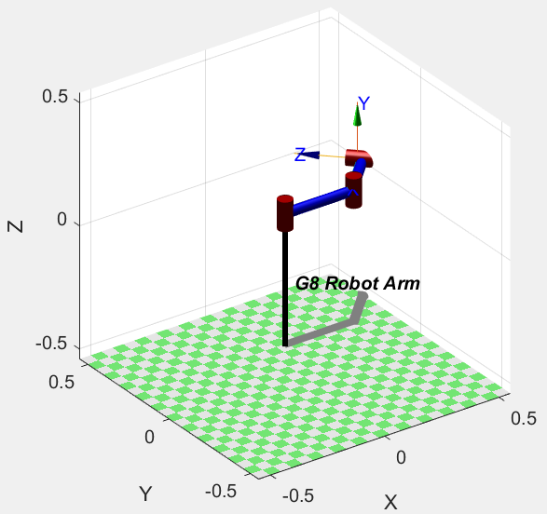

Slide 6
Maximum reachable space
Joint3
r=a2
a2
Joint2
r=a1
a1
Joint1

Slide 7
Minimum reachable space
Joint2
r=a1
a2
r=a1-a2
a1
Joint3
Joint1

Slide 8
reachable space
r=a1+a2
r=a1
r=a2
r=a2

Slide 9
Maximum reachable space

