Slide 1
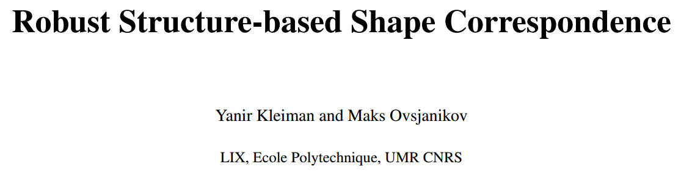
Computer Graphics Forum (CGF),2018.
汇报人：罗 闪
日 期：20180521

Slide 2
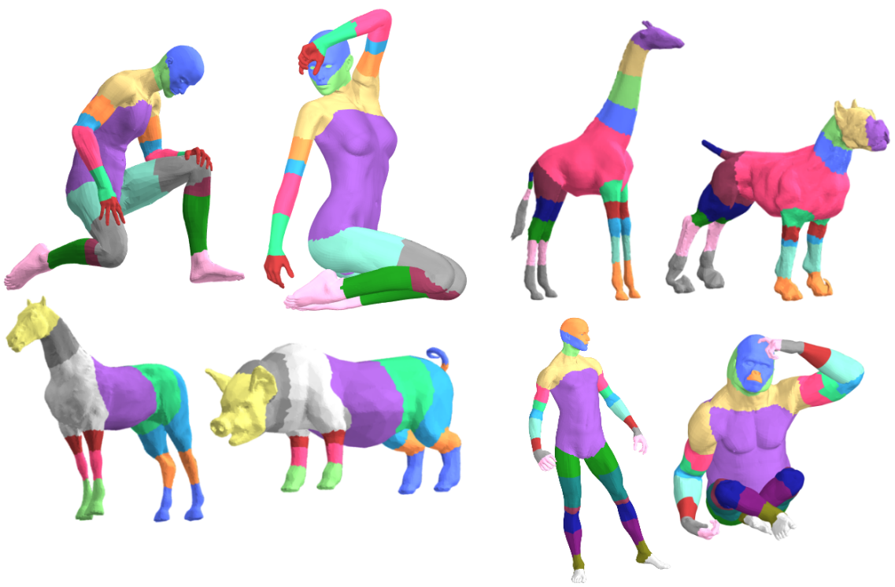
1. Introduction
Main idea: find region-level correspondences between shapes
Application:
constraints to point-to-point maps
identify parts that do not have a match across shapes

Slide 3
1. Introduction
Contributions:
Robust in the presence of significant geometric variability,
Significantly more efficient than the most directly related approaches,
Capable of handling different representations, such as triangle meshes and point clouds,
Able to both produce matches that mix symmetric parts, or disambiguate between them, when necessary.

Slide 4
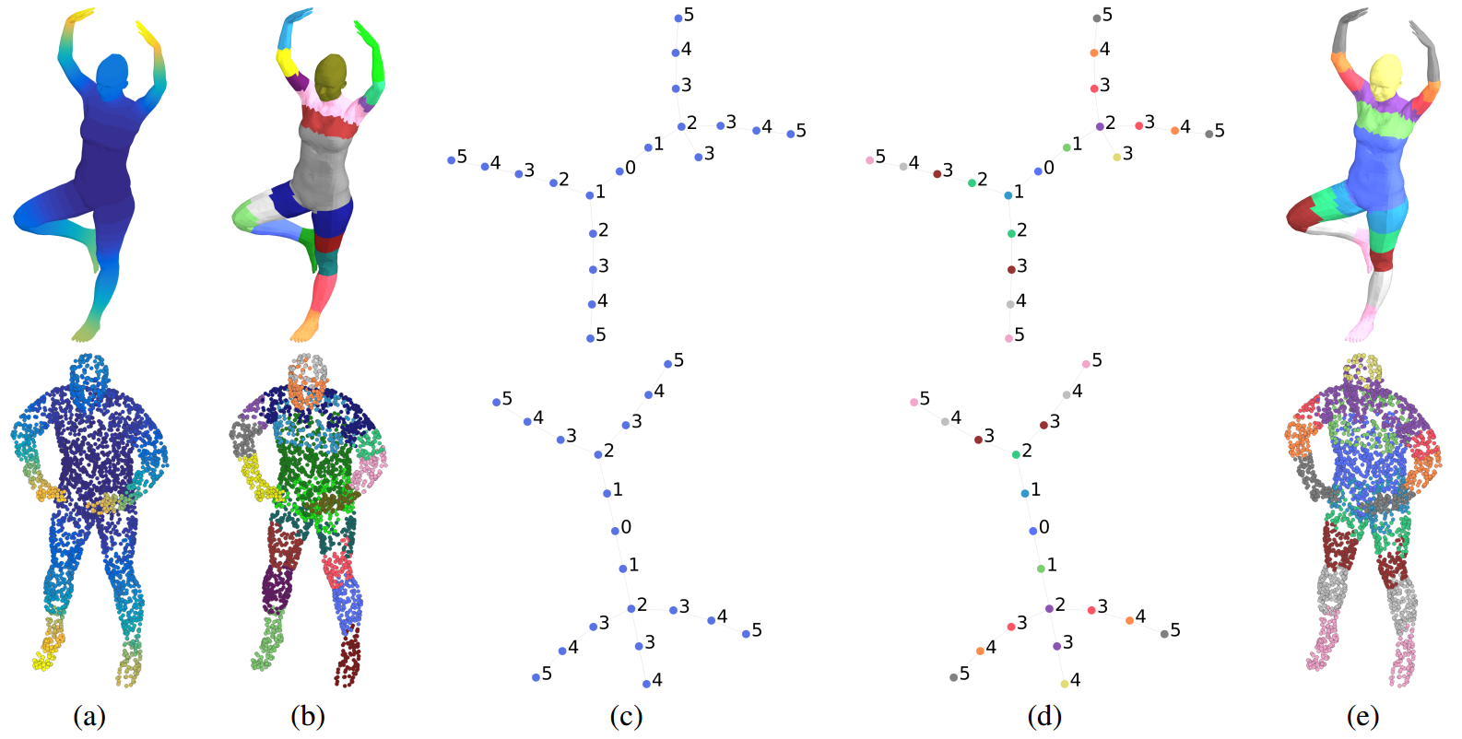
2. Pipeline
compute descriptors
joint segmentation
generate a shape graph
match shape graphs
result

Slide 5
3. Descriptors
Property:
Smooth. (segments are not overly fragmented )
Robust. (match shapes with varying geometry)
Descriptive. (differentiate between different elements of the shape )
HKS (15 time steps).
Laplacian matrix :
Triangle meshes: cotangent weight discretization
Point clouds: a Laplacian with a Gaussian weight on a k-nearest neighbor graph

Slide 6
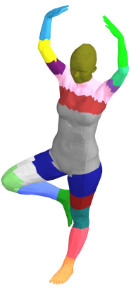
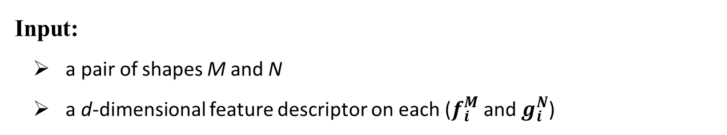
4. Joint segmentation
Input:
a pair of shapes M and N
a d-dimensional feature descriptor on each ($f_{i}^{M}$ and $g_{i}^{N}$)
Goal: co-segment these shapes in a consistent manner .
Note:
This algorithm does not seek a semantic segmentation of the shape; a semantic part may be cut into several segments.

Slide 7
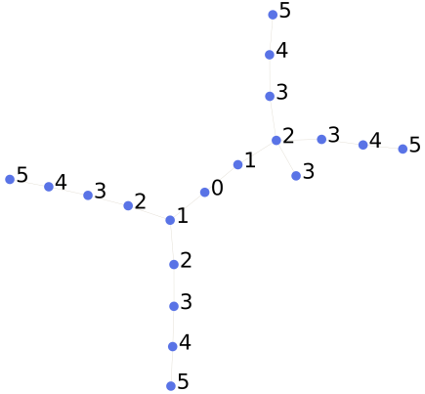
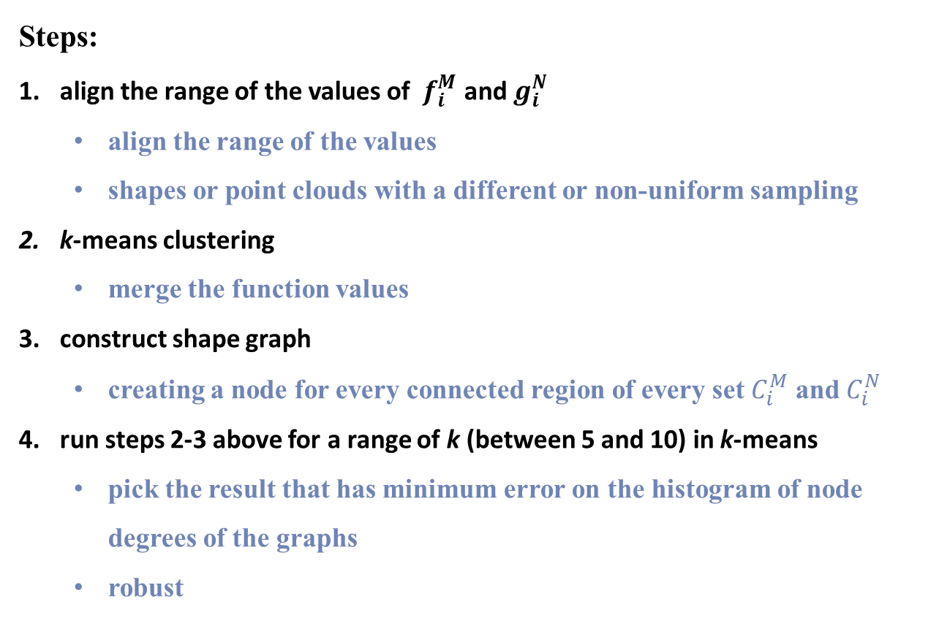
4. Joint segmentation
Steps:
align the range of the values of $f_{i}^{M}$ and $g_{i}^{N}$
align the range of the values
shapes or point clouds with a different or non-uniform sampling
k-means clustering
merge the function values
construct shape graph
creating a node for every connected region of every set $C_{i}^{M}$ and $C_{i}^{N}$
run steps 2-3 above for a range of k (between 5 and 10) in k-means
pick the result that has minimum error on the histogram of node degrees of the graphs
robust

Slide 8
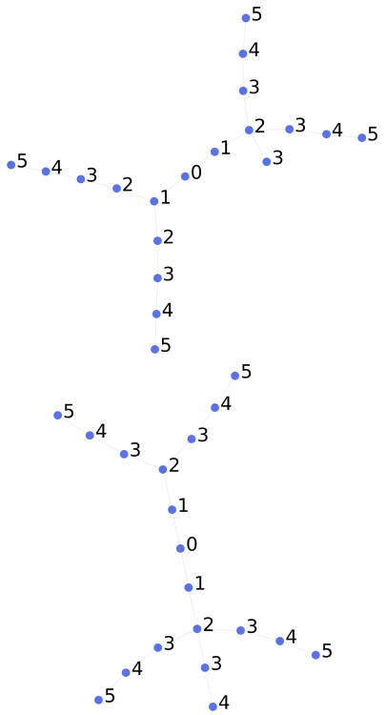
5. Region Matching
This algorithm relies only on the graph structure of the shape, without additional geometric data.
Information:
node degrees
their connectivity

Slide 9
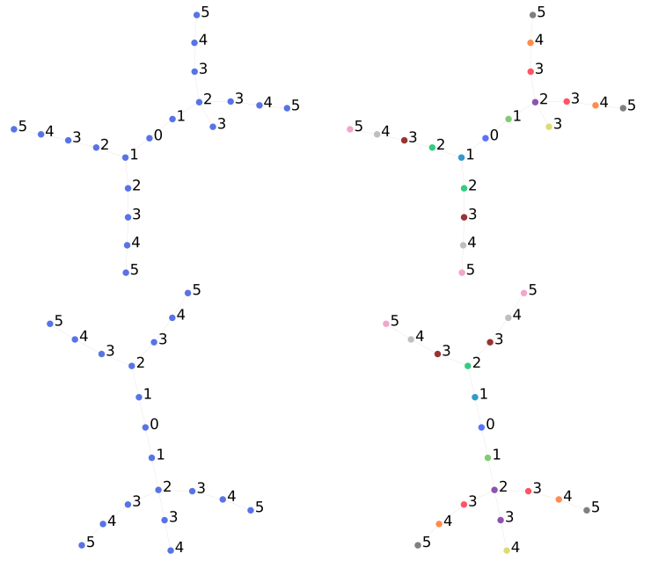
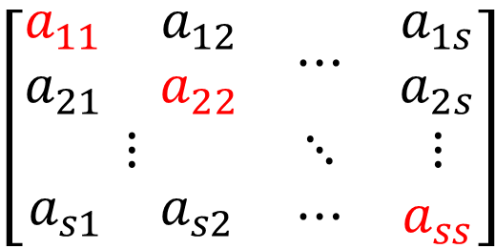
5. Region Matching
Input: two graphs with n and m number of nodes
Output: correspondence between the graphs (1-1 correspondence vector x)
Construct a matrix M of n · m rows and n · m columns: (s = m*n)
$$\left[\begin{matrix}\begin{matrix}a_{11} & a_{12} \\ a_{21} & a_{22}\end{matrix} & ⋯ & \begin{matrix}a_{1s} \\ a_{2s}\end{matrix} \\ ⋮ & ⋱ & ⋮ \\ \begin{matrix}a_{s1} & a_{s2}\end{matrix} & ⋯ & a_{ss}\end{matrix}\right]$$
diagonal terms：
affinity between a pair of nodes (i,j)
off-diagonal terms:
compatibility between a match (i,j) and another match (k,l)
Goal: find a binary one-to-one correspondence vector x that maximizes $x^{T}Mx$
Optimization method:
the eigenvector corresponding to the largest eigenvalue of M.

Slide 10




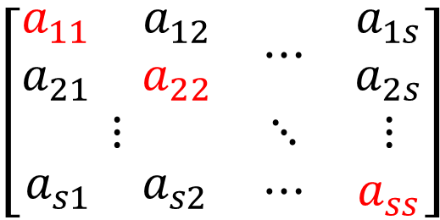
5. Region Matching
Compute the matrix M:
diagonal terms:
the histogram of graph distances
off-diagonal terms:
the difference of graph distances
the difference of the unary costs between the matches
$$\left[\begin{matrix}\begin{matrix}a_{11} & a_{12} \\ a_{21} & a_{22}\end{matrix} & ⋯ & \begin{matrix}a_{1s} \\ a_{2s}\end{matrix} \\ ⋮ & ⋱ & ⋮ \\ \begin{matrix}a_{s1} & a_{s2}\end{matrix} & ⋯ & a_{ss}\end{matrix}\right]$$

Slide 11
6. Symmetry Breaking
Goal: consistent and without discontinuities. (consistently flipped is not penalized)
The symmetry breaking is based on the assumption that geodesic distances between nearby regions do not change drastically between the shapes.
first: produce a one-to-one matching for the group arbitrarily.
others: match regions which are nearest to previously resolved regions.

Slide 12
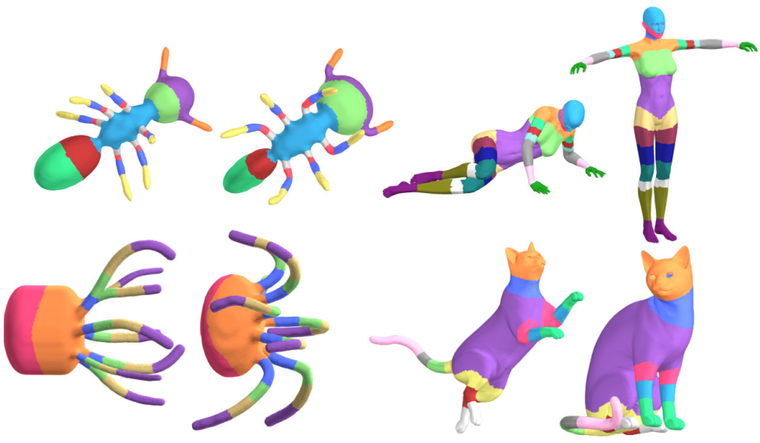
7. Results
This method is not limited to bilateral symmetry.

Slide 13
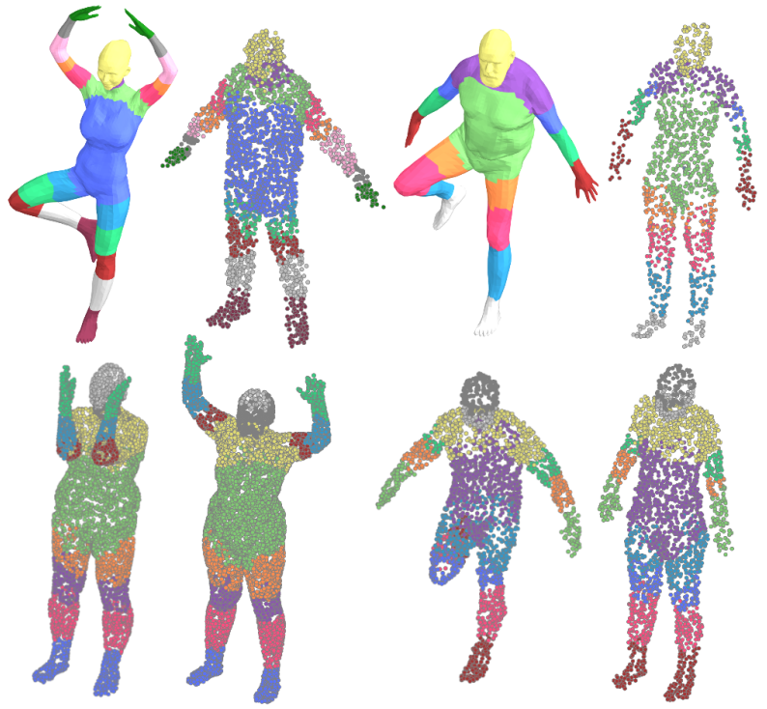
7. Results
Shapes with different representations：

Slide 14
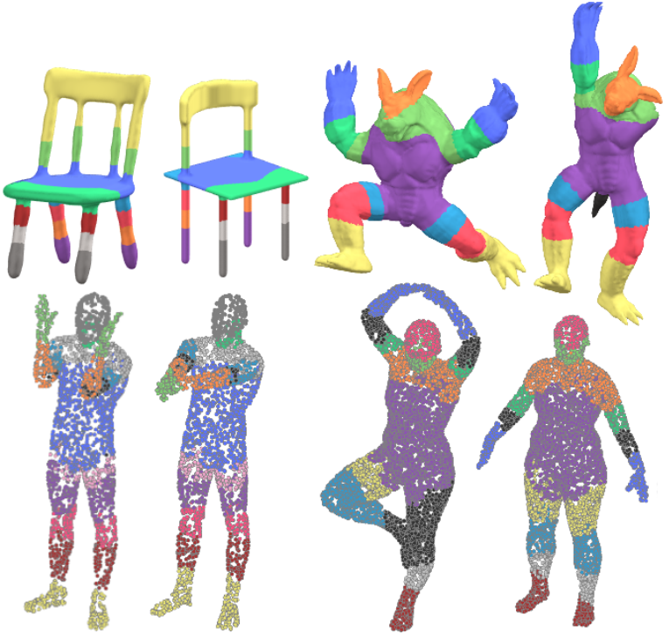
7. Results
Shapes with different topological structure ：

Slide 15
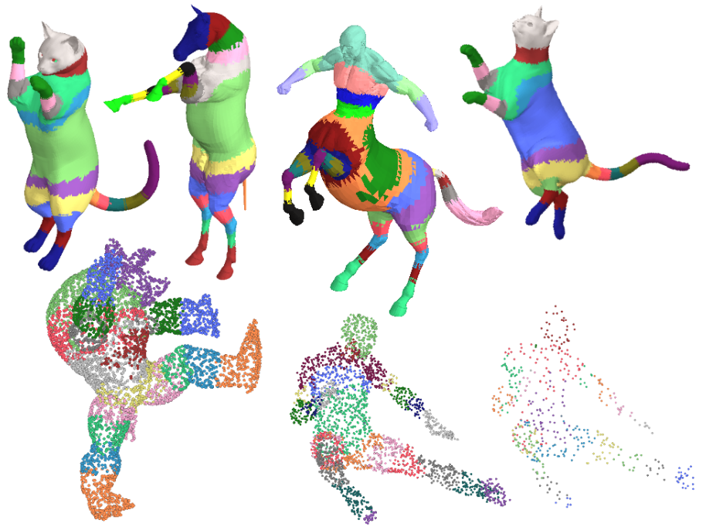
7. Results
region-level symmetry detection：

Slide 16
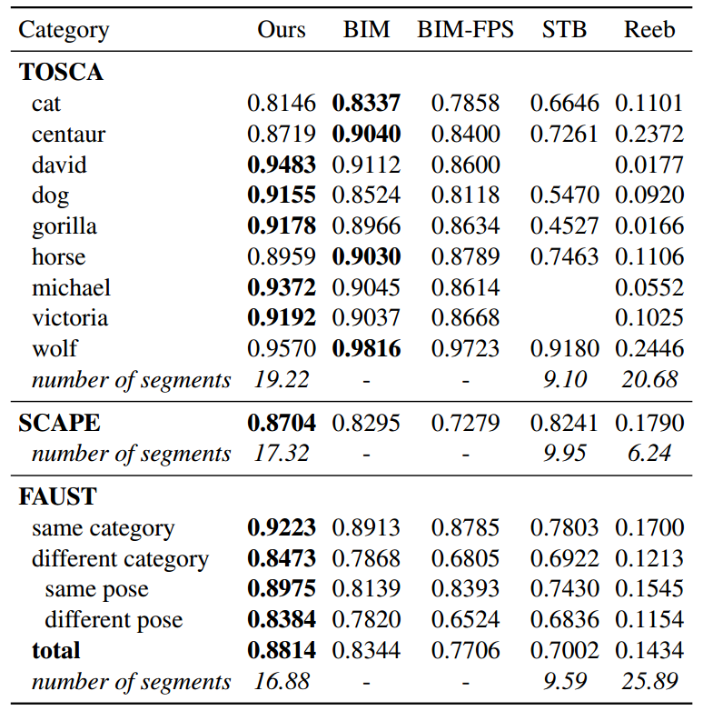
7. Results
Region Accuracy：

Slide 17
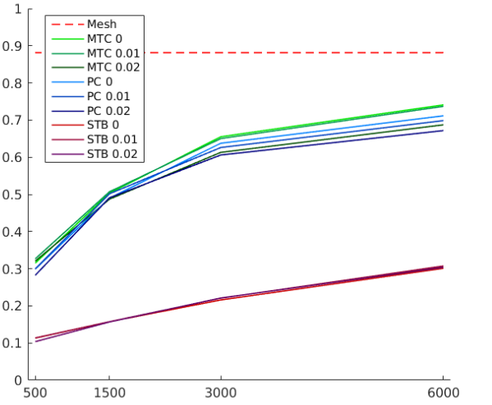
7. Results - Matching Point Clouds
Stability of matching point clouds with varying sampling densities and noise levels：
a triangular mesh to a point cloud (MTC)
two point clouds (PC)
two point clouds using the stable region method (STB)
samples

Slide 18
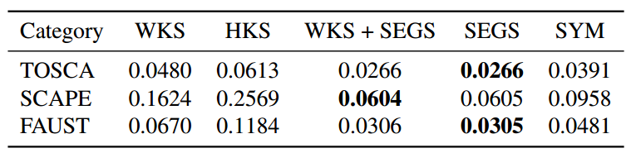
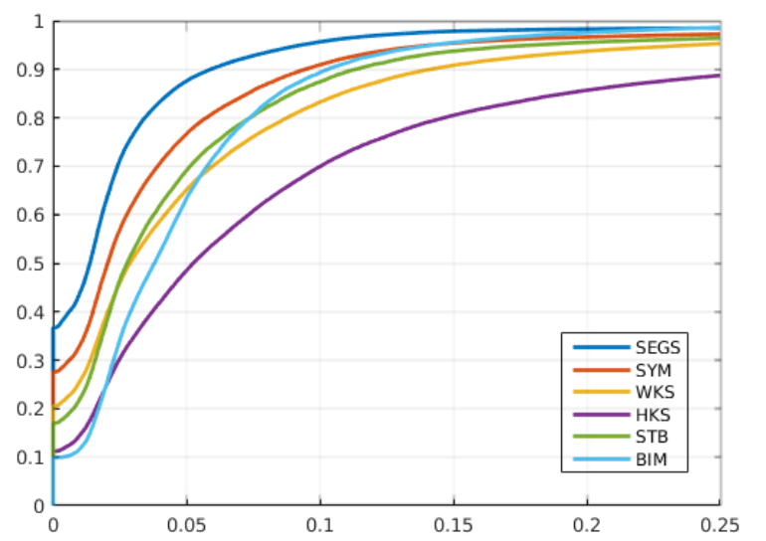
7. Results - Point-to-point maps
Average geodesic error
(Functional map framework)
FAUST dataset:

Slide 19
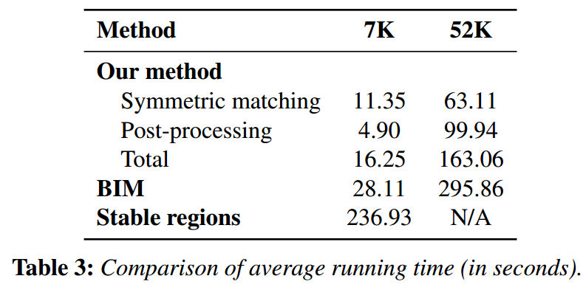
7. Results - times

Slide 20
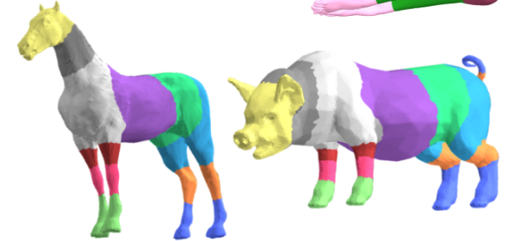
8. Conclusion
both computationally efficient and robust
outperform state-of-the-art shape correspondence methods within the domain of matching shape regions
partial shapes and shapes with different topology sometimes may fail to provide a meaningful correspondence
structural data may not be enough to distinguish between parts

Slide 21
Thanks!

