Slide 1
UofT Engineering Finance Club Technology Sector
Cymer Inc.
CYMI (NASDAQ)
Lead Analyst: Ashton Wu
Sep 15, 2011

Slide 2

Company Description
World’s leading supplier of excimer light sources
Develop deep utraviolet photolithography sources used in semiconductor chips
Provide support services through OnPulse
Founded in 1986, IPO on Sep 1996
Headquarters: San Diego, California
Approximately 1,000 employees (Wiki)
Introduction
Description
Key Drivers
Valuation
Conclusion
Notes:
2

Slide 3
Company Description
Jan 2010 – Acquired TCZ, which develops laser crystallization production equipment for flat panel display
Co-founded by Dr. Robert Akins and Dr. Richard Sandstrom at the University of California, San Diego
Supplies to companies such as ASML Holding, Nikon, and Canon
Offices located in North America, Asia, and Europe (major chip-making locations)
Introduction
Description
Key Drivers
Valuation
Conclusion
Notes:
3

Slide 4

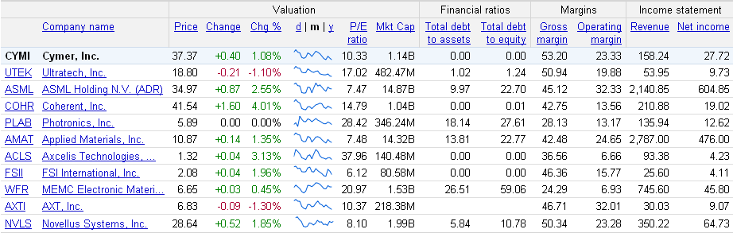
Competitors
Introduction
Description
Key Drivers
Valuation
Conclusion
Notes:
4

Slide 5
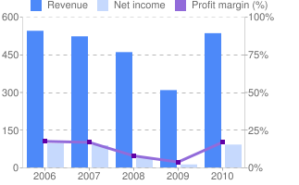
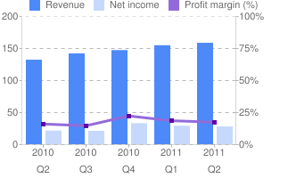
Revenue Breakdown
Annual Data
Quarterly Data
Introduction
Description
Key Drivers
Valuation
Conclusion
Notes:
5

Slide 6
Revenue Breakdown
End of Q2:
Shipped 47 light sources, installed 56 = $140 million
DUV backlog of $57.8 million
Introduction
Description
Key Drivers
Valuation
Conclusion
Notes:
6

Slide 7
Revenue Breakdown
Projections for Q3 (Q2):
Revenue = $130 million ($158.2 million)
Gross margin = 50% (53%)
R&D = $34.5 million ($30.45 million)
SG&A = $16.5 million ($16.82 million)
Tax Rate = 21% (25%)
Reduced number of orders due to chipmakers reassessing their capital investments
Introduction
Description
Key Drivers
Valuation
Conclusion
Notes:
7

Slide 8
Basic Figures
Current Stock Price: $41.56
P/E Ratio: 11.49, EPS: 3.62
52-wk High: $58.19, 52-wk Low: $32.18
Market Cap: 1.27B
Shares: 30.54M
Operating Margin: 23.33%
D/E ratio: 0.00
Introduction
Description
Key Drivers
Valuation
Conclusion
Notes:
8

Slide 9
Management
Dr. Robert Akins
CEO and Chairman
Bachelor in Physics and Literature, Doctorate in Applied Physics, UCSD
Awarded for contributions in the field of DUV
Company awarded for demonstrating positive impact on society
Dr. Richard Sandstrom
SVP and Chief Technical Advisor
Bachelor in Physics, Doctorate in Engineering Physics, UCSD
Awarded for contributions in the field of DUV
Introduction
Description
Key Drivers
Valuation
Conclusion
Notes:
9

Slide 10
Revenue Growth
Annual Data
Quarterly Data
Improved DUV competitive position
Growth in EUV sector, next-generation DUV
Increased revenue from OnPulse and TCZ
Introduction
Description
Key Drivers
Valuation
Conclusion
Notes:
10

Slide 11
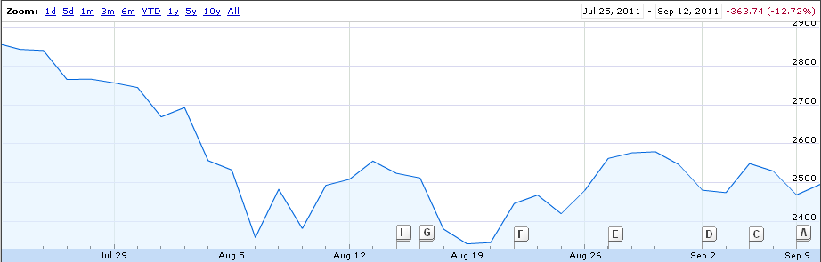
Macro Effects
Extreme volatility in past few months
Is it better to wait? Or is it a good time to buy now?
Introduction
Description
Key Drivers
Valuation
Conclusion
Notes:
11

Slide 12
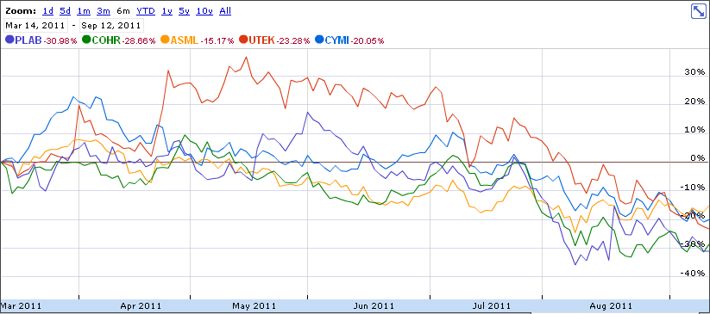
Projections & Trends (6m)
at&t
Introduction
Description
Key Drivers
Valuation
Conclusion
Notes:
12

Slide 13
Team Recommendation
$47
12 Month Price Target:
<$40
Appropriate Entry Price:
Top Three Reasons to BUY:
1
Good Management focused on the Company’s Success
2
3
Strong Financials and DCF
Large Revenue Growth over past year
Introduction
Description
Key Drivers
Valuation
Conclusion
Notes:
13

Slide 14
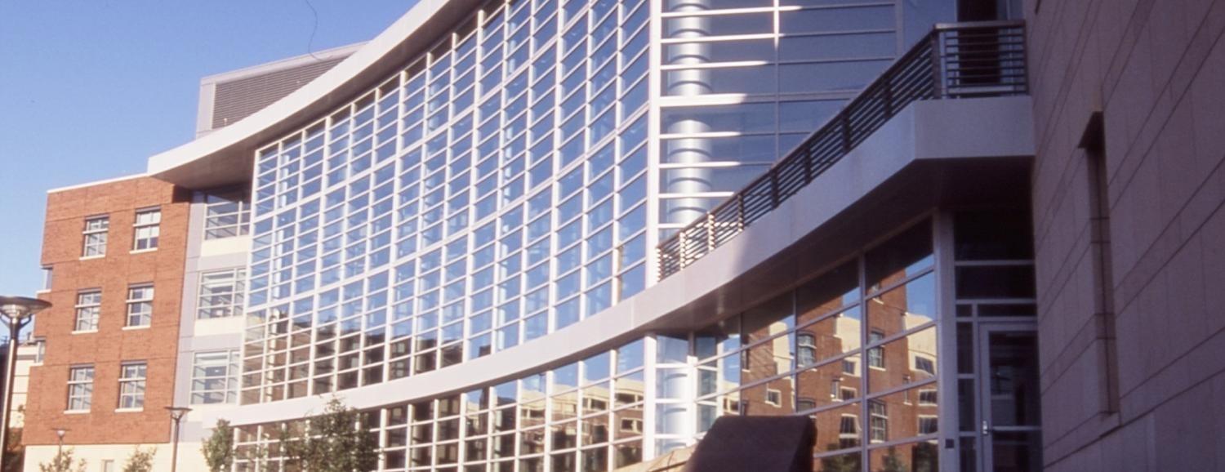
Questions or Comments?
Notes:
14

