Slide 1
UofT Engineering Finance Association Technology Sector
Netflix
NFLX (NASDAQ)
Lead Analyst: Ashton Wu
Sep 27, 2011

Slide 2

Company Description
World’s leader in internet subscription service for movies and TV
Streaming available from many devices such as: PC, Xbox, iPhone, DVRs, Android, Google TV
Founded 1997, HQ: Los Gatos, CA
900 Employees
IPO in May 2002: 5.5M shares at $15
Introduction
Description
Key Drivers
Valuation
Conclusion
Notes:
2

Slide 3
Company Description
25 million members at the end of June 2011
Price hike initiated Sep 1st, lost 1 million subscribers
CEO Reed Hastings posts an apology blog for lousy product launch and announces Qwikster
Loses Starz Entertainment contract renewal
Stock price down over 50% over the past 3 months
Recently gain exclusive DreamWorks contract
Introduction
Description
Key Drivers
Valuation
Conclusion
Notes:
3

Slide 4







Competitors
Introduction
Description
Key Drivers
Valuation
Conclusion
Notes:
4

Slide 5
Basic Figures
Current Stock Price: $127.49
P/E Ratio: 32.29
EPS: 3.95
Market Cap: 6.70B
Shares: 52.54M
Operating Margin: 14.60%
D/E ratio: 70.41%
Introduction
Description
Key Drivers
Valuation
Conclusion
Notes:
5

Slide 6
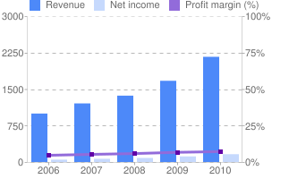
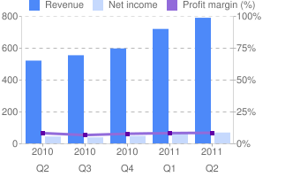
Revenue Breakdown
Annual Data
Quarterly Data
Introduction
Description
Key Drivers
Valuation
Conclusion
Notes:
6

Slide 7
Change in Operation
Q2/11
$7.99 per month unlimited streaming only
$9.99 per month unlimited streaming and 1 DVD
$14.99 per month unlimited streaming and 2 DVDs
25.56M subs and $789M = $10.29 per sub per month
Q3/11
$7.99 per month unlimited streaming
$7.99 per month unlimited DVDs and video games
Projected revenue?
Introduction
Description
Key Drivers
Valuation
Conclusion
Notes:
7

Slide 8
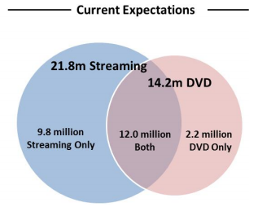
Revenue Projection
Assume Jul and Aug = (2/3)*(24/25)*$789M = $505M
36M subs to $7.99 plan = $288M ($864M per Q)
Total Rev = $793M
Total Rev 2012 = $719M + $789M + $793M + $864M = $3,165M
Introduction
Description
Key Drivers
Valuation
Conclusion
Notes:
8

Slide 9
Revenue Projection
Qwikster subsidiary dies out over 5 years
Streaming subscribers grow at a slower rate from 15% to 25%
Annual Revenue assumes $7.99 price sticks
Introduction
Description
Key Drivers
Valuation
Conclusion
Notes:
9

Slide 10
Team Recommendation
??
12 Month Price Target:
??
Appropriate Entry Price:
Top Three Reasons to ??:
1
Has had strong revenue growth
2
3
Possible over-reaction?
Still world leader in industry
Introduction
Description
Key Drivers
Valuation
Conclusion
Notes:
10

Slide 11
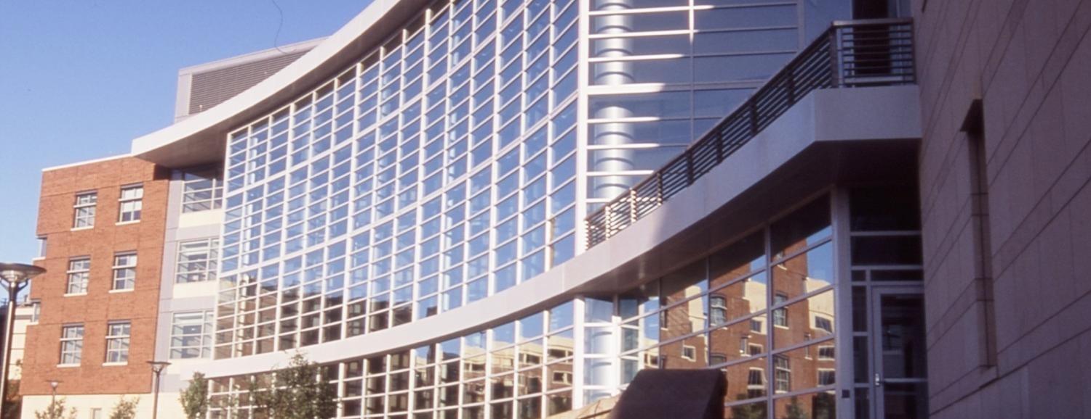
Questions or Comments?
Notes:
11

