Slide 1
SIMULATION AND HUMAN-COMUTER INTERACTION TO ANALYZE GENE REGULATORY NETWORKS
Linn Htet Oo

Slide 2
Gene Regulatory Networks
A collection of DNA segments in a cell
interacting with each other indirectly and with other substances in the cell
thereby governing the expression levels of mRNA and proteins
Source: Wikipedia

Slide 3
Importance of GRN
Play an important role in every process of life
Help us understand the mechanisms of diseases
Speed up biotechnological projects
Have proved to be a valuable research tool
Source: Modelling and analysis of gene regulatory networks
By Guy Karlebach & Ron Shamir
Notes:
Gene regulatory networks have an important role in every process of life, including cell differentiation, metabolism, the cell cycle and signal transduction. By understanding the dynamics of these networks we can shed light on the mechanisms of diseases that occur when these cellular processes are dysregulated. Accurate prediction of the behaviour of regulatory networks will also speed up biotechnological projects, as such predictions are quicker and cheaper than lab experiments. Computational methods, both for supporting the development of network models and for the analysis of their functionality, have already proved to be a valuable research tool.

Slide 4
Agenda
What GNW could do
How GNW is improved
Demonstration
Challenges
Further Improvement

Slide 5
Agenda
What GNW could do
How GNW is improved
Demonstration
Challenges
Further Improvement

Slide 6


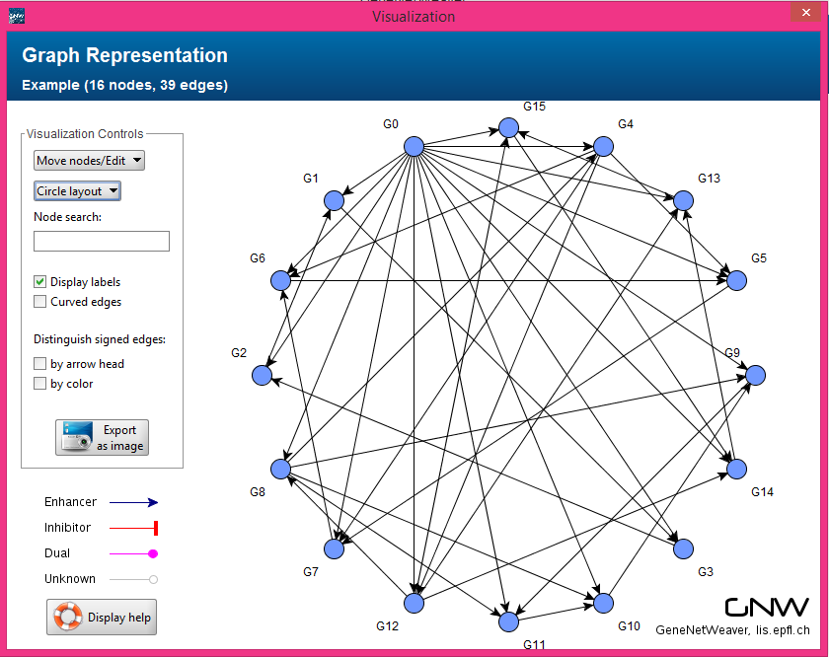
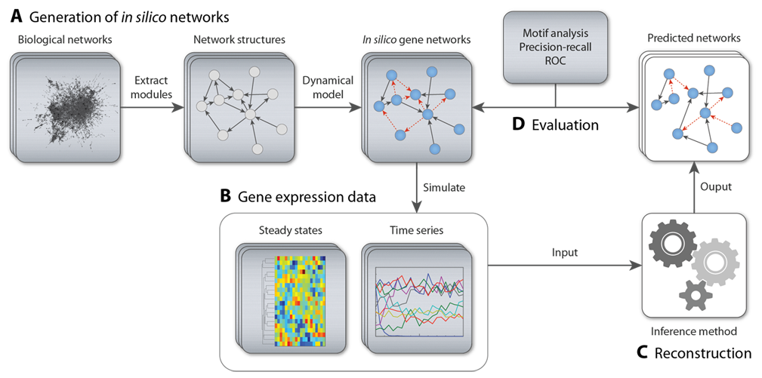
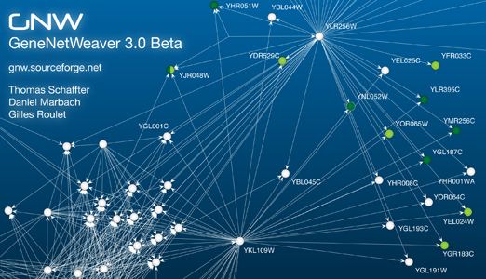
GENENETWEAVER

Slide 7
However, it still lacks features…
To visualize generated time series data
To modify the structure of networks
To analyze effects after modification

Slide 8
Why these features are essential
Diseases occur when cellular processes are dysregulated
Analyze how the behaviors of a normal GRN have changed when modified
A great help to understand the cause and symptoms of diseases

Slide 9
Agenda
What GNW could do
How GNW is improved
Demonstration
Challenges
Further Improvement

Slide 10
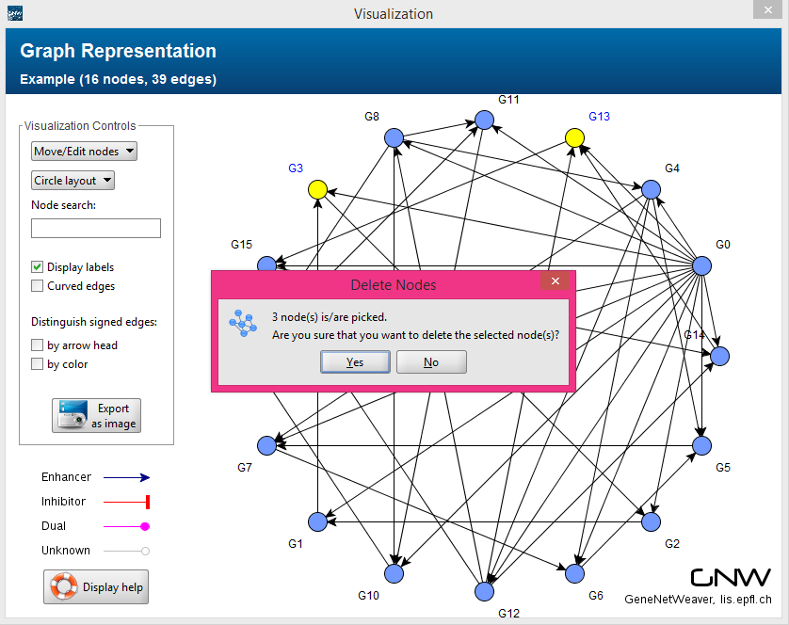
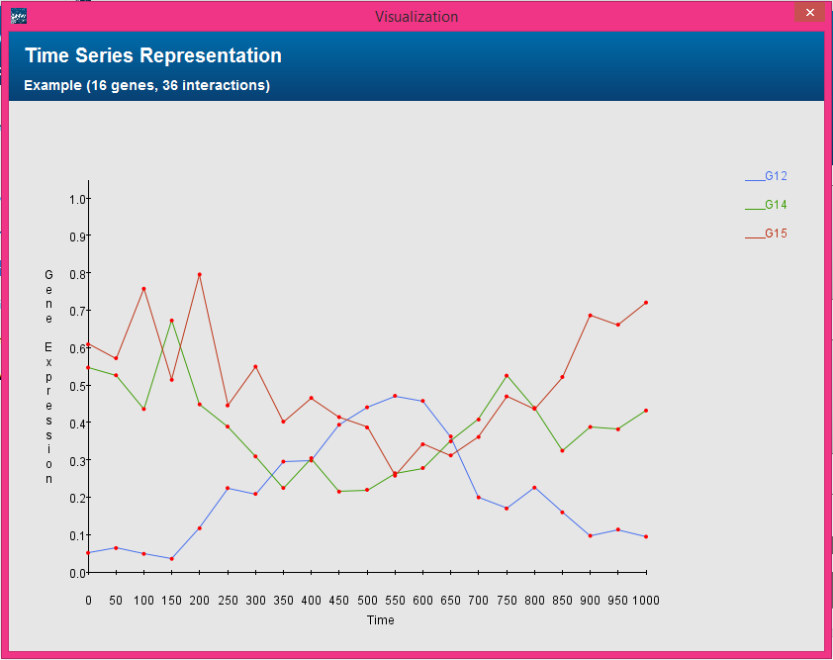
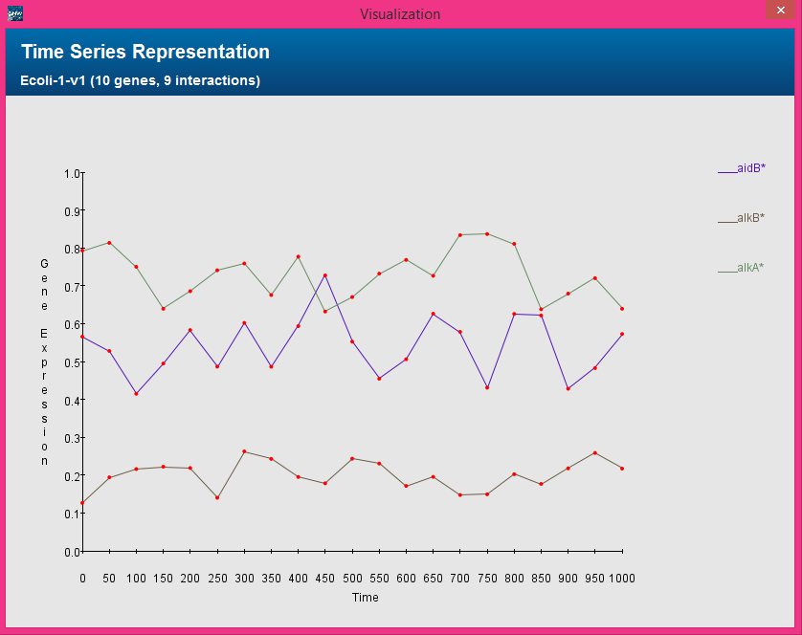
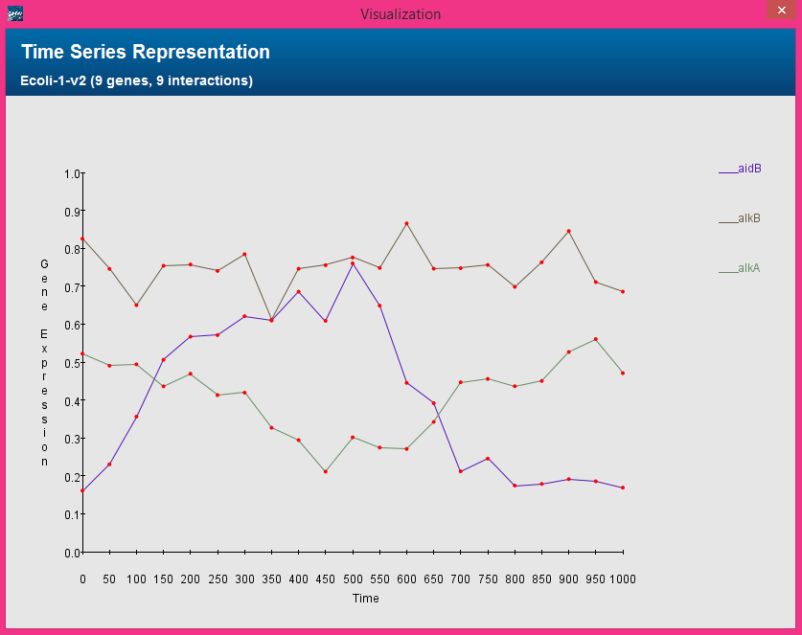
GENENETWEAVER

Slide 11

New Features Integrated
Edit network structure
Delete nodes
Select nodes to delete
Add edges
Select source and target nodes
Delete edges
Select edges to delete

Slide 12
New Features Integrated
Visualize time series data
Display all genes
For networks with a manageable amount of genes
Display one or more genes
For networks with a large number of genes

Slide 13
New Features Integrated
Compare time series data
Using one window
Using separate windows
Only for common genes from two versions
Ignore the rest

Slide 14
Agenda
What GNW could do
How GNW is improved
Demonstration
Challenges
Further Improvement

Slide 15
DEMONSTRATION

Slide 16
Agenda
What GNW could do
How GNW is improved
Demonstration
Challenges
Further Improvement

Slide 17


Slide 18
Challenges
Understanding the existing application
Size
Complexity
Limited biological knowledge
Integration
Notes:
30 libraries and 130+ classes

Slide 19
Agenda
What GNW could do
Further Improvement
Challenges
Demonstration
How GNW is improved

Slide 20

FURTHER IMPROVEMENT

Slide 21
Analysis of Effects by Changes
Analyze on behalf of user
Give useful comments
Highlight changes
Notes:
Compare gene expression data before modification and after modification

Slide 22
Time Delay For Interactions
Some processes involve many reactions
They could not be correctly modeled as an instantaneous interaction
Hence, need to consider the time it takes for the entire process to be complete
Add time delay property to Edge
Improve the formula to calculate
gene expression to generate
Notes:
Since some processes, such as gene transcription, involve many reactions and could not be correctly modeled as an instantaneous reaction in a single step, it was proposed to model these reactions as single step multiple delayed reactions in order to account for the time it takes for the entire process to be complete.

Slide 23

Q & A

Slide 24


