Slide 1
SIMULATION AND HUMAN-COMUTER INTERACTION TO ANALYZE GENE REGULATORY NETWORKS
Linn Htet Oo

Slide 2
Gene Regulatory Networks
A collection of DNA segments in a cell
interacting with each other indirectly and with other substances in the cell
thereby governing the expression levels of mRNA and proteins
Source: Wikipedia

Slide 3
Importance of GRN
Play an important role in every process of life
Help us understand the mechanisms of diseases
Speed up biotechnological projects
Have proved to be a valuable research tool
Source: Modelling and analysis of gene regulatory networks
By Guy Karlebach & Ron Shamir
Notes:
Gene regulatory networks have an important role in every process of life, including cell differentiation, metabolism, the cell cycle and signal transduction. By understanding the dynamics of these networks we can shed light on the mechanisms of diseases that occur when these cellular processes are dysregulated. Accurate prediction of the behaviour of regulatory networks will also speed up biotechnological projects, as such predictions are quicker and cheaper than lab experiments. Computational methods, both for supporting the development of network models and for the analysis of their functionality, have already proved to be a valuable research tool.

Slide 4
Agenda
What GNW could do
Challenges
How GNW is improved
Demonstration
Further Improvement

Slide 5
Agenda
What GNW could do
Challenges
How GNW is improved
Demonstration
Further Improvement

Slide 6


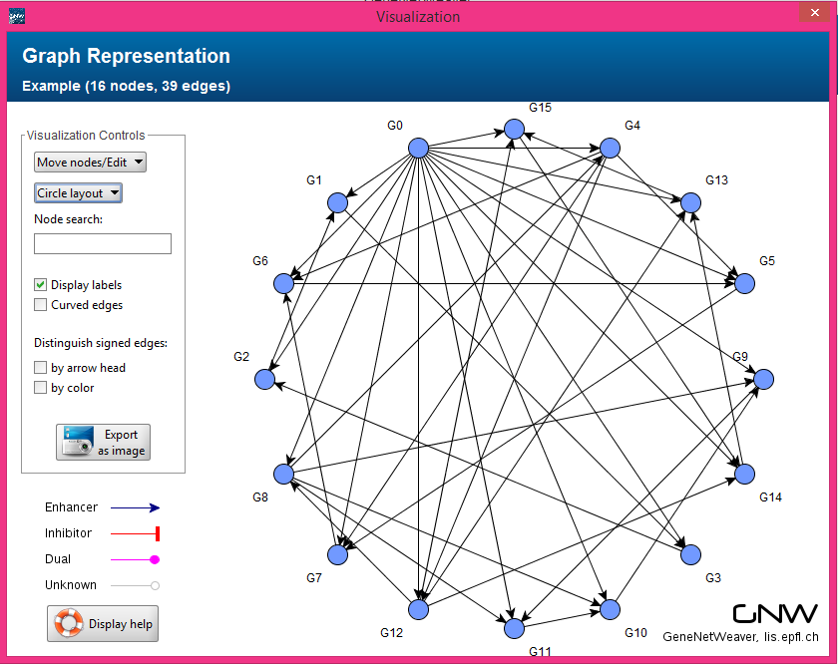
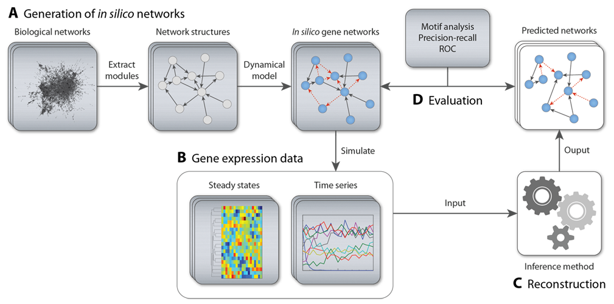
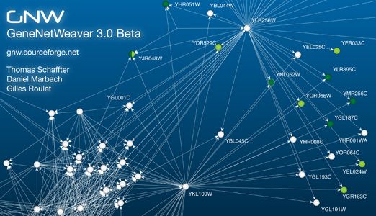
GENENETWEAVER

Slide 7
However, it still lacks features…
To visualize generated time series data
To modify the structure of networks
To analyze effects after modification

Slide 8
Why these features are essential
Diseases occur when cellular processes are dysregulated
Analyze how the behaviors of a normal GRN have changed when modified
A great help to understand the cause and symptoms of diseases

Slide 9
Agenda
What GNW could do
Challenges
How GNW is improved
Demonstration
Further Improvement

Slide 10


Slide 11
Challenges
Understanding the existing application
Size
Complexity
Limited biological knowledge
Integration
Notes:
30 libraries and 130+ classes

Slide 12
Agenda
What GNW could do
Challenges
How GNW is improved
Demonstration
Further Improvement

Slide 13
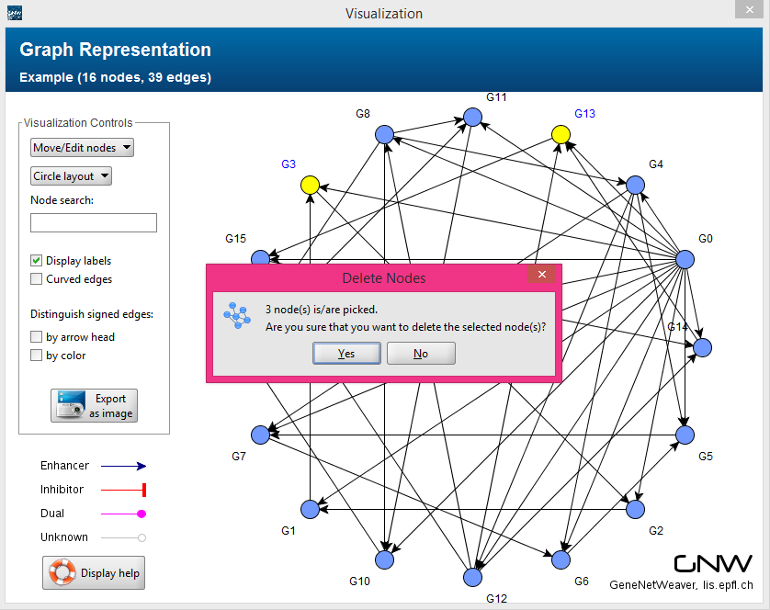
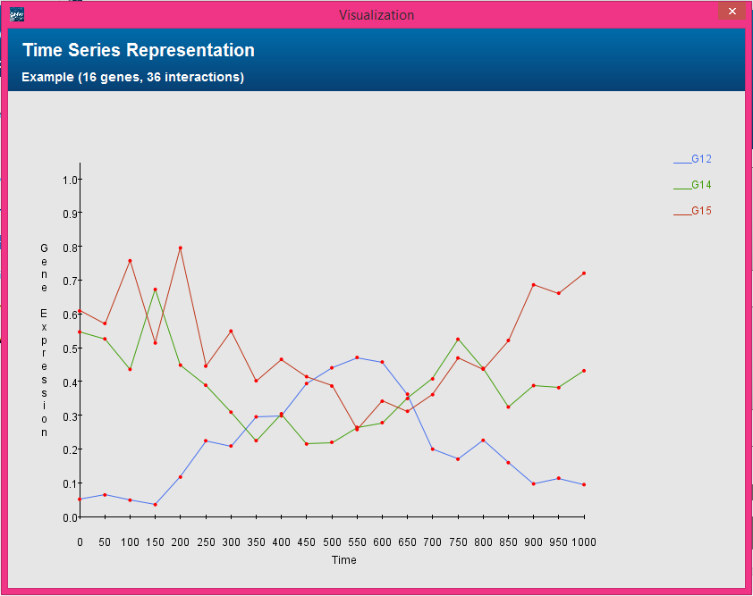
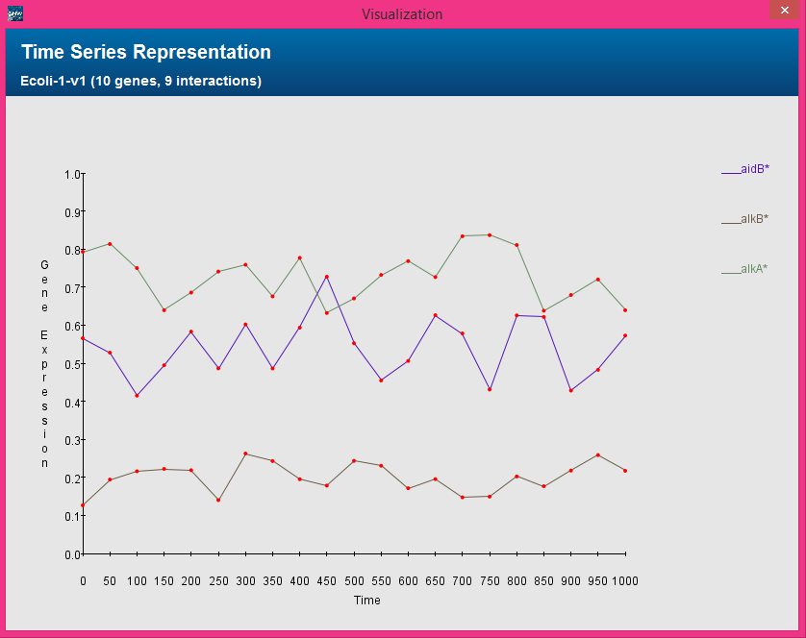
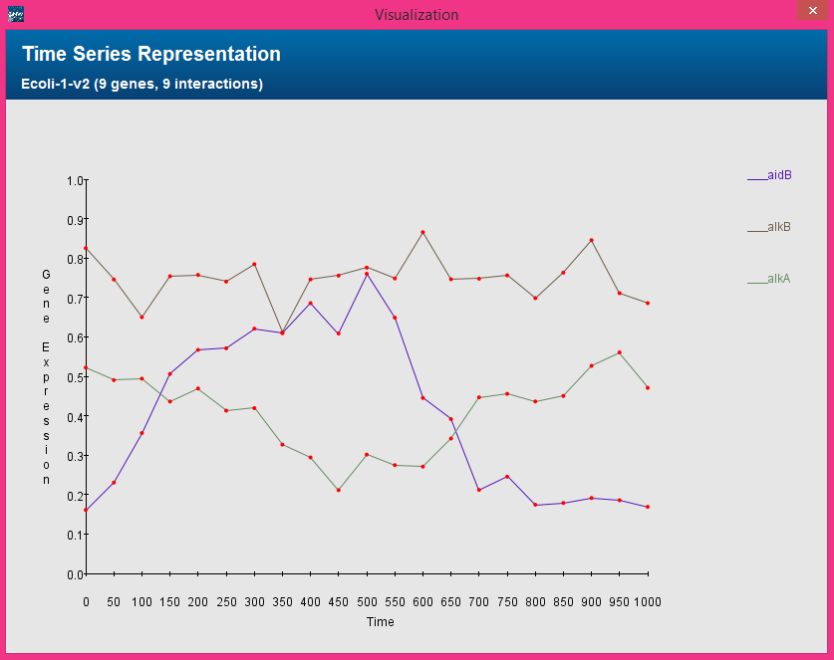
GENENETWEAVER

Slide 14
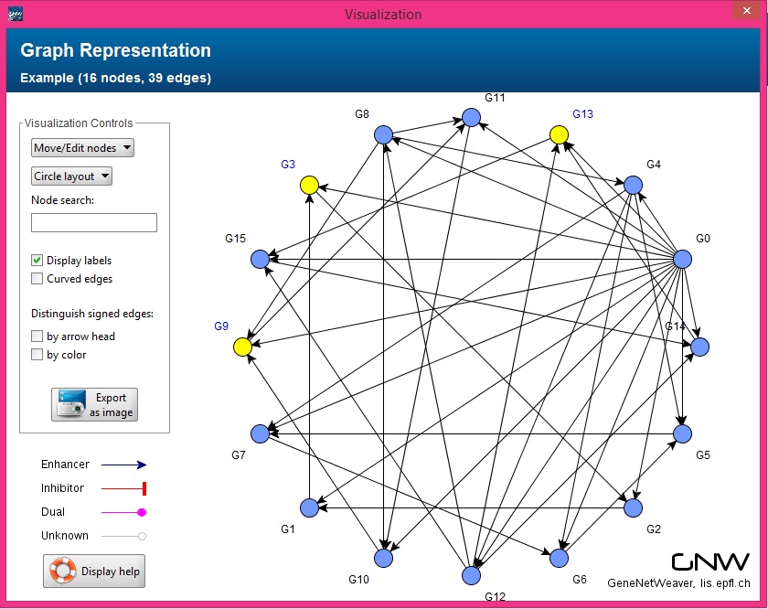
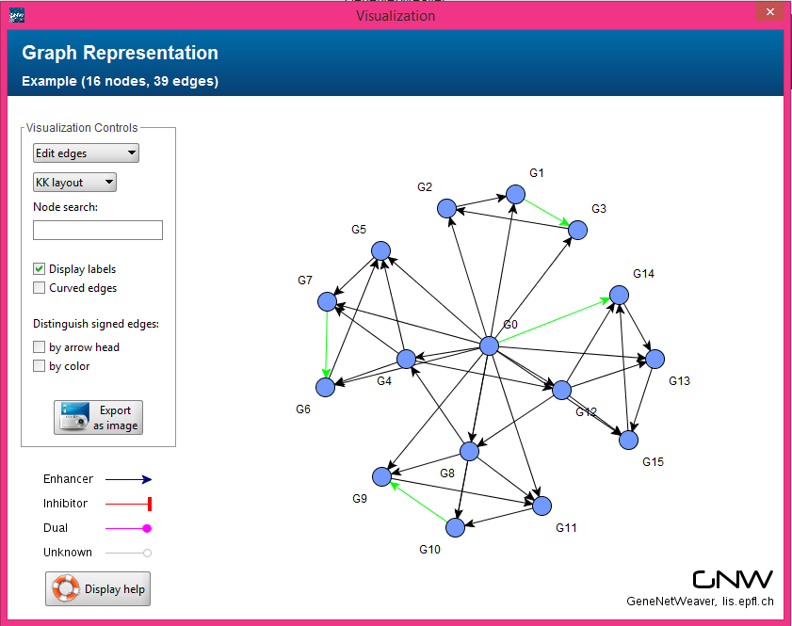
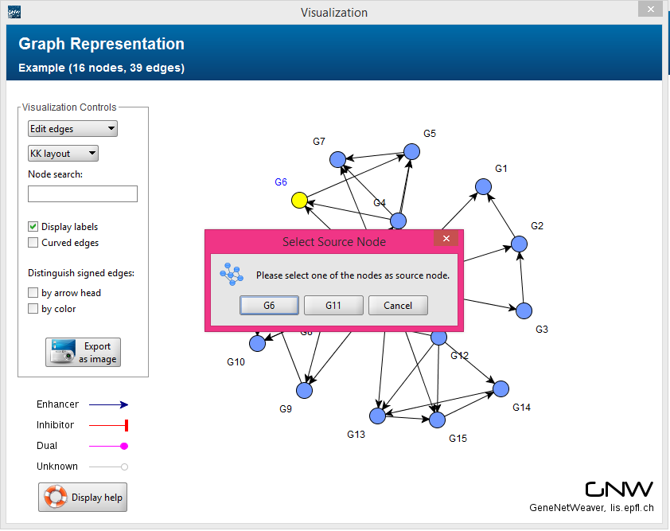

Edit Network Structure
Delete nodes
Select nodes to delete
Delete edges
Select edges to delete
Add edges
Select source and target nodes

Slide 15
Edit Network Structure
Pros
Real-time update of changes
Saving changes as a new version
Cons
No direct overwriting the original network
Need to import to GNW desktop to view

Slide 16
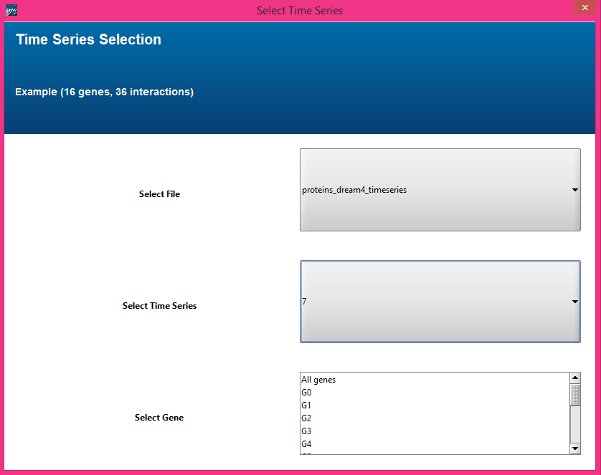
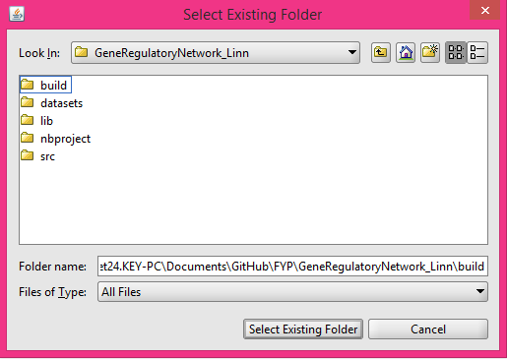
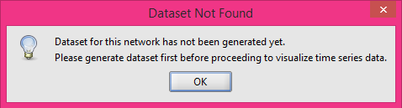
Visualize Time Series Data
Display all genes
For networks with a manageable amount of genes
Display one or more genes
For networks with a large number of genes
Verify if the correct dataset exists in the selected folder
Prompt to generate if not

Slide 17
Visualize Time Series Data
Pros
Better representation for time series data
Options available for effective visualization
Cons
Some light colors may hinder analysis process

Slide 18
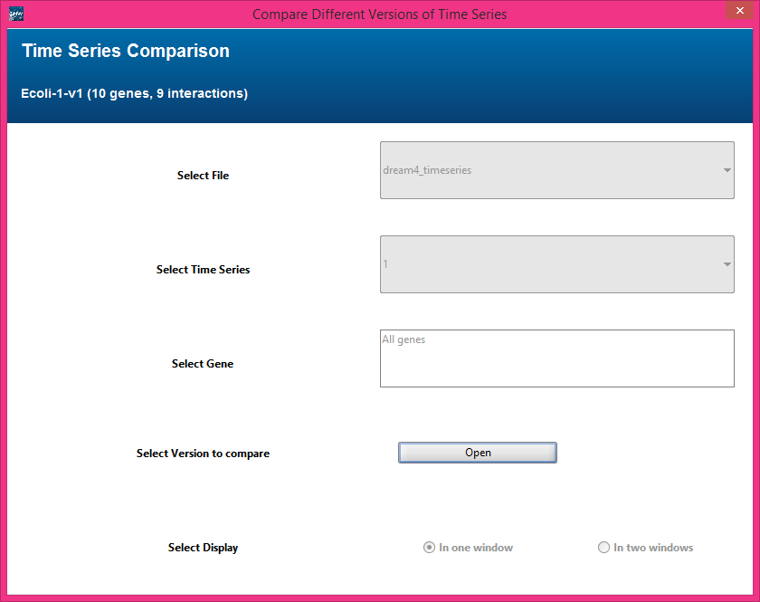
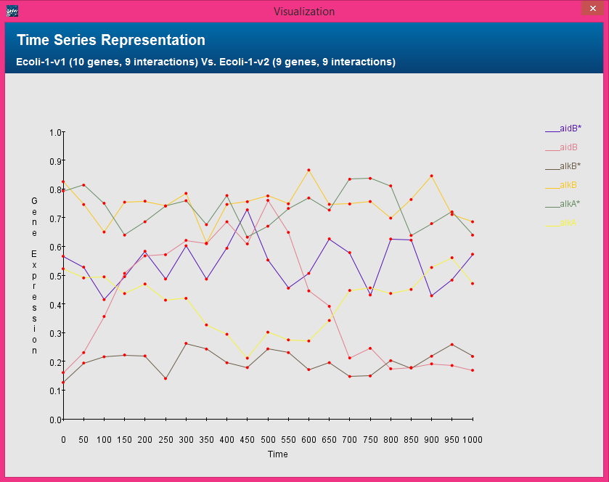
Compare Time Series Data
Using one window
Using separate windows
Only for common genes from two versions
Ignore the rest

Slide 19
Compare Time Series Data
Pros
Easy to compare differences (before and after)
Options available for effective visualization
Cons
Some light colors may hinder analysis process
Manual analysis

Slide 20
Agenda
What GNW could do
Challenges
How GNW is improved
Demonstration
Further Improvement

Slide 21
DEMONSTRATION
Notes:
Edit structure using Example network
Visualize using ecoli v1
Compare using ecoli v1 and v2

Slide 22
Agenda
What GNW could do
Further Improvement
Demonstration
How GNW is improved
Challenges

Slide 23

FURTHER IMPROVEMENT

Slide 24
Analysis of Effects by Changes
Analyze on behalf of user
Give useful comments
Highlight changes
Notes:
Compare gene expression data before modification and after modification

Slide 25
Time Delay For Interactions
Some processes involve many reactions
They could not be correctly modeled as an instantaneous interaction
Hence, need to consider the time it takes for the entire process to be complete
Add time delay property to Edge
Improve the formula to calculate
gene expression to generate
Notes:
Since some processes, such as gene transcription, involve many reactions and could not be correctly modeled as an instantaneous reaction in a single step, it was proposed to model these reactions as single step multiple delayed reactions in order to account for the time it takes for the entire process to be complete.

Slide 26

Q & A

Slide 27


