Slide 1
Cox Regresson – SAS & R
Midterm Exam on November 1, 2018
In class

Slide 2
Hazard function
Given patient survived to time t, what is the probability they develop outcome very soon?
(t + small amount of time)
Approximates proportion of patients having event around time t

Slide 3
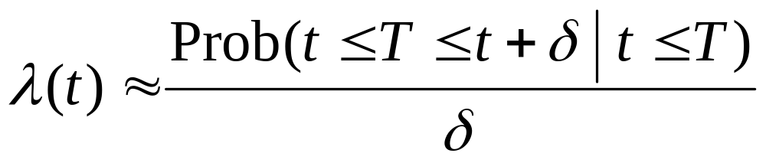
Hazard function
Hazard less intuitive than survival curve (*notice some books use h(t))
Conditional p the event will occur between t and t+ δ given it has not previously occurred
Rate per unit of time, as δ goes to 0 get instant rate
Tells us where the greatest risk is given survival up to that time

Slide 4
Possible Hazard of Death from Birth
Probability of dying in next year as function of age
λ (t)
0 6 17 23 80
At which age would the hazard be greatest?

Slide 5
Possible Hazard of Divorce
0 2 10 25 35 50

Slide 6
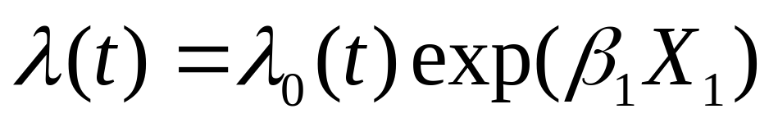
Proportional hazards regression model
λ₀(t) - unspecified baseline hazard; the hazard for subject with X=0
β₁ = regression coefficient associated with the predictor (X)
β₁ positive indicates larger X increases the hazard
Can include more than one predictor

Slide 7
Interpretation of Regression Parameters
For a binary predictor; X₁ = 1 if exposed and 0 if unexposed,
exp(β₁) is the relative hazard for exposed versus unexposed
(β₁ is the log of the relative hazard)
exp(β₁) can be interpreted as relative risk

Slide 8
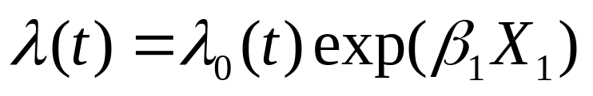
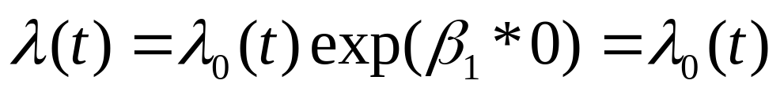
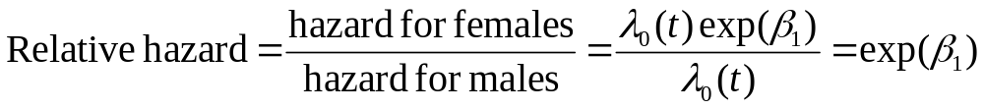
Example - risk of outcome for women vs. men
Suppose X₁=1 for females, 0 for males
For females;
For males;

Slide 9
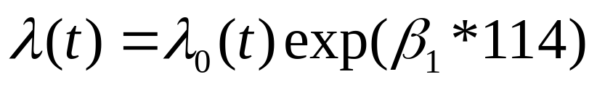
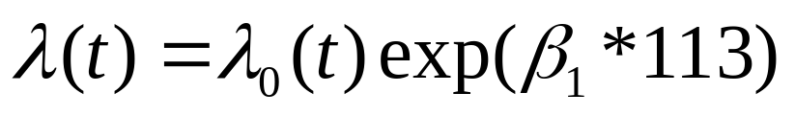
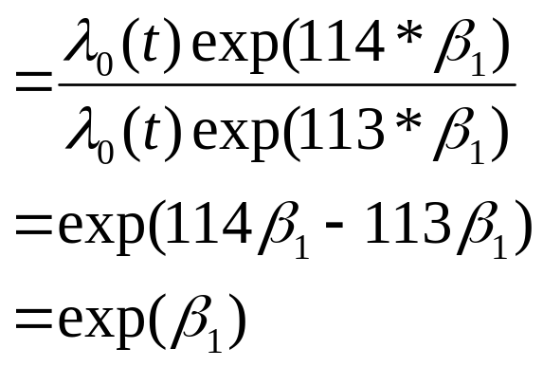
Example - Risk of outcome for
1 unit change in blood pressure
Suppose X₁= systolic blood
pressure (mm Hg)
For person with SBP = 114
For person with SBP = 113
Relative risk of 1 unit
increase in SBP:

Slide 10
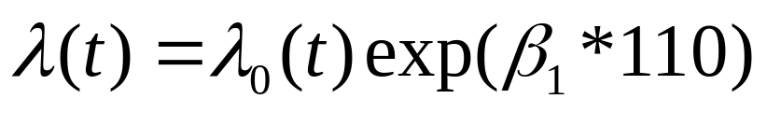
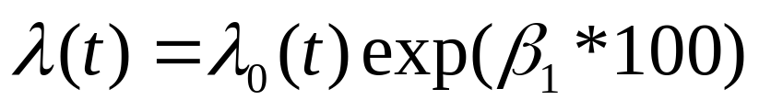
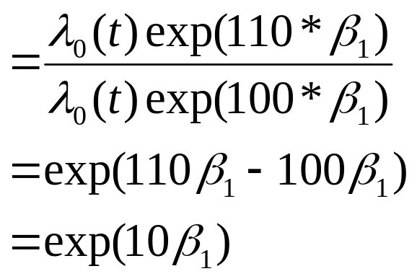
Example - Risk of outcome for
10 unit change in blood pressure
Suppose X= systolic blood
pressure (mmHg)
For person with SBP = 110
For person with SBP = 100
Relative risk of 10 unit
increase in SBP:

Slide 11
Proportional hazards regression model
Above is model with multiple predictors
This allows to use the “usual” regression techniques;
adjust for confounding
model interactions
relate non-linear terms to survival

Slide 12
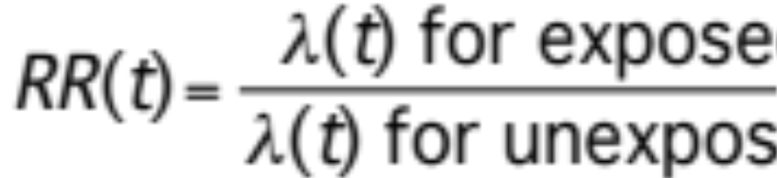
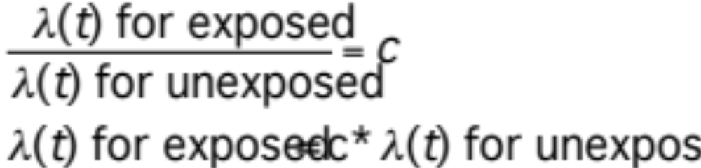
Why “proportional hazards”?
Ratio of hazards measures relative risk
(*aka hazard ratio HR)
If we assume relative risk is constant over time…
The hazards are proportional (does not depend on t

Slide 13
Parameter estimation
How do we come up with estimates for β_{i}?
Maximum partial-likelihood
  Given our data, what are the values of β_{i} that are most likely?

Slide 14
Inference for proportional hazards regression
Collect data, choose model, estimate β_{i}s
Describe hazard ratios, exp(β_{i}), in statistical terms.
  How confident are we of our estimate?
  Is the hazard ratio is different from one due to chance?

Slide 15
Confidence Intervals for proportional hazards regression coefficients
General form of 95% CI: Estimate ± 1.96*SE
  B_{i} estimate, provided by SAS
  SE is complicated, provided by SAS
    Related to variability of our data and sample size
Equivalent to a hypothesis test; reject Ho: β_{i} = 0 at alpha = 0.05

Slide 16
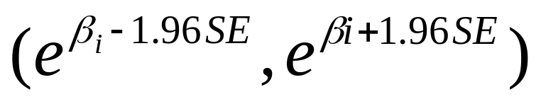
95% Confidence Intervals for the relative risk (hazard ratio)
Based on transforming the 95% CI for the hazard ratio
Supplied automatically by SAS
“We have a statistically significant association between the predictor and the outcome controlling for all other covariates”
Equivalent to a hypothesis test; reject H_{o}: RR = 1 at alpha = 0.05 (H_{a}: RR≠1)

Slide 17
Hypothesis test for individual PH regression coefficient
Null and alternative hypotheses
  Ho : B_{i} = 0, Ha: B_{i} ≠ 0
Test statistic and p-values supplied by SAS
If p<0.05, “there is a statistically significant association between the predictor and outcome variable controlling for all other covariates” at alpha = 0.05

Slide 18
Hypothesis test for all coefficients
Null and alternative hypotheses
  Ho : all B_{i} = 0, Ha: not all B_{i} ≠ 0
Several test statistics, each supplied by SAS
  Likelihood Ratio test,
  Score test (=log rank test),
  Wald test
p-values are supplied by SAS
If p<0.05, “there is a statistically significant association between the predictors and outcome at alpha = 0.05”

Slide 19
Example survival analysis
Veteran’s Administration lung cancer data
- Data: http://dataset.lixoft.com/data-set-examples/veterans-administration-lung-cancer-data-set/
- SAS: https://v8doc.sas.com/sashtml/stat/chap37/sect19.htm
- SAS: https://support.sas.com/documentation/cdl/en/statug/63033/HTML/default/viewer.htm#statug_phreg_sect034.htm
137 Males with inoperable lung cancer
Randomized to standard or new chemo therapy
Primary endpoint; time to death
9 observations censored
  9 patients survived for length of study

Slide 20
Example - VA Lung Cancer variables
- R: https://stat.ethz.ch/R-manual/R-devel/library/survival/html/veteran.html
https://bioconnector.org/r-survival.html
SurvTime - time to death or study end
death - 1 if died, 0 if censored
treatment - new or standard treatment
  1 = new, 0 = standard
celltype - type of cancer
  adeno, squamous, small cell ,large cell
kps - general health measure (0-100)
diagtime - time between diagnosis and study entry
age - age at entry
prior - prior treatment, 1 = yes, 0 = no

Slide 21
PROC PHREG
PROC PHREG DATA = vet;
MODEL SurvTime*death(0) = treatment;
RUN;
Fit proportional hazards model with time to death as outcome
“death(0)”; observations with death variable = 0 are censored
  death = 1 means an event occurred
Look at effect of new vs. standard treatment on mortality
Same as LIFETEST

Slide 22
PROC PHREG Output
Summary of the Number of Event and Censored Values
Percent
Total Event Censored Censored
137 128 9 6.57
Analysis of Maximum Likelihood Estimates
Parameter Standard Hazard
Variable DF Estimate Error Chi-Square Pr > ChiSq Ratio
newtrt 1 b1 0.01633 0.18065 0.0082 0.9280 1.016
P-value for test of regression coefficient (hazard ratio)
exp(b1)
Relative risk of death for new vs. standard treatment

Slide 23
Logistic Regression Versus
Cox Regression
If event rate is small will likely get similar results for betas
If event rate is high could get quite different results (almost everyone has event)

Slide 24
Interactions and non-linear terms
Regression allows for us to model effects of predictors in different ways
Can add quadratic terms and interactions, just like in linear and logistic regression
Similar issues with testing coefficients
  Calculation needed to get appropriate relative risks from parameter estimates

Slide 25
Interactions and non-linear terms
PROC PHREG DATA = heart;
MODEL time*status(0) = trt prior trt_prior;
RUN;
Fit interaction between new treatment and prior
  trt_prior variable defined in DATA STEP as “trt_prior = trt*prior”
PROC PHREG DATA = vet;
MODEL time*status(0) = age age2;
RUN;
Fit a quadratic term for effect of age
  age2 variable defined in DATA STEP as “age2 = age*age”

Slide 26
Interactions in proportional hazards regression
Effect modification leads to complications in interpreting parameter estimates (the B_{i}s)
Example;
λ(t) = λ₀(t) exp(B₁newtrtrt + B₂prior + B₃trt*prior)
What is relative risk for those on the new treatment vs. the standard treatment?
How does prior treatment effect this RR?

Slide 27
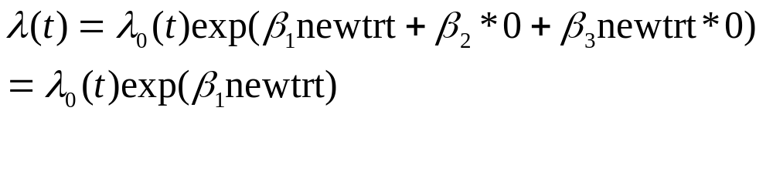
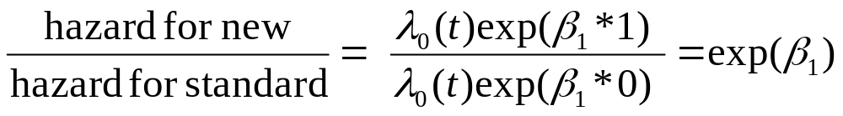
Interactions in proportional hazards regression
λ(t) = λ₀(t) exp(B₁newtrt + B₂prior + B₃newtrt*prior)
For those with no prior treatment (prior = 0);
Relative risk for new vs. standard treatment;

Slide 28
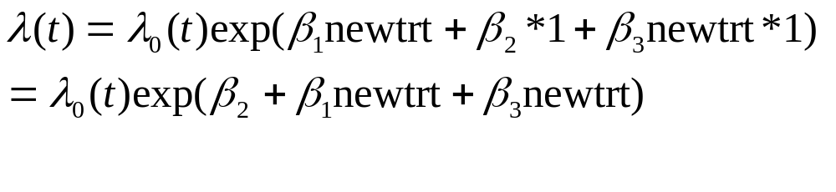
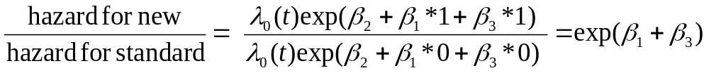
Interactions in proportional hazards regression
λ(t) = λ₀(t) exp(B_{o} + B₁newtrt + B₂prior + B₃newtrt*prior)
For those with prior treatment (prior = 1);
Relative risk for new vs. standard treatment;

Slide 29
Tied event times
Observations with outcome on same time are called “ties”
They complicate the calculations
Different methods for dealing with them
  Breslow, discrete, Efron, exact
Not many ties; all methods similar
  Exact best, but computer intensive
  Efron probably the next best
  Breslow default in SAS

Slide 30
Methods for ties in PROC PHREG
PROC PHREG DATA = vet;
MODEL time*status(0) = newtrt / ties = exact;
RUN;
Use “exact” method for handling ties
Other options “efron”, “breslow”, and “discrete”

Slide 31
Ties in PROC PHREG
VA lung cancer data, effect of treatment, different methods for ties
Analysis of Maximum Likelihood Estimates
Parameter Standard Hazard
Method Estimate Error Chi-Square Pr > ChiSq Ratio
Exact 0.01775 0.18066 0.0097 0.9217 1.018
Efron 0.01775 0.18066 0.0097 0.9217 1.018
Breslow 0.01633 0.18065 0.0082 0.9280 1.016
Discrete 0.01645 0.18129 0.0082 0.9277 1.017
For this data, exact and Efron methods are identical

Slide 32
Getting Confidence Intervals
PHREG
PROC PHREG DATA = vet;
MODEL SurvTime*death(0)
= treatment/cl
RUN;
Provides 95% CI for HR

Slide 33
Assessing Impact of Variable on Odds Ratio
Analysis of Maximum Likelihood Estimates
Standard Wald
Parameter DF Estimate Error Chi-Square Pr > ChiSq
Intercept 1 0.3085 1.3532 0.0520 0.8197
AGE 1 -0.0705 0.0250 7.9595 0.0048
men 1 0.7296 0.3350 4.7443 0.0294
smoker 1 0.7118 0.3696 3.7082 0.0541
BLACK 1 0.3839 0.3559 1.1636 0.2807
Odds Ratio Estimates
Point 95% Wald
Effect Estimate Confidence Limits
AGE 0.932 0.887 0.979
men 2.074 1.076 3.999
smoker 2.038 0.987 4.205
BLACK 1.468 0.731 2.949
Is effect of age small or large ?

Slide 34
Proportional hazards regression model
If X is binary then exp (β) is relative hazard of group 1 versus group 0
If X is continuous then exp (β) is relative hazard of 1 unit difference in X variable

Slide 35
Hazard of Divorce
Proportional Hazards
λ (t)*c
Previously married
λ (t)
Never married before
0 2 10 25 35 50

Slide 36
Proportional Hazard of Death from Birth
Probability of dying in next year as function of age
λ (t)
0 6 17 23 80
At which age would the hazard be greatest?

Slide 37
95% Confidence Intervals for the relative risk (hazard ratio)
Based on transforming the 95% CI for the hazard ratio
Supplied by SAS (CL option on model statement)
“We have a statistically significant association between the predictor and the outcome controlling for all other covariates”
Equivalent to a hypothesis test; reject H_{o}: RR = 1 at alpha = 0.05 (H_{a}: RR≠1)

Slide 38
Logistic Regression Versus
Cox Regression
Logistic regression
  Exp (β) is relative odds
Cox Regression regression
  Exp (β) is relative hazard
Relative hazard is often simply referred to as relative risk

Slide 39
Complications with PH regression
Similar issues arise that we saw in linear and logistic regression; assumptions may not hold
Independence of observations?
  Correlation can cause problems; use other methods
Linearity of terms?
  Can check for quadratic term, transform
Correlated predictor variables?
  Causes interpretation problems for individual parameter estimates

Slide 40
Complications with PH regression
Unique issue; proportional hazards assumption
One example of violation, crossing survival curves
Remedies;
Stratify time scale so PH assumption holds over intervals, fit model to each interval
Transformation of time variable (example; log)
Use other models

Slide 41
Question 1
A journal article reports a 95%CI for the relative risk (RR) of an event (treatment versus control as (0.55, 0.97). What can be said of the p-value associated with testing Ho: RR=1?
  The p-value is < 0.01.
  The p-value is < 0.05.
  The p-value is > 0.05
  No statement can be said about the p-value.

Slide 42
Question 2
If S (t) is the survival function and t is in years what is the meaning of S(3) .
  The probability of dying at year 3.
  The probability of surviving to year 3.
  The probability of dying by year 3
  The hazard of dying at year 3.

Slide 43
Question 3
In logistic regression with a continuous variable age what is the meaning of β₁ ?
  The difference in log odds between two persons 1 year apart in age
  The relative odds between two persons 1 year apart in age
  The difference in probabilities between two persons 1 year apart in age

Slide 44
Question 4
If the probability of developing diabetes is 0.20 among Hispanics and 0.15 among whites, what is the relative odds (Hispanics v white) of developing diabetes.
  1.42
  0.70
  0.75
  1.33

Slide 45
Question 5
Suppose the logistic regression model: log odds = β₀ + β₁X₁ + β₂X₂ +β₃X₁*X₂ where X₁ is an indicator for treatment and X₂ is an indicator for male gender. The relative odds (treatment versus no treatment) for women is:
  β₁
  β₂.
  β₁ + β₃
  β₁ - β₃

Slide 46
Question 6
The probability and odds of an event will be nearly equal if:
  The probability of the event is small
  The probability of the event is large
  The probability of the event is 0.50

