Slide 1
ADHD Comorbidity Diary
Linna Kuang

Slide 2

7/13/2026
Pipeline
Stage 0
Stage 1
sTable 1 & 2 range modification
Stage 2

Slide 3
Aims
Developmental Burden
Determine whether ADHD carries an earlier and broader cross-system disease burden from birth to adolescence.
Multimorbidity Profile
Resolve that burden into distinct clinical profiles, testing whether ADHD multimorbidity is heterogeneous rather than uniformly high.
Early Life Origin
Trace those profiles back to distinct prenatal exposures, linking later clinical heterogeneity to its origins at birth.

Slide 4
Data
Case - ADHD only: 573
Control - NT: 1,851
Age at ADHD Diagnosis: median 7.1yrs (31% by 6, 72% by 9)
Conditions: 132

Slide 5
Method
Cumulative Proportion
Directly standardized cumulative incidence of first diagnosis by age in each of 16 body systems, ADHD (n=573) vs NT (n=1,852), with bootstrap CIs.
First Diagnosis
Median age (IQR) at first diagnosis per system, ADHD vs NT — referenced to the median ADHD diagnosis age (7.1y) to separate pre- from post-diagnosis onset.
Developmental Pattern
Standardized ADHD−NT prevalence difference for each condition across developmental windows, showing when each gap emerges relative to diagnosis.
NMF
Non-negative matrix factorization on the NT-residualized condition matrix, isolating ADHD-specific structure. K chosen by split-half stability; each child receives continuous loadings on all profiles.
Clinical Characterization
Regress each child's profile loadings on the prenatal/perinatal panel (adjusted for sex, race, education; FDR-corrected) to define each profile's early-life exposure signature.

Slide 6
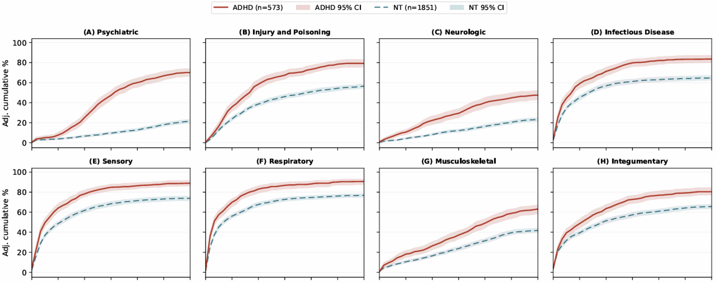
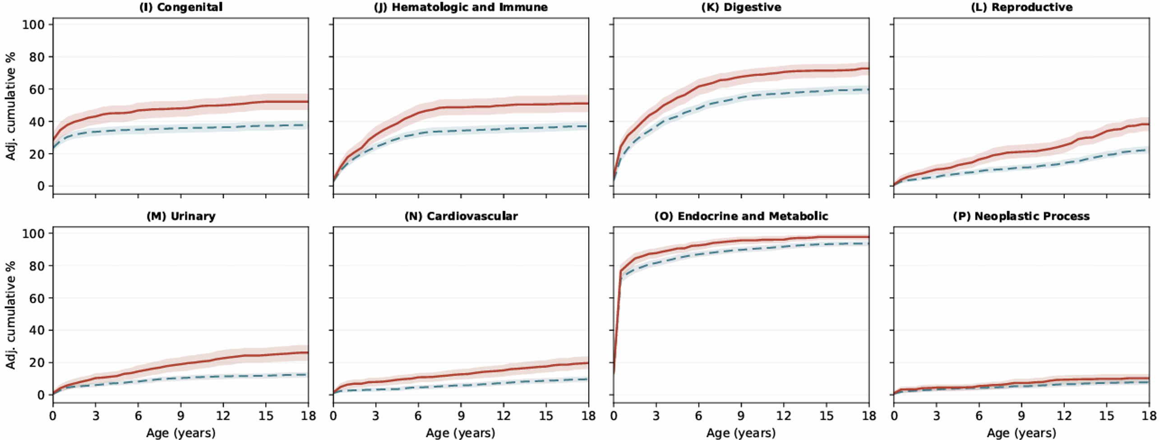

Slide 7
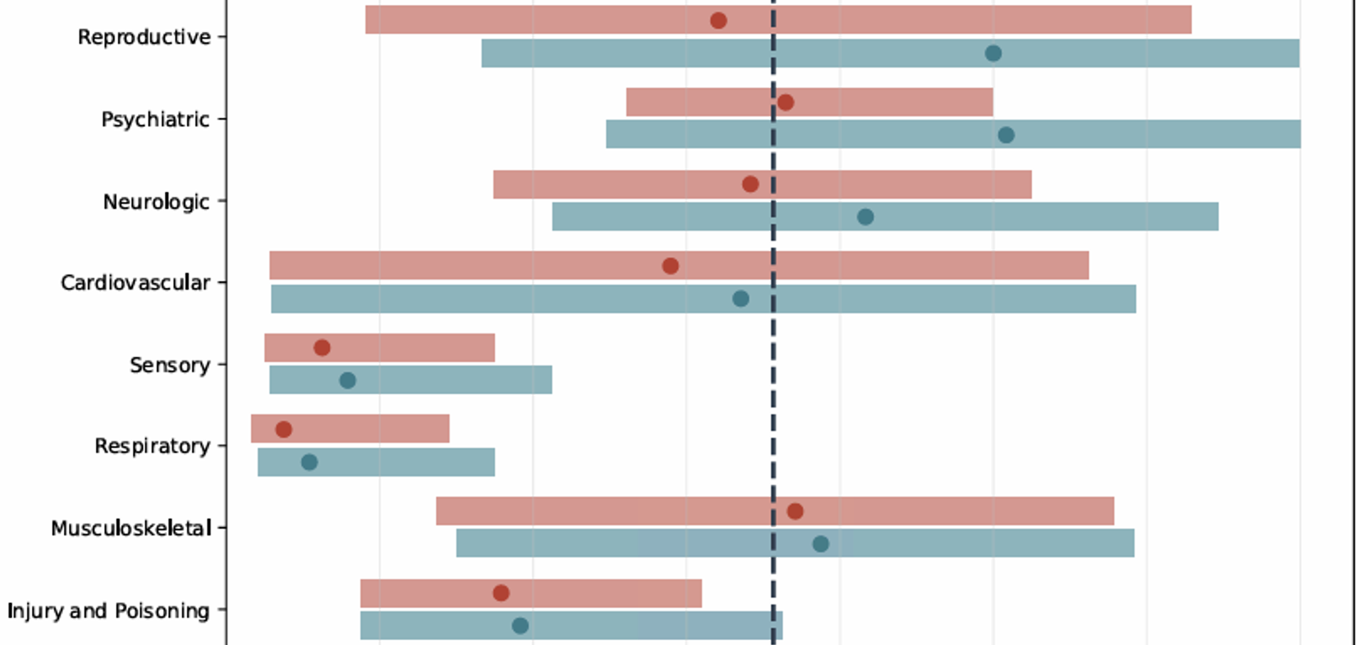
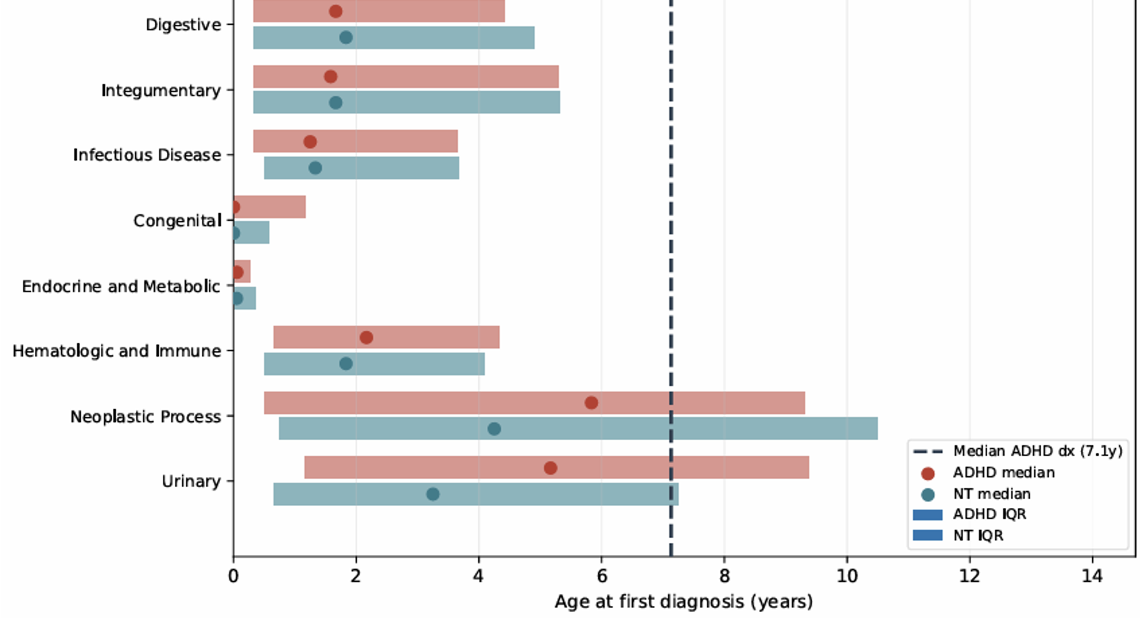

Slide 8
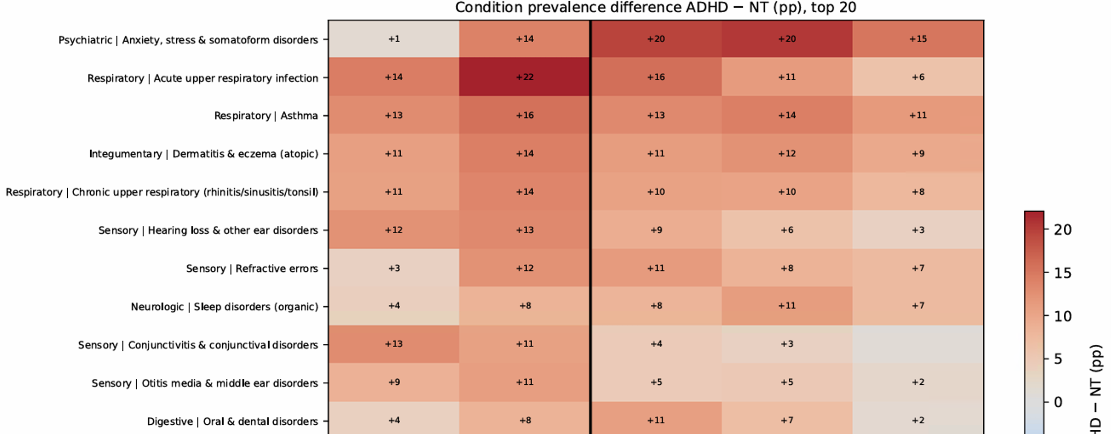

Slide 9
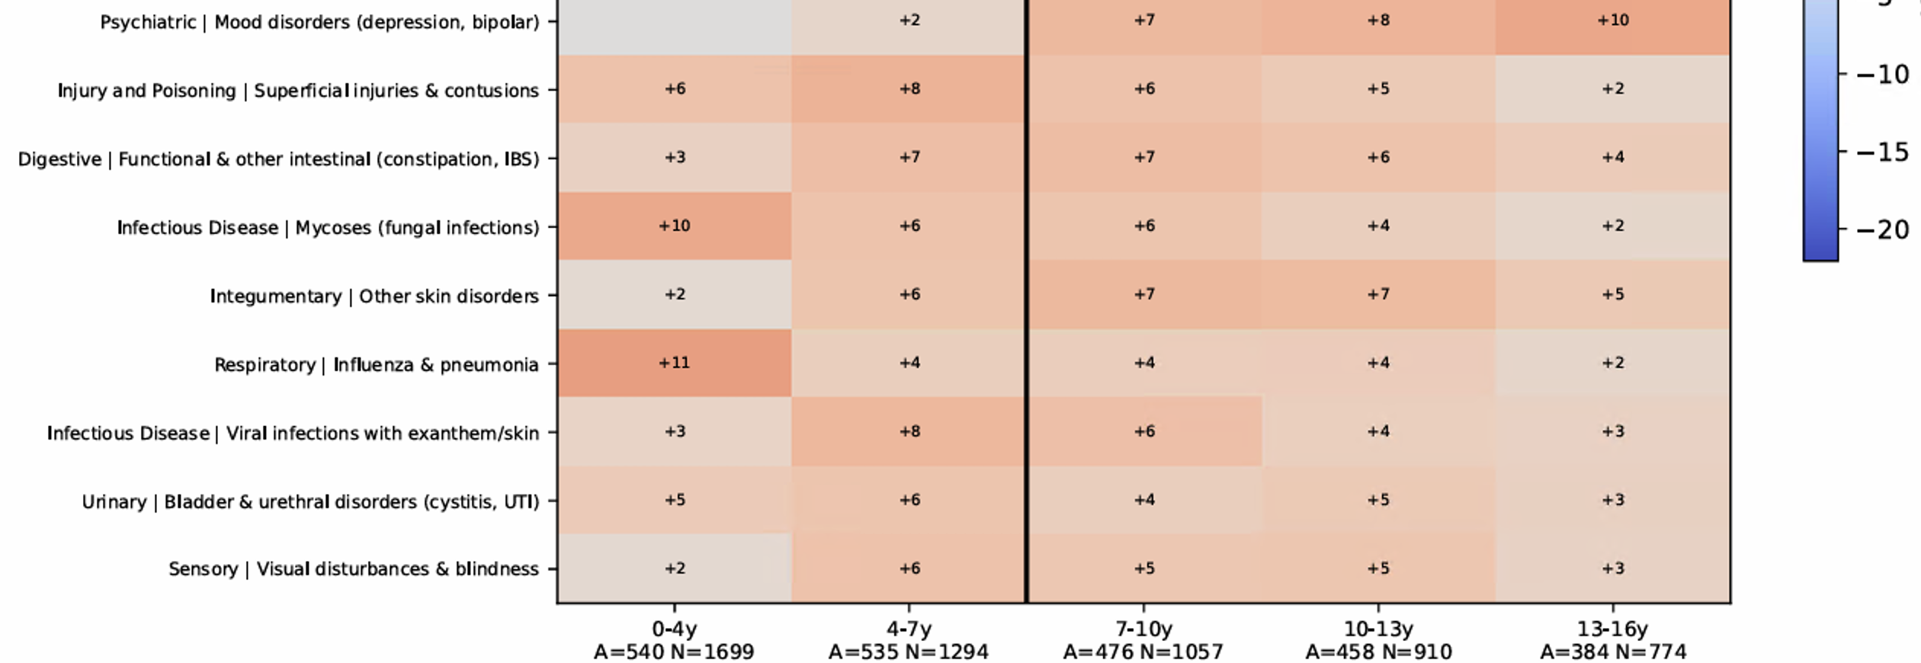

Slide 10
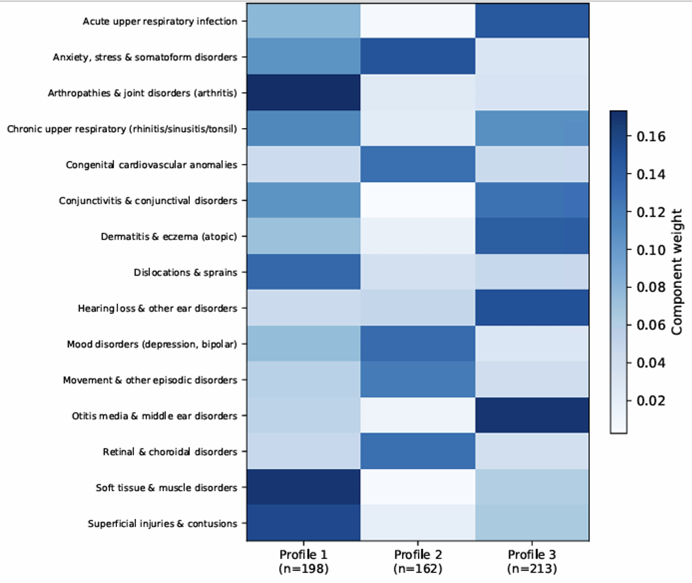
Profile 1: Musculoskeletal–injury
Profile 2: Psychiatric/internalizing
Profile 3: Atopic/ENT–infectious

Slide 11
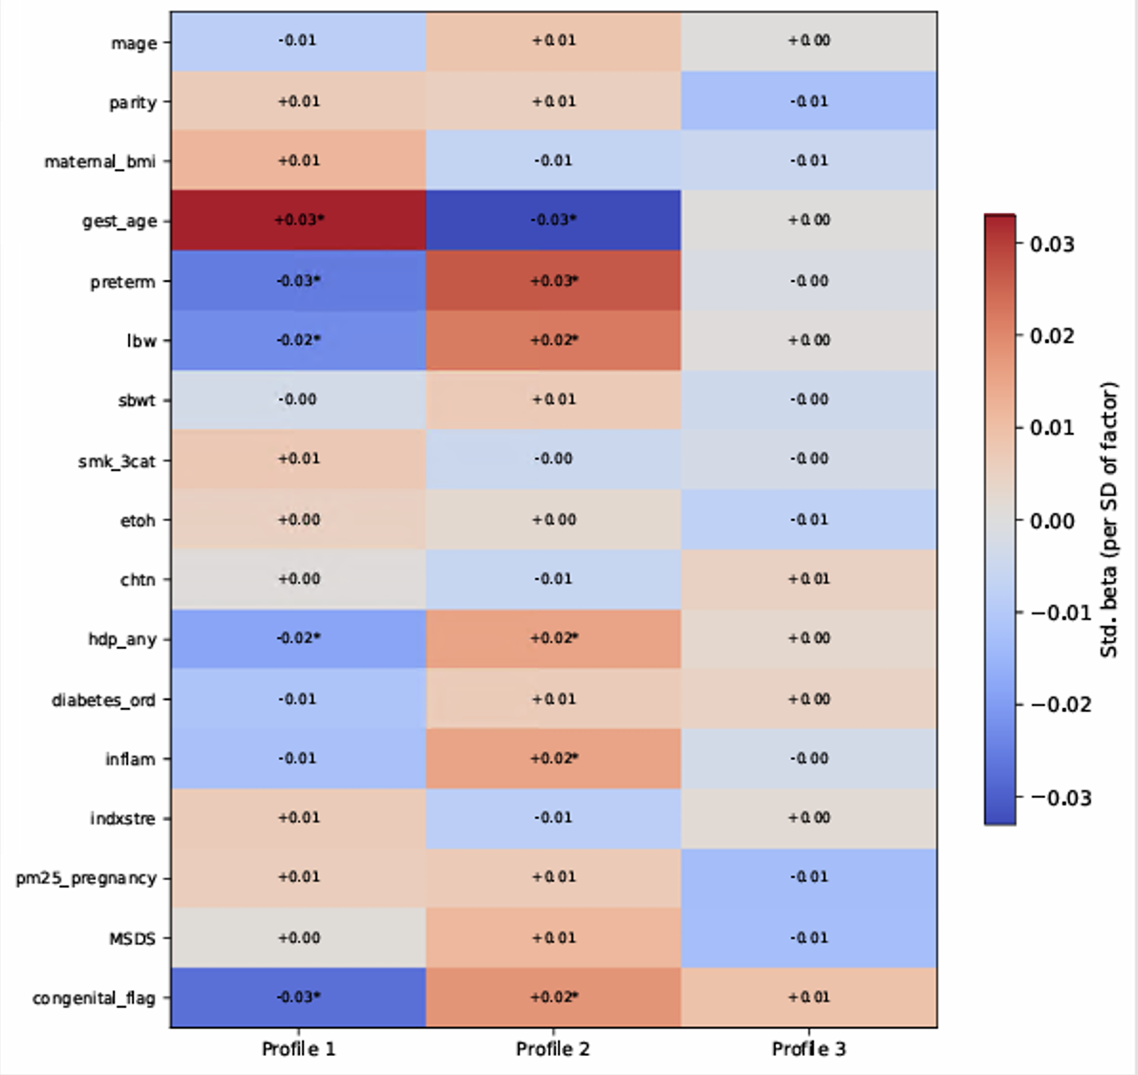

Slide 12
7/13/2026
Citations

Slide 13
Reference
American Academy of Pediatrics. “Clinical Practice Guideline: Diagnosis and Evaluation of the Child With Attention-Deficit/Hyperactivity Disorder.” Pediatrics. 2000;105(5):1158–1170. DOI: 10.1542/peds.105.5.1158
Shalaby, N., Sengupta, S., & Williams, J. B. (2024). Large-scale analysis reveals racial disparities in the prevalence of ADHD and conduct disorders. Scientific Reports, 14, Article 25123. https://doi.org/10.1038/s41598-024-75954-5

Slide 14
7/20/2026
ADHD subtypes
Supplementary figures and tables
Codes cleaning
Figure 1
NMF (Add any_ADHD)
Prenatal profile
Developmental figure (any ADHD)
ADHD only vs. ASD + ADHD table

