Slide 1
AuE 8930 Robust Predictive Control
Comparison of Stochastic Predictive Control Techniques Applied to Hybrid Energy System (Microgrid)
Team No. 7
Vipul Kumbhar
Nate Goulet
Manav Patel

Slide 2
Content
Introduction
Microgrid Layout
Microgrid plant model
Control Framework
Nominal MPC
Stochastic MPC
CC-MPC
MS-MPC
TB-MPC
Results and analysis
Conclusion

Slide 3
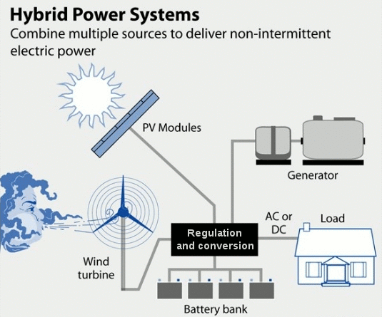
Introduction
Hybrid Energy System:
Renewable energy sources combined to form a network generating electric energy is typically known as a hybrid energy system.
Microgrid:
A hybrid energy system on a small scale that integrates renewable energy sources is called a microgrid.
Type of Microgrid:
Here we focus on Hydrogen-based Microgrid
The microgrid under study is the lab-scale microgrid called HyLab in University of Seville, Spain.
Notes:
e.g. Large-scale hybrid wind energy systems, Solar hybrid systems combined with diesel gensets etc.

Slide 4
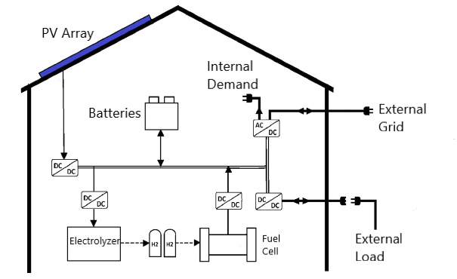
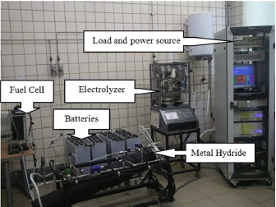
Hydrogen-based Microgrid
HyLab Setup:
Photovoltaic Array: The primary source of power is the PV array
Electrolyzer: Excess power from the PV array is converted into hydrogen by electrolysis in the electrolyzer
Storage tanks: Hydrogen is stored as metal hydrides in an alloy storage tank
Battery Pack: Used to maintain constant voltage across the microgrid bus. Charged either by PV array or the fuel cell.
PEM Fuel cell: Uses stored Hydrogen to produce electricity and provide it to the load or the battery pack
External Power grid: It either absorbs power or delivers it to the microgrid
Schematic of HyLab
Experimental Setup

Slide 5
Control Objective
Energy Management of Microgrid:
Why?
To consider the uncertain nature of renewable energy sources
To improve efficiency of the microgrid equipment
How?
Stochastic MPC techniques:
Can be applied to deal with uncertainties in power demand and generation
Focuses on the energy management of the microgrid without compromising the efficiency and product life of the components
Meet consumer demand in an optimal, economic, and safe manner.
Control Problem requires handling issues of constraints and disturbances

Slide 6
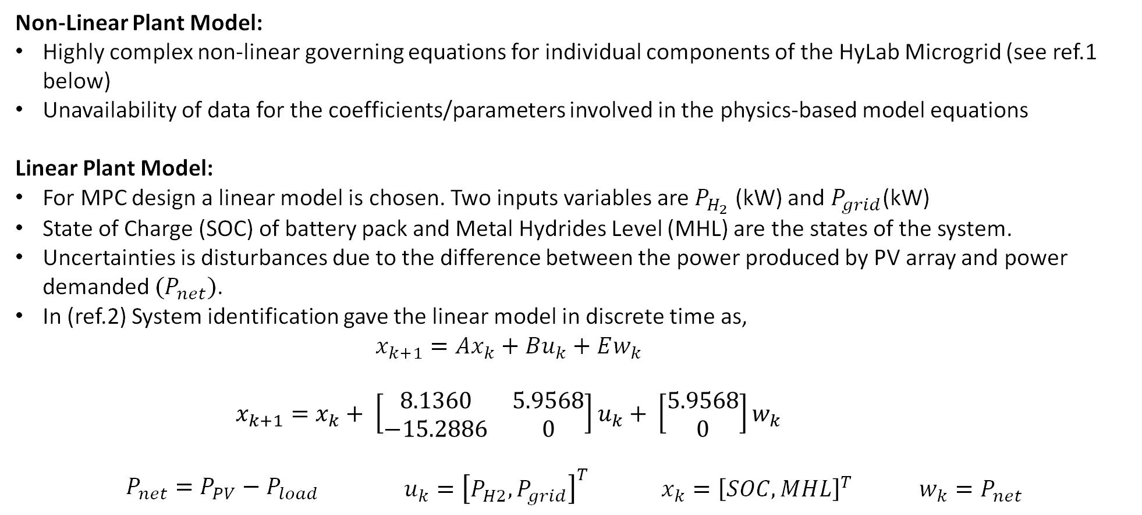
HyLab Model
Non-Linear Plant Model:
Highly complex non-linear governing equations for individual components of the HyLab Microgrid (see ref.1 below)
Unavailability of data for the coefficients/parameters involved in the physics-based model equations
Linear Plant Model:
For MPC design a linear model is chosen. Two inputs variables are $P_{H_{2}}$ (kW) and $P_{grid}$(kW)
State of Charge (SOC) of battery pack and Metal Hydrides Level (MHL) are the states of the system.
Uncertainties is disturbances due to the difference between the power produced by PV array and power demanded ${(P}_{net})$.
In (ref.2) System identification gave the linear model in discrete time as,
$$x_{k+1}=Ax_{k}+Bu_{k}+Ew_{k}$$
$$\begin{aligned}x_{k+1}=x_{k}+ \left[\begin{matrix}8.1360 & 5.9568 \\ −15.2886 & 0\end{matrix}\right]u_{k}+ \left[\begin{matrix}5.9568 \\ 0\end{matrix}\right]w_{k}\#\end{aligned}$$
$$P_{net}=P_{PV}−P_{load} \begin{matrix}u_{k}={\left[P_{H2},P_{grid}\right]}^{T} & x_{k}={\left[SOC,MHL\right]}^{T} & w_{k}=P_{net}\end{matrix}$$
1. ‘Modeling, simulation and experimental set-up of a renewable hydrogen-based domestic microgrid’, L. Valverde, F. Rosa, A.J. del Real, A. Arce, C. Bordons
2. ‘Periodic Economic Control of a Nonisolated Microgrid’, Mario Pereira, Daniel Limon, David Muñoz de la Peña, Luis Valverde, and Teodoro Alamo
3. ‘On the Comparison of Stochastic Model Predictive Control Strategies Applied to a Hydrogen-based Microgrid’ , P. Velarde & et. al

Slide 7
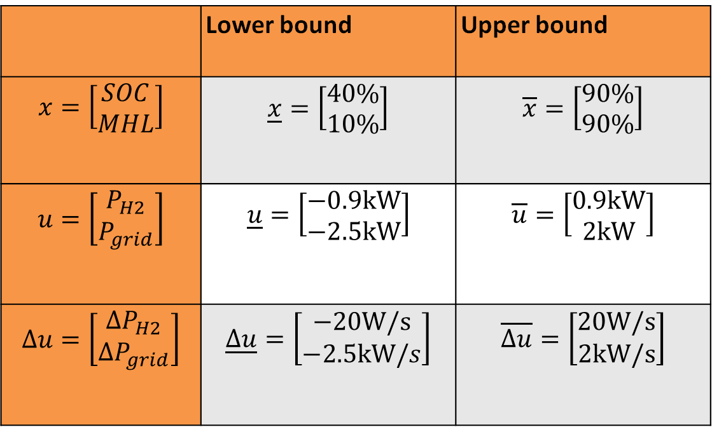
HyLab Model
State, input, and input rate of change bound values
- Dead zone in the Hydrogen system between -100W and 100W
 | Lower bound | Upper bound
$$x=\left[\begin{aligned}SOC \\ MHL\end{aligned}\right]$$ | $$\underline{x}=\left[\begin{aligned}40\% \\ 10\%\end{aligned}\right]$$ | $$\overline{x}=\left[\begin{aligned}90\% \\ 90\%\end{aligned}\right]$$
$$u=\left[\begin{aligned}P_{H2} \\ P_{grid}\end{aligned}\right]$$ | $$\underline{u}=\left[\begin{aligned}−0.9kW \\ −2.5kW\end{aligned}\right]$$ | $$\overline{u}=\left[\begin{aligned}0.9kW \\ 2kW\end{aligned}\right]$$
$$Δu=\left[\begin{aligned}ΔP_{H2} \\ ΔP_{grid}\end{aligned}\right]$$ | $$\underline{Δu}=\left[\begin{aligned}−20W/s \\ −2.5kW/s\end{aligned}\right]$$ | $$\overline{Δu}=\left[\begin{aligned}20W/s \\ 2kW/s\end{aligned}\right]$$

Slide 8
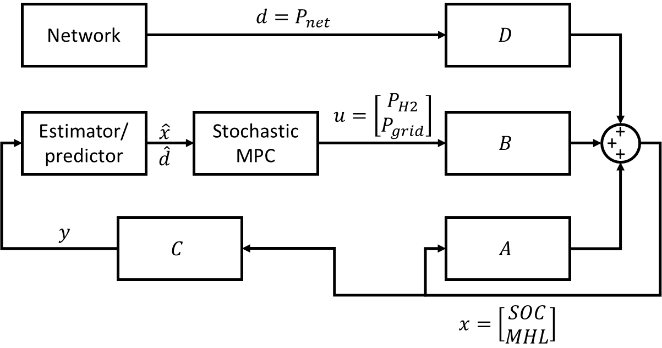
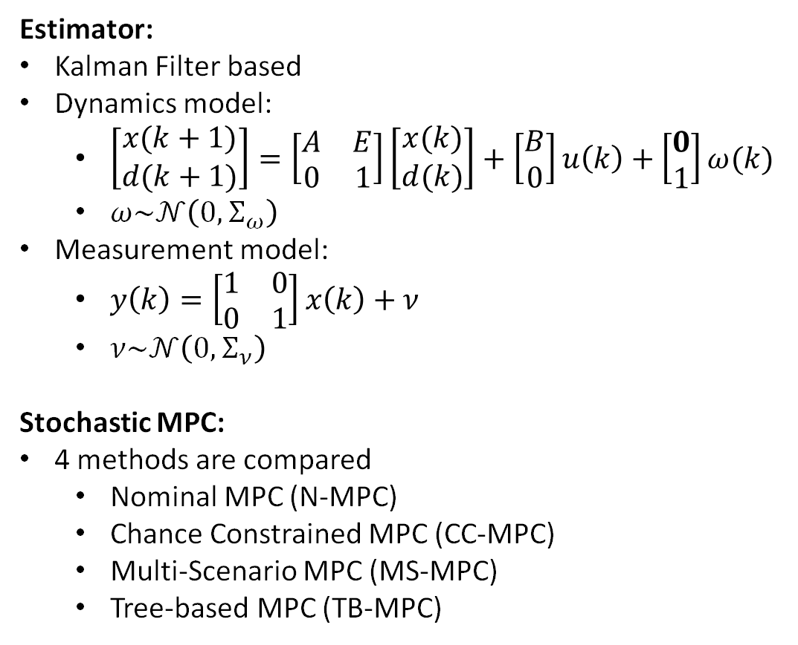
Control Framework
Estimator:
Kalman Filter based
Dynamics model:
$\left[\begin{aligned}x(k+1) \\ d(k+1)\end{aligned}\right]=\left[\begin{matrix}A & E \\ 0 & 1\end{matrix}\right]\left[\begin{aligned}x(k) \\ d(k)\end{aligned}\right]+\left[\begin{aligned}B \\ 0\end{aligned}\right]u\left(k\right)+\left[\begin{aligned}0 \\ 1\end{aligned}\right]ω(k)$
$ω\sim 𝒩\left(0,Σ_{ω}\right)$
Measurement model:
$y\left(k\right)=\left[\begin{matrix}1 & 0 \\ 0 & 1\end{matrix}\right]x\left(k\right)+ν$
$ν\sim 𝒩\left(0,Σ_{ν}\right)$
Stochastic MPC:
4 methods are compared
Nominal MPC (N-MPC)
Chance Constrained MPC (CC-MPC)
Multi-Scenario MPC (MS-MPC)
Tree-based MPC (TB-MPC)

Slide 9
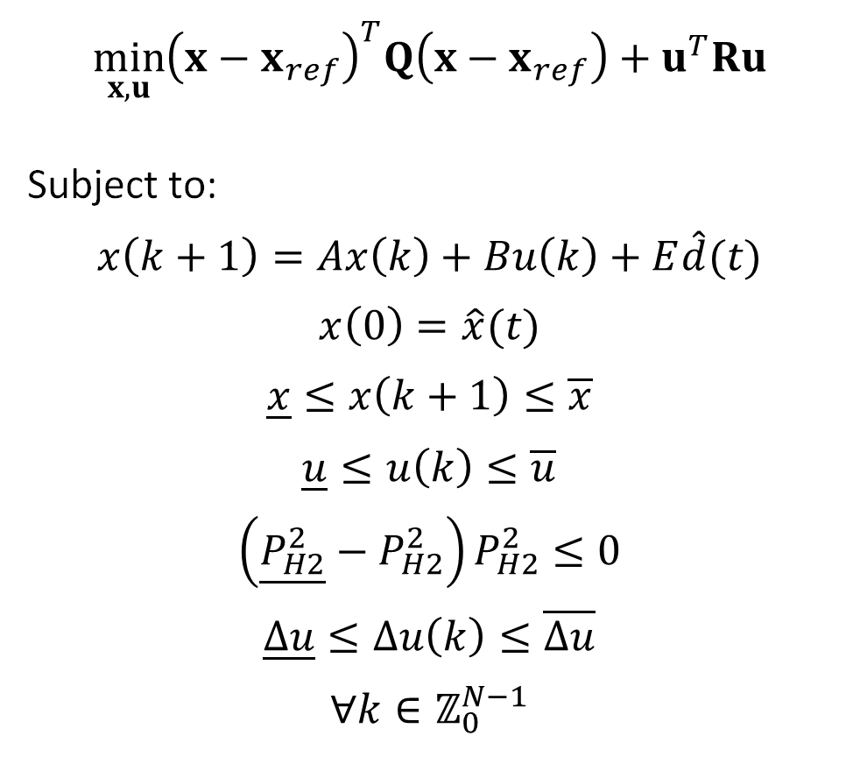
Nominal MPC
$$\min_{x,u}{{\left(x−x_{ref}\right)}^{T}Q\left(x−x_{ref}\right)+u^{T}Ru}$$
Subject to:
$$x\left(k+1\right)=Ax\left(k\right)+Bu\left(k\right)+E\hat{d}(t)$$
$$x\left(0\right)=\hat{x}(t)$$
$$\underline{x}≤x\left(k+1\right)≤\overline{x}$$
$$\underline{u}≤u\left(k\right)≤\overline{u}$$
$$\left(\underline{P_{H2}^{2}}−P_{H2}^{2}\right)P_{H2}^{2}≤0$$
$$\underline{Δu}≤Δu\left(k\right)≤\overline{Δu}$$
$$∀k∈ℤ_{0}^{N−1}$$

Slide 10
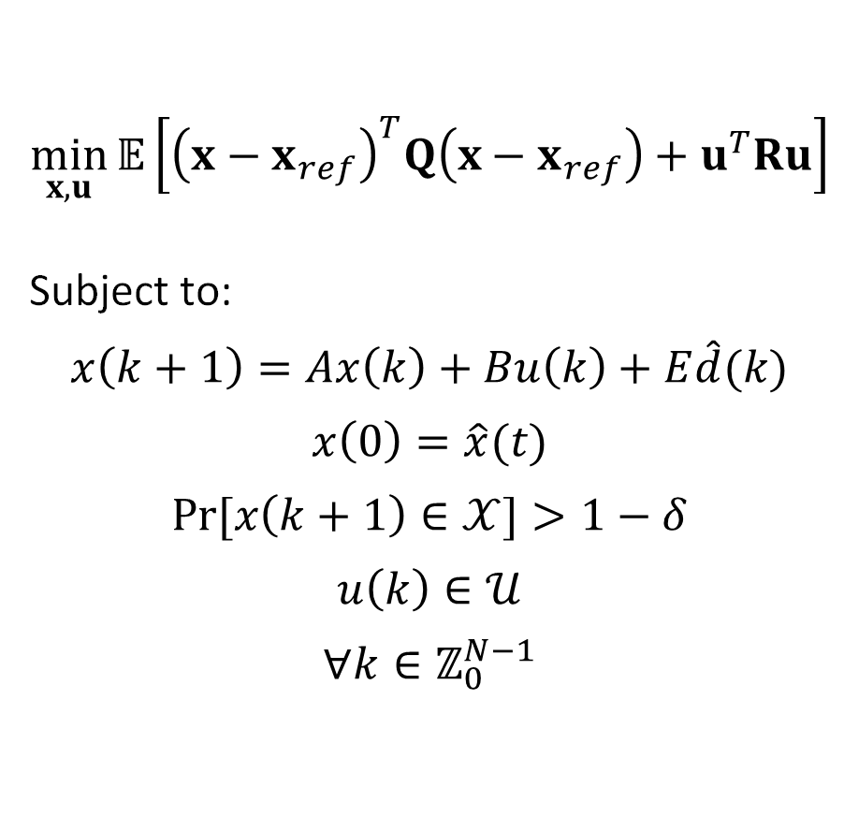
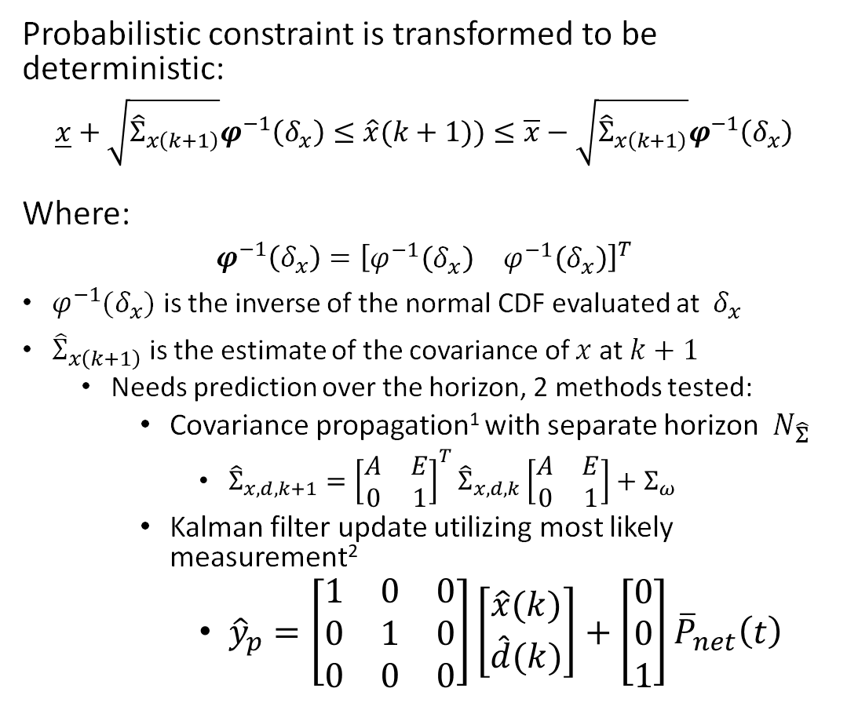
Chance Constrained MPC
$$\min_{x,u}{𝔼\left[{\left(x−x_{ref}\right)}^{T}Q\left(x−x_{ref}\right)+u^{T}Ru\right]}$$
Subject to:
$$x\left(k+1\right)=Ax\left(k\right)+Bu\left(k\right)+E\hat{d}(k)$$
$$x\left(0\right)=\hat{x}(t)$$
$$\operatorname{Pr}{[x\left(k+1\right)∈𝒳]}>1−δ$$
$$u\left(k\right)∈𝒰$$
$$∀k∈ℤ_{0}^{N−1}$$
Probabilistic constraint is transformed to be deterministic:
$$\underline{x}+\sqrt{{\hat{Σ}}_{x\left(k+1\right)}}φ^{−1}\left(δ_{x}\right)≤\hat{x}(k+1))≤\overline{x}−\sqrt{{\hat{Σ}}_{x\left(k+1\right)}}φ^{−1}\left(δ_{x}\right)$$
Where:
$$φ^{−1}\left(δ_{x}\right)={\left[\begin{matrix}φ^{−1}\left(δ_{x}\right) & φ^{−1}\left(δ_{x}\right)\end{matrix}\right]}^{T}$$
$φ^{−1}(δ_{x})$ is the inverse of the normal CDF evaluated at $δ_{x}$
${\hat{Σ}}_{x\left(k+1\right)}$ is the estimate of the covariance of $x$ at $k+1$
Needs prediction over the horizon, 2 methods tested:
Covariance propagation¹ with separate horizon $N_{\hat{Σ}}$
${\hat{Σ}}_{x,d,k+1}={\left[\begin{matrix}A & E \\ 0 & 1\end{matrix}\right]}^{T}{\hat{Σ}}_{x,d,k}\left[\begin{matrix}A & E \\ 0 & 1\end{matrix}\right]+Σ_{ω}$
Kalman filter update utilizing most likely measurement²
${\hat{y}}_{p}=\left[\begin{matrix}1 & 0 & 0 \\ 0 & 1 & 0 \\ 0 & 0 & 0\end{matrix}\right]\left[\begin{aligned}\hat{x}(k) \\ \hat{d}(k)\end{aligned}\right]+\left[\begin{aligned}0 \\ 0 \\ 1\end{aligned}\right]{\overline{P}}_{net}\left(t\right)$
Farina, M., Giulioni, L., Magni, L., & Scattolini, R. (2015). An approach to output feedback MPC of stochastic linear discrete-time systems. Automatica, 55, 140-149.
N. E. Du Toit and J. W. Burdick, "Robot Motion Planning in Dynamic, Uncertain Environments," IEEE Transactions on Robotics, vol. 28, pp. 101-115, 2012.

Slide 11
Comparison of Covariance Prediction Methods
Covariance Propagation over shortened horizon
KF Update with Most Likely Measurement

Slide 12
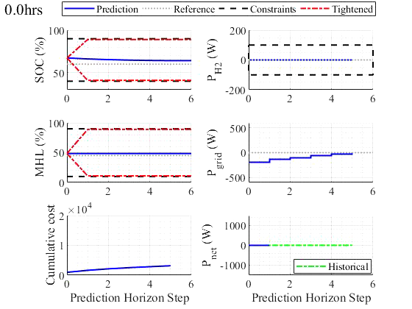
Sample Scenario – CC-MPC

Slide 13
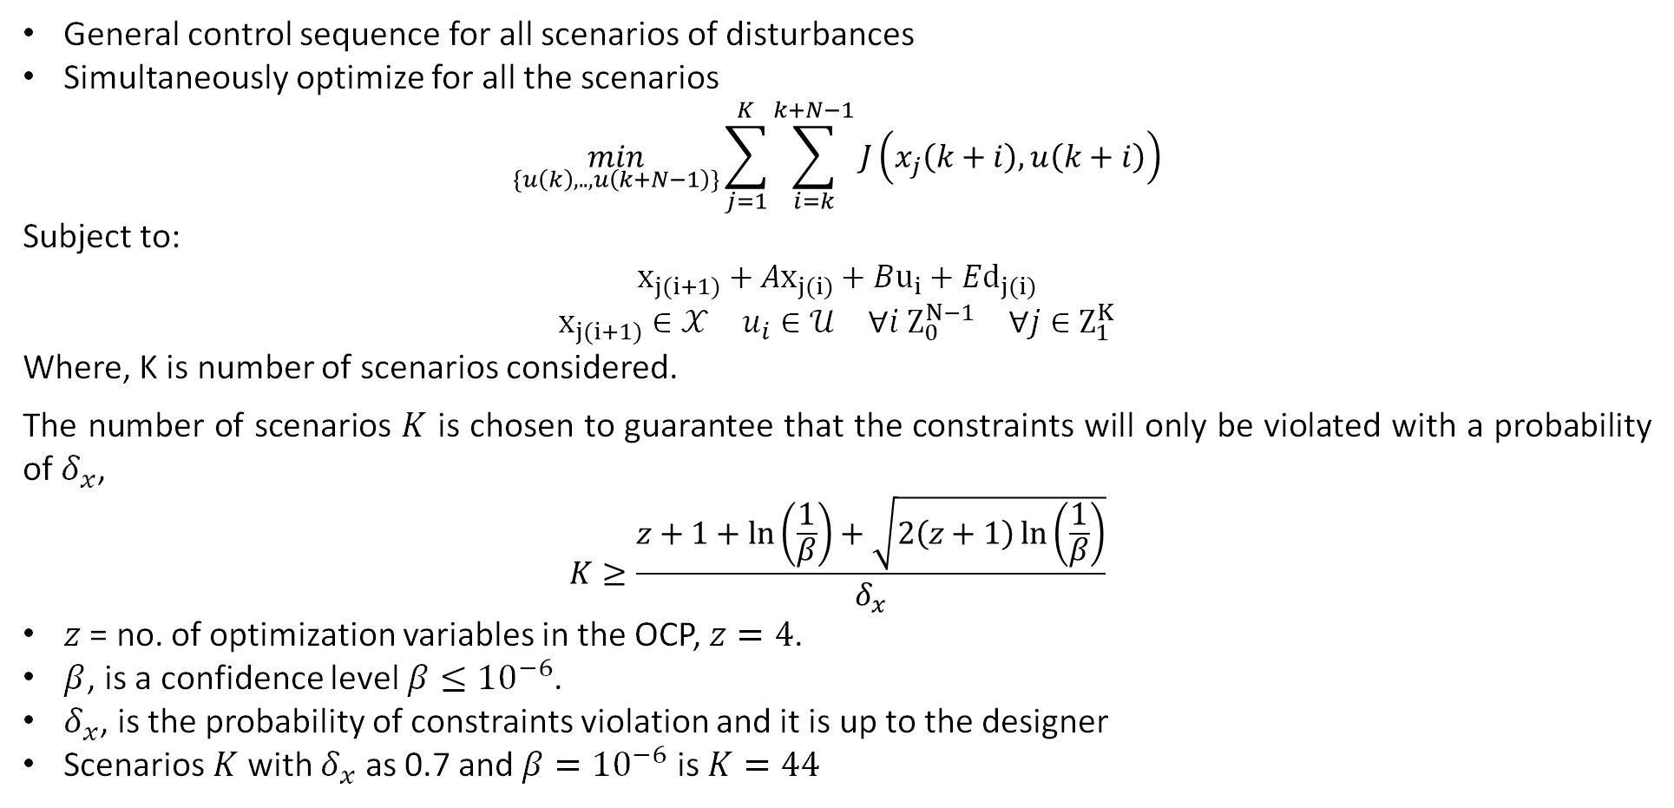
Multi-Scenario MPC
General control sequence for all scenarios of disturbances
Simultaneously optimize for all the scenarios
$$\min_{\{u\left(k\right),..,u\left(k+N−1\right)\}}{\sum_{j=1}^{K}{\sum_{i=k}^{k+N−1}{J\left(x_{j}\left(k+i\right),u\left(k+i\right)\right)}}}$$
Subject to:
$$x_{j(i+1)}+Ax_{j(i)}+Bu_{i}+Ed_{j(i)}$$
$$\begin{matrix}x_{j(i+1)}∈𝒳 & u_{i}∈𝒰 & ∀i Z_{0}^{N−1} & ∀j∈Z_{1}^{K}\end{matrix}$$
Where, K is number of scenarios considered.
The number of scenarios $K$ is chosen to guarantee that the constraints will only be violated with a probability of $δ_{x}$,
$$K≥\frac{z+1+\ln\left(\frac{1}{β}\right)+\sqrt{2\left(z+1\right)\ln\left(\frac{1}{β}\right)}}{δ_{x}}$$
$z$ = no. of optimization variables in the OCP, $z=4$.
$β$, is a confidence level $β≤{10}^{−6}$.
$δ_{x}$, is the probability of constraints violation and it is up to the designer
Scenarios $K$ with $δ_{x}$ as 0.7 and $β={10}^{−6}$ is $K=44$

Slide 14
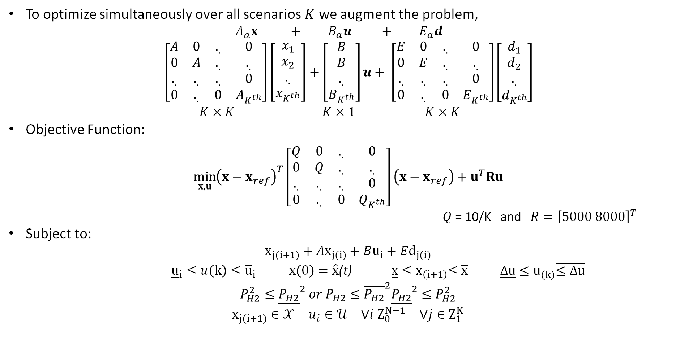
Multi-Scenario MPC
To optimize simultaneously over all scenarios $K$ we augment the problem,
$A_{a}x + B_{a}u + E_{a}d$
$$\left[\begin{matrix}A & 0 & ._{.} & 0 \\ 0 & A & ._{.} & ._{.} \\ ._{.} & ._{.} & ._{.} & 0 \\ 0 & ._{.} & 0 & A_{K^{th}}\end{matrix}\right]\left[\begin{matrix}x_{1} \\ x_{2} \\ ._{.} \\ x_{K^{th}}\end{matrix}\right]+\left[\begin{matrix}B \\ B \\ ._{.} \\ B_{K^{th}}\end{matrix}\right]u+ \left[\begin{matrix}E & 0 & ._{.} & 0 \\ 0 & E & ._{.} & ._{.} \\ ._{.} & ._{.} & ._{.} & 0 \\ 0 & ._{.} & 0 & E_{K^{th}}\end{matrix}\right]\left[\begin{matrix}d_{1} \\ d_{2} \\ ._{.} \\ d_{K^{th}}\end{matrix}\right]$$
$K×K K×1 K×K$
Objective Function:
$$\min_{x,u}{{\left(x−x_{ref}\right)}^{T}\left[\begin{matrix}Q & 0 & ._{.} & 0 \\ 0 & Q & ._{.} & ._{.} \\ ._{.} & ._{.} & ._{.} & 0 \\ 0 & ._{.} & 0 & Q_{K^{th}}\end{matrix}\right]\left(x−x_{ref}\right)+u^{T}Ru}$$
$Q$ = 10/K and $R={\left[5000 8000\right]}^{T}$
Subject to:
$$x_{j(i+1)}+Ax_{j(i)}+Bu_{i}+Ed_{j(i)}$$
${\underline{u}}_{i}≤u\left(k\right)≤{\overline{u}}_{i}$ $x\left(0\right)=\hat{x}$(t) $\underline{x}{≤x}_{\left(i+1\right)}≤\overline{x}$ $\begin{matrix}\underline{Δu}{≤u}_{\left(k\right)}\overline{≤Δu}\end{matrix}$
$$P_{H2}^{2}≤{\underline{P_{H2}}}^{2} or P_{H2}≤{\overline{P_{H2}}}^{2}{\underline{P_{H2}}}^{2}≤P_{H2}^{2}$$
$$\begin{matrix}x_{j(i+1)}∈𝒳 & u_{i}∈𝒰 & ∀i Z_{0}^{N−1} & ∀j∈Z_{1}^{K}\end{matrix}$$

Slide 15
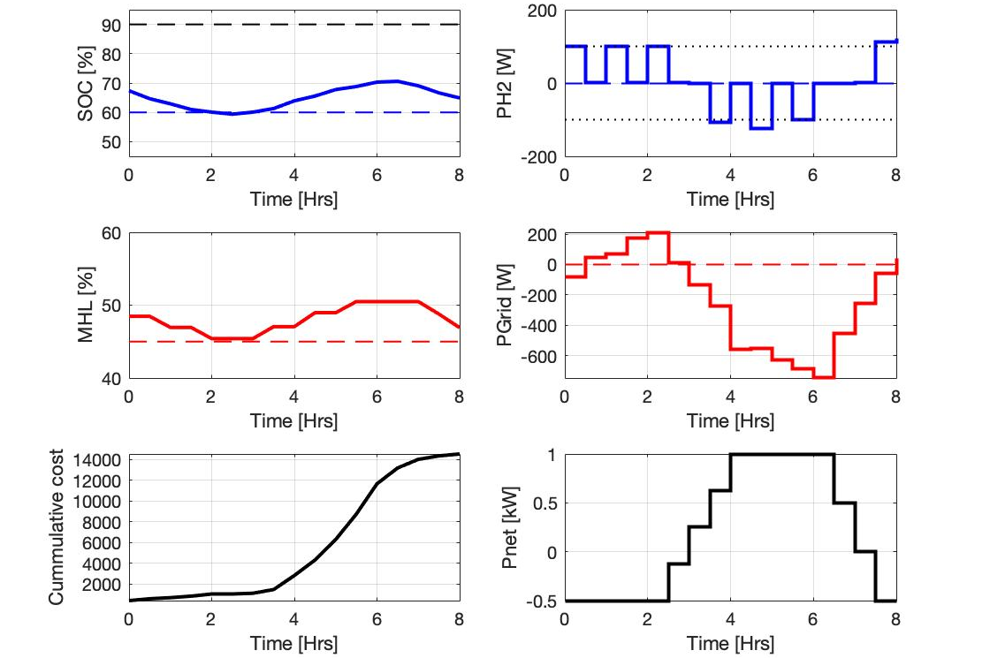
Multi-Scenario MPC (MS-MPC)
Results:

Slide 16
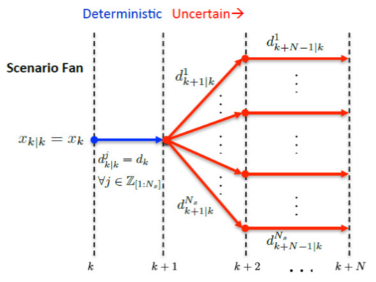
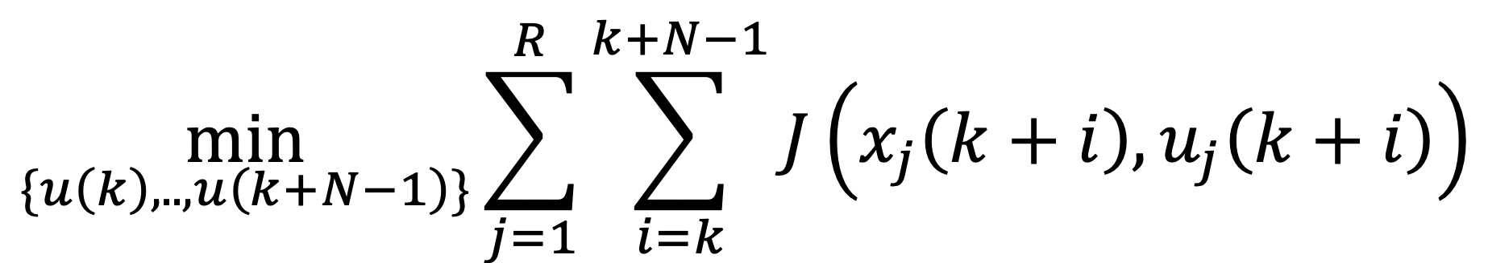
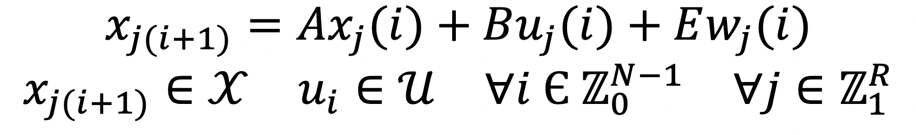
Tree based MPC
Transforms the different possible evolutions of disturbances into a rooted tree.
Each scenario in the tree has its own control signal
Objective function:
Subject to

Slide 17

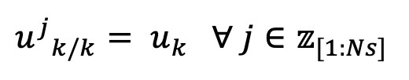


Tree based MPC
For root branch, disturbances and controls inputs are same:
… Disturbance modelling
After bifurcation point:
… Disturbance modelling

Slide 18
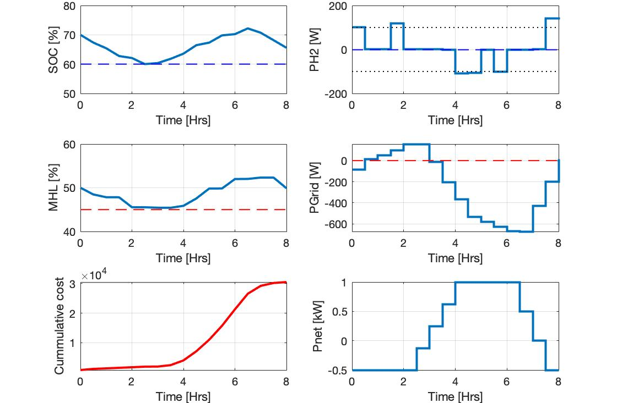
Tree based MPC - Results

Slide 19

Monte-Carlo Simulations
$N_{sim}=100$
Randomness:
$y=\left[\begin{matrix}1 & 0 \\ 0 & 1\end{matrix}\right]x+ν$
$ν\sim 𝒩(0,1)$
$P_{net}\left(t\right)={\overline{P}}_{net}\left(t\right)+ω$
$ω\sim 𝒩\left(0,0.36 {kW}^{2}\right)$
Nominal MPC violates the constraints during 2 of the simulations
No constraints were violated with stochastic approaches
Nominal MPC
Violations

Slide 20
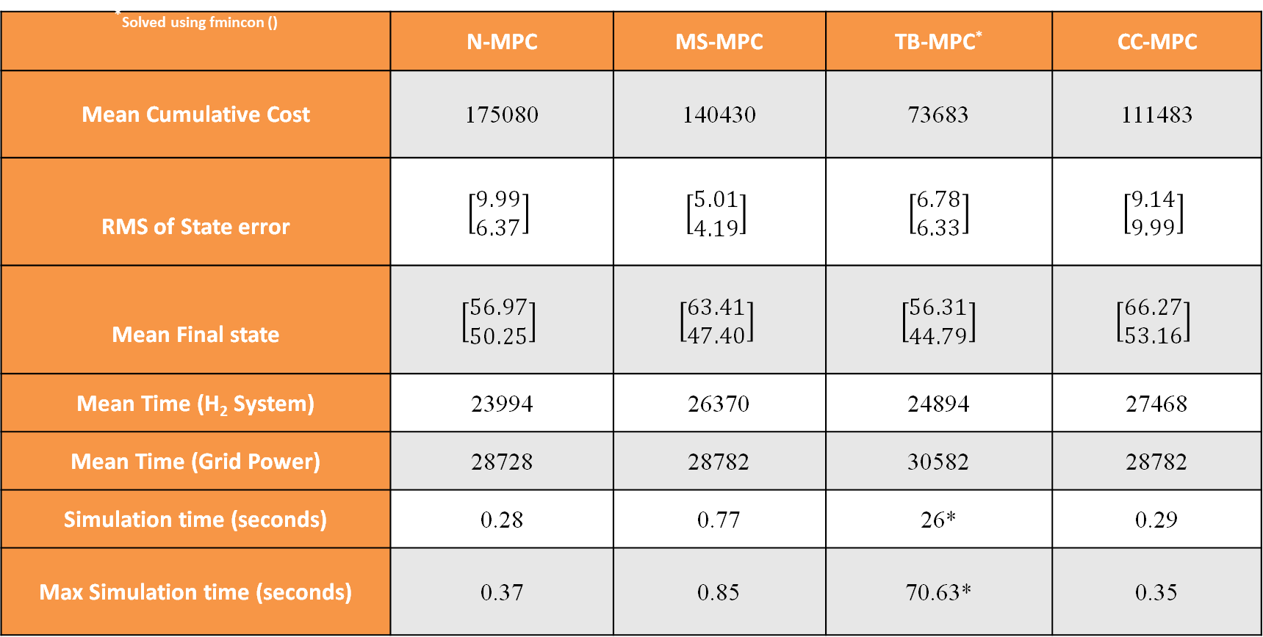
Results and Analyses: KPI summary
KPIs are evaluated from Monte-Carlo analysis (100 test scenarios)
*Solved using fmincon () | N-MPC | MS-MPC | TB-MPC* | CC-MPC
Mean Cumulative Cost | 175080 | 140430 | 73683 | 111483
RMS of State error | $$\left[\begin{aligned}9.99 \\ 6.37\end{aligned}\right]$$ | $$\left[\begin{matrix}5.01 \\ 4.19\end{matrix}\right]$$ | $$\left[\begin{matrix}6.78 \\ 6.33\end{matrix}\right]$$ | $$\left[\begin{aligned}9.14 \\ 9.99\end{aligned}\right]$$
Mean Final state | $$\left[\begin{aligned}56.97 \\ 50.25\end{aligned}\right]$$ | $$\left[\begin{matrix}63.41 \\ 47.40\end{matrix}\right]$$ | $$\left[\begin{matrix}56.31 \\ 44.79\end{matrix}\right]$$ | $$\left[\begin{aligned}66.27 \\ 53.16\end{aligned}\right]$$
Mean Time (H₂ System) | 23994 | 26370 | 24894 | 27468
Mean Time (Grid Power) | 28728 | 28782 | 30582 | 28782
Simulation time (seconds) | 0.28 | 0.77 | 26* | 0.29
Max Simulation time (seconds) | 0.37 | 0.85 | 70.63* | 0.35

Slide 21
Results and Analyses
Type | Pros | Cons
MS-MPC | Does not require assumption of form of probability distribution function for uncertainty prediction. Less computationally expensive than TB-MPC | The use of one control sequence for all possible scenarios can be overly conservative
TB-MPC | Does not require assumption of shape of probability function for uncertainty prediction and allows for different control sequences after bifurcations, resulting in less conservative control trajectories. | It is the most computationally expensive.
CC-MPC | This method is computationally efficient since the probabilistic constraint is transformed into linear constraints and the optimal control problem is solved deterministically. | Assumptions are required to characterize the shape of the probability distribution function and uncertainty

Slide 22
Thank you!
Questions?

Slide 23
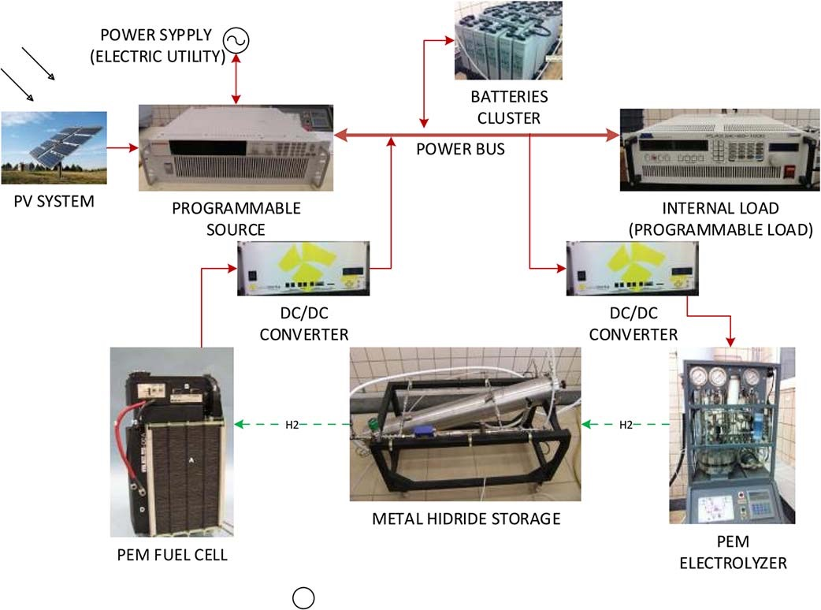
Extra - ref

Slide 24
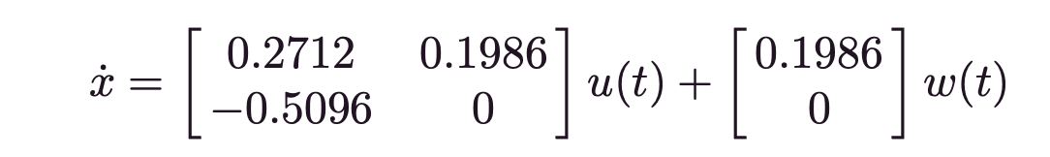
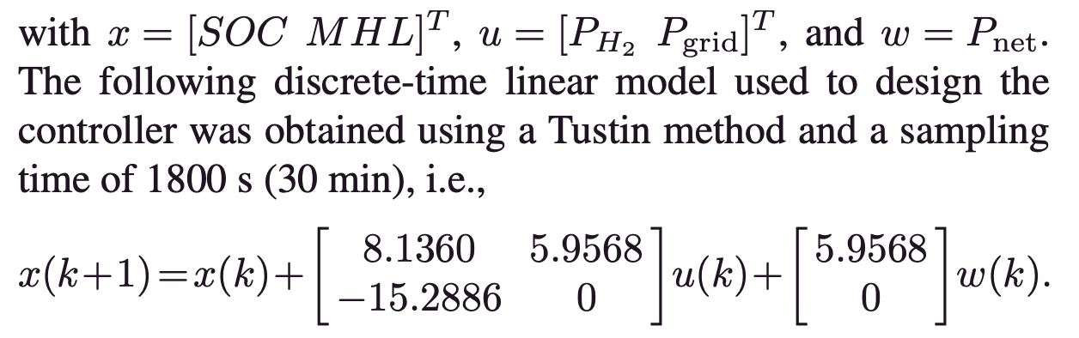
Linearization
In order to implement the control law, a discrete-time linear model is needed. After analyzing the response of the system, the microgrid was modeled as two integrators with weighted inputs. A series of simulations was carried out using the nonlinear model to identify the slope of the step response to each input. For each input, over 300 simulations of 30 min with different initial states and step amplitudes were done. The parameters of the system were obtained as the mean value of these slopes. The resulting continuous-time
linear model was
Mario Pereira, Daniel Limon, David Muñoz de la Peña, Luis Valverde, and Teodoro Alamo, "Periodic Economic Control of a Nonisolated Microgrid," IEEE TRANSACTIONS ON INDUSTRIAL ELECTRONICS, vol. 62, no. 8, pp. 5247-5255, AUGUST 2015.

Slide 25
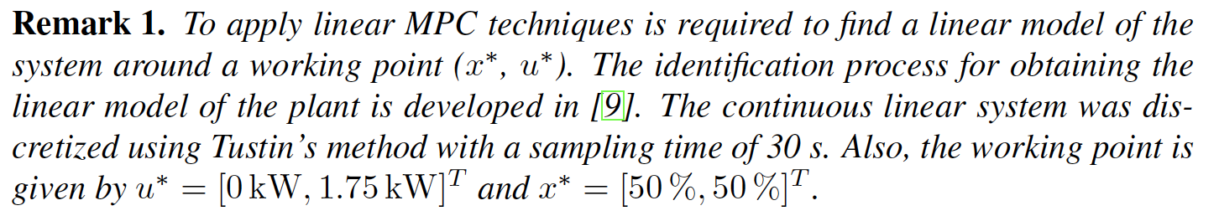
Nominal point
[9]

