Slide 1

Chains of Invariant Subspaces
Linnea Jones, Maddie Kloud, Liam Leasure, Max Rodgers

Slide 2

The problem we want to solve
Notes:
Google used to do code jam programming problems for anyone to solve, this one is from 2022 and it has a very elegant mathematical solution

Slide 3
Example
Database Sequence: 10101010
Database outputs:
We input: 01010101
Database Sequence: 00000000
Database outputs:
4
0
Notes:
Explain what the problem looks like, demonstrate the hidden information
Unusual database
Send in as many inputs as necessary to make it a sequence of all 0s
Fun fact – we actually don’t need the info about the number of ones in the database sequence

Slide 4

Behind the Scenes Operations
The database takes our input and cycles it some number of times:
01010101 10101010
Then it applies the binary exclusive or operator (XOR) to its string and our cycled string:
10101010
10101010
00000000
Our Cycled String
Database String
Notes:
Define XOR – addition % 2
Define cycling
Now we want to find an algorithm
how do we solve the problem for other sizes of strings? Such as 16, 32, 64, 128, 256 bit.
How do we solve for lengths that are not a power of 2
Summarize whole prolem

Slide 5
Solution for 4-bit Sequences
V₄
1000 0100 0010 0001
1110 0111 1011 1101
2-bit Solution
1100 0110
0011 1001
V₃
V₂
10
01
1010
0101
11
g
V₁
1111
00
V₀
0000
Notes:
Demonstrate 2 bit sol first
Define the boxes – how we found them
Each box is an invariant subspace
This is where chains of invariant subspaces come from
Use one element from each box to make a basis that covers all 4-bit sequences

Slide 6
Expanding basis elements
2 bits
4 bits
8 bits
16 bits
11
01
1111
0101
0011
0001
1111
0101
0011
0001
1111
0101
0011
0001
1111
0101
0011
0001
1111
0101
0011
0001
1111
0101
0011
0001
1111
0101
0011
0001
0000
0000
0000
0000
1111
0101
0011
0001
1111
0101
0011
0001
0000
0000
0000
0000
0000
0000
0000
0000
1111
0101
0011
0001
2^{n} bits...
0000
0000
0000
0000
0000
0000
0000
0000
1111
0101
0011
0001
1111
0101
0011
0001
0000
0000
0000
0000
0000
0000
0000
0000
0000
0000
0000
0000
1111
0101
0011
0001
Notes:
We obtain an interesting pattern with our basis elements when we expand the length of our vectors...

Slide 7
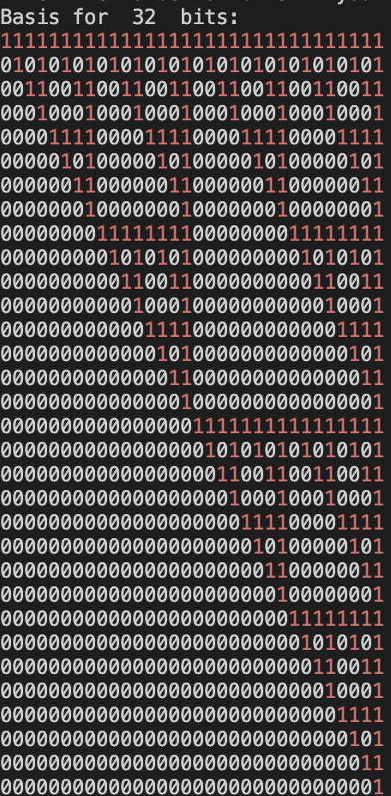
Larger dimensions have the same pattern
Notice that this matrix is triangular, rows are linearly independent
So, we can expand the pattern and get an n dimensional chain of nested subspaces
The subspace generated by the first k rows is invariant
Notes:
Since this basis forms an upper triangular matrix, we know that the columns must be linearly independent – containment. Need to prove each column is cyclic as well

Slide 8

How do we know the subspace is invariant?
11111111 = b₈
01010101 = b₇
00110011 = b₆
00010001 = b₅
00001111 = b₄
00000101 = b₃
00000011 = b₂
00000001 = b₁
11111111 = b₈
10101010 = b₇ + b₈
01100110 = b₆ + b₇
00100010 = b₅ + b₆
00011110 = b₄ + b₅
00001010 = b₃ + b₄
00000110 = b₂ + b₃
00000010 = b₁ + b₂

Slide 9
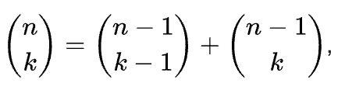
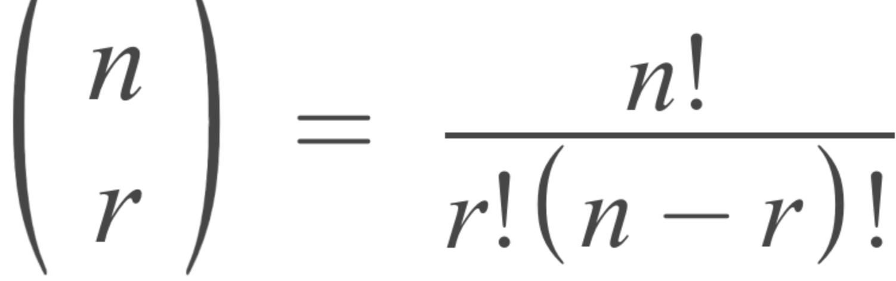
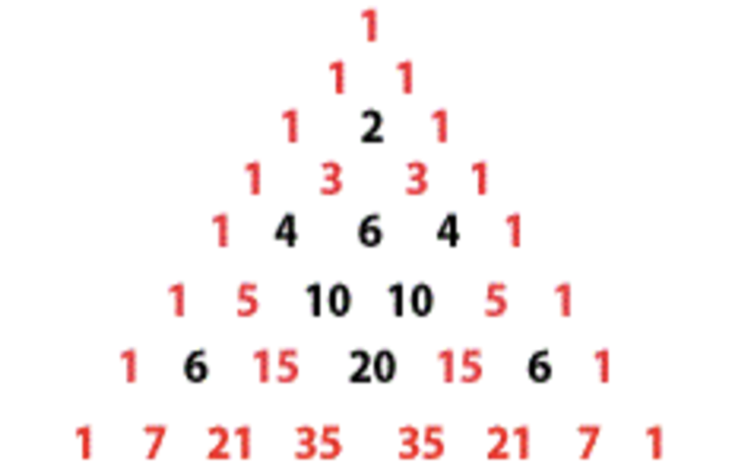
Pascal's triangle
Take combinations of row n choose k (both nonnegative integers such that 0 ≤ k < n) we get Pascal's triangle.
We get the same pattern as our basis elements when we convert these values to binary
n=0
= 00000001
n=1
= 00000011
n=2
= 00000101
n=3
= 00001111
n=4
= 00010001
n=5
= 00110011
n=6
= 01010101
n=7
= 11111111

Slide 10
Motivating Fact
The Lattice of invariant subspaces is a chain if and only if V is cyclic and primary.
4
4
3
3
2
2
2b
1
1
0
0

Slide 11


Cyclic Spaces
A vector space is cyclic or , if it can be generated by a basis of the form .
The cyclic basis for the fourth dimension is (0001,0010,0100,1000).

Slide 12


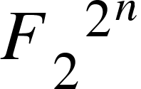
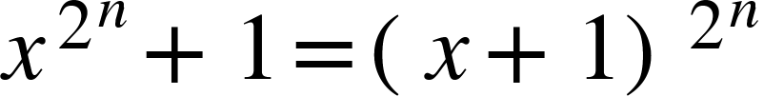
Primary Vector Spaces
Minimal polynomial of : monic polynomial of minimal degree such that = 0
A vector space is primary if its minimal polynomial is the power of an irreducible polynomial.
Minimal polynomial of w.r.t :

Slide 13
What's Next?
Notes:
Questions that guide our further exploration into this topic.

Slide 14



Patterns Found in Vector Arranged in a Square
0 1 2 3
4 5 6 7
8 9 10 11
12 13 14 15
Vectors arranged in ascending order
Colored based on subspaces
Darker = Smaller Subspace

Slide 15
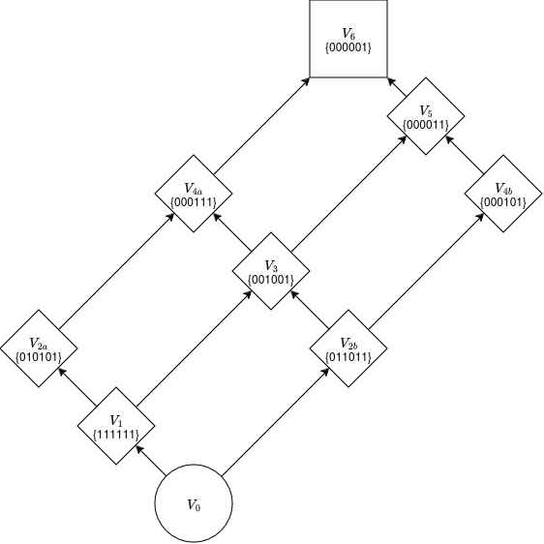

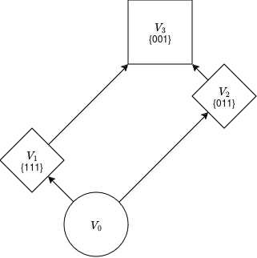
Lattices (for non-powers of two)
Powers of two create chains
Non-powers of two create lattices that aren't chains
More complicated to compute
Notes:
3: we don't yet have an algorithm to find these, or any real theory on how they work

Slide 16
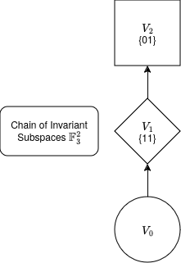
Different Fields
Same addition and cycling
Lattices / chains
Code Jam solutions
+ | 0 | 1 | X | X+1
0 | 0 | 1 | X | X+1
1 | 1 | 0 | X+1 | X
X | X | X+1 | 0 | 1
X+1 | X+1 | X | 1 | 0

