Slide 1
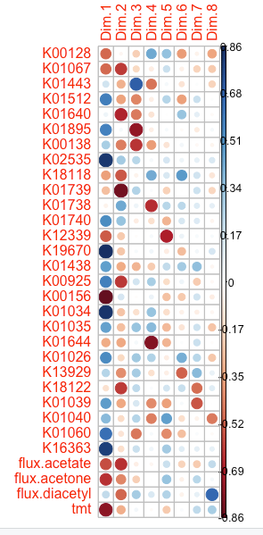
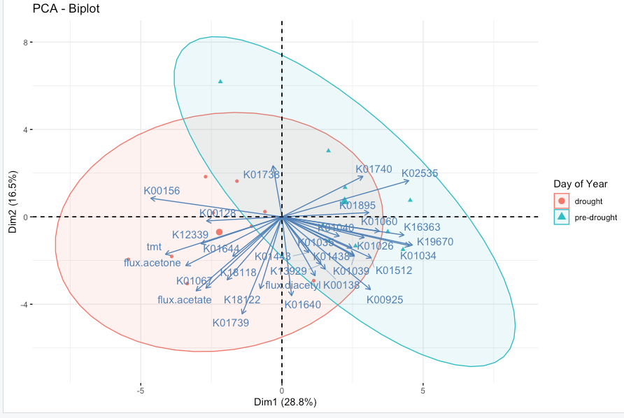
Full list of genes that cycle acetate (stars indicate those discussed in paper)
Acetate
contribution
ACH1
*
*
*
*
*
*
*
*
*
*
*
* *
*
* *
*
*
*
*
*
*
*
*
*
*
*
* *
* *
* *
acyP
acs
aarC
PCAtest – significance results
The first 3 PC axes are significant and account for 60.6% of the total variation
Variables 1, 3, 4, 6, 8, 11, 13, 14, 16, 17, 18, 19, 20, 21, 22, 24, 25, 27, 29, 30, and 31 have significant loadings on PC 1
Variables 2, 5, 9, 10, 12, 13, 16, 23, 28, 29, 30, and 31 have significant loadings on PC 2
Variables 3, 5, 6, 7, 11, 12, 15, 25, and 26 have significant loadings on PC 3
ackA
poxB
pct
Maybe only show significant loadings?
* Significantly contributes to PC

Slide 2
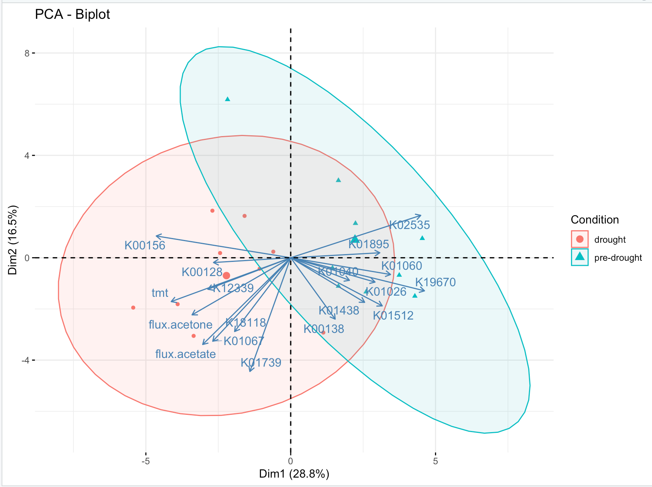
Full list of genes that cycle acetate (stars indicate those discussed in paper)
contribution
*
*
*
*
*
*
*
* *
*
*
* *
*. *
*
*
*
*
*
*
*
*
*
* *
*
* *
*
*
*
PCAtest – significance results
Acetate –reran on 10/17 – 18 samples, instead of 36
ACH1
acyP
acs
========================================================
Test of PCA significance: 31 variables, 18 observations
1000 bootstrap replicates, 1000 random permutations
========================================================
Empirical Psi = 141.3998, Max null Psi = 53.3301, Min null Psi = 33.0967, p-value = 0
Empirical Phi = 0.4088, Max null Phi = 0.2691, Min null Phi = 0.2250, p-value = 0
Empirical eigenvalue #1 = 10.25558, Max null eigenvalue = 5.82641, p-value = 0
Empirical eigenvalue #2 = 7.26539, Max null eigenvalue = 4.82101, p-value = 0
PC 1 is significant and accounts for 33.1% (95%-CI:30-45.8) of the total variation
PC 2 is significant and accounts for 23.4% (95%-CI:17-30.2) of the total variation
The first 2 PC axes are significant and account for 56.5% of the total variation
Variables 1, 3, 4, 6, 7, 8, 9, 10, 13, 14, 15, 17, 21, 25, 26, 27, 28, 29, and 31 have significant loadings on PC 1
Variables 10, 11, 12, 13, 14, 16, 18, 19, 23, 24, 26, 28, and 30 have significant loadings on PC 2
aarC
ackA
poxB
pct
Significant loadings for PC1
* Significantly contributes to PC

Slide 4
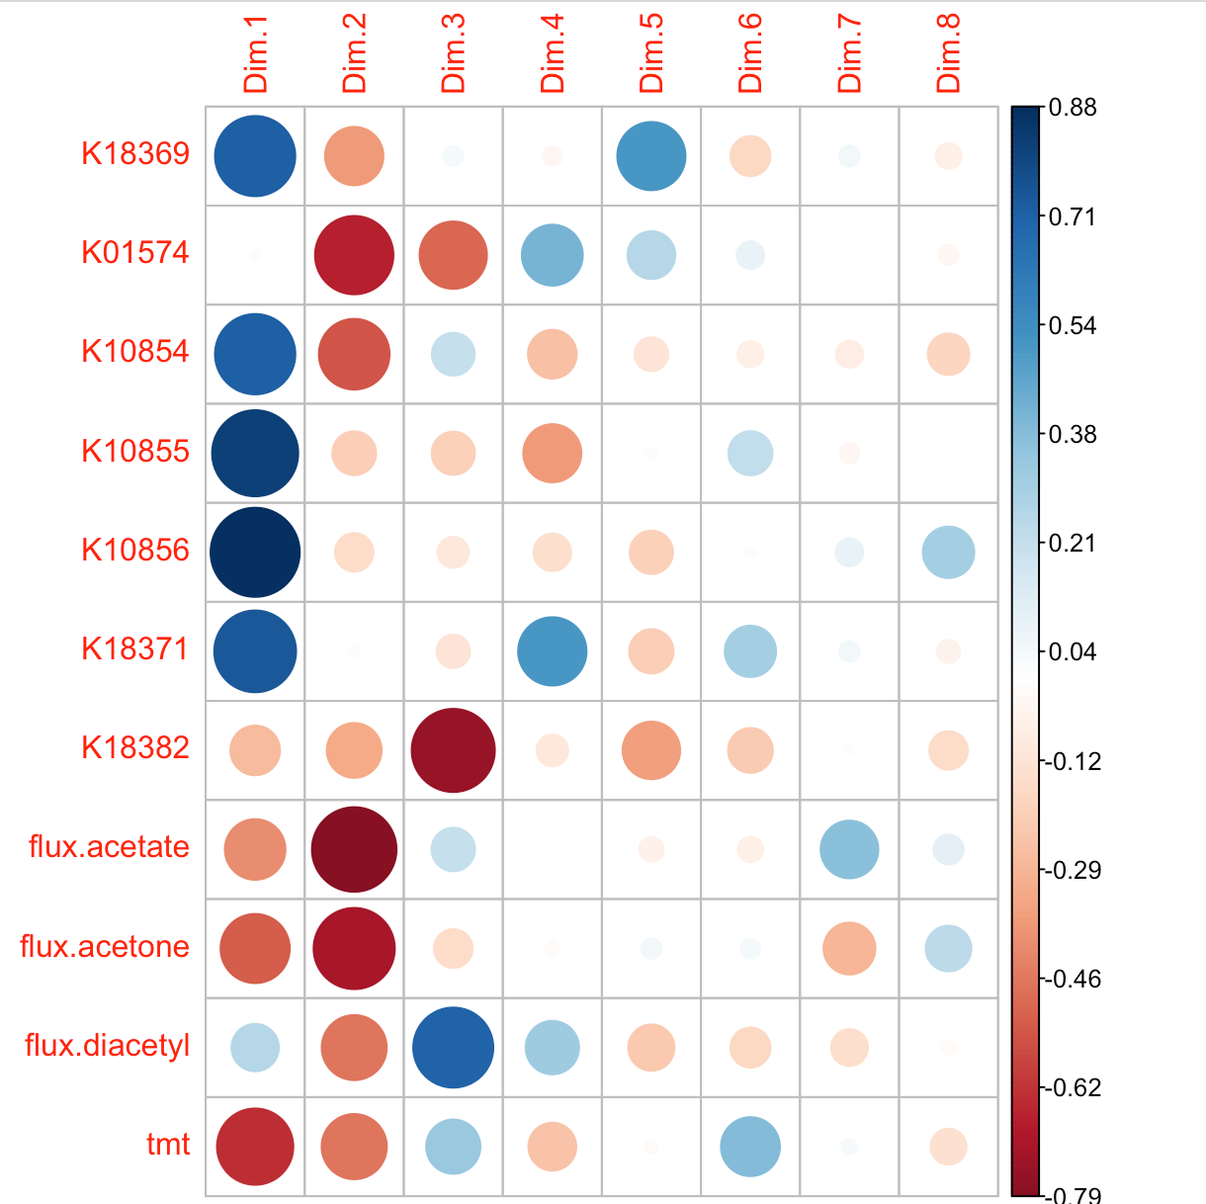
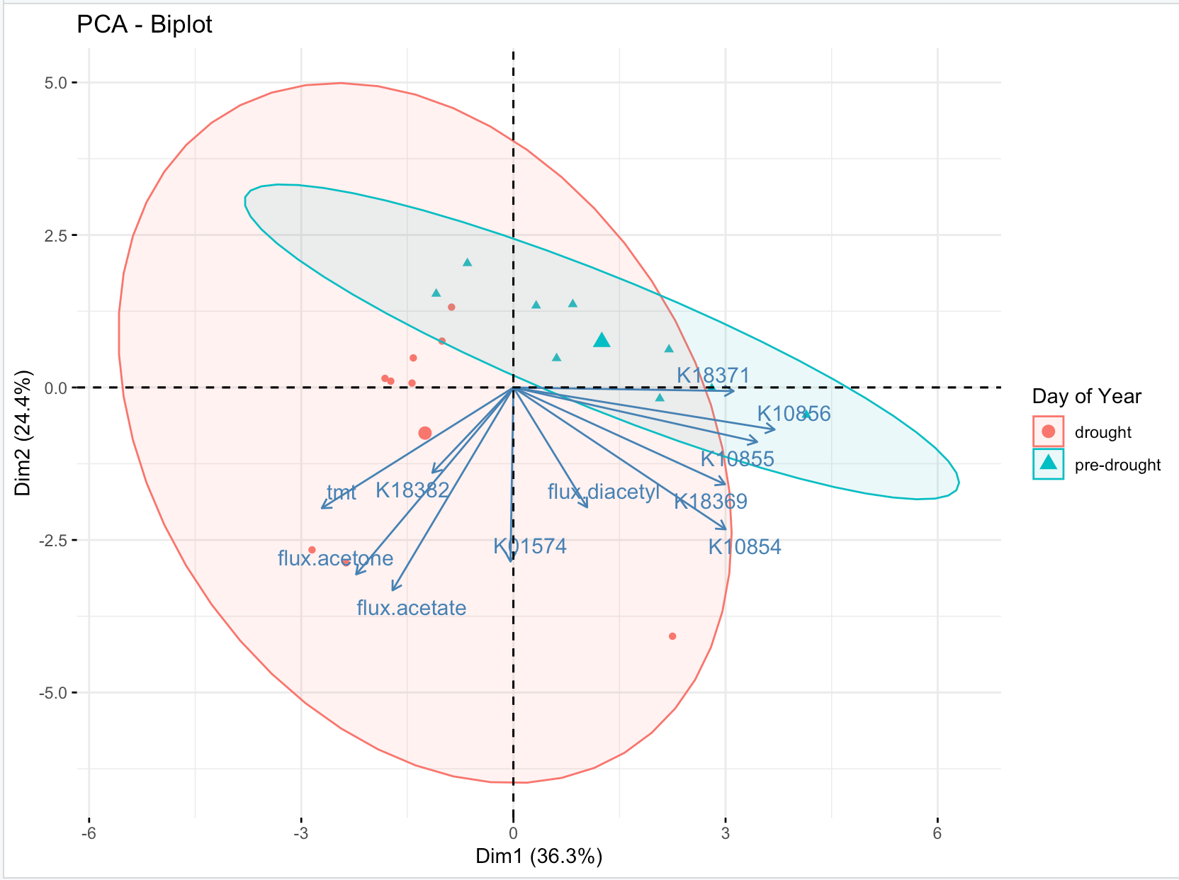
Acetone
Full list of genes that cycle acetone (stars indicate those discussed in paper)
contribution
PCAtest – significance results
*
* *
*
*
*
*
*
*
*
The first 2 PC axes are significant and account for 64.9% of the total variation
Variables 1, 2, 3, 4, 5, and 6 have significant loadings on PC 1
Variables 2, 7, 9, and 10 have significant loadings on PC 2
adc
acxB
acxA
acxC
acmM
adh1
Maybe only show significant loadings?
* Significantly contributes to PC

Slide 5
Acetone –reran on 10/17 – 18 samples, instead of 36
Full list of genes that cycle acetone (stars indicate those discussed in paper)
contribution
PCAtest – significance results
*
*
*
*
*
*
*
*
adc
========================================================
Test of PCA significance: 11 variables, 18 observations
100 bootstrap replicates, 100 random permutations
========================================================
Empirical Psi = 24.3715, Max null Psi = 9.5342, Min null Psi = 4.0207, p-value = 0
Empirical Phi = 0.4707, Max null Phi = 0.2944, Min null Phi = 0.1912, p-value = 0
Empirical eigenvalue #1 = 5.12096, Max null eigenvalue = 3.20587, p-value = 0
Empirical eigenvalue #2 = 2.33397, Max null eigenvalue = 2.45295, p-value = 0.03
PC 1 is significant and accounts for 46.6% (95%-CI:35.7-60.4) of the total variation
PC 2 is significant and accounts for 21.2% (95%-CI:16.8-29.6) of the total variation
The first 2 PC axes are significant and account for 67.8% of the total variation
Variables 1, 3, 4, 5, 8, 9, and 11 have significant loadings on PC 1
Variables , and 10 have significant loadings on PC 2
acxB
acxA
acxC
acmM
adh1
Maybe only show significant loadings?
* Significantly contributes to PC

Slide 6
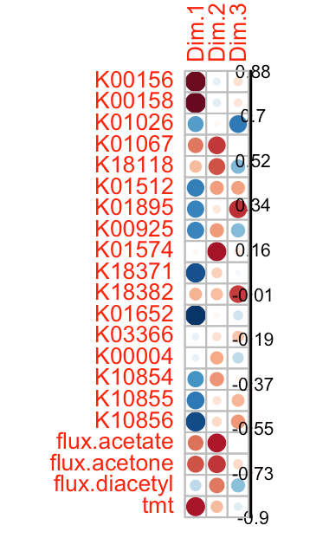
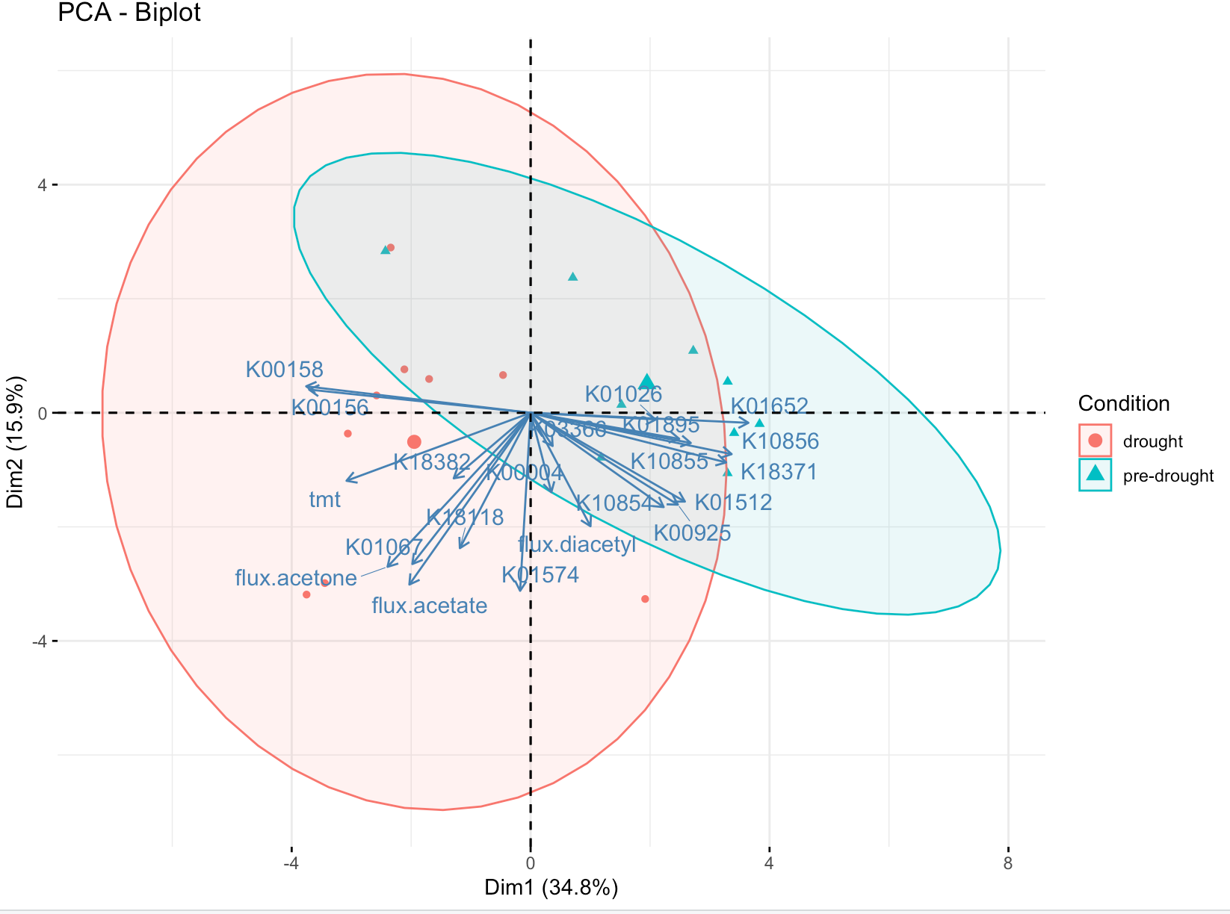
All genes – 10/19
Test of PCA significance: 21 variables, 18 observations
1000 bootstrap replicates, 1000 random permutations
========================================================
Empirical Psi = 52.7759, Max null Psi = 29.7064, Min null Psi = 15.4422, p-value = 0
Empirical Phi = 0.3677, Max null Phi = 0.2833, Min null Phi = 0.2152, p-value = 0
Empirical eigenvalue #1 = 6.51142, Max null eigenvalue = 4.72366, p-value = 0
Empirical eigenvalue #2 = 4.04095, Max null eigenvalue = 3.85052, p-value = 0
Empirical eigenvalue #3 = 3.00226, Max null eigenvalue = 3.19063, p-value = 0.008
PC 1 is significant and accounts for 31% (95%-CI:27.4-43.2) of the total variation
PC 2 is significant and accounts for 19.2% (95%-CI:16.9-27.6) of the total variation
PC 3 is significant and accounts for 14.3% (95%-CI:11.3-19) of the total variation
The first 3 PC axes are significant and account for 64.5% of the total variation
Variables 1, 2, 7, 8, 9, 10, and 17 have significant loadings on PC 1
Variables 4, 13, 15, 16, and 18 have significant loadings on PC 2
Variables 5, 6, and 21 have significant loadings on PC 3

