Slide 1

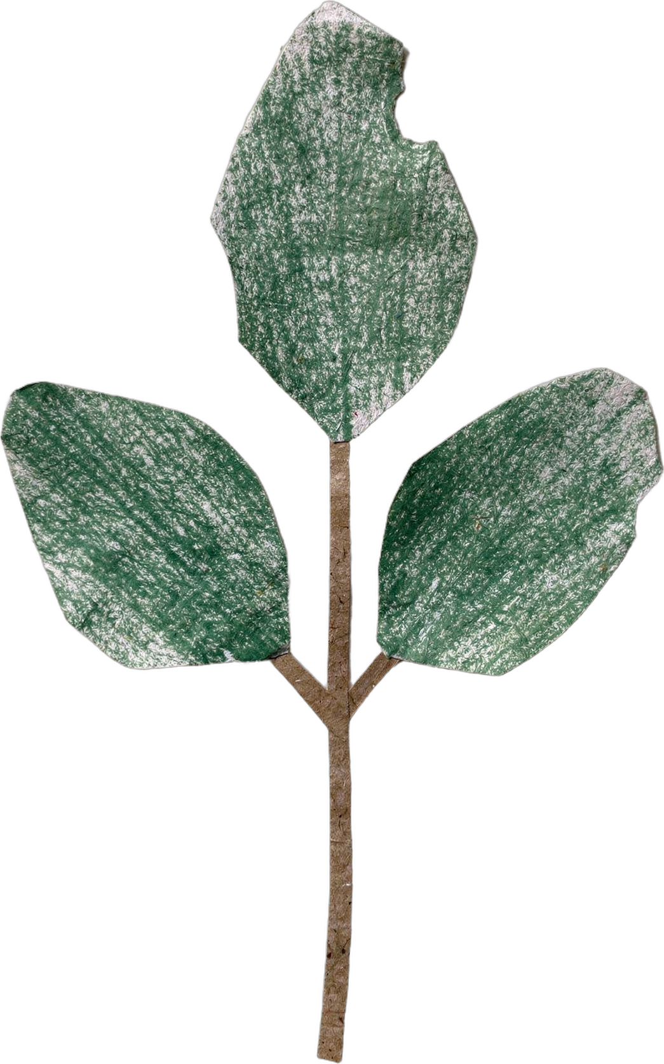
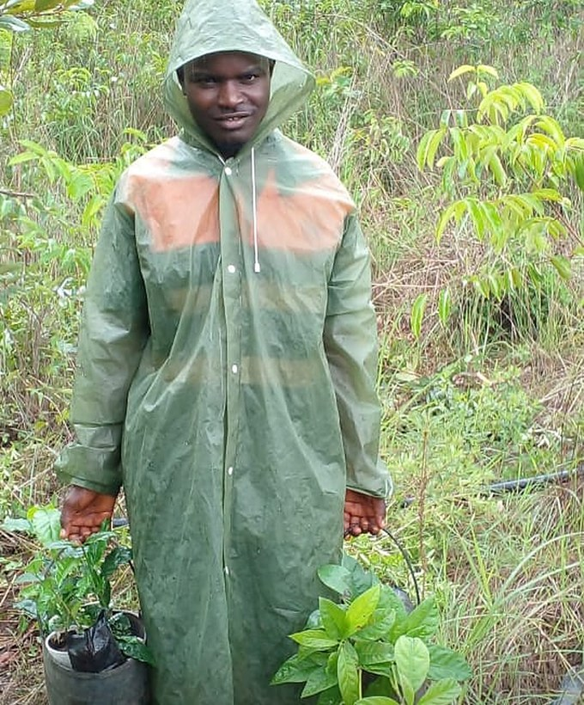
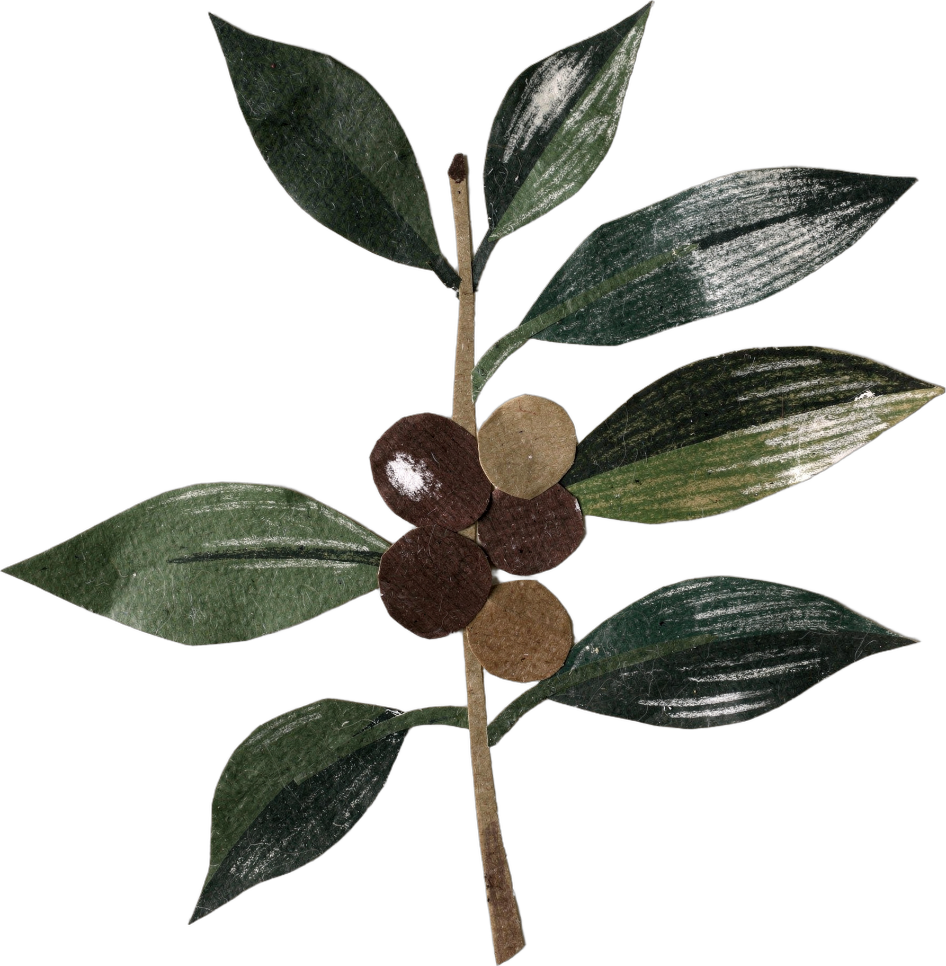

Soil Regenerators in the wild
Boubacar Tidiane Diallo, Guinea
Notes:
Template 1, scrapbook. Instagram collab: @tidia.diallo.1 (from Boubacar's reply to Allison) [VERIFY]. Sources: Impact story sheet, Boubacar Tidiane Diallo: https://docs.google.com/spreadsheets/d/10UHLwzJLBQAsmJqmg4hiCQRjBKXPAx7UnOudU-Vsg5U/edit; YouTube: https://www.youtube.com/@boubacartidianediallo; Facebook: https://www.facebook.com/btidja; Photos: sent by Boubacar to Stephanie on WhatsApp, 17 August 2026. [TAG @Stephanie] Send Boubacar the final caption and slides to approve before posting, and confirm he studied on a scholarship. Photo: assets/photo/boubacar/boubacar-raincoat-seedlings-cropped-2x.jpg, cropped from the phone screenshot of his Facebook post of 17 July 2024 (status bar, Facebook header and buttons removed) and upscaled 2x. [PHOTO NEEDED: the original file from Boubacar]. Cut-paper pieces are objects only (flux-2-pro); nothing generated shows Boubacar or his farm.

Slide 2
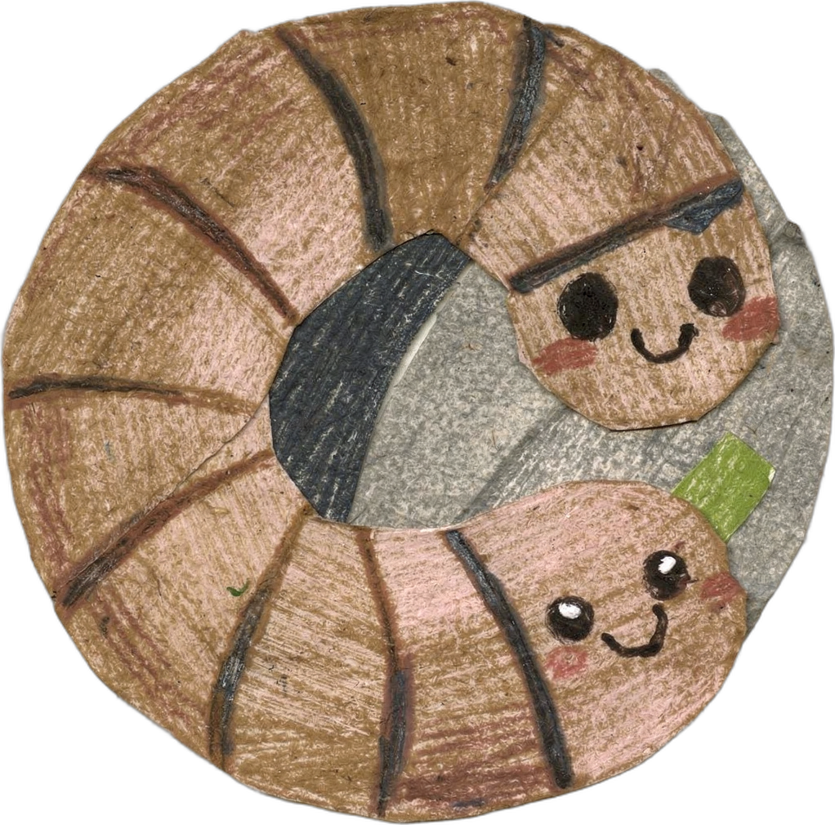
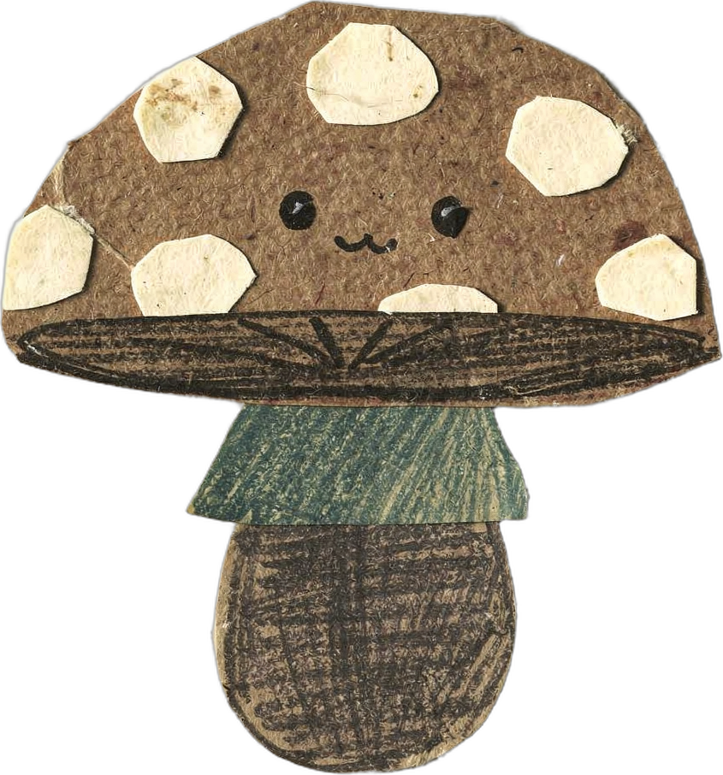
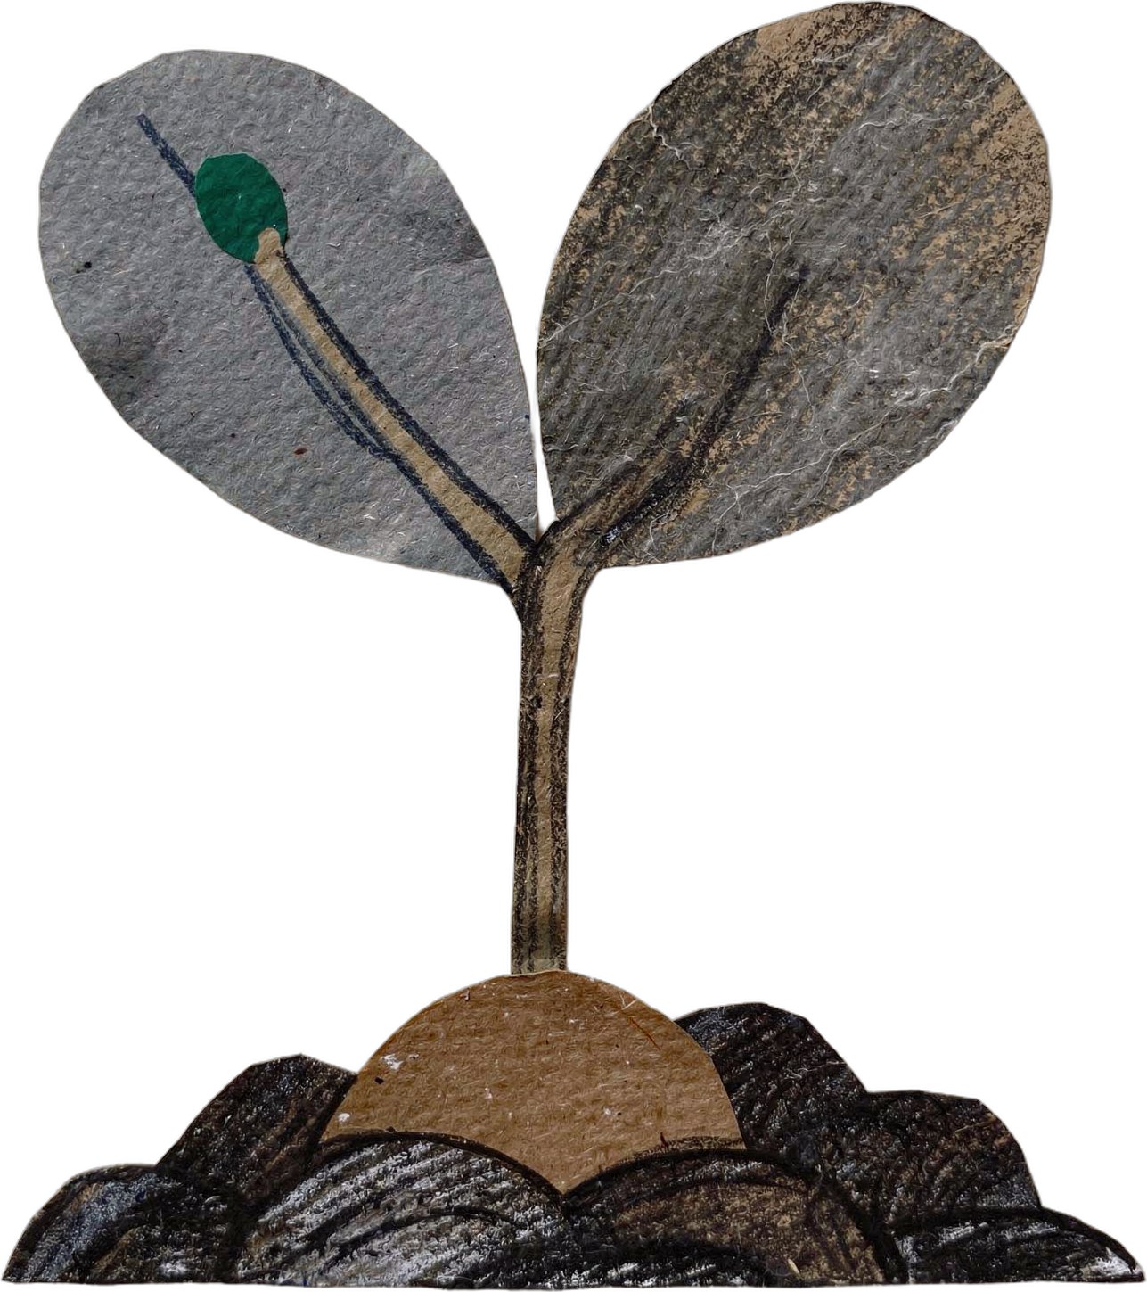
“
“Today, I ask a different question: What does the soil food web need to thrive?”
Notes:
Quote slide. No microscope photo: Boubacar wrote (reply to Allison) that he does not have a microscope yet, and that he sees healthier soil as more earthworms, mushrooms and active decomposition. The cut-paper earthworm, mushroom and seedling show those signs. [PHOTO NEEDED: Boubacar on his farm or his mulched soil, which he says he will send]. Cut-paper pieces are objects only (flux-2-pro); nothing generated shows Boubacar or his farm.

Slide 3
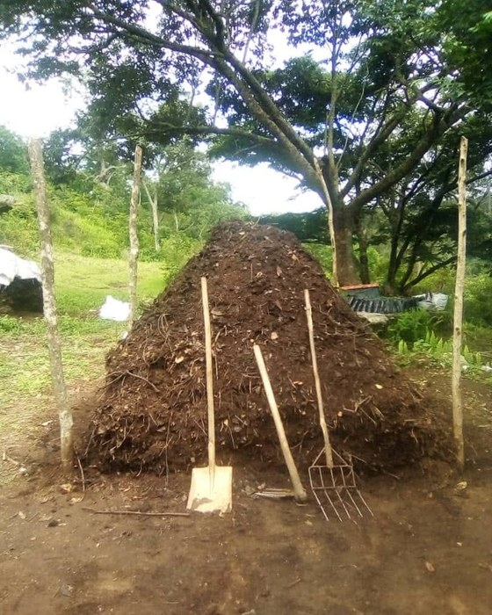
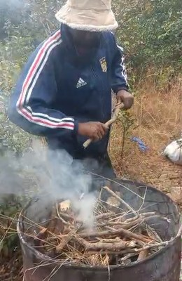
How he feeds his soil:
compost, vermicompost, activated biochar, permanent mulch, and cover crops.
Notes:
Photo slide. Main photo: assets/photo/boubacar/boubacar-compost-pile.jpeg (WhatsApp, 17 Aug 2026). Small print: assets/photo/boubacar/still-biochar-kiln-smoke-73s.png, from assets/video/boubacar/making-biochar-in-barrel-kiln.mp4 (WhatsApp Video 2026-08-17 at 13.46.34) at 1:13. Cut-paper pieces are objects only (flux-2-pro); nothing generated shows Boubacar or his farm.

Slide 4
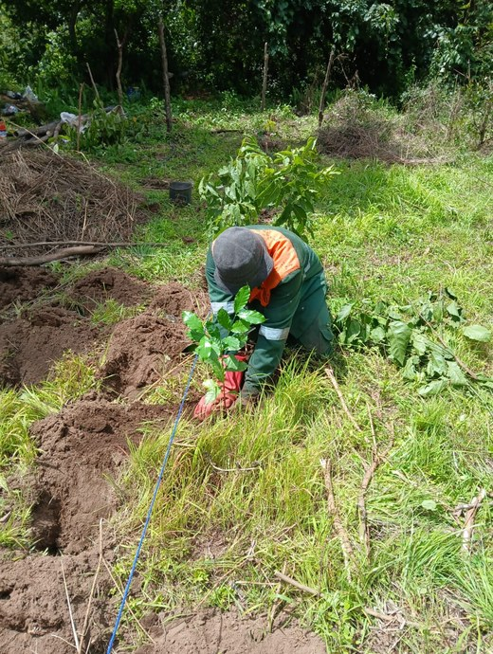
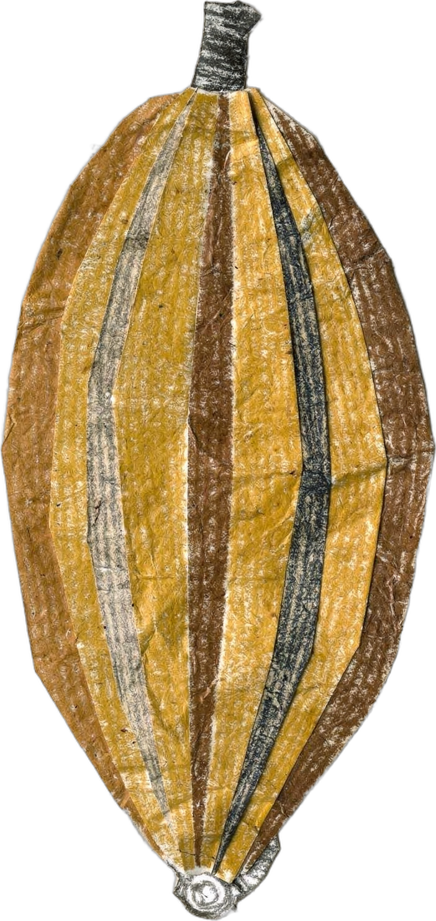
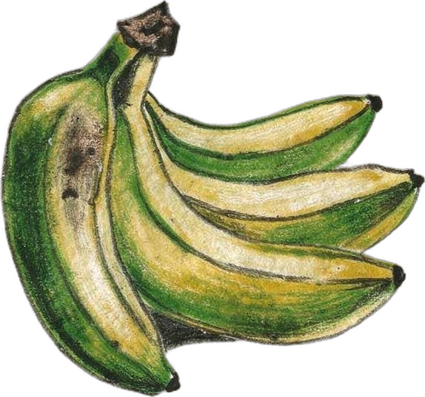
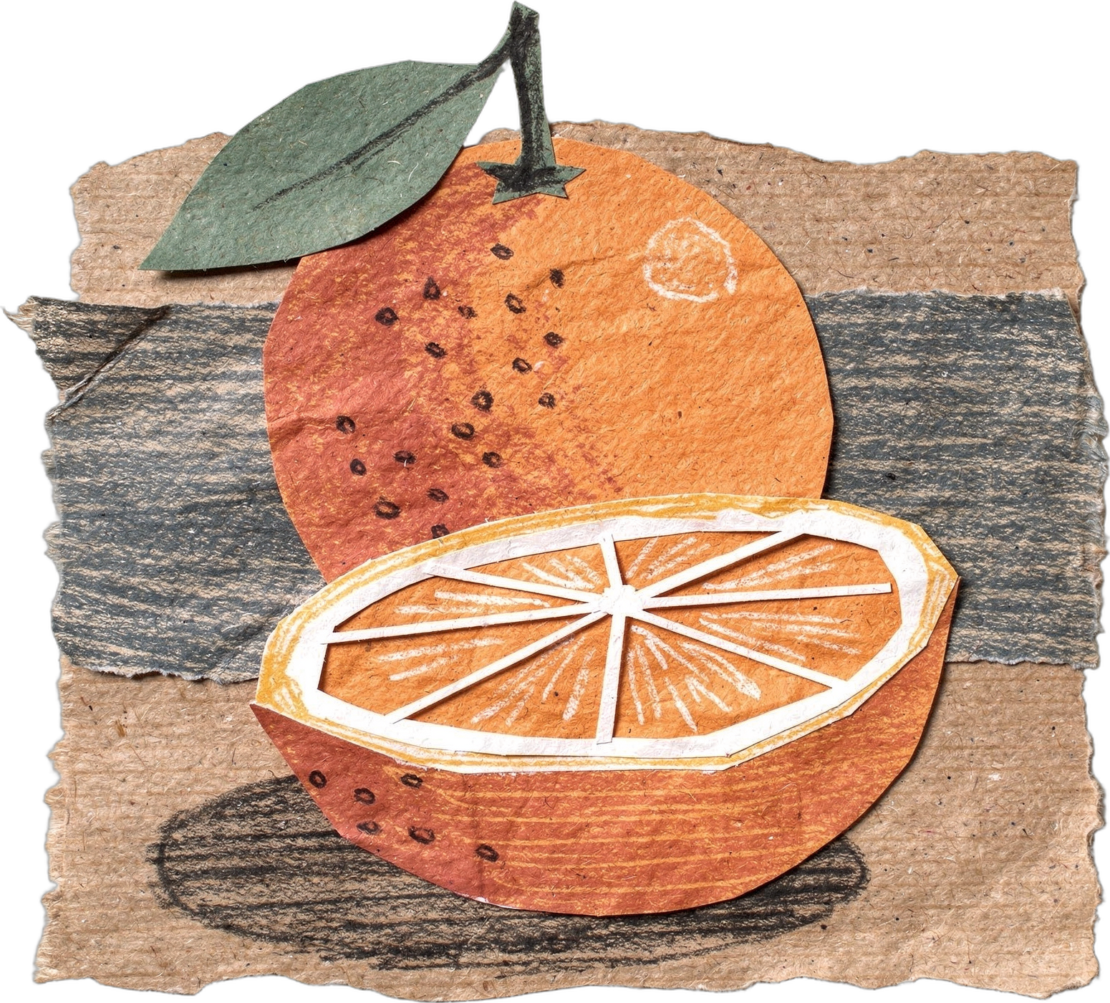
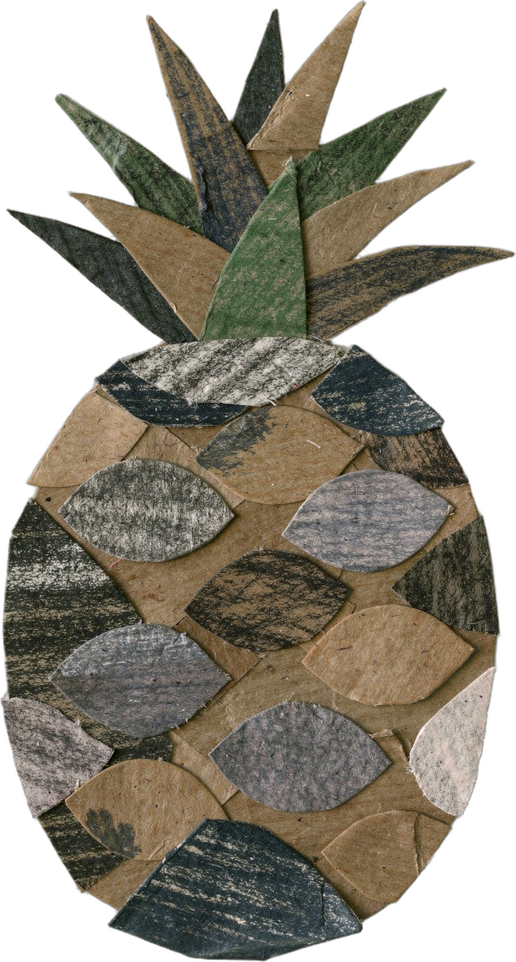
What he grows together:
coffee, cacao, bananas, citrus, and pineapple, in a syntropic agroforestry system.
Notes:
Photo slide. Photo: assets/photo/boubacar/planting-seedling-in-agroforest.jpeg (WhatsApp, 17 Aug 2026). [PHOTO NEEDED: coffee growing between cacao, banana and citrus, a still from his YouTube channel]. Cut-paper crops: coffee, cacao, banana, citrus, pineapple. Cut-paper pieces are objects only (flux-2-pro); nothing generated shows Boubacar or his farm.

Slide 5
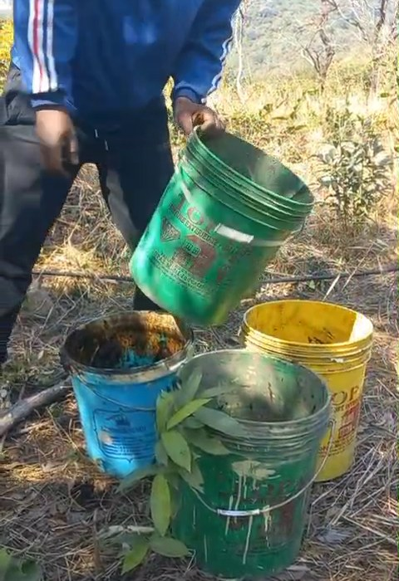
What he's seeing:
more earthworms, better soil structure, better moisture, and stronger young plants.
Notes:
Photo slide. Photo: assets/photo/boubacar/still-young-plants-buckets-29s.png, from assets/video/boubacar/watering-young-plants-in-buckets.mp4 (WhatsApp Video 2026-08-17 at 13.45.52) at 0:29. Low resolution (478 x 850 video). [PHOTO NEEDED: earthworms in his soil, a still from his YouTube channel]. Cut-paper pieces are objects only (flux-2-pro); nothing generated shows Boubacar or his farm.

Slide 6

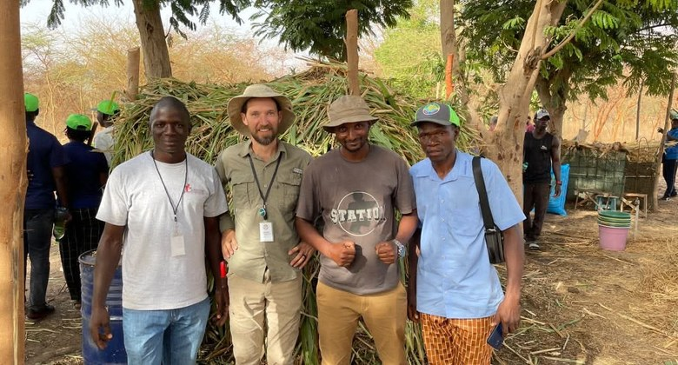
“
“I am cultivating the life that makes healthy agriculture possible.”
Follow him on YouTube: @boubacartidianediallo
Notes:
Quote slide. Photo: assets/photo/boubacar/group-of-five-farmers.jpeg (WhatsApp, 17 Aug 2026). Confirm with Boubacar where and when it was taken, and that it shows him with farmers at Gnaly [VERIFY]. Cut-paper pieces are objects only (flux-2-pro); nothing generated shows Boubacar or his farm.

