Slide 1
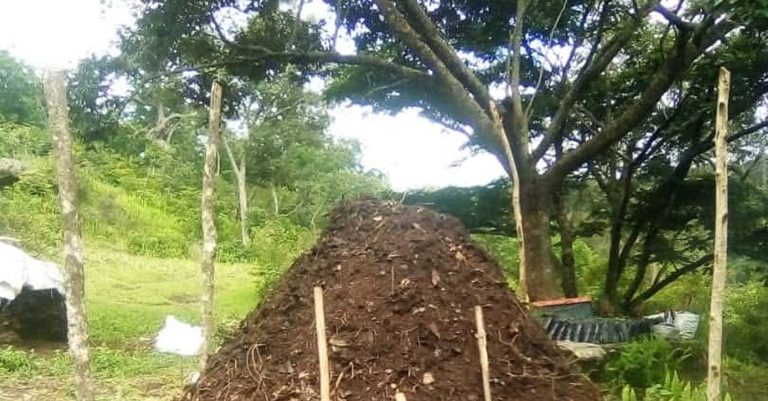

Notes:
LinkedIn image. Instagram collab: @tidia.diallo.1 (from Boubacar's reply to Allison) [VERIFY]. Sources: Impact story sheet, Boubacar Tidiane Diallo: https://docs.google.com/spreadsheets/d/10UHLwzJLBQAsmJqmg4hiCQRjBKXPAx7UnOudU-Vsg5U/edit; YouTube: https://www.youtube.com/@boubacartidianediallo; Facebook: https://www.facebook.com/btidja; Photos: sent by Boubacar to Stephanie on WhatsApp, 17 August 2026. [TAG @Stephanie] Send Boubacar the final caption and slides to approve before posting, and confirm he studied on a scholarship. Photo: assets/photo/boubacar/boubacar-compost-pile.jpeg, cropped to landscape: compost pile in the lower half, tree canopy above. The WhatsApp file is 810 x 1080, so this crop is upscaled about 1.5x; ask Boubacar for the original. No text on the photo.

