Slide 1

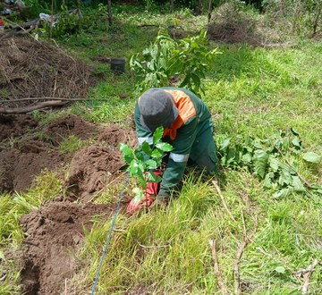
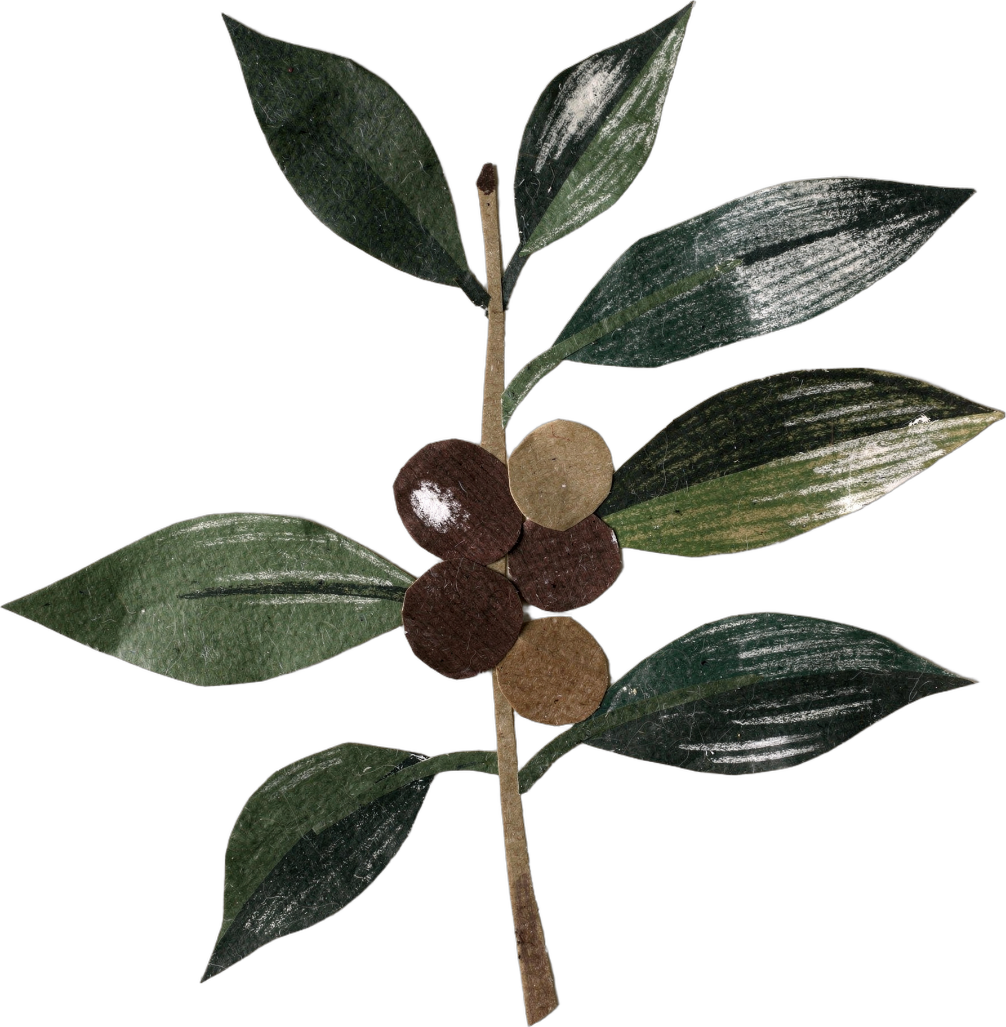
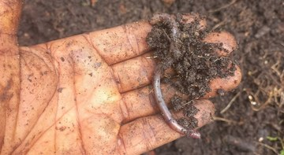

HAPPY INTERNATIONAL COFFEE DAY
“
I now believe that agriculture is biology, not chemical fertilizer.”
Boubacar Tidiane Diallo
Gnaly Coffee & AgroÉcole Bio, Fouta Djallon, Guinea-Conakry
Notes:
Option D, freestyle field journal. Trifold style: gradient panel, tracked eyebrow, Montserrat headline, EB Garamond serif. EB Garamond is in the repo (assets/font) and in Canva. No stickers. Quote from Boubacar's email to Allison, 30 Sep 2026. Photos: planting-seedling-in-agroforest.jpeg and boubacar-hand-compost-worm.jpg. Call to action: his YouTube channel (his Instagram @tidia.diallo.1 is private). Sources: Impact story sheet, Boubacar Tidiane Diallo: https://docs.google.com/spreadsheets/d/10UHLwzJLBQAsmJqmg4hiCQRjBKXPAx7UnOudU-Vsg5U/edit; Email from Boubacar to Allison, 30 September 2026; Instagram: https://www.instagram.com/tidia.diallo.1/; YouTube: https://www.youtube.com/@boubacartidianediallo; Facebook: https://www.facebook.com/btidja; Photos: sent by Boubacar to Stephanie on WhatsApp, 17 August 2026, and to Allison, September 2026. [TAG @Stephanie] Send Boubacar the final caption and slides to approve before posting, and confirm he studied on a scholarship.

