Slide 1
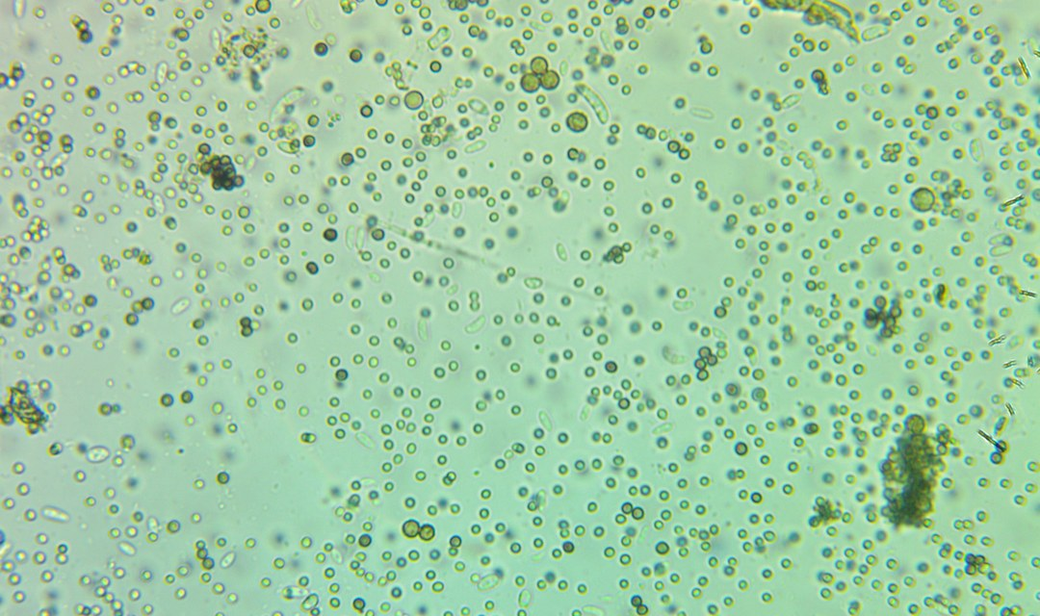
DID YOU KNOW
[COPY: Allison] One surprising fact, specific and nerdy. Name the organism or the molecule.
Swipe for the mechanism
Notes:
POST: Mon 5 Oct 2026 | Did you know #1
Cover. Photo: assets/microscopy/fungal-spores-in-suspension.jpg (brightfield soil sample: round spores and short bacterial rods). Swap to match the fact. Fact must have a named source before posting.

Slide 2
STEP 1
[DIAGRAM: mechanism, step 1]
Label parts in plain words.
[COPY: Allison] First step of the mechanism, one line. Name the organism, enzyme or compound.
[COPY: Allison] Source line: who measured it, where, which year. No source, no number.
@soilfoodwebschool
Notes:
POST: Mon 5 Oct 2026 | Did you know #1
Mechanism STEP 1. One line only. Diagram: draw it, or use assets/illustration; label parts in plain words.

Slide 3
STEP 2
[DIAGRAM: mechanism, step 2]
Label parts in plain words.
[COPY: Allison] Second step, one line. Chemical or microbial level: what moves, what is released.
[COPY: Allison] Source line: who measured it, where, which year. No source, no number.
@soilfoodwebschool
Notes:
POST: Mon 5 Oct 2026 | Did you know #1
Mechanism STEP 2. One line only. Diagram: draw it, or use assets/illustration; label parts in plain words.

Slide 4
STEP 3
[DIAGRAM: mechanism, step 3]
Label parts in plain words.
[COPY: Allison] Third step, one line. Where it ends up: in the soil, in the root, in the plant.
[COPY: Allison] Source line: who measured it, where, which year. No source, no number.
@soilfoodwebschool
Notes:
POST: Mon 5 Oct 2026 | Did you know #1
Mechanism STEP 3. One line only. Diagram: draw it, or use assets/illustration; label parts in plain words.

Slide 5
WHY THIS MATTERS FOR YOUR SOIL
[COPY: Allison] One line. What the reader can now look for or do on their own ground.
[COPY: Allison] One call to action only, or none.
@soilfoodwebschool
Notes:
POST: Mon 5 Oct 2026 | Did you know #1
Close. One line, tied to the reader's own ground.

