Slide 1
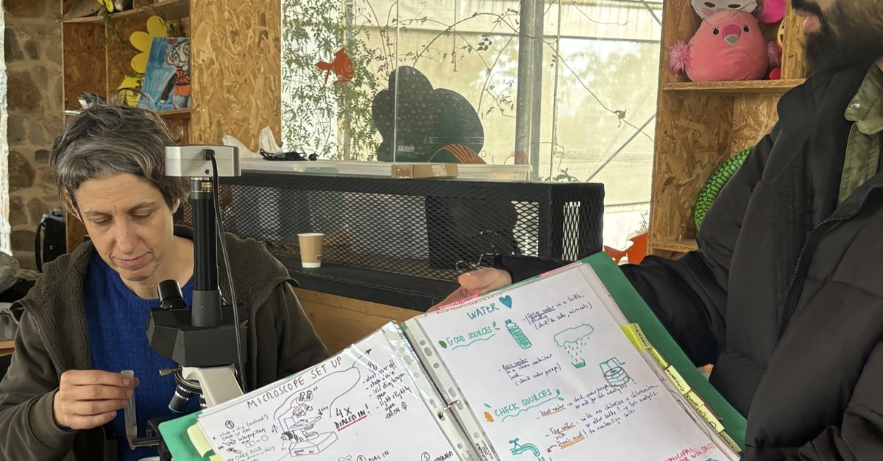

Notes:
LinkedIn image, no text on the image. Sources: Dr. Elaine Ingham, "How to Build Great Soil, Part 1", Diego Footer, 29:19: https://www.youtube.com/watch?v=ErMHR6Mc4Bk&t=1759s; Dr. Elaine Ingham, "How to Build Great Soil, Part 1", Diego Footer, 30:04: https://www.youtube.com/watch?v=ErMHR6Mc4Bk&t=1804s. [TAG @Stephanie] Numbers for paragraph 3: students trained, countries, mentors. Photo: assets/photo/cy-classes-4.jpg (Foundation library), a class at microscopes with a teacher holding a binder; swap if there is a closer photo of a mentor teaching at a microscope. Credit line for every quote: Dr. Elaine Ingham, "How to Build Great Soil, Part 1", Diego Footer. Short quotes with credit are fine; video clips and long excerpts need Evan to check with Diego first. Caption needs review by Allison (AI-generated by Linnea).

