Slide 1

DR. ELAINE INGHAM · HOW TO BUILD GREAT SOIL
Soil crumb is built in two steps. Bacteria glue. Fungi tie.
Dr. Elaine Ingham, How to Build Great Soil, Part 1, 4:43, 9:19 and 10:42
Notes:
Template 3. Type only. Sources: Dr. Elaine Ingham, "How to Build Great Soil, Part 1", Diego Footer, 4:43: https://www.youtube.com/watch?v=ErMHR6Mc4Bk&t=283s; Dr. Elaine Ingham, "How to Build Great Soil, Part 1", Diego Footer, 9:19: https://www.youtube.com/watch?v=ErMHR6Mc4Bk&t=559s; Dr. Elaine Ingham, "How to Build Great Soil, Part 1", Diego Footer, 10:42: https://www.youtube.com/watch?v=ErMHR6Mc4Bk&t=642s. [VERIFY with Wes] The glomalin line on slide 4; some viewers questioned it. Credit line for every quote: Dr. Elaine Ingham, "How to Build Great Soil, Part 1", Diego Footer. Short quotes with credit are fine; video clips and long excerpts need Evan to check with Diego first. Caption needs review by Allison (AI-generated by Linnea).

Slide 2
DR. ELAINE INGHAM · HOW TO BUILD GREAT SOIL
1
Step 1: bacteria make sticky glues to hold on to their food, like grabbing the dinner table when water rushes through.
COLLAGE: bacteria-sand-grain-1.png
Dr. Elaine Ingham, How to Build Great Soil, Part 1, 4:43, 9:19 and 10:42
soilfoodweb.com
Notes:
Template 3. Collage: bacteria-sand-grain. Credit line for every quote: Dr. Elaine Ingham, "How to Build Great Soil, Part 1", Diego Footer. Short quotes with credit are fine; video clips and long excerpts need Evan to check with Diego first. Caption needs review by Allison (AI-generated by Linnea).

Slide 3
DR. ELAINE INGHAM · HOW TO BUILD GREAT SOIL
Those glues bind sand, silt, clay and organic matter into micro aggregates.
COLLAGE: soil-crumb-1.png
Dr. Elaine Ingham, How to Build Great Soil, Part 1, 4:43, 9:19 and 10:42
soilfoodweb.com
Notes:
Template 3. Collage: soil-crumb. Credit line for every quote: Dr. Elaine Ingham, "How to Build Great Soil, Part 1", Diego Footer. Short quotes with credit are fine; video clips and long excerpts need Evan to check with Diego first. Caption needs review by Allison (AI-generated by Linnea).

Slide 4
DR. ELAINE INGHAM · HOW TO BUILD GREAT SOIL
In aerobic soil, bacterial glue is alkaline. Dr. Elaine taught that most of the glue in soil is bacterial, and fungal glomalin is a small share.
Dr. Elaine Ingham, How to Build Great Soil, Part 1, 4:43, 9:19 and 10:42
soilfoodweb.com
Notes:
Template 3. Type only. [VERIFY with Wes] glomalin line. Credit line for every quote: Dr. Elaine Ingham, "How to Build Great Soil, Part 1", Diego Footer. Short quotes with credit are fine; video clips and long excerpts need Evan to check with Diego first. Caption needs review by Allison (AI-generated by Linnea).

Slide 5
DR. ELAINE INGHAM · HOW TO BUILD GREAT SOIL
2
Step 2: fungi grow as threads and tie micro aggregates together, like string around a bundle of small packages.
COLLAGE: fungi-tie-crumbs-1.png
Dr. Elaine Ingham, How to Build Great Soil, Part 1, 4:43, 9:19 and 10:42
soilfoodweb.com
Notes:
Template 3. Collage: fungi-tie-crumbs. Credit line for every quote: Dr. Elaine Ingham, "How to Build Great Soil, Part 1", Diego Footer. Short quotes with credit are fine; video clips and long excerpts need Evan to check with Diego first. Caption needs review by Allison (AI-generated by Linnea).

Slide 6
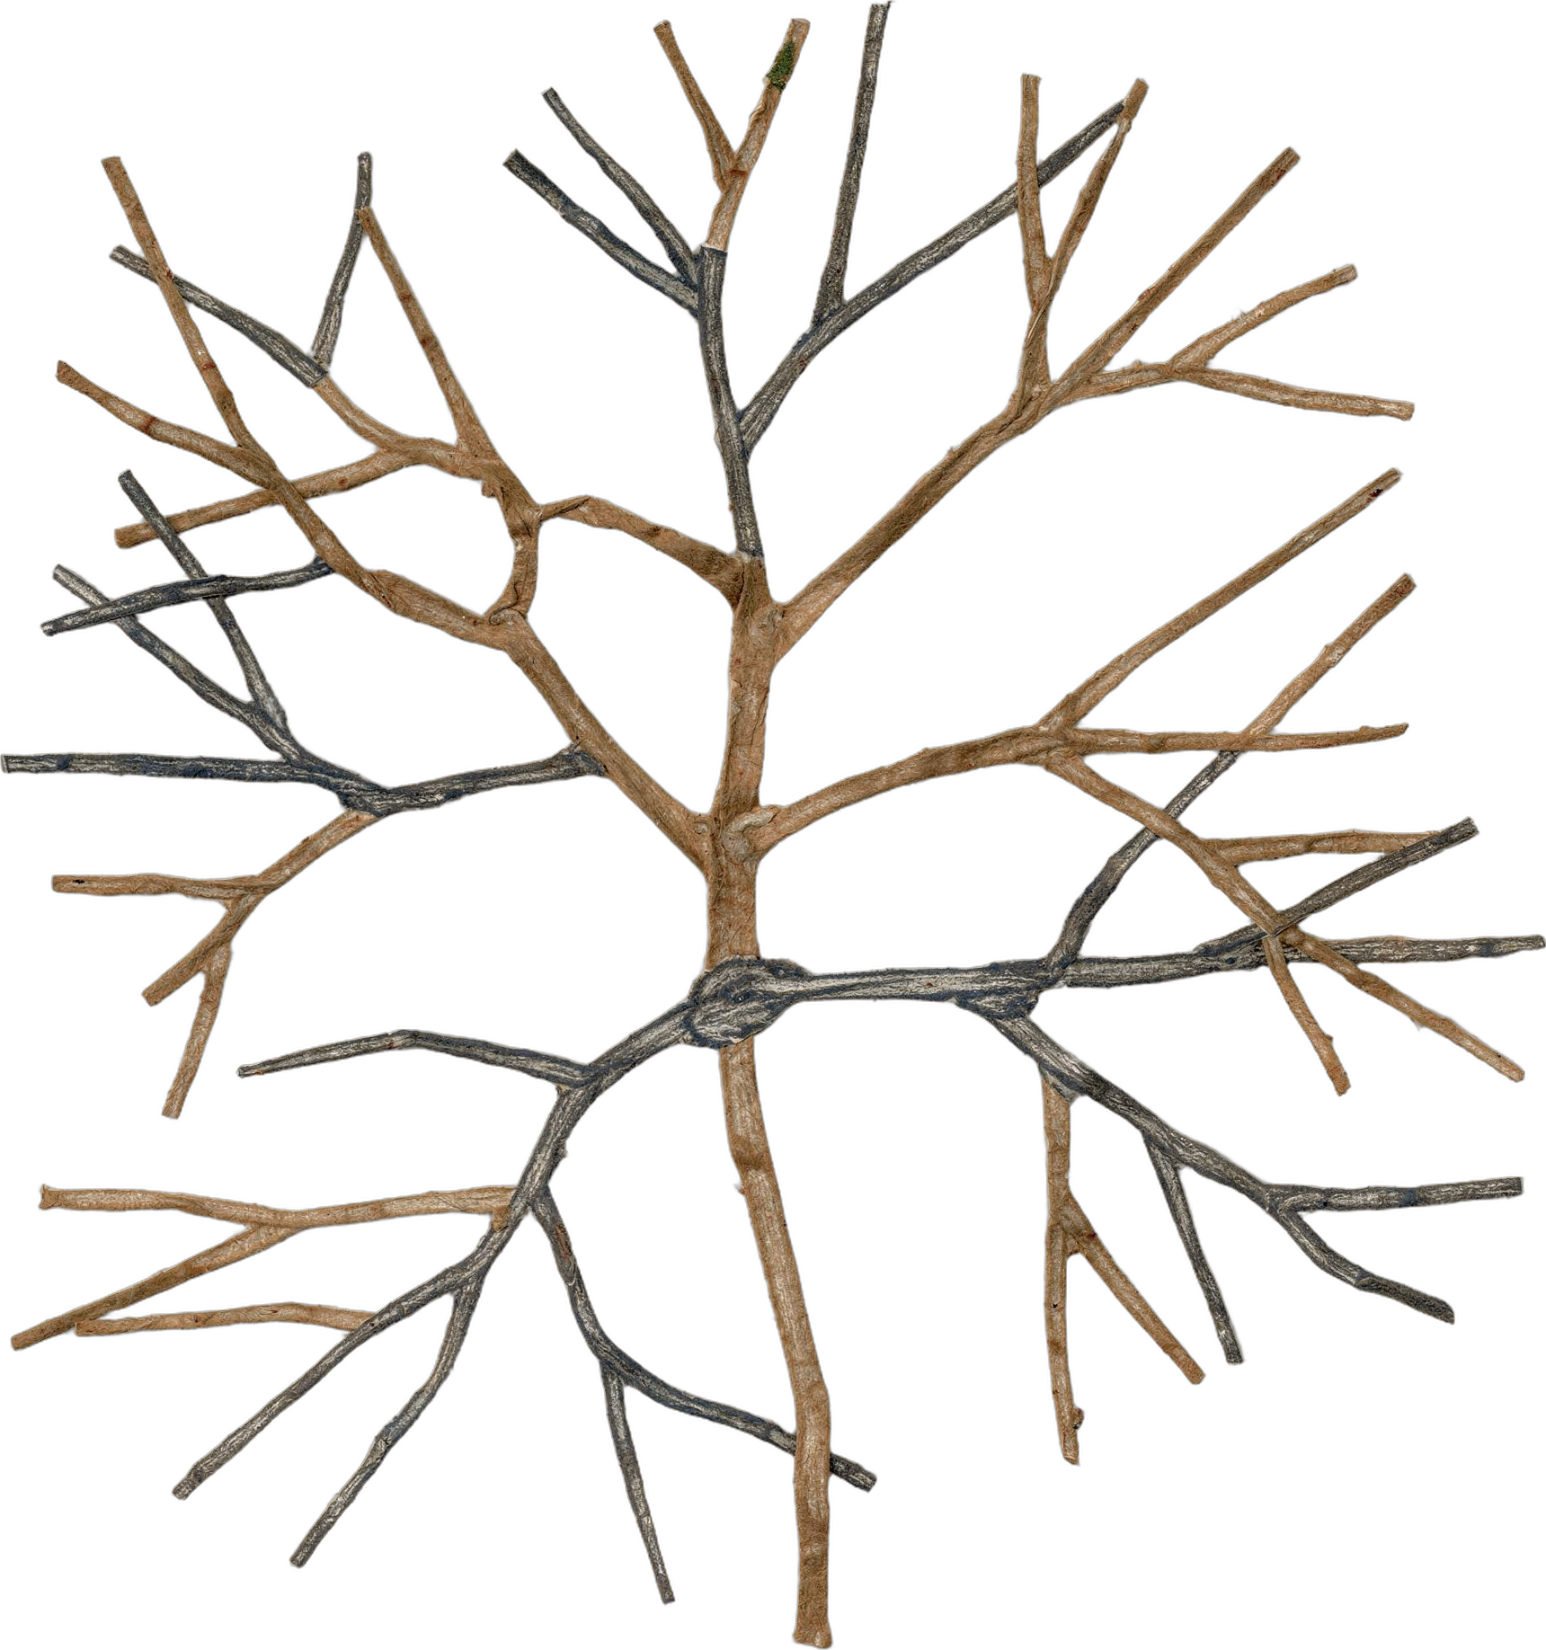
DR. ELAINE INGHAM · HOW TO BUILD GREAT SOIL
That makes macro aggregates with big pores: air passages, plus space where water moves and stays.
Dr. Elaine Ingham, How to Build Great Soil, Part 1, 4:43, 9:19 and 10:42
soilfoodweb.com
Notes:
Template 3. No fungal-hyphae microscopy in assets/microscopy/; the library's fungal-hyphae collage cutout stands in. Replace with a micrograph when one is supplied (Wes). Credit line for every quote: Dr. Elaine Ingham, "How to Build Great Soil, Part 1", Diego Footer. Short quotes with credit are fine; video clips and long excerpts need Evan to check with Diego first. Caption needs review by Allison (AI-generated by Linnea).

Slide 7
DR. ELAINE INGHAM · HOW TO BUILD GREAT SOIL
Aerobic fungi release organic acids at pH 5.5 to 7. Bacterial soil leans alkaline. Fungal soil leans slightly acidic.
Dr. Elaine Ingham, How to Build Great Soil, Part 1, 4:43, 9:19 and 10:42
Notes:
Template 3. Type only. Credit line for every quote: Dr. Elaine Ingham, "How to Build Great Soil, Part 1", Diego Footer. Short quotes with credit are fine; video clips and long excerpts need Evan to check with Diego first. Caption needs review by Allison (AI-generated by Linnea).

