Slide 1

DR. ELAINE INGHAM · HOW TO BUILD GREAT SOIL
20 min
2 yrs
20 minutes vs 2 years.
Dr. Elaine Ingham, How to Build Great Soil, Part 1, 7:06, 7:51 and 8:16
Notes:
Template 5 big number, two numbers side by side. Sources: Dr. Elaine Ingham, "How to Build Great Soil, Part 1", Diego Footer, 7:06: https://www.youtube.com/watch?v=ErMHR6Mc4Bk&t=426s; Dr. Elaine Ingham, "How to Build Great Soil, Part 1", Diego Footer, 7:51: https://www.youtube.com/watch?v=ErMHR6Mc4Bk&t=471s; Dr. Elaine Ingham, "How to Build Great Soil, Part 1", Diego Footer, 8:16: https://www.youtube.com/watch?v=ErMHR6Mc4Bk&t=496s. [VERIFY with Wes] The nematode life cycle on slide 3. Credit line for every quote: Dr. Elaine Ingham, "How to Build Great Soil, Part 1", Diego Footer. Short quotes with credit are fine; video clips and long excerpts need Evan to check with Diego first. Caption needs review by Allison (AI-generated by Linnea).

Slide 2

DR. ELAINE INGHAM · HOW TO BUILD GREAT SOIL
Some disease-causing bacteria can double every 20 minutes.
Dr. Elaine Ingham, How to Build Great Soil, Part 1, 7:06, 7:51 and 8:16
soilfoodweb.com
Notes:
Template 3. Library cutout: cute-bacterium-1. Credit line for every quote: Dr. Elaine Ingham, "How to Build Great Soil, Part 1", Diego Footer. Short quotes with credit are fine; video clips and long excerpts need Evan to check with Diego first. Caption needs review by Allison (AI-generated by Linnea).

Slide 3
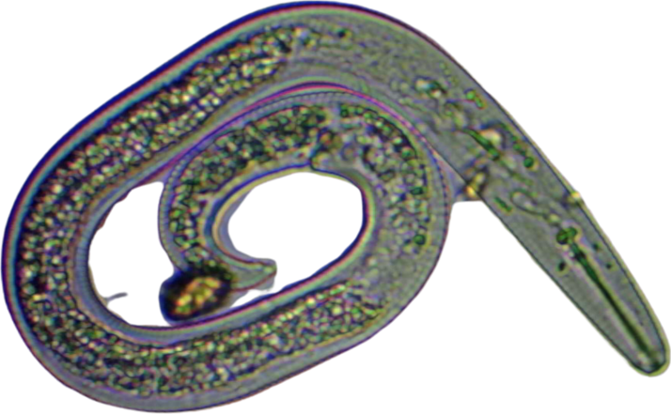
DR. ELAINE INGHAM · HOW TO BUILD GREAT SOIL
Some beneficial nematodes reproduce once every two years, and lay one or two eggs.
Dr. Elaine Ingham, How to Build Great Soil, Part 1, 7:06, 7:51 and 8:16
soilfoodweb.com
Notes:
Template 3. Microscopy: assets/microscopy/cutout-6.png (nematode). [VERIFY with Wes] nematode life cycle. Credit line for every quote: Dr. Elaine Ingham, "How to Build Great Soil, Part 1", Diego Footer. Short quotes with credit are fine; video clips and long excerpts need Evan to check with Diego first. Caption needs review by Allison (AI-generated by Linnea).

Slide 4
DR. ELAINE INGHAM · HOW TO BUILD GREAT SOIL
Kill everything in a soil and the fast ones move in first. Dr. Elaine compared it to gangsters moving into a trashed city block.
COLLAGE: city-block-weed-1.png
Dr. Elaine Ingham, How to Build Great Soil, Part 1, 7:06, 7:51 and 8:16
soilfoodweb.com
Notes:
Template 3. Collage: city-block-weed. Credit line for every quote: Dr. Elaine Ingham, "How to Build Great Soil, Part 1", Diego Footer. Short quotes with credit are fine; video clips and long excerpts need Evan to check with Diego first. Caption needs review by Allison (AI-generated by Linnea).

Slide 5
“
There is no way to kill just the bad guys.
Dr. Elaine Ingham
How to Build Great Soil, Part 1 · Diego Footer
How to Build Great Soil, Part 1, 7:06
soilfoodweb.com
Notes:
Template 1B quote, Legacy Purple (Dr. Elaine content). Quote at 7:06. Credit line for every quote: Dr. Elaine Ingham, "How to Build Great Soil, Part 1", Diego Footer. Short quotes with credit are fine; video clips and long excerpts need Evan to check with Diego first. Caption needs review by Allison (AI-generated by Linnea).

Slide 6

DR. ELAINE INGHAM · HOW TO BUILD GREAT SOIL
The faster way back: inoculate with biologically complete compost, so the beneficials arrive in numbers.
Dr. Elaine Ingham, How to Build Great Soil, Part 1, 7:06, 7:51 and 8:16
Notes:
Template 3. Type only. Credit line for every quote: Dr. Elaine Ingham, "How to Build Great Soil, Part 1", Diego Footer. Short quotes with credit are fine; video clips and long excerpts need Evan to check with Diego first. Caption needs review by Allison (AI-generated by Linnea).

