Slide 1
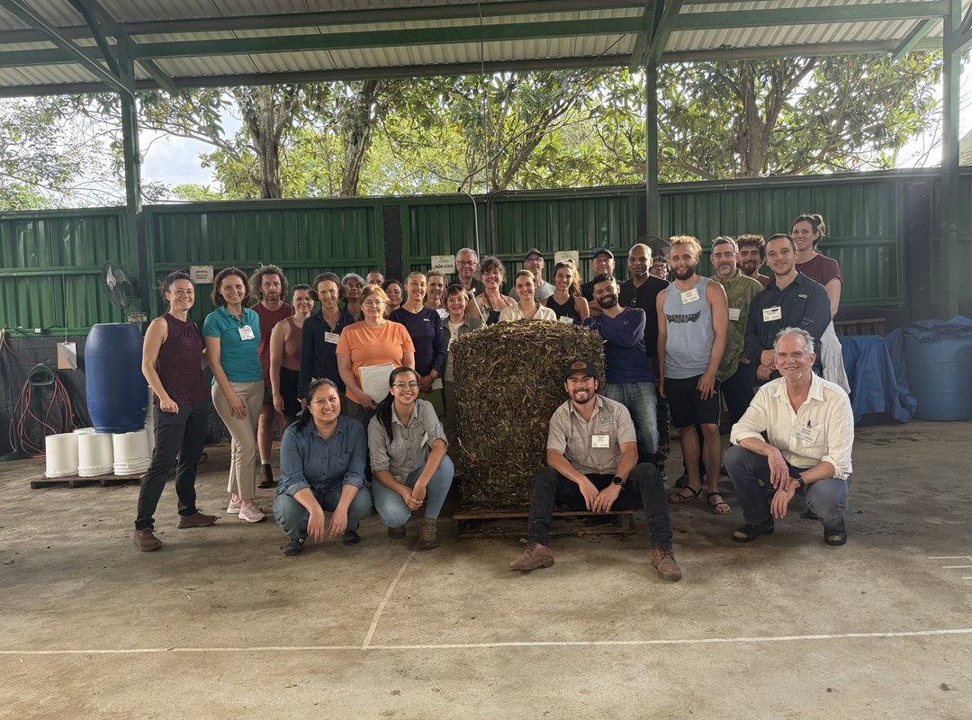
WORLD TEACHERS' DAY
Five mentors.
Five tips for anyone starting out.
@soilfoodwebschool
Notes:
POST: 05-10-2026 Mon | World Teachers' Day: five mentors, five tips
Slide 1 of 7. Group photo of mentors at a workshop (Costa Rica or Wild Ken Hill). Placeholder photo: assets/photo/workshop-group-around-compost-pile.jpg. Swap for a real mentor group photo.

Slide 2
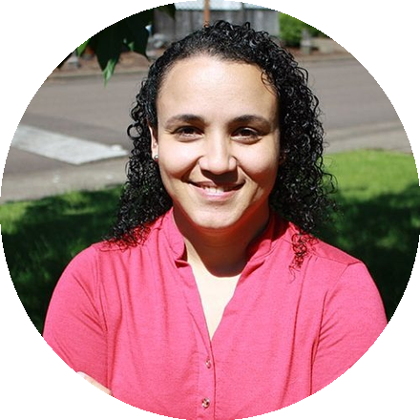
Dr. Carla Portugal
Science Leader
[COPY: Allison] “[PLACEHOLDER tip]”
@soilfoodwebschool
Notes:
POST: 05-10-2026 Mon | World Teachers' Day: five mentors, five tips
Slide 2 of 7. Dr. Carla Portugal, Science Leader. Portrait: round headshot from the website, with consent. Tip: from Allison's question 'What is the one thing you wish every new student knew?' One or two sentences, in the mentor's words.

Slide 3
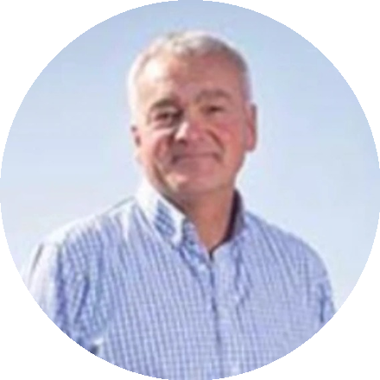
Nick Padwick
Farmer, Norfolk
[COPY: Allison] “[PLACEHOLDER tip]”
@soilfoodwebschool
Notes:
POST: 05-10-2026 Mon | World Teachers' Day: five mentors, five tips
Slide 3 of 7. Nick Padwick, Farmer, Norfolk. Portrait: round headshot from the website, with consent. Tip: from Allison's question 'What is the one thing you wish every new student knew?' One or two sentences, in the mentor's words.

Slide 4
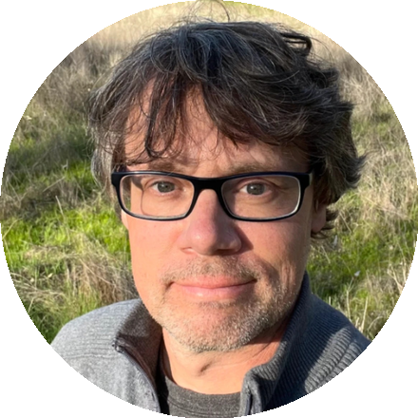
Wes Sander
Microscopy
[COPY: Allison] “[PLACEHOLDER tip]”
@soilfoodwebschool
Notes:
POST: 05-10-2026 Mon | World Teachers' Day: five mentors, five tips
Slide 4 of 7. Wes Sander, Microscopy. Portrait: round headshot from the website, with consent. Tip: from Allison's question 'What is the one thing you wish every new student knew?' One or two sentences, in the mentor's words.

Slide 5
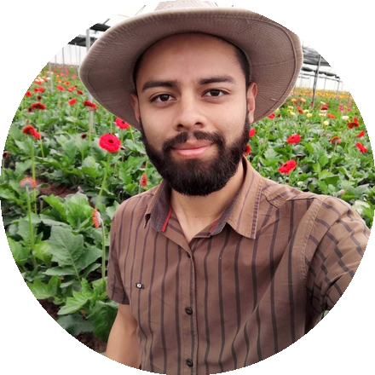
Gerald Ramirez
Compost extracts and teas
[COPY: Allison] “[PLACEHOLDER tip]”
@soilfoodwebschool
Notes:
POST: 05-10-2026 Mon | World Teachers' Day: five mentors, five tips
Slide 5 of 7. Gerald Ramirez, Compost extracts and teas. Portrait: round headshot from the website, with consent. Tip: from Allison's question 'What is the one thing you wish every new student knew?' One or two sentences, in the mentor's words.

Slide 6
[PHOTO: Dr. Caterina Capri]
Dr. Caterina Capri
Advanced Programs
[COPY: Allison] “[PLACEHOLDER tip]”
@soilfoodwebschool
Notes:
POST: 05-10-2026 Mon | World Teachers' Day: five mentors, five tips
Slide 6 of 7. Dr. Caterina Capri, Advanced Programs. Portrait: round headshot from the website, with consent. Tip: from Allison's question 'What is the one thing you wish every new student knew?' One or two sentences, in the mentor's words.

Slide 7
[PHOTO: a mentor and student at a microscope]
[COPY: Allison] Thank you to every mentor. 💚
@soilfoodwebschool
Notes:
POST: 05-10-2026 Mon | World Teachers' Day: five mentors, five tips
Slide 7 of 7. Photo of a mentor and student at a microscope. Real photo, with consent.

