Slide 1


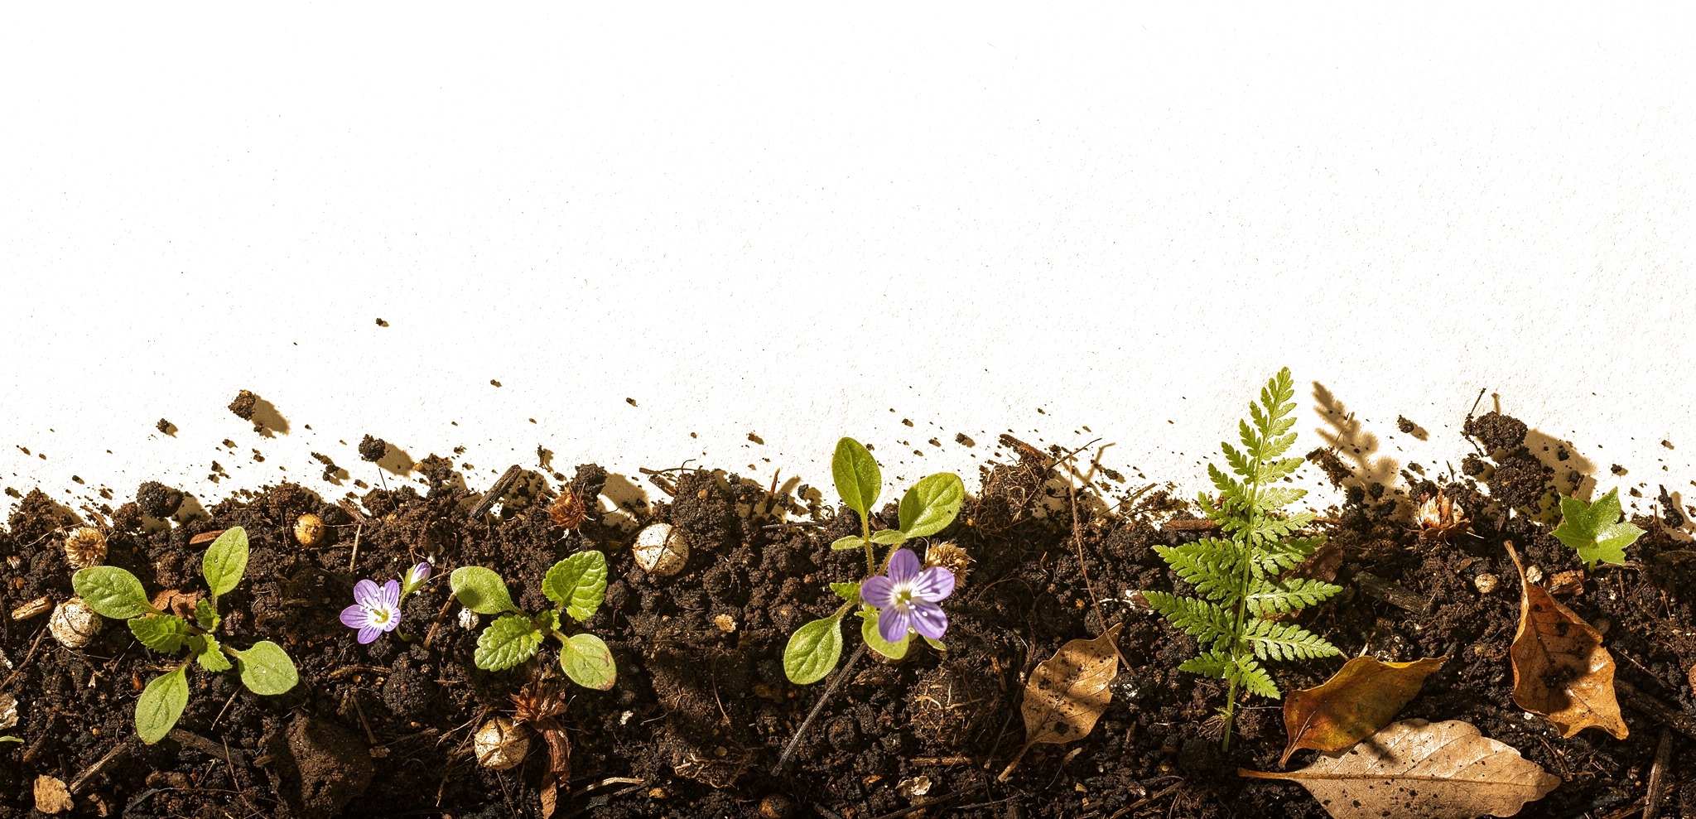
OCTOBER 5
Happy World Teachers' Day
Thank you to our instructors and education staff.
Swipe →
Notes:
Cover. Mentor photos: Linnea's Drive folder (5 Oct 2026). Soil: cut from assets/photo/hand-of-compost.jpg. Names and titles: Stephanie McDaniel, 6 Oct 2026.

Slide 2


Ib Borup Pedersen
Farmer, Mentor & Consultant
Brian Daubenspeck
Mentor & Consultant
Notes:
People: Ib Borup Pedersen, Brian Daubenspeck. Mentor photos: Linnea's Drive folder (5 Oct 2026). Soil: cut from assets/photo/hand-of-compost.jpg. Names and titles: Stephanie McDaniel, 6 Oct 2026.

Slide 3


Elena Kalli
School Administration Officer
Nick Padwick
Farmer, Mentor & Consultant
Notes:
People: Elena Kalli, Nick Padwick. Mentor photos: Linnea's Drive folder (5 Oct 2026). Soil: cut from assets/photo/hand-of-compost.jpg. Names and titles: Stephanie McDaniel, 6 Oct 2026.

Slide 4


Dr. Carla Ribeiro Machado e Portugal
Mentor & Science Lead
Gerald Ramírez
Mentor
Notes:
People: Carla Ribeiro Machado e Portugal, Gerald Ramírez. Mentor photos: Linnea's Drive folder (5 Oct 2026). Soil: cut from assets/photo/hand-of-compost.jpg. Names and titles: Stephanie McDaniel, 6 Oct 2026.

Slide 5

Kavi Reddy
Permaculture Instructor
Wesley Sander
Mentor & Consultant
Notes:
People: Kavi Reddy, Wesley Sander. Mentor photos: Linnea's Drive folder (5 Oct 2026). Soil: cut from assets/photo/hand-of-compost.jpg. Names and titles: Stephanie McDaniel, 6 Oct 2026.

Slide 6

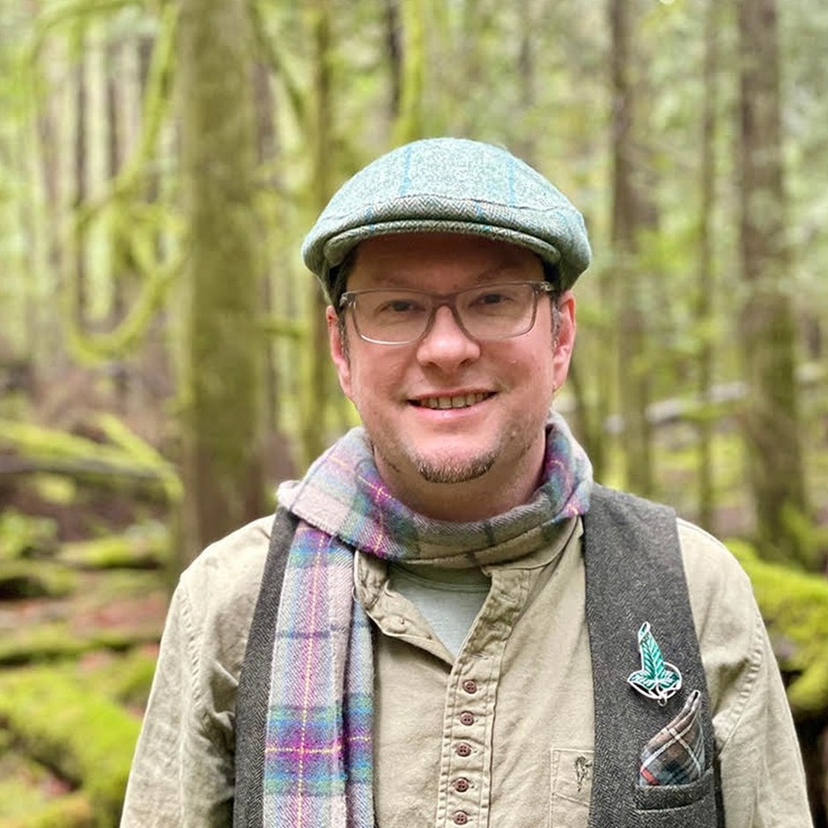
Isadora Schmidt
Mentor & Consultant
Delvin Solkinson
Graham Bell Legacy PDC Permaculture Lead Instructor
Notes:
People: Isadora Schmidt, Delvin Solkinson. Mentor photos: Linnea's Drive folder (5 Oct 2026). Soil: cut from assets/photo/hand-of-compost.jpg. Names and titles: Stephanie McDaniel, 6 Oct 2026.

Slide 7


Tommy Tepper
Education Department Director & Mentor
Dora Tkalec
Mentor & Consultant
Notes:
People: Tommy Tepper, Dora Tkalec. Mentor photos: Linnea's Drive folder (5 Oct 2026). Soil: cut from assets/photo/hand-of-compost.jpg. Names and titles: Stephanie McDaniel, 6 Oct 2026.

Slide 8


Ayşen Üstünay
Mentor & Consultant
Loida Vasquez
Advanced Programs Lead & Mentor
Notes:
People: Ayşen Üstünay, Loida Vasquez. Mentor photos: Linnea's Drive folder (5 Oct 2026). Soil: cut from assets/photo/hand-of-compost.jpg. Names and titles: Stephanie McDaniel, 6 Oct 2026.

Slide 9

Casey Williams
Mentor & Consultant
Thank you to all our instructors and education staff.
Notes:
People: Casey Williams. Mentor photos: Linnea's Drive folder (5 Oct 2026). Soil: cut from assets/photo/hand-of-compost.jpg. Names and titles: Stephanie McDaniel, 6 Oct 2026.

Slide 10














Happy World Teachers' Day
Ib Borup Pedersen
Brian Daubenspeck
Elena Kalli
Nick Padwick
Carla Portugal
Gerald Ramírez
Kavi Reddy
Wesley Sander
Isadora Schmidt
Delvin Solkinson
Tommy Tepper
Dora Tkalec
Ayşen Üstünay
Loida Vasquez
Casey Williams
Notes:
Everyone in one grid. Mentor photos: Linnea's Drive folder (5 Oct 2026). Soil: cut from assets/photo/hand-of-compost.jpg. Names and titles: Stephanie McDaniel, 6 Oct 2026.

