Slide 1
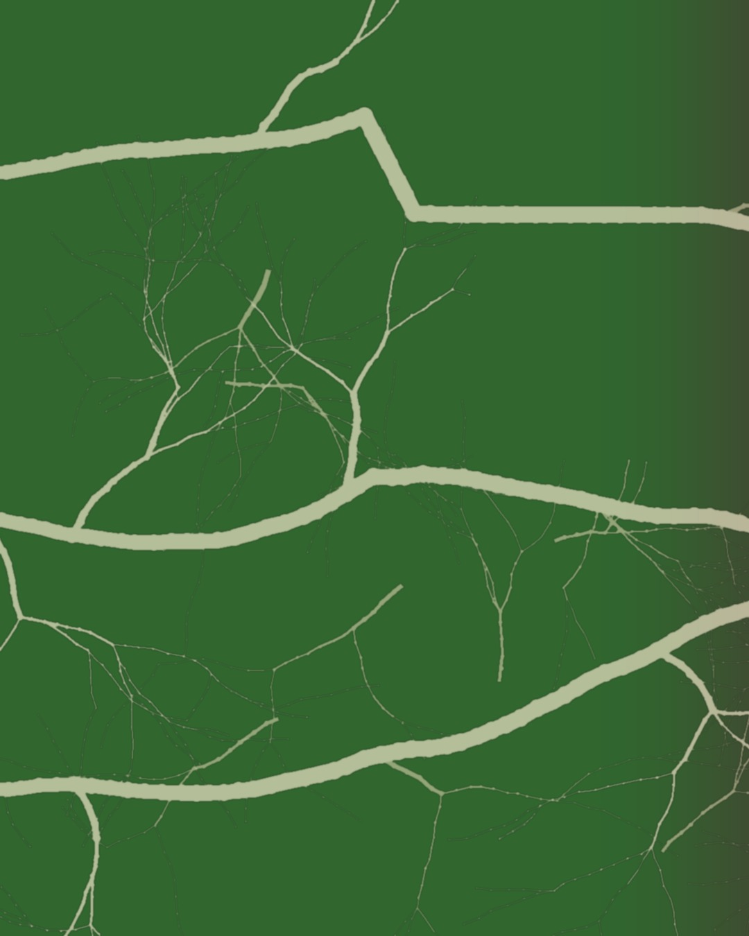
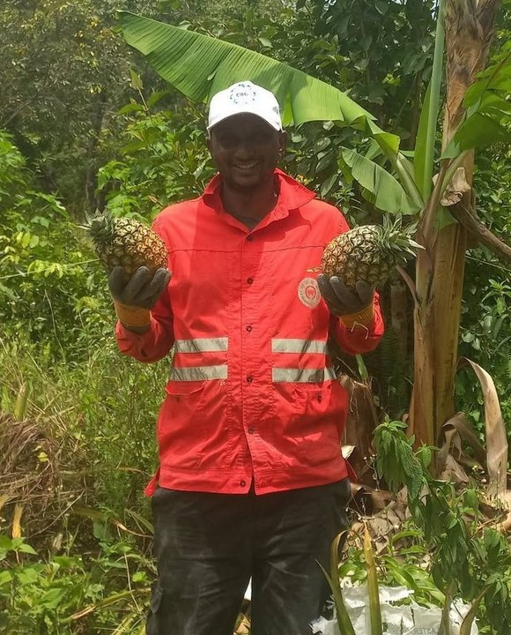

Happy
International
Coffee Day
Boubacar Tidiane Diallo
Guinea-Conakry
Graduated from the Soil Food Web School in July 2026
Notes:
Cover. Grid and continuous hyphae panorama after Stephanie's feedback. Background: assets/collage/boubacar-panorama/ (tools/make_hyphae_panorama.py, drawn by code). His quotes from his email to Allison, 30 Sep 2026. Call to action: his YouTube channel (his Instagram @tidia.diallo.1 is private). Sources: Impact story sheet, Boubacar Tidiane Diallo: https://docs.google.com/spreadsheets/d/10UHLwzJLBQAsmJqmg4hiCQRjBKXPAx7UnOudU-Vsg5U/edit; Email from Boubacar to Allison, 30 September 2026; Instagram: https://www.instagram.com/tidia.diallo.1/; YouTube: https://www.youtube.com/@boubacartidianediallo; Facebook: https://www.facebook.com/btidja; Photos: sent by Boubacar to Stephanie on WhatsApp, 17 August 2026, and to Allison, September 2026. [TAG @Stephanie] Send Boubacar the final caption and slides to approve before posting, and confirm he studied on a scholarship. Photo: boubacar-portrait-bananas-closer.jpg. Graduation line from Linnea (1 Oct 2026): confirm the exact course or program and the date [VERIFY].

Slide 2
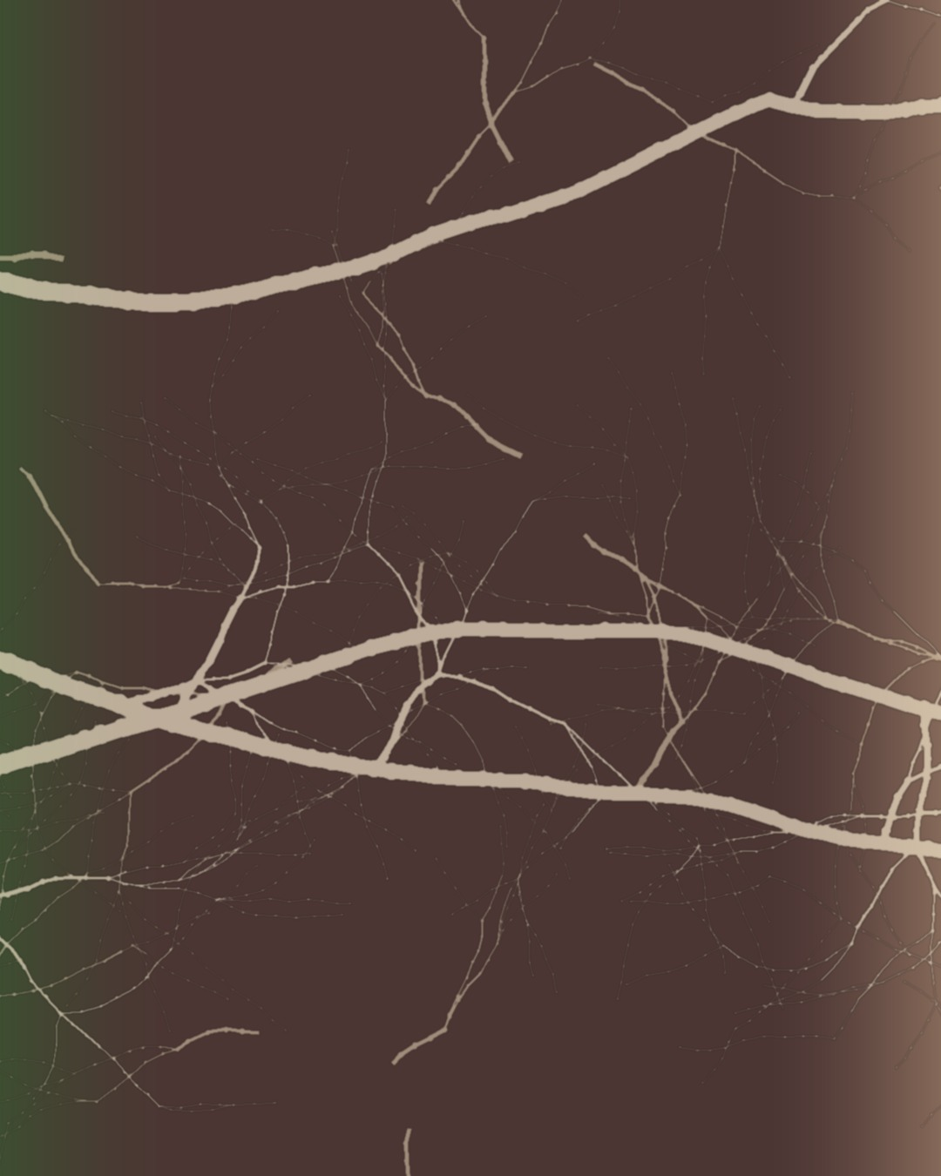
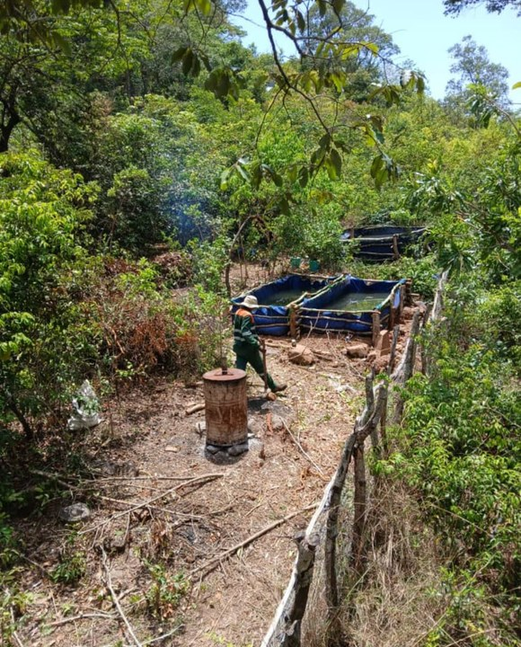
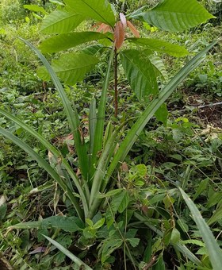
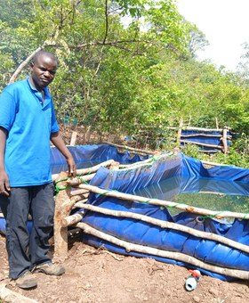
When he started, the land was worn out.
The soil at Gnaly Coffee & AgroÉcole Bio, in the Fouta Djallon highlands of Guinea-Conakry, had been degraded and poorly managed for years.
soilfoodweb.com
Notes:
Gnaly. Grid and continuous hyphae panorama after Stephanie's feedback. Background: assets/collage/boubacar-panorama/ (tools/make_hyphae_panorama.py, drawn by code). His quotes from his email to Allison, 30 Sep 2026. Photos: farm-overview-with-tanks.jpeg, young-tree-with-pineapples.jpg, man-by-water-tanks.jpeg. NEW COPY for approval (narrative hook): based on his email and the approved caption draft. From the caption: 'When he started, the soil had been degraded and poorly managed for years.'

Slide 3
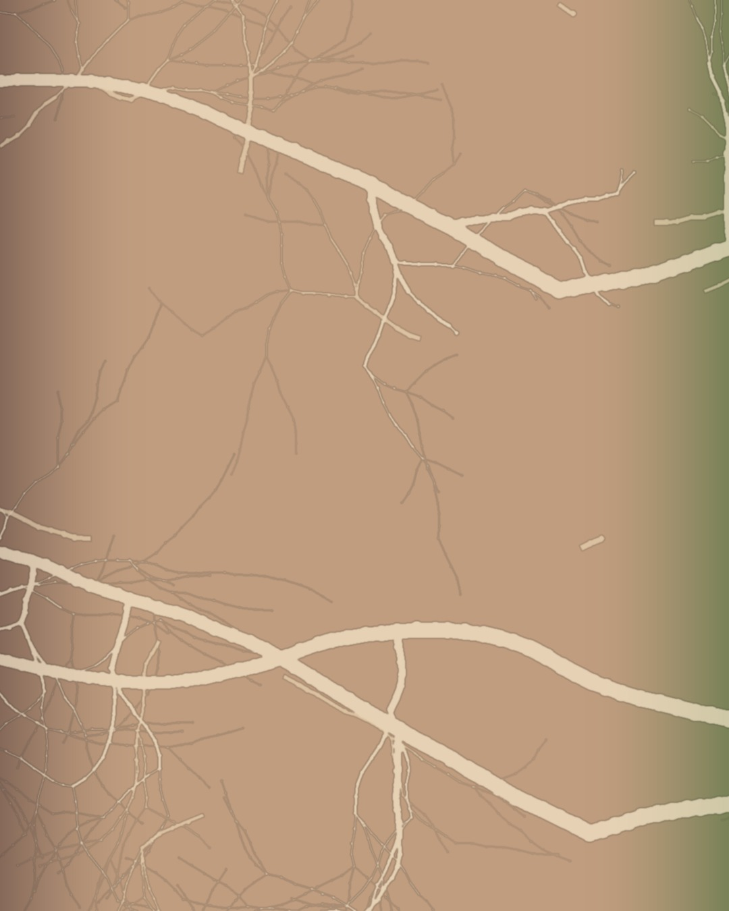
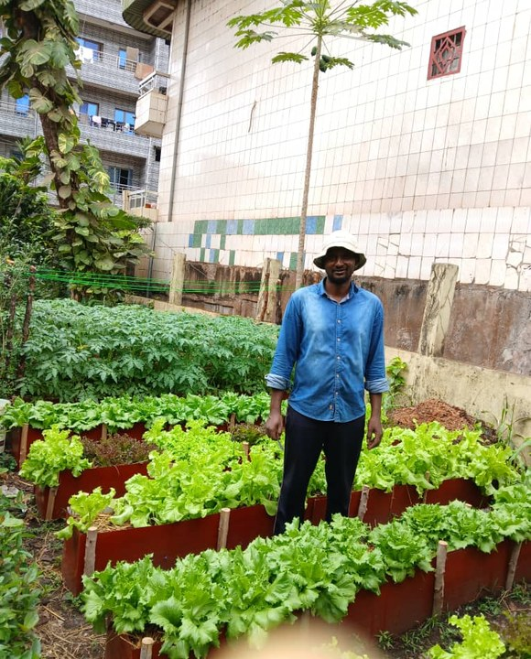

“
So he changed the question:
“Today, I ask a different question: What does the soil food web need to thrive?”
soilfoodweb.com
Notes:
The question. Grid and continuous hyphae panorama after Stephanie's feedback. Background: assets/collage/boubacar-panorama/ (tools/make_hyphae_panorama.py, drawn by code). His quotes from his email to Allison, 30 Sep 2026. Photo: vegetable-beds-by-building.jpeg. NEW COPY for approval (narrative hook): based on his email and the approved caption draft. Lead-in 'So he changed the question' is new; the quote is his.

Slide 4
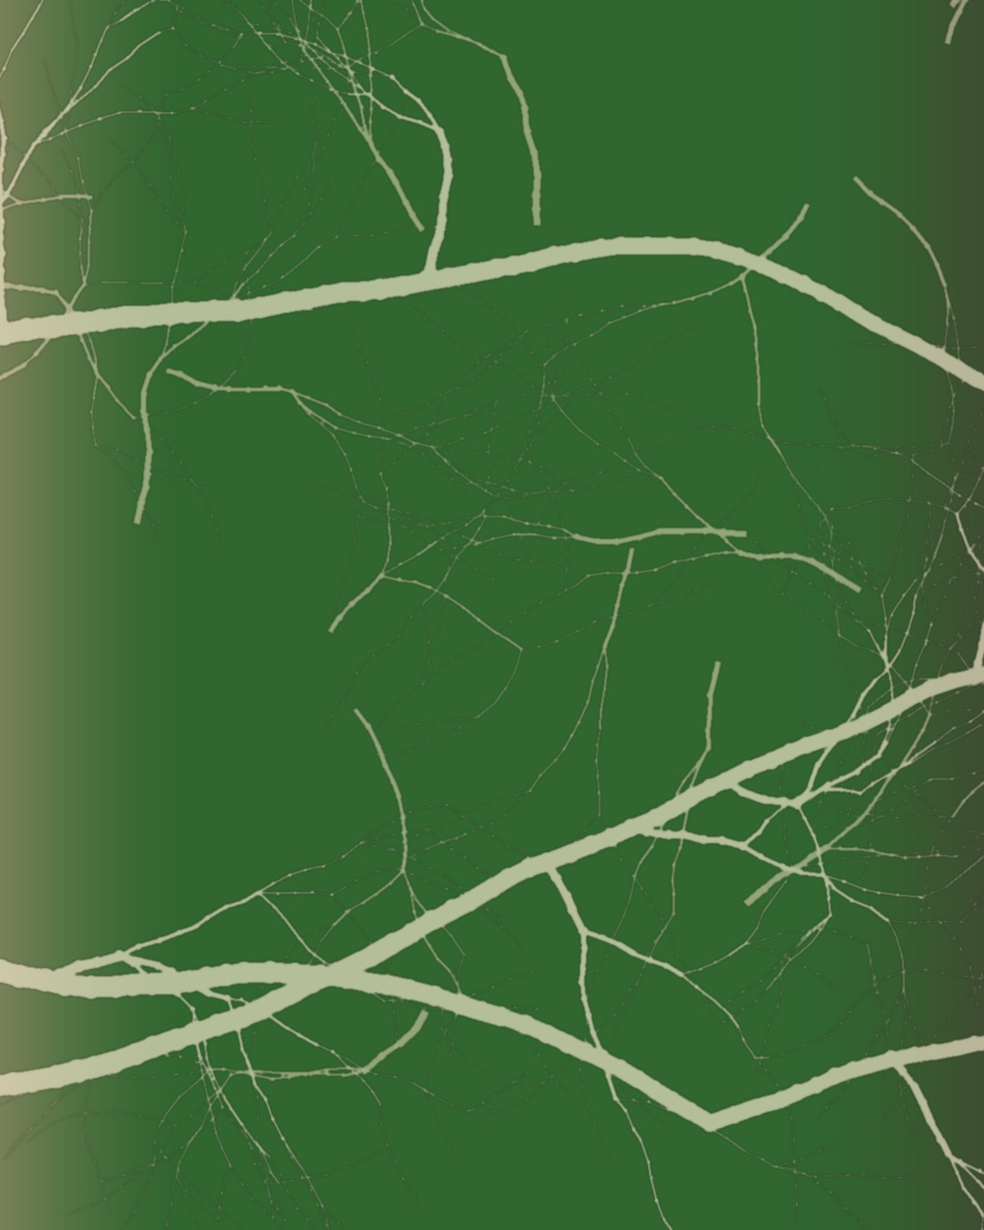
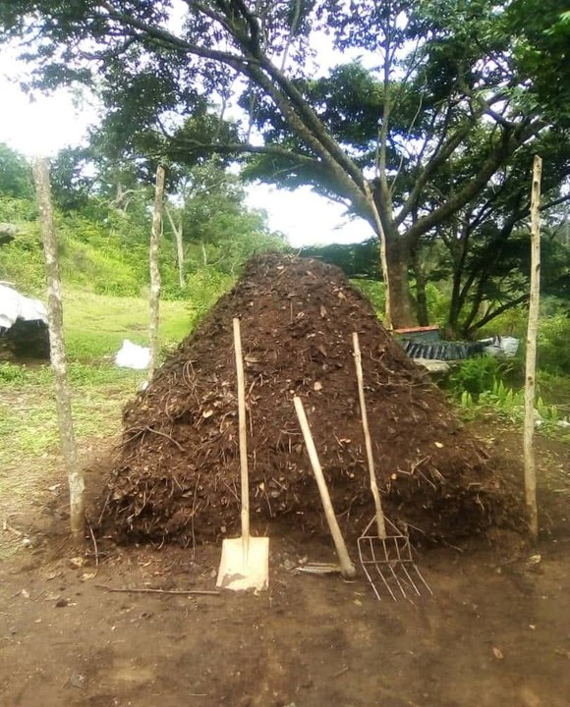
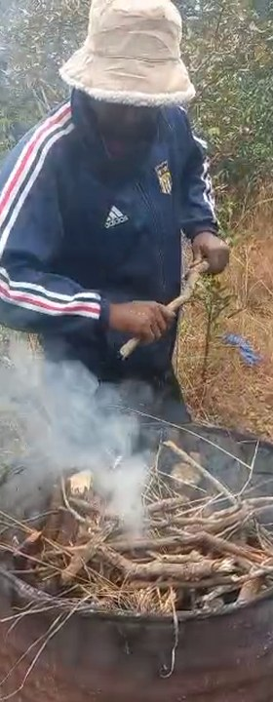
How he feeds his soil:
living groundcover, mulch from his farm and the forest, and compost with biochar activated with fish hydrolysate and compost tea.
soilfoodweb.com
Notes:
Feeding the soil. Grid and continuous hyphae panorama after Stephanie's feedback. Background: assets/collage/boubacar-panorama/ (tools/make_hyphae_panorama.py, drawn by code). His quotes from his email to Allison, 30 Sep 2026. Photos: boubacar-compost-pile.jpeg; still-biochar-kiln-smoke-73s.png (making-biochar-in-barrel-kiln.mp4 at 1:13).

Slide 5
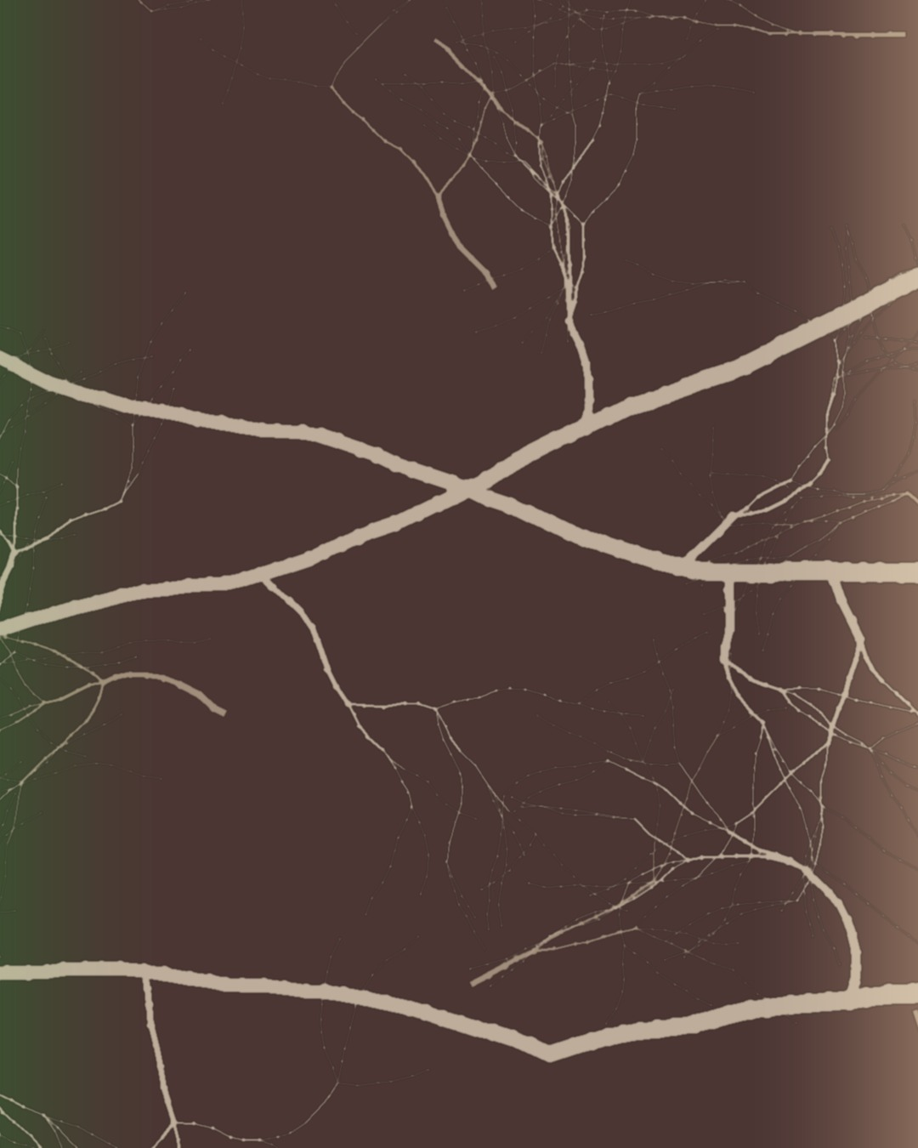
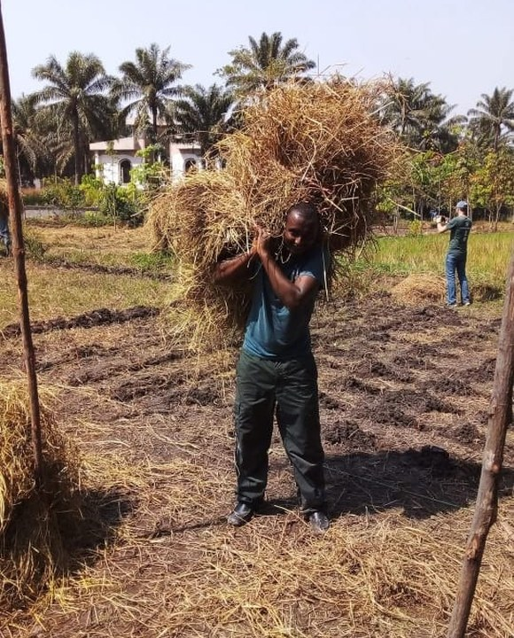
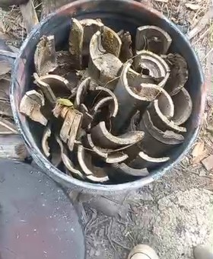
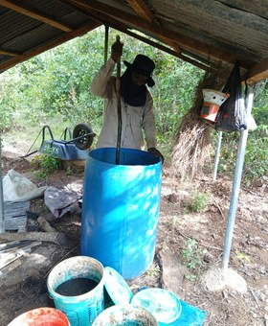
“I apply compost regularly around young trees and whenever I add new mulch.”
soilfoodweb.com
Notes:
In practice. Grid and continuous hyphae panorama after Stephanie's feedback. Background: assets/collage/boubacar-panorama/ (tools/make_hyphae_panorama.py, drawn by code). His quotes from his email to Allison, 30 Sep 2026. Photos: carrying-mulch.jpg, still-biochar-charcoal-16s.png, barrel-brew-under-shelter.jpeg.

Slide 6
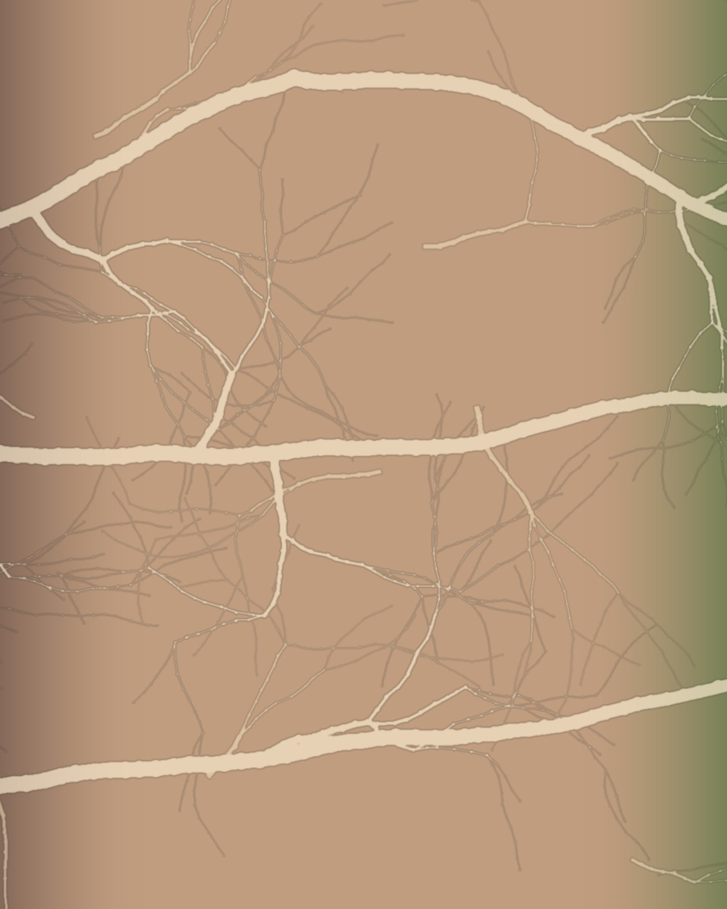
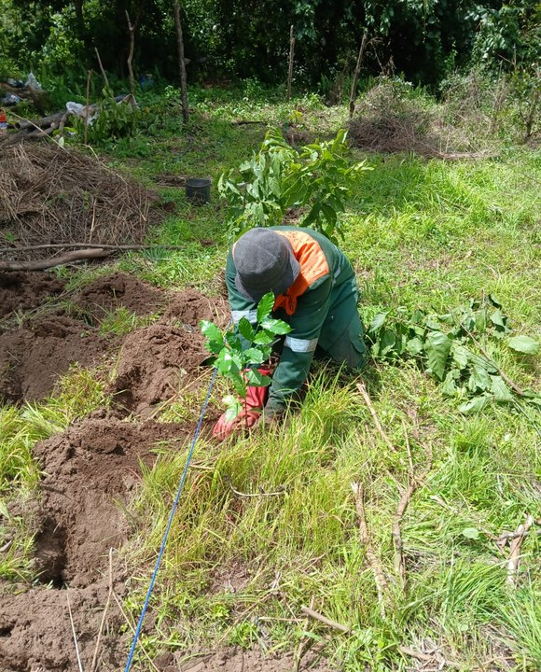
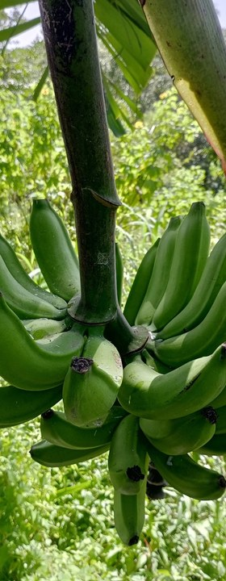
What he grows together:
coffee, cacao, bananas, citrus, and pineapple.
soilfoodweb.com
Notes:
What grows. Grid and continuous hyphae panorama after Stephanie's feedback. Background: assets/collage/boubacar-panorama/ (tools/make_hyphae_panorama.py, drawn by code). His quotes from his email to Allison, 30 Sep 2026. Photos: planting-seedling-in-agroforest.jpeg, banana-bunch.jpg.

Slide 7
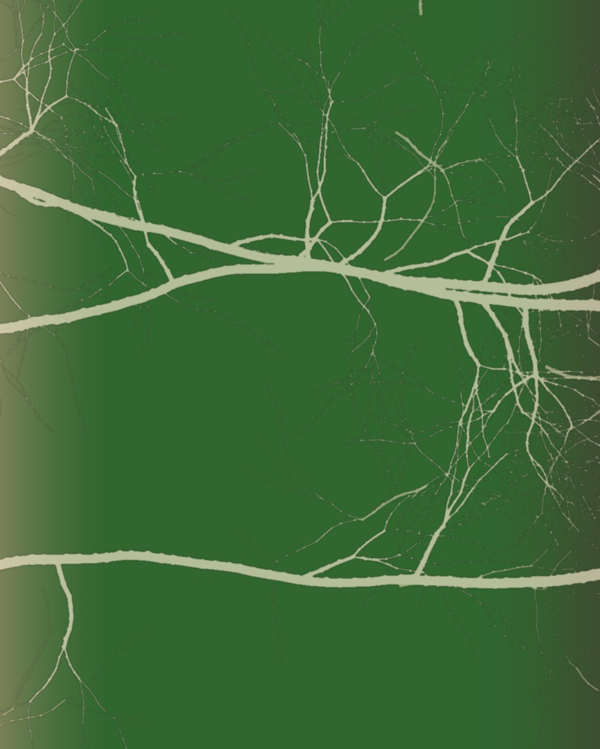
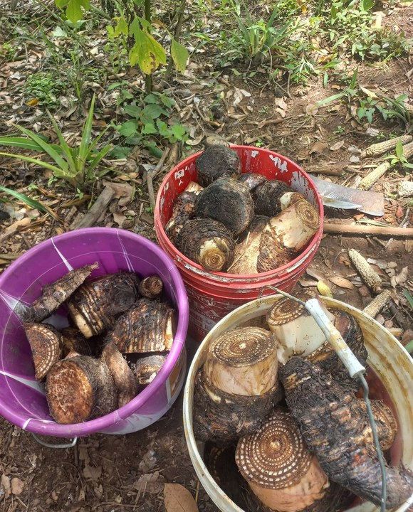
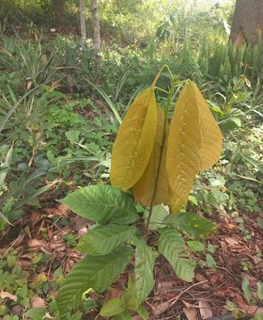
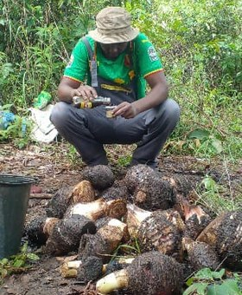
“My compost includes plant residues, animal manure when available, biochar activated with fish hydrolysate and compost tea, and local organic materials.”
soilfoodweb.com
Notes:
His compost. Grid and continuous hyphae panorama after Stephanie's feedback. Background: assets/collage/boubacar-panorama/ (tools/make_hyphae_panorama.py, drawn by code). His quotes from his email to Allison, 30 Sep 2026. Photos: buckets-of-tubers.jpg, young-tree-yellow-new-leaves.jpg, man-with-harvested-tubers.jpeg [VERIFY who].

Slide 8
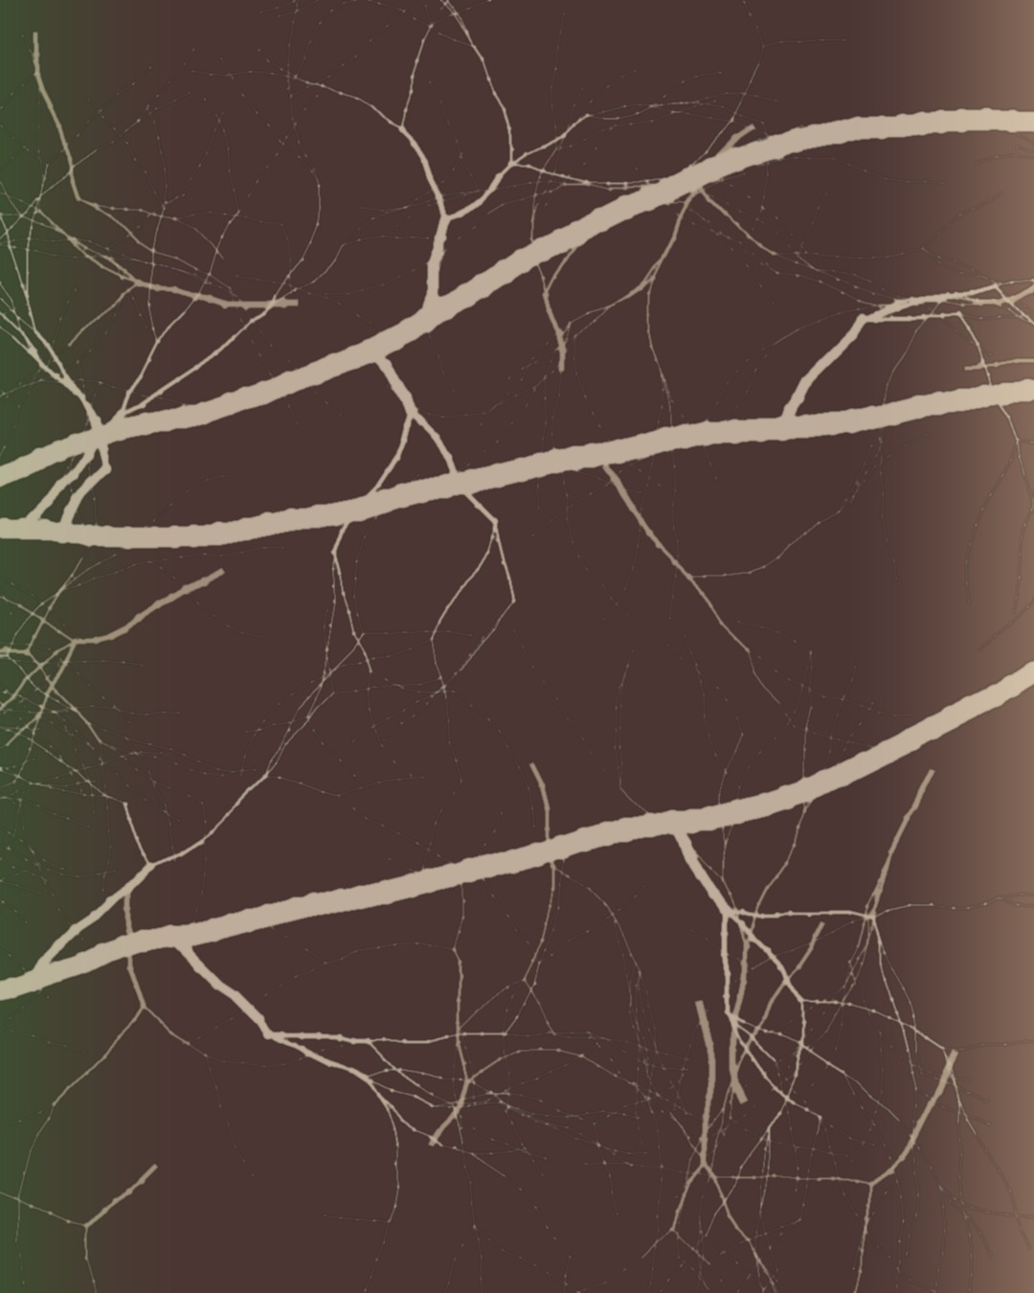
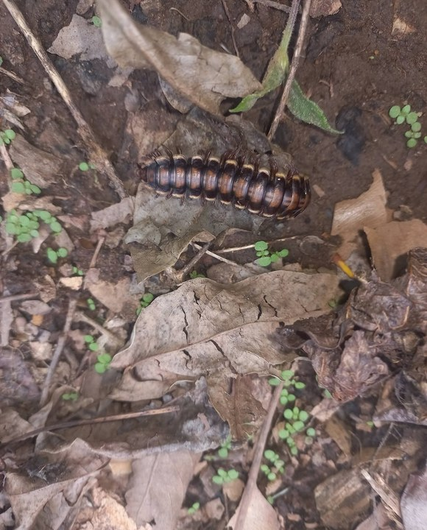
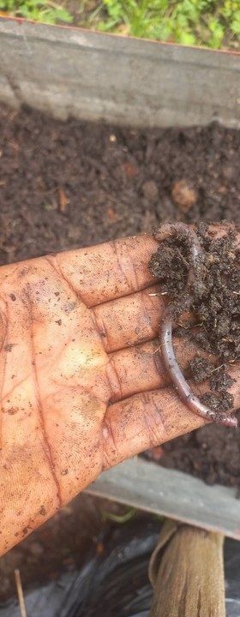
What he's seeing:
more earthworms, more mushrooms, active decomposition, and better soil structure.
soilfoodweb.com
Notes:
What's changing. Grid and continuous hyphae panorama after Stephanie's feedback. Background: assets/collage/boubacar-panorama/ (tools/make_hyphae_panorama.py, drawn by code). His quotes from his email to Allison, 30 Sep 2026. Photos: millipede-leaf-litter.jpg, boubacar-hand-compost-worm.jpg.

Slide 9
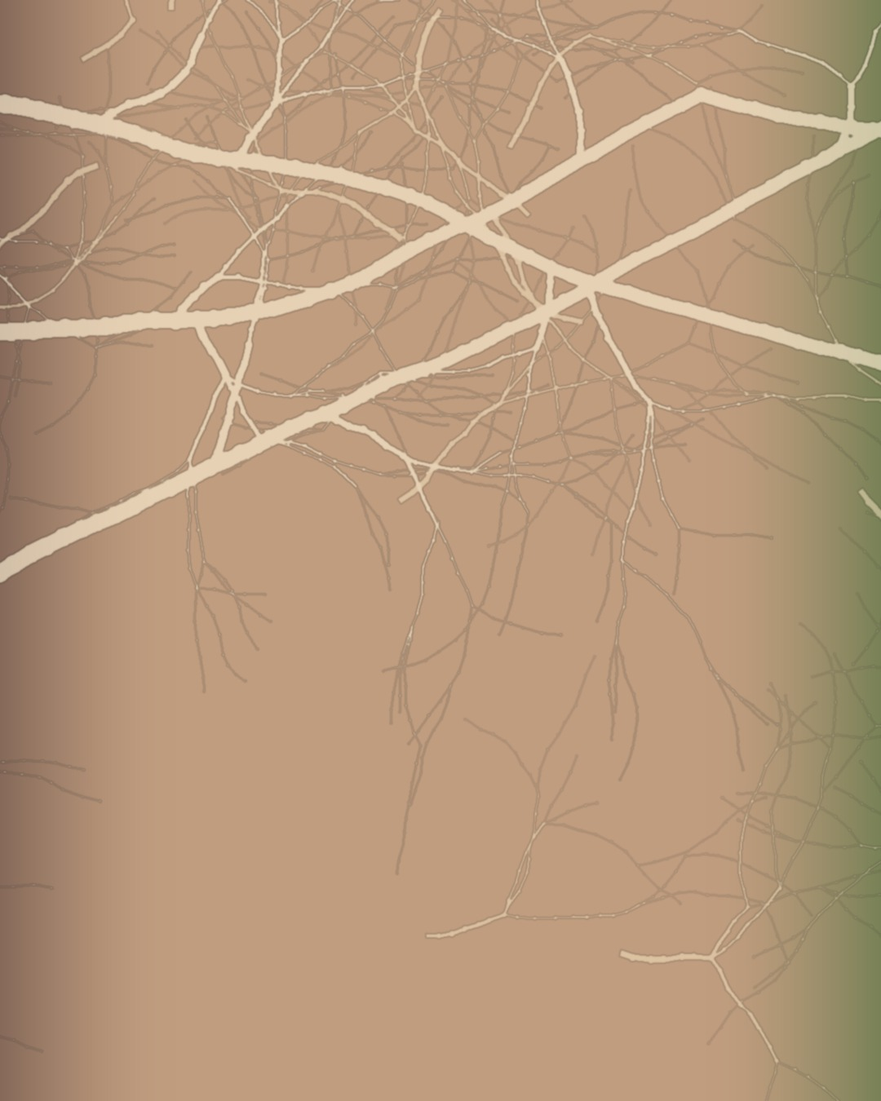
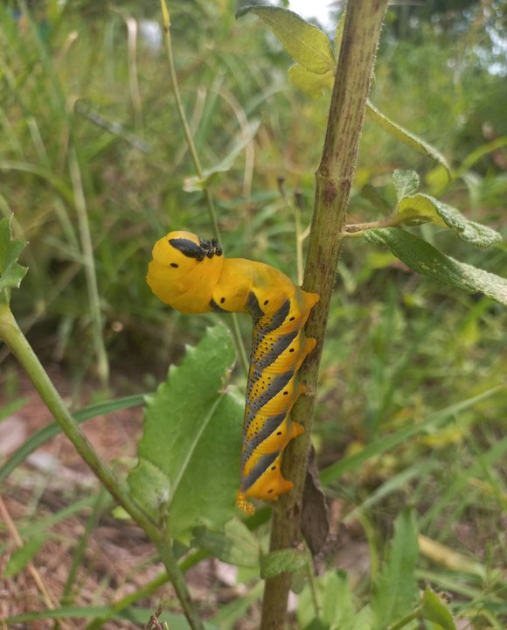
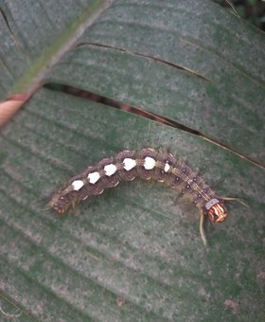
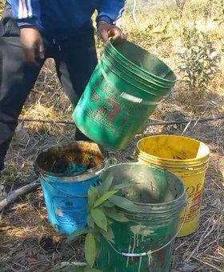
“I can already see signs of healthier soil in the field, including more earthworms, mushrooms, and active decomposition.”
soilfoodweb.com
Notes:
Life returns. Grid and continuous hyphae panorama after Stephanie's feedback. Background: assets/collage/boubacar-panorama/ (tools/make_hyphae_panorama.py, drawn by code). His quotes from his email to Allison, 30 Sep 2026. Photos: yellow-caterpillar-on-stem.jpg, caterpillar-on-leaf.jpg, still-young-plants-buckets-29s.png.

Slide 10
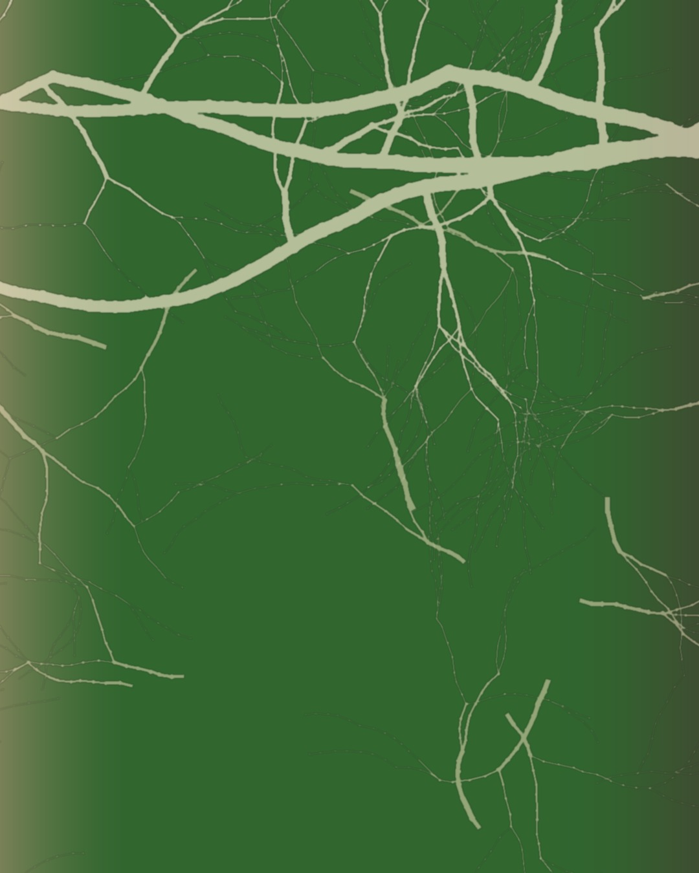
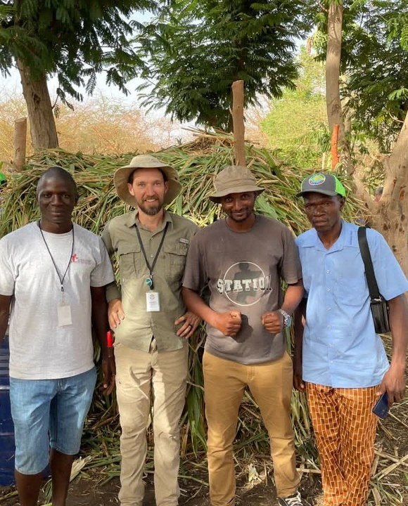
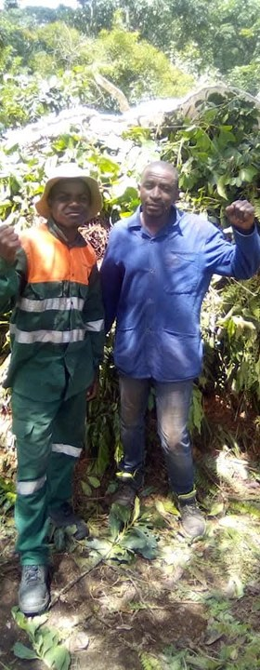
“Your training changed the way I see agriculture. I now believe that agriculture is biology, not chemical fertilizer.”
soilfoodweb.com
Notes:
Passing it on. Grid and continuous hyphae panorama after Stephanie's feedback. Background: assets/collage/boubacar-panorama/ (tools/make_hyphae_panorama.py, drawn by code). His quotes from his email to Allison, 30 Sep 2026. Photos: group-of-five-farmers.jpeg, two-men-at-shade-house.jpeg [VERIFY who, where, when].

Slide 11
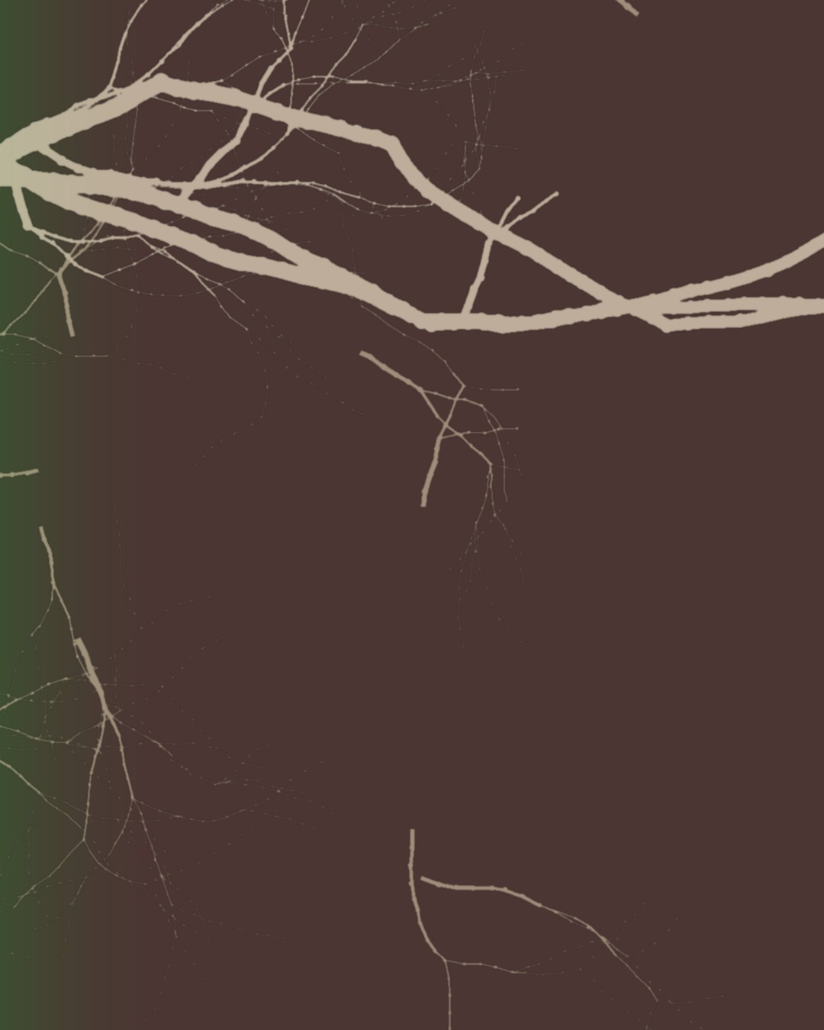
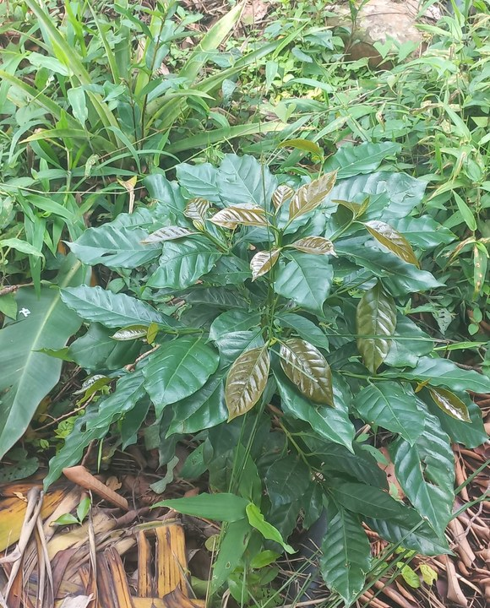
“
“My dream is to restore degraded land in the Fouta Djallon and help my community learn living-soil practices.”
Subscribe on YouTube: @boubacartidianediallo
Notes:
The dream and the call to action (YouTube). Grid and continuous hyphae panorama after Stephanie's feedback. Background: assets/collage/boubacar-panorama/ (tools/make_hyphae_panorama.py, drawn by code). His quotes from his email to Allison, 30 Sep 2026. Photo: young-coffee-plant.jpg.

