Slide 1
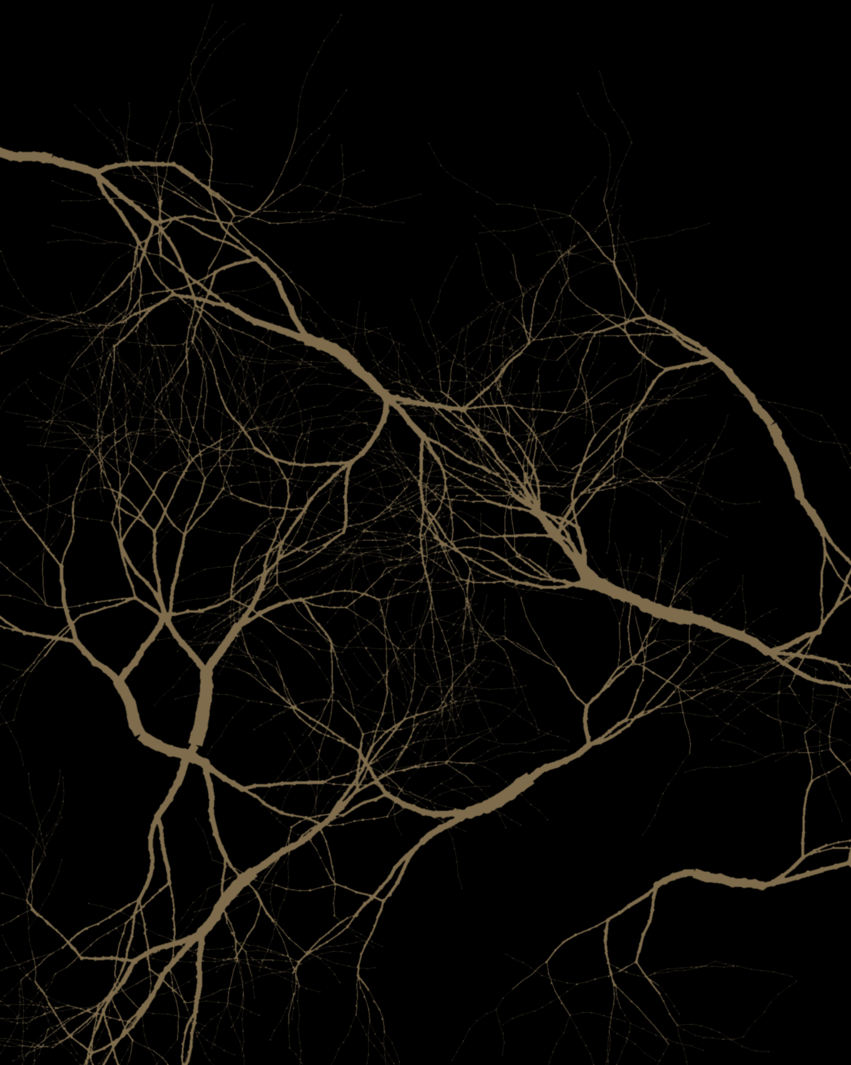

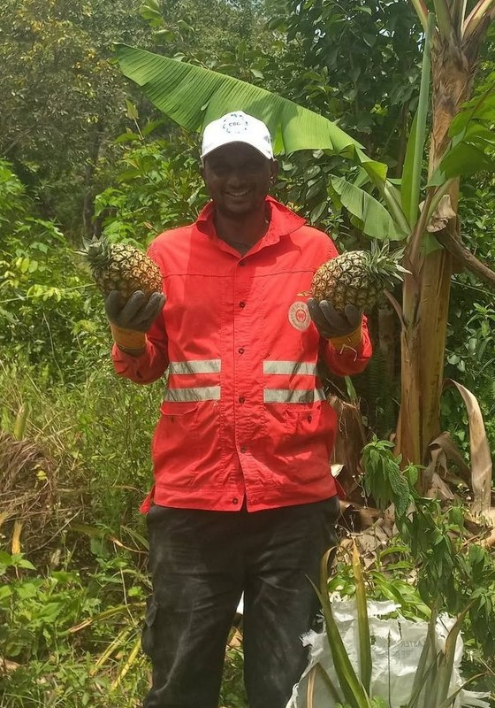
Happy International Coffee Day
Boubacar Tidiane Diallo,
Guinea-Conakry
Notes:
Cover. Root-network style (as the LinkedIn option E card). Fonts: Montserrat and EB Garamond (brand). Same words as the scrapbook version. Call to action: his YouTube channel (his Instagram @tidia.diallo.1 is private). Sources: Impact story sheet, Boubacar Tidiane Diallo: https://docs.google.com/spreadsheets/d/10UHLwzJLBQAsmJqmg4hiCQRjBKXPAx7UnOudU-Vsg5U/edit; Email from Boubacar to Allison, 30 September 2026; Instagram: https://www.instagram.com/tidia.diallo.1/; YouTube: https://www.youtube.com/@boubacartidianediallo; Facebook: https://www.facebook.com/btidja; Photos: sent by Boubacar to Stephanie on WhatsApp, 17 August 2026, and to Allison, September 2026. [TAG @Stephanie] Send Boubacar the final caption and slides to approve before posting, and confirm he studied on a scholarship. Photo: boubacar-portrait-bananas-closer.jpg.

Slide 2
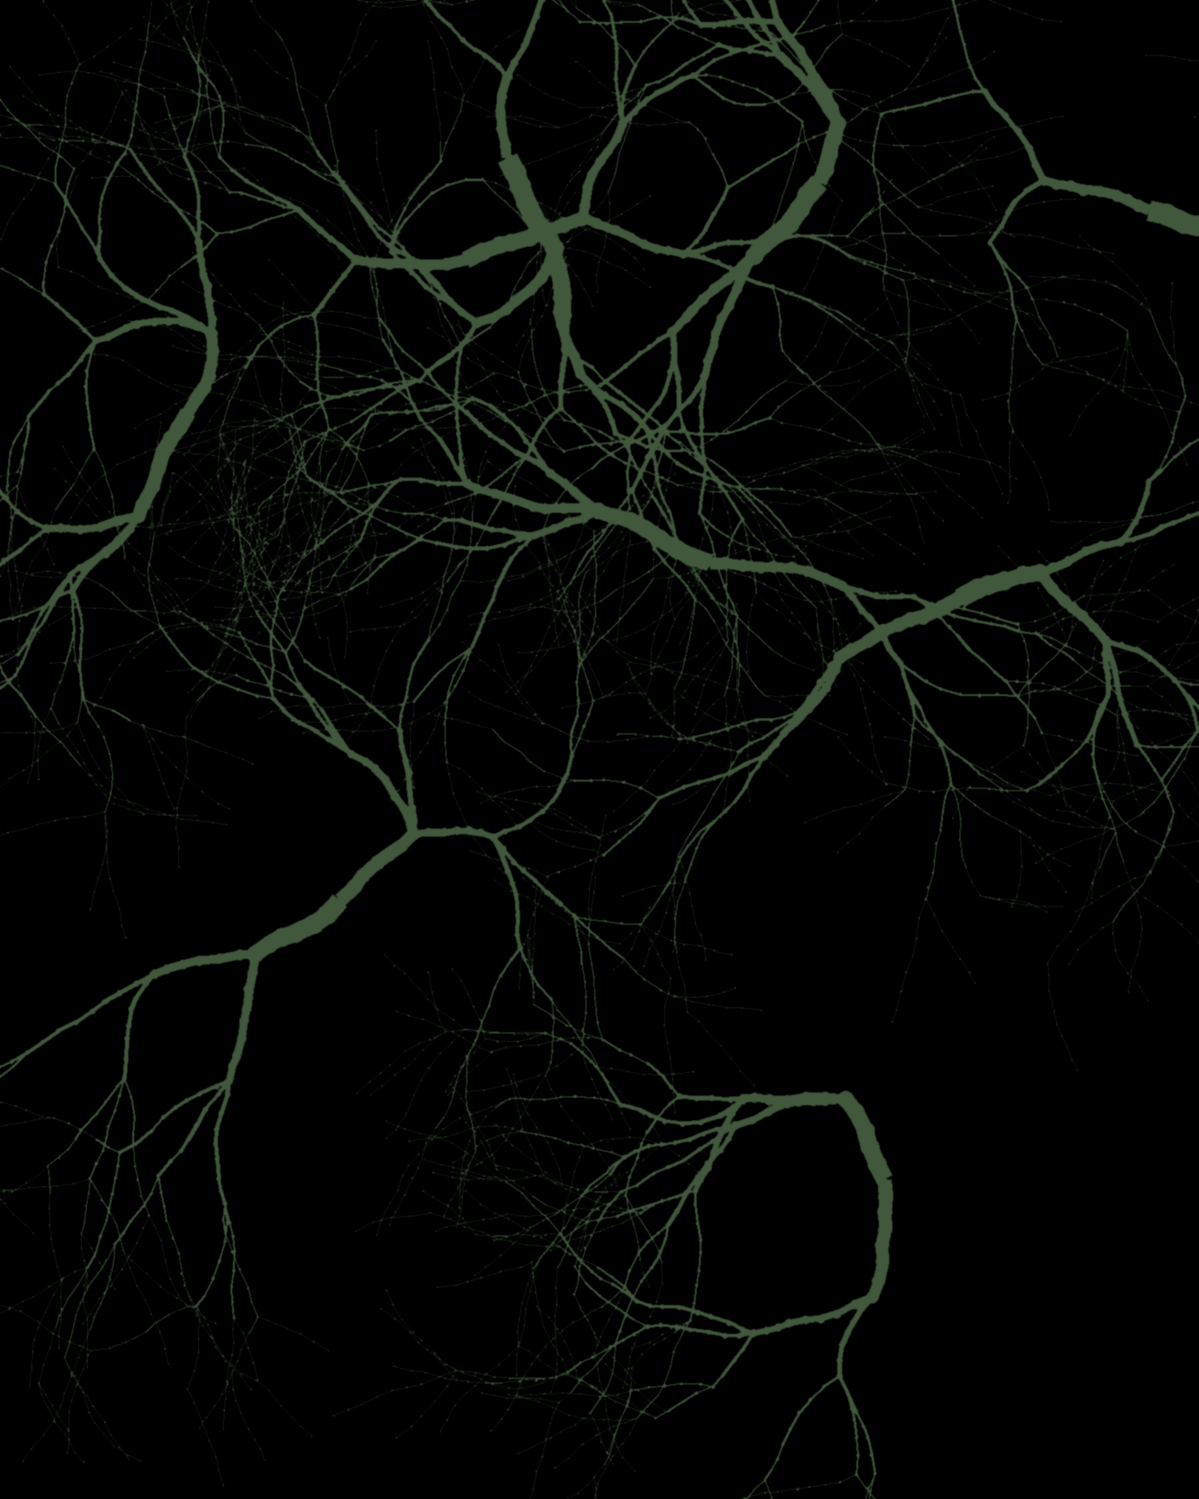
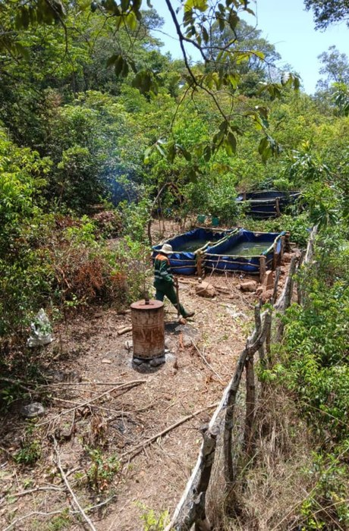
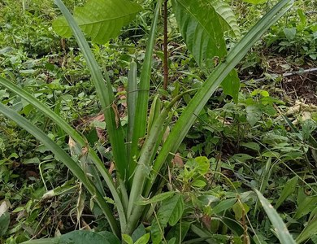
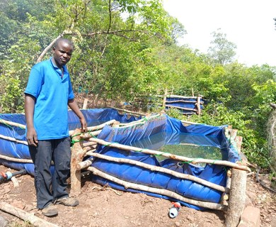
Gnaly Coffee & AgroÉcole Bio
Fouta Djallon, Guinea-Conakry
soilfoodweb.com
Notes:
Gnaly. Root-network style (as the LinkedIn option E card). Fonts: Montserrat and EB Garamond (brand). Same words as the scrapbook version. Photos: farm-overview-with-tanks.jpeg, young-tree-with-pineapples.jpg, man-by-water-tanks.jpeg.

Slide 3
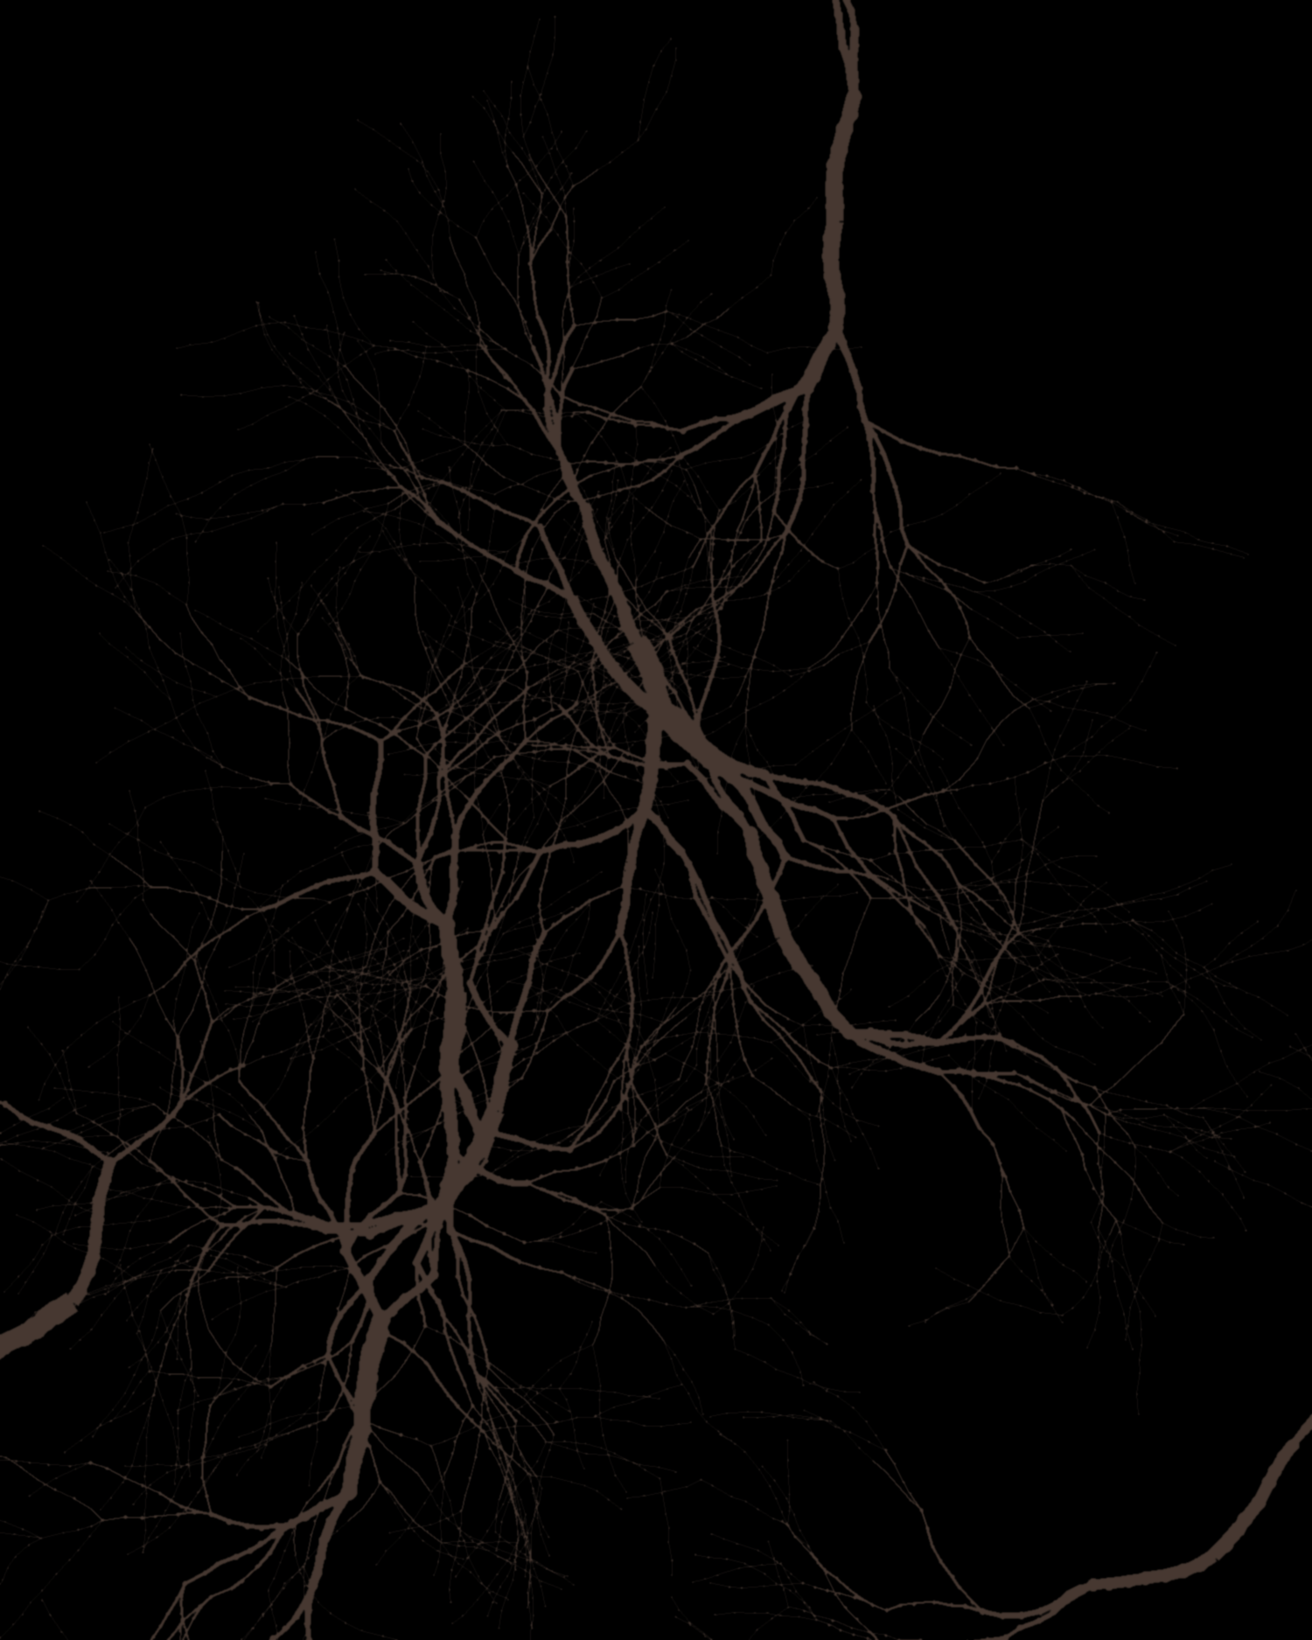
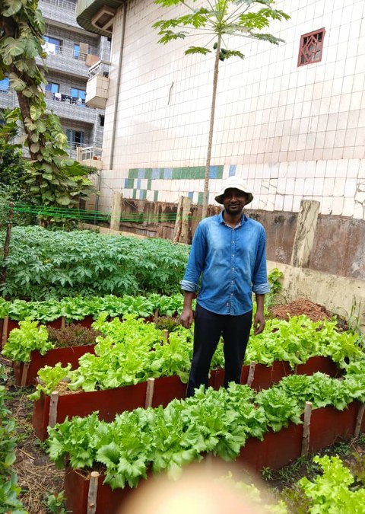
“
“Today, I ask a different question: What does the soil food web need to thrive?”
soilfoodweb.com
Notes:
Quote. Root-network style (as the LinkedIn option E card). Fonts: Montserrat and EB Garamond (brand). Same words as the scrapbook version. Photo: vegetable-beds-by-building.jpeg.

Slide 4
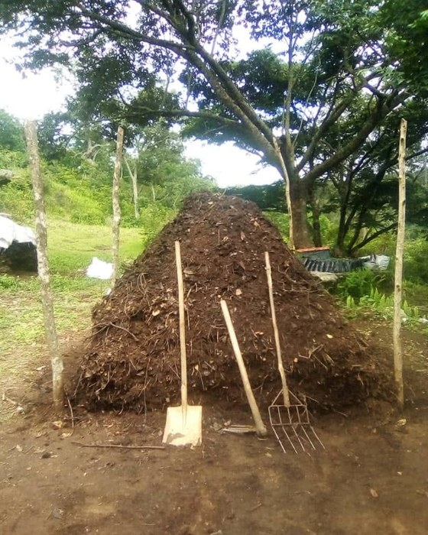
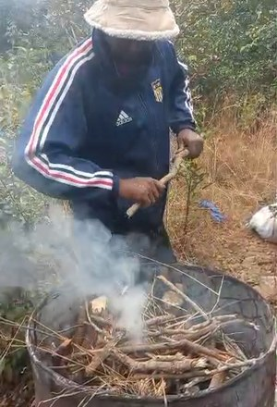
How he feeds his soil:
living groundcover, mulch from his farm and the forest, and compost with biochar activated with fish hydrolysate and compost tea.
soilfoodweb.com
Notes:
Method. Root-network style (as the LinkedIn option E card). Fonts: Montserrat and EB Garamond (brand). Same words as the scrapbook version. Photos: boubacar-compost-pile.jpeg; still-biochar-kiln-smoke-73s.png (making-biochar-in-barrel-kiln.mp4 at 1:13).

Slide 5
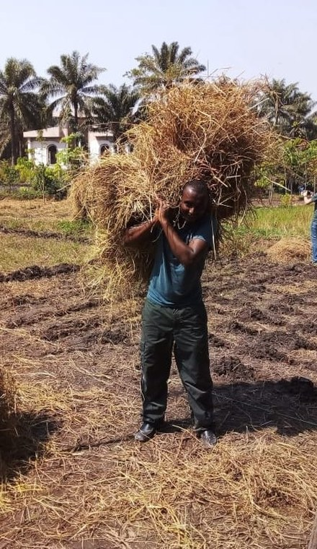
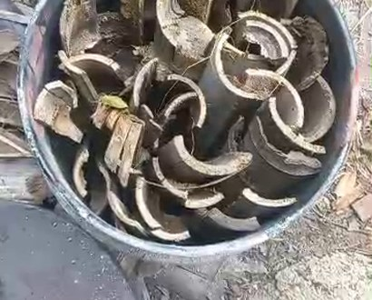
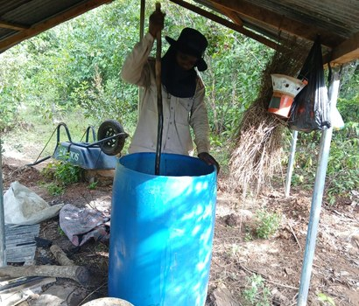
“I apply compost regularly around young trees and whenever I add new mulch.”
soilfoodweb.com
Notes:
His words (email to Allison, 30 Sep 2026). Root-network style (as the LinkedIn option E card). Fonts: Montserrat and EB Garamond (brand). Same words as the scrapbook version. Photos: carrying-mulch.jpg, still-biochar-charcoal-16s.png, barrel-brew-under-shelter.jpeg.

Slide 6
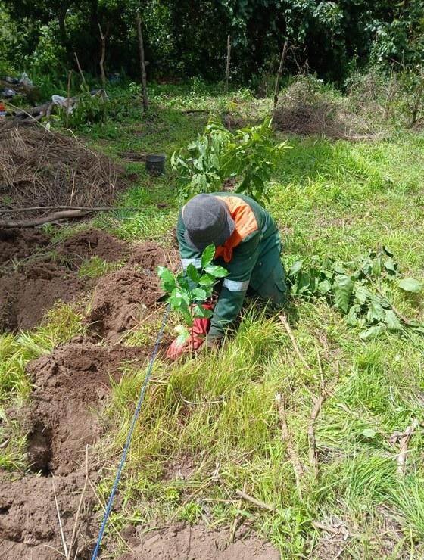
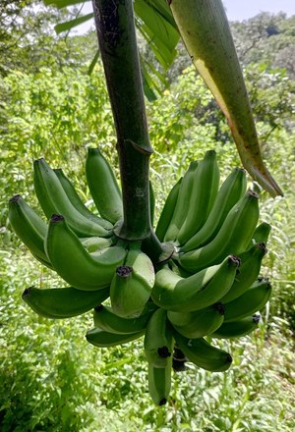
What he grows together:
coffee, cacao, bananas, citrus, and pineapple.
soilfoodweb.com
Notes:
Crops. Root-network style (as the LinkedIn option E card). Fonts: Montserrat and EB Garamond (brand). Same words as the scrapbook version. Photos: planting-seedling-in-agroforest.jpeg, banana-bunch.jpg.

Slide 7
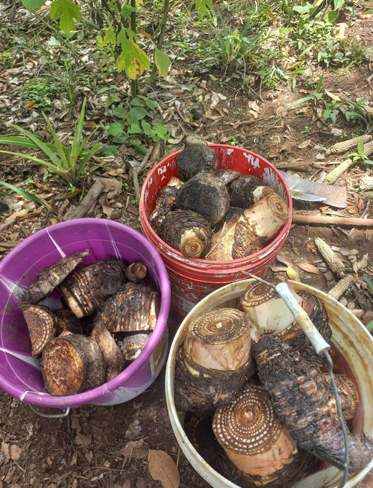
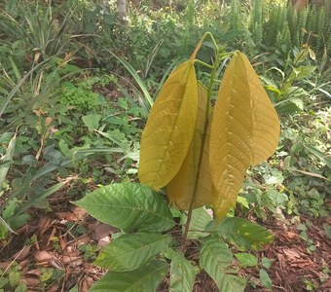
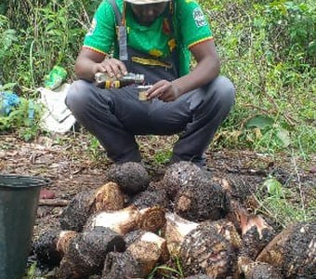
“My compost includes plant residues, animal manure when available, biochar activated with fish hydrolysate and compost tea, and local organic materials.”
soilfoodweb.com
Notes:
His words (email to Allison, 30 Sep 2026). Root-network style (as the LinkedIn option E card). Fonts: Montserrat and EB Garamond (brand). Same words as the scrapbook version. Photos: buckets-of-tubers.jpg, young-tree-yellow-new-leaves.jpg, man-with-harvested-tubers.jpeg [VERIFY who].

Slide 8
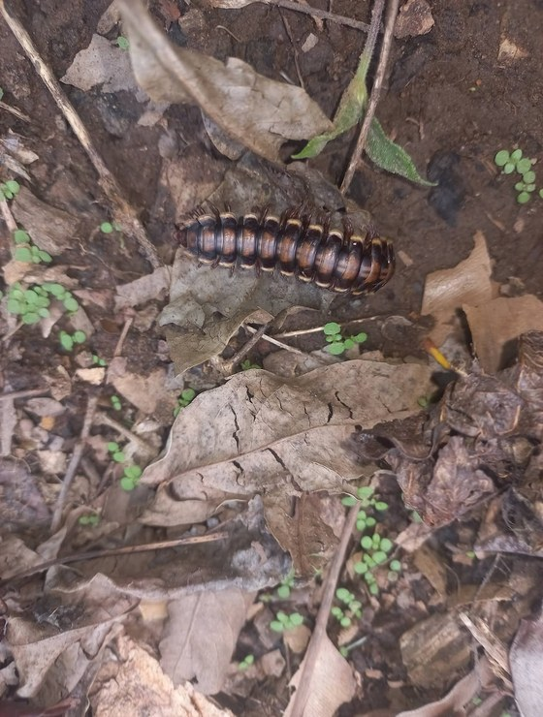
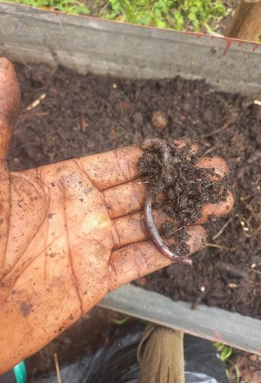
What he's seeing:
more earthworms, more mushrooms, active decomposition, and better soil structure.
soilfoodweb.com
Notes:
Results. Root-network style (as the LinkedIn option E card). Fonts: Montserrat and EB Garamond (brand). Same words as the scrapbook version. Photos: millipede-leaf-litter.jpg, boubacar-hand-compost-worm.jpg.

Slide 9
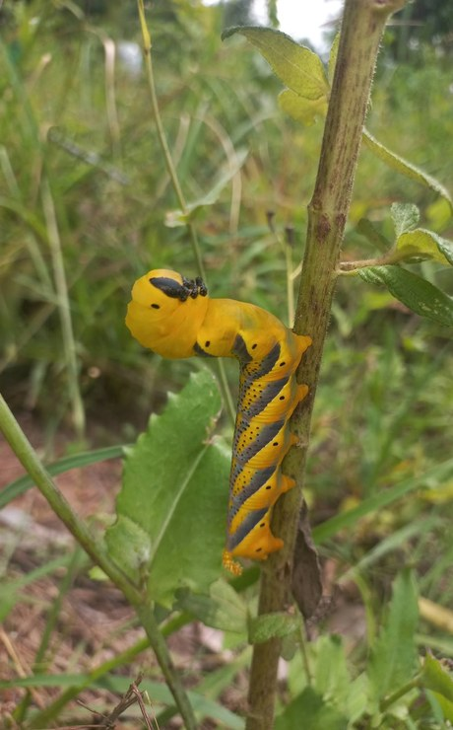
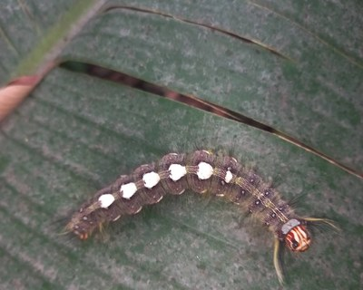
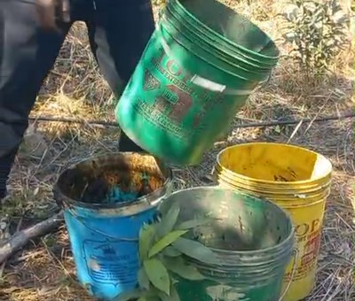
“I can already see signs of healthier soil in the field, including more earthworms, mushrooms, and active decomposition.”
soilfoodweb.com
Notes:
His words (email to Allison, 30 Sep 2026). Root-network style (as the LinkedIn option E card). Fonts: Montserrat and EB Garamond (brand). Same words as the scrapbook version. Photos: yellow-caterpillar-on-stem.jpg, caterpillar-on-leaf.jpg, still-young-plants-buckets-29s.png.

Slide 10
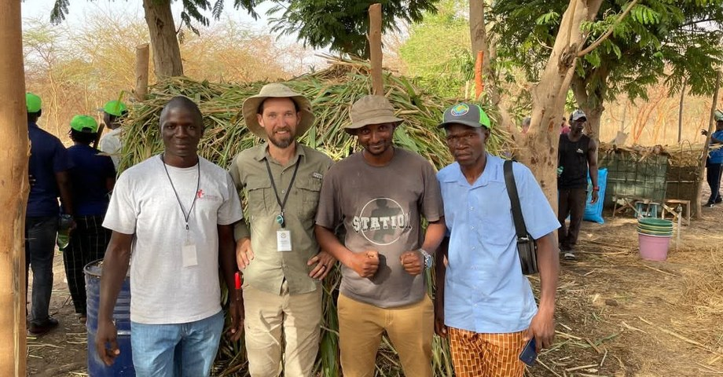
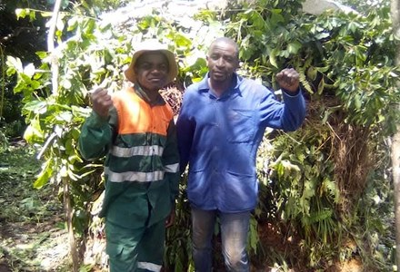
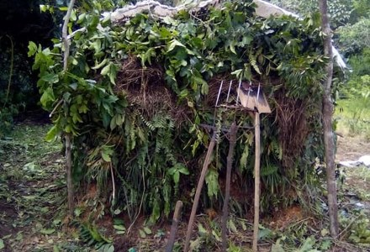
“Your training changed the way I see agriculture. I now believe that agriculture is biology, not chemical fertilizer.”
soilfoodweb.com
Notes:
His words (email to Allison, 30 Sep 2026). Root-network style (as the LinkedIn option E card). Fonts: Montserrat and EB Garamond (brand). Same words as the scrapbook version. Photos: group-of-five-farmers.jpeg, two-men-at-shade-house.jpeg, shade-house.jpg [VERIFY who, where, when].

Slide 11

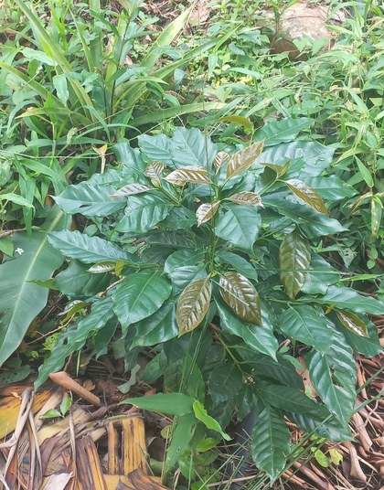
“
“My dream is to restore degraded land in the Fouta Djallon and help my community learn living-soil practices.”
Subscribe on YouTube: @boubacartidianediallo
Notes:
Closing quote and call to action (YouTube). Root-network style (as the LinkedIn option E card). Fonts: Montserrat and EB Garamond (brand). Same words as the scrapbook version. Photo: young-coffee-plant.jpg.

