Slide 1


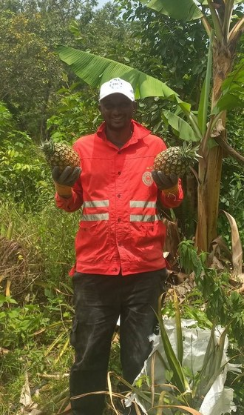
Happy International Coffee Day
Boubacar Tidiane
Diallo
Gnaly Coffee & AgroÉcole Bio
Fouta Djallon, Guinea-Conakry
Notes:
Option E, gold roots (style of the SFW 'Welcome Eric Feiler' card). Fonts: Montserrat and EB Garamond (brand). Photo: assets/photo/boubacar/boubacar-portrait-bananas.jpg in an arch frame. Root network: assets/collage/root-network-gold.png, drawn by code. Call to action: his YouTube channel (his Instagram @tidia.diallo.1 is private). Sources: Impact story sheet, Boubacar Tidiane Diallo: https://docs.google.com/spreadsheets/d/10UHLwzJLBQAsmJqmg4hiCQRjBKXPAx7UnOudU-Vsg5U/edit; Email from Boubacar to Allison, 30 September 2026; Instagram: https://www.instagram.com/tidia.diallo.1/; YouTube: https://www.youtube.com/@boubacartidianediallo; Facebook: https://www.facebook.com/btidja; Photos: sent by Boubacar to Stephanie on WhatsApp, 17 August 2026, and to Allison, September 2026. [TAG @Stephanie] Send Boubacar the final caption and slides to approve before posting, and confirm he studied on a scholarship.

