Slide 1
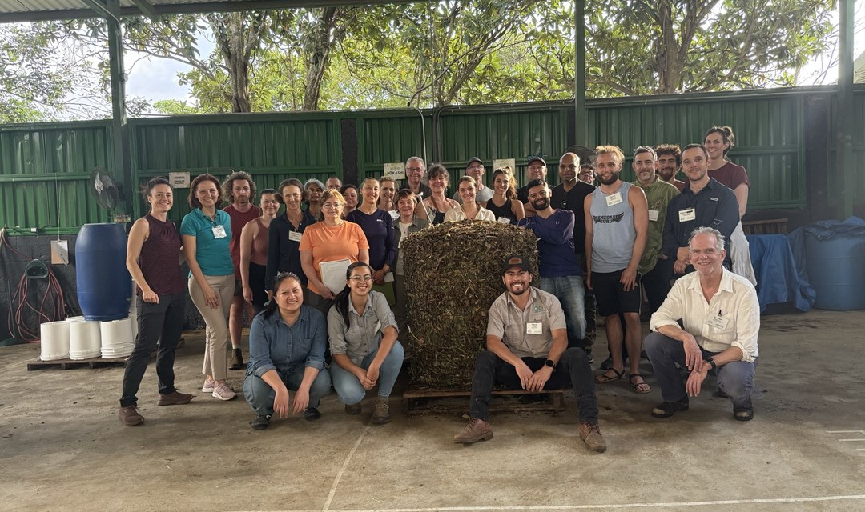
1/5
FOUNDATION COURSES
Every graduate you met this month started with the same course.
LOGO
Notes:
2A.

Slide 2
PHOTO: Boubacar, small portrait
2/5
GRADUATE
Boubacar, Guinea.
Notes:
1C.

Slide 3
PHOTO: Christina, small portrait
3/5
GRADUATE
Christina, Tennessee.
Notes:
1C.

Slide 4
PHOTO: Jason, small portrait
4/5
GRADUATE
Jason, Indiana.
Notes:
1C.

Slide 5
5/5
The Foundation Courses. Learn soil biology, compost, extracts and microscopy.
Scholarships available.
Save this
Send this
LOGO
Notes:
2D.

