Slide 1
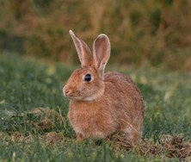
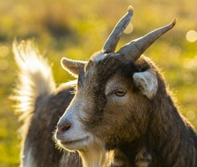
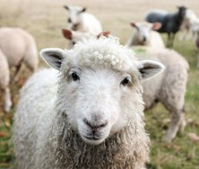
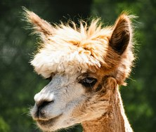
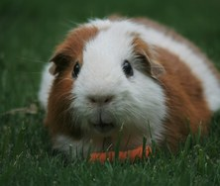
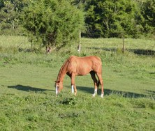
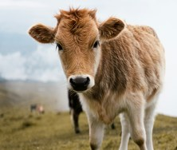
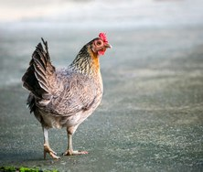
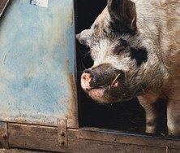
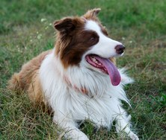
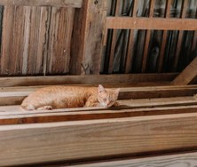

WORLD ANIMAL DAY, 4 OCTOBER 2026
soilfoodweb.com
Whose manure belongs in your compost?
Happy World Animal Day, October 4.
Rabbit
Goat
Sheep
Alpaca
Guinea pig
Horse
Cow
Chicken
GOES IN
HOT PILE ONLY
STAYS OUT
Pig
Dog
Cat
Photo: Adrian Pereira, Maxime Agnelli, Sam Carter, Maksim Samuilionak, Jack Catalano, Roger Starnes Sr, Diana Shchurova, sippakorn yamkasikorn, Pauline Bernfeld, iridial, Sean Foster on Unsplash
Notes:
Cover, research style. Sources: Soil Food Web School, Compost Manual: [LINK FROM CARLA]. Soil Food Web School, BioComplete Compost, Lecture 4: Thermophilic Composting (Part 2): https://pt.soilfoodweb.com/?p=2067. Miller et al. (2015). Ascariasis in humans and pigs on small-scale farms, Maine, USA, 2010 to 2013. Emerging Infectious Diseases, 21(2): https://doi.org/10.3201/eid2102.140048. USDA NRCS and Fairbanks Soil and Water Conservation District (2005). Composting Dog Waste: https://www.epa.gov/system/files/documents/2022-11/Composting-Dog-Waste-Booklet-Alaska.pdf. CDC (2025). About Toxoplasmosis: https://www.cdc.gov/toxoplasmosis/about/index.html. Course: https://school.soilfoodweb.com/bundles/advanced-biocomplete-compost-production Photo rabbit.jpg: Adrian Pereira on Unsplash, https://unsplash.com/photos/brown-hare-on-grass-field-cIH81koe-ao. Photo goat.jpg: Maxime Agnelli on Unsplash, https://unsplash.com/photos/selective-focus-photography-of-brown-goat-during-daytime-bhD6TGRjnWc. Photo sheep.jpg: Sam Carter on Unsplash, https://unsplash.com/photos/white-sheep-on-green-grass-during-daytime-GHOiyov2TSQ. Photo alpaca.jpg: Maksim Samuilionak on Unsplash, https://unsplash.com/photos/a-close-up-of-a-fluffy-alpacas-head-DyABRVYb4b8. Photo guinea-pig.jpg: Jack Catalano on Unsplash, https://unsplash.com/photos/brown-and-white-guinea-pig-eating-carrot-q1pw1dOW0_0. Photo horse.jpg: Roger Starnes Sr on Unsplash, https://unsplash.com/photos/a-brown-horse-grazes-peacefully-in-a-sunny-green-field-3w1VfQHm_Lc. Photo cow.jpg: Diana Shchurova on Unsplash, https://unsplash.com/photos/a-brown-and-white-cow-standing-on-top-of-a-grass-covered-field-tDRZNFrz9yA. Photo chicken.jpg: sippakorn yamkasikorn on Unsplash, https://unsplash.com/photos/white-and-brown-chicken-on-green-grass-field-during-daytime-wWIK8hnESnY. Photo pig.jpg: Pauline Bernfeld on Unsplash, https://unsplash.com/photos/black-pig-in-blue-wooden-cage-S99OqS453go. Photo dog.jpg: iridial on Unsplash, https://unsplash.com/photos/border-collie-lying-in-green-grass-GmgYWfGTWPA. Photo cat.jpg: Sean Foster on Unsplash, https://unsplash.com/photos/an-orange-cat-laying-on-top-of-a-wooden-floor-19eq09rpv-M.

Slide 2

WORLD ANIMAL DAY, 4 OCTOBER 2026
soilfoodweb.com
Manure: a high-nitrogen feedstock
A Soil Food Web thermophilic compost recipe combines three feedstocks: high-nitrogen material such as manure (about 10% in summer), green plant material (about 30%) and woody material (about 60%). Bedding, such as straw or wood shavings, counts toward the woody share.¹
¹ Soil Food Web School, BioComplete Compost, Lecture 4
Notes:
Feedstocks, text, footnote 1.

Slide 3


WORLD ANIMAL DAY, 4 OCTOBER 2026
soilfoodweb.com
High nitrogen, 10% · Green, 30% · Woody, 60%
0%
25%
50%
75%
100%
High nitrogen, 10%
Green, 30%
Woody, 60%
¹ Soil Food Web School, BioComplete Compost, Lecture 4
Notes:
Feedstocks, chart: one 100% stacked bar (10, 30, 60) with a 0 to 100% axis and a legend. Icons: assets/icons/.

Slide 4
WORLD ANIMAL DAY, 4 OCTOBER 2026
soilfoodweb.com
Rabbit
Goat
Sheep
Alpaca
Guinea pig
Horse
Cow
Chicken
Photo: Adrian Pereira, Maxime Agnelli, Sam Carter, Maksim Samuilionak, Jack Catalano, Roger Starnes Sr, Diana Shchurova, sippakorn yamkasikorn on Unsplash
GOES IN
Plant-eaters and poultry
Rabbit, goat, sheep, alpaca, guinea pig, horse, cow and chicken. Their manure is a great high-nitrogen ingredient. Use it fresh, or dry it and store it until you build the pile.¹
¹ Soil Food Web School, Compost Manual
Notes:
Plant-eaters and poultry. Photo rabbit.jpg: Adrian Pereira on Unsplash, https://unsplash.com/photos/brown-hare-on-grass-field-cIH81koe-ao. Photo goat.jpg: Maxime Agnelli on Unsplash, https://unsplash.com/photos/selective-focus-photography-of-brown-goat-during-daytime-bhD6TGRjnWc. Photo sheep.jpg: Sam Carter on Unsplash, https://unsplash.com/photos/white-sheep-on-green-grass-during-daytime-GHOiyov2TSQ. Photo alpaca.jpg: Maksim Samuilionak on Unsplash, https://unsplash.com/photos/a-close-up-of-a-fluffy-alpacas-head-DyABRVYb4b8. Photo guinea-pig.jpg: Jack Catalano on Unsplash, https://unsplash.com/photos/brown-and-white-guinea-pig-eating-carrot-q1pw1dOW0_0. Photo horse.jpg: Roger Starnes Sr on Unsplash, https://unsplash.com/photos/a-brown-horse-grazes-peacefully-in-a-sunny-green-field-3w1VfQHm_Lc. Photo cow.jpg: Diana Shchurova on Unsplash, https://unsplash.com/photos/a-brown-and-white-cow-standing-on-top-of-a-grass-covered-field-tDRZNFrz9yA. Photo chicken.jpg: sippakorn yamkasikorn on Unsplash, https://unsplash.com/photos/white-and-brown-chicken-on-green-grass-field-during-daytime-wWIK8hnESnY.

Slide 5
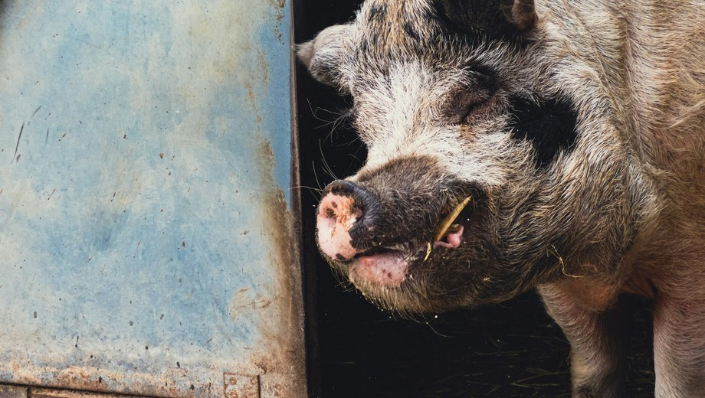
WORLD ANIMAL DAY, 4 OCTOBER 2026
soilfoodweb.com
Photo: Pauline Bernfeld on Unsplash
HOT PILE ONLY
Pig
Pig roundworm can infect people.¹ Pig manure goes into a pile that completes the thermophilic requirements, and raw pig manure stays away from produce.
¹ Miller et al. 2015, Emerging Infectious Diseases
Notes:
Pig. Photo pig.jpg: Pauline Bernfeld on Unsplash, https://unsplash.com/photos/black-pig-in-blue-wooden-cage-S99OqS453go.

Slide 6
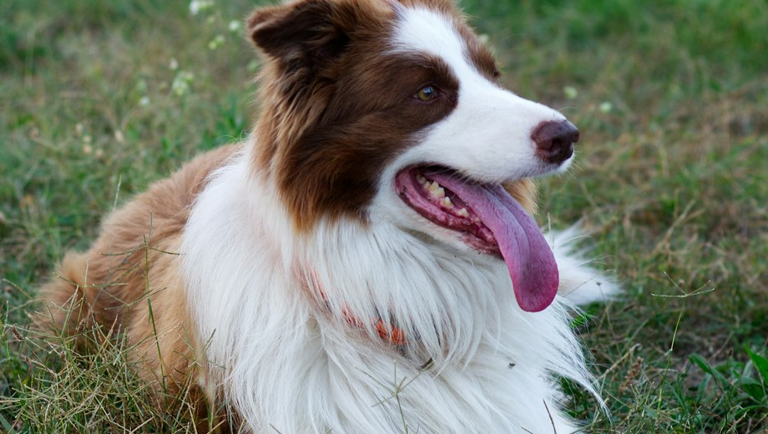
WORLD ANIMAL DAY, 4 OCTOBER 2026
soilfoodweb.com
Photo: iridial on Unsplash
STAYS OUT
Dog and cat
Dog feces can carry roundworm (Toxocara) eggs. If swallowed, the larvae can migrate to the liver, lungs and eyes.¹
¹ USDA NRCS 2005; CDC 2025
Notes:
Dog and cat, part 1. Photo dog.jpg: iridial on Unsplash, https://unsplash.com/photos/border-collie-lying-in-green-grass-GmgYWfGTWPA.

Slide 7
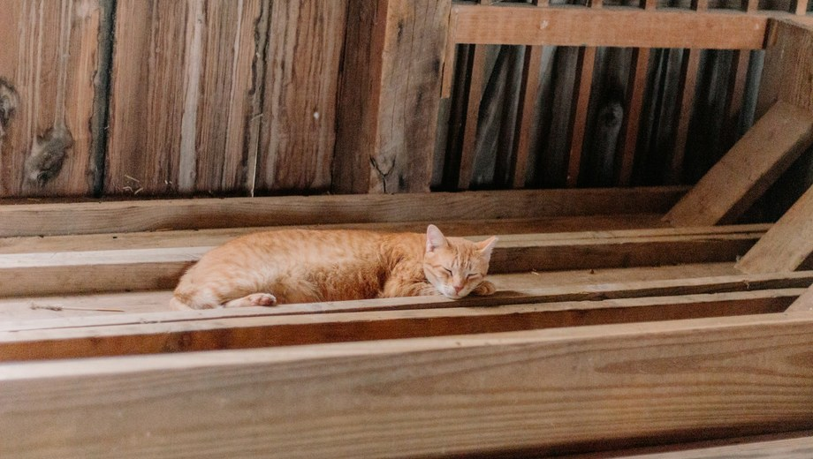
WORLD ANIMAL DAY, 4 OCTOBER 2026
soilfoodweb.com
Photo: Sean Foster on Unsplash
STAYS OUT
Cat feces can carry Toxoplasma gondii, which people can also pick up from contaminated soil.² USDA advises against using dog waste compost on food crops, even after hot composting, and against composting cat waste or litter at all.¹
¹ USDA NRCS 2005
² CDC 2025
Notes:
Dog and cat, part 2. Photo cat.jpg: Sean Foster on Unsplash, https://unsplash.com/photos/an-orange-cat-laying-on-top-of-a-wooden-floor-19eq09rpv-M.

Slide 8
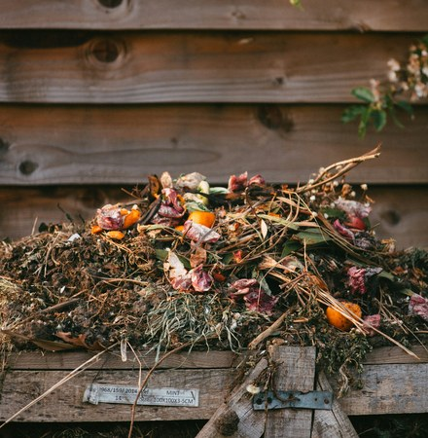
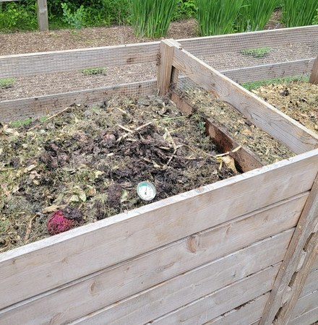
WORLD ANIMAL DAY, 4 OCTOBER 2026
soilfoodweb.com
Slow or hot, both work.
Cold or static pile: fine for plant-eater and poultry manure, on a longer timeline.¹
Thermophilic pile: above 55°C (131°F) for 3 days at the center.¹
Photo: Edward Howell on Unsplash
Photo: Frank Thiemonge on Unsplash
¹ Soil Food Web School, Compost Manual
Notes:
Slow or hot, comparison in two columns. Photo compost-2.jpg: Edward Howell on Unsplash, https://unsplash.com/photos/dried-leaves-on-ground-beside-wooden-fence-v7G32kVgM84. Photo compost-4.jpg: Frank Thiemonge on Unsplash, https://unsplash.com/photos/a-couple-of-wooden-boxes-filled-with-dirt-GXEPGA3k7N0.

Slide 9

WORLD ANIMAL DAY, 4 OCTOBER 2026
soilfoodweb.com
Thermophilic pile: above 55°C (131°F) for 3 days at the center. Turn it so every part passes through the hot center.¹
above 55°C (131°F)
3 days
¹ Soil Food Web School, Compost Manual
Notes:
Thermophilic pile, diagram: a pile cross-section drawn with shapes (tan pile, gold hot center), arrows show turning the outside into the center. Thermometer icon: assets/icons/.

Slide 10
WORLD ANIMAL DAY, 4 OCTOBER 2026
soilfoodweb.com
Advanced BioComplete Compost Production
Building and assessing three compost piles that meet biological minimums. At the Soil Food Web School. Link in bio.
Notes:
Closing. Course: https://school.soilfoodweb.com/bundles/advanced-biocomplete-compost-production

