Slide 1


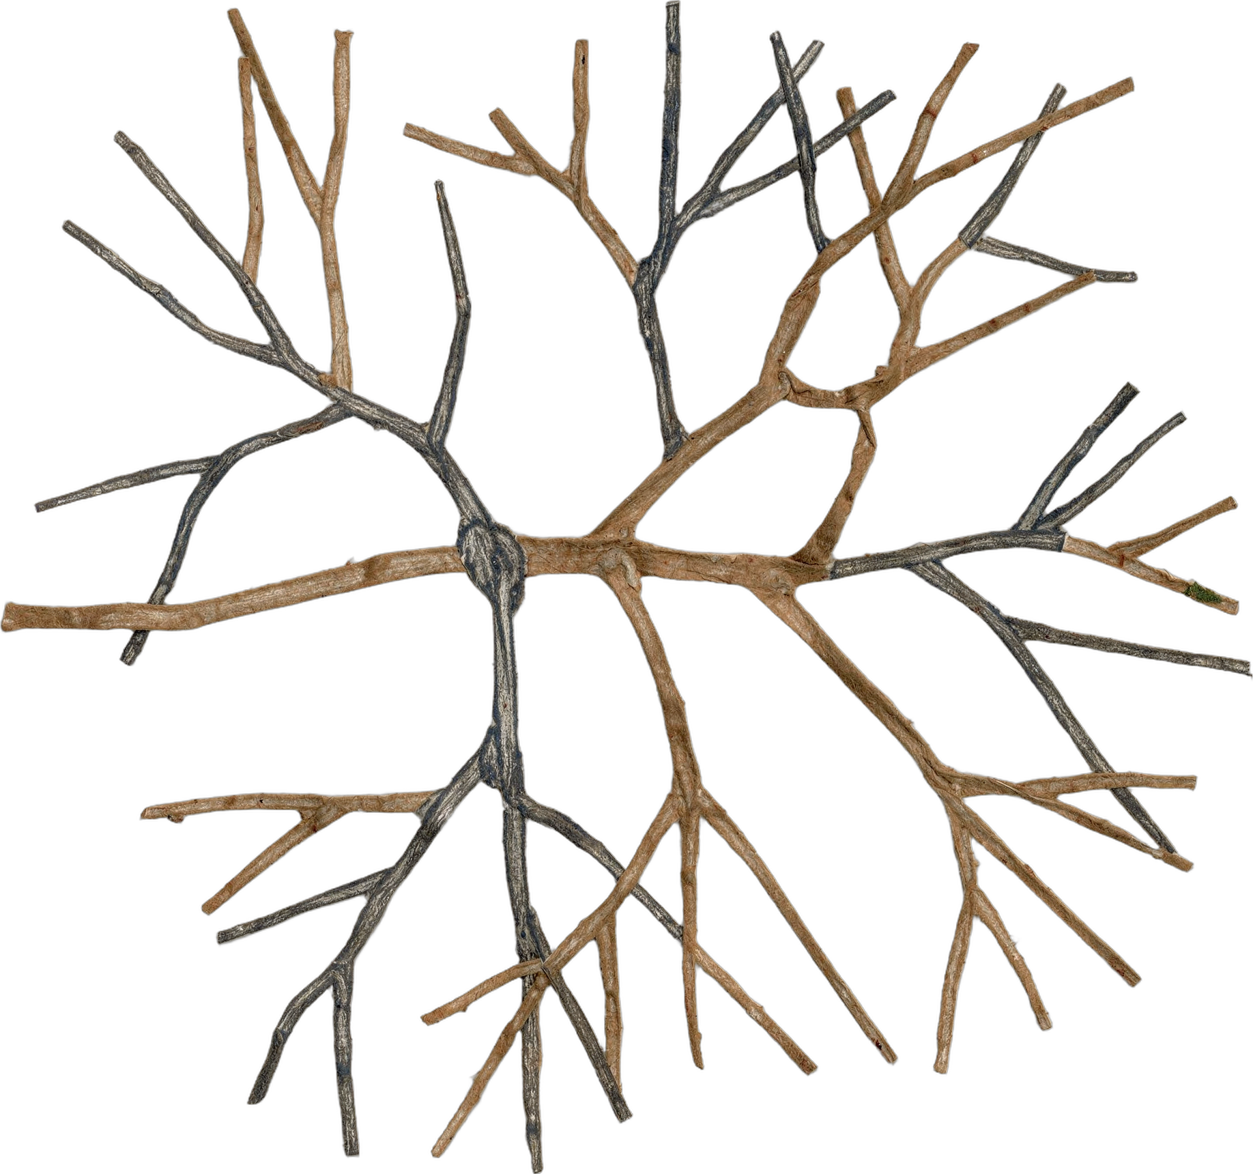
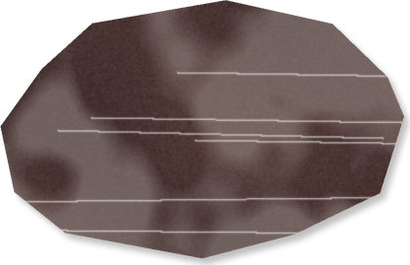

39% more soil carbon
on the most regenerative farms, 1000 Farms Initiative, 2026
Notes:
LinkedIn image. Sources: Lundgren et al., Environmental Research: Food Systems, 2026, https://doi.org/10.1088/2976-601X/ae8f4e; Ecdysis Foundation press release, 17 September 2026, https://www.globenewswire.com/news-release/2026/09/17/3363925/0/en/regenerative-farming-outpaces-tech-based-carbon-capture-solutions-in-first-large-scale-systemic-study.html Right half: the slide 1 collage on Food Web Green so the white logo reads.

