Slide 1
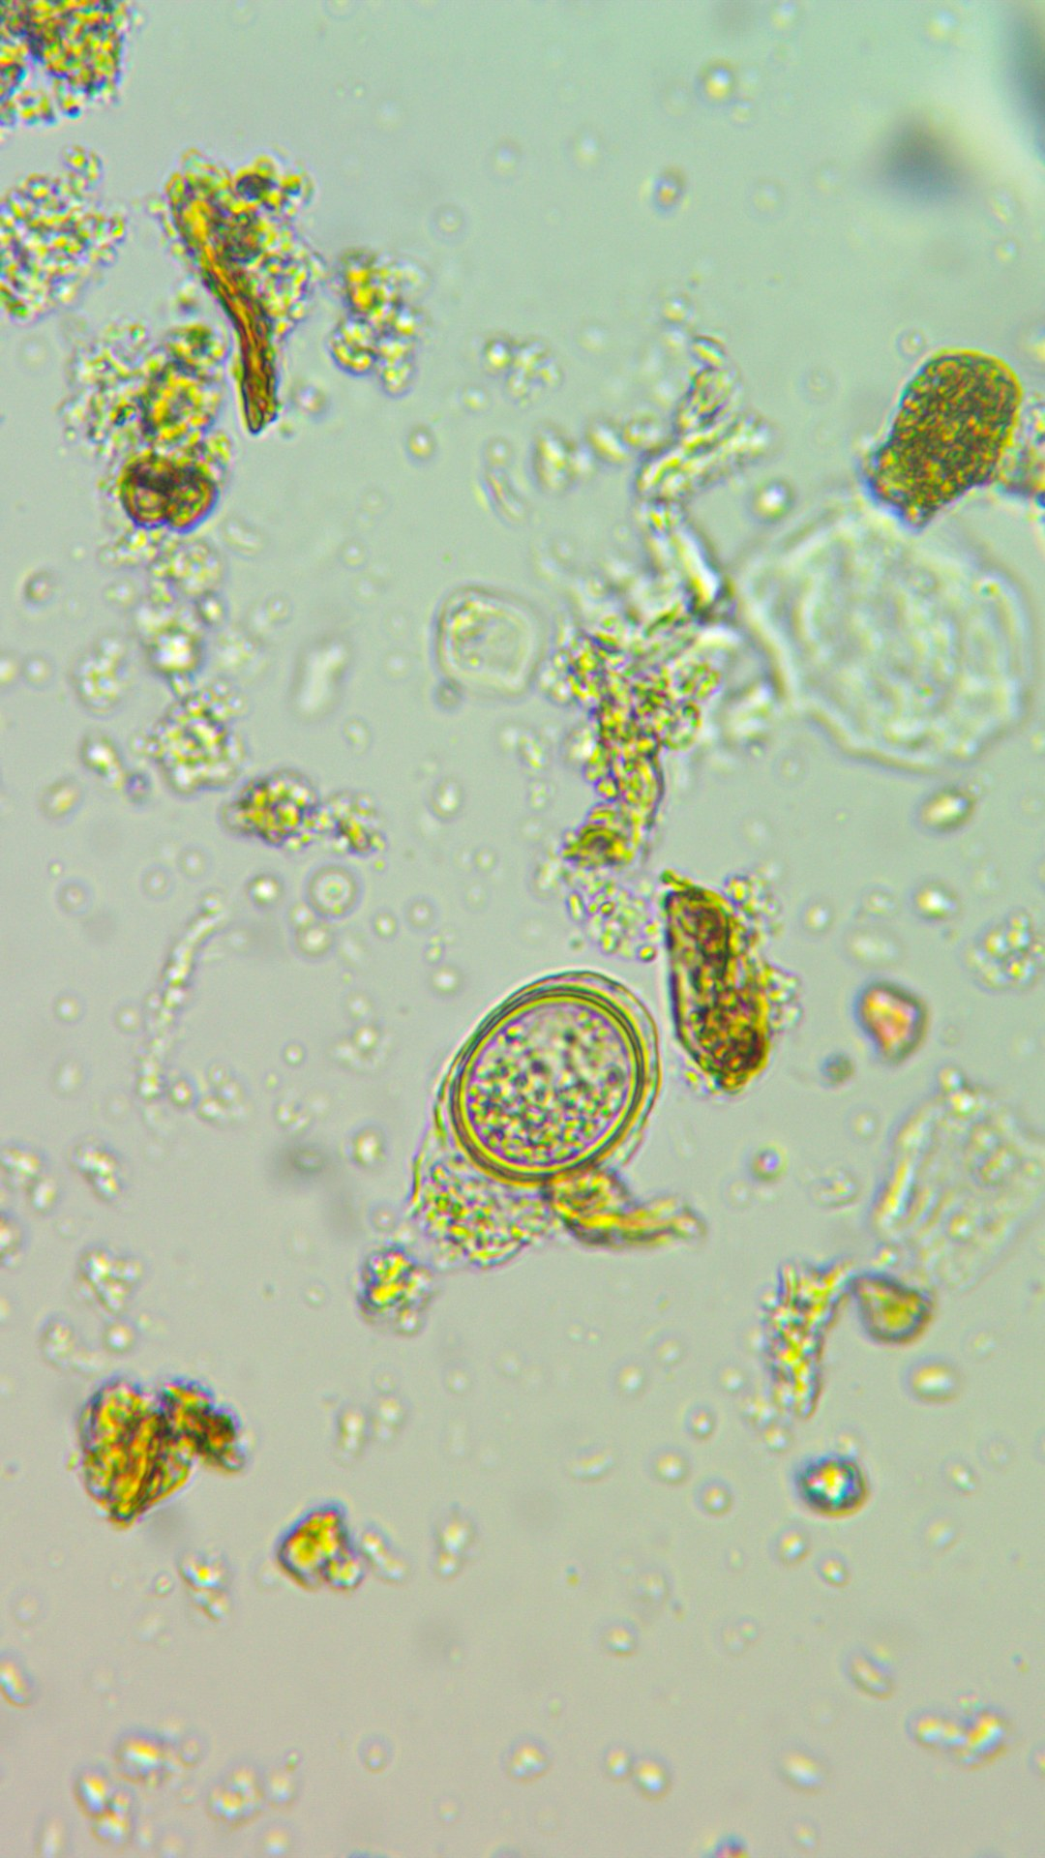

The biggest habitat on Earth is under your feet.
More than half of all species live in soil.
Notes:
Story. Source: Anthony, Bender and van der Heijden, PNAS, 2023, https://doi.org/10.1073/pnas.2304663120. Microscopy: assets/microscopy/testate-amoeba-encysting-40x-joy-kaluf.jpg (Joy Kaluf, per the file name). Leave y 1100 to 1450 empty for the poll sticker.

