Slide 1







Happy World Teachers' Day. Our mentors' best advice, in one line each.
Notes:
Opening slide. Source: mentor roster from Linnea, September 2026, and mentor bios on https://soilfoodweb.com. Leaf frame built from existing cutouts (ferns, leaf sprigs, dried flowers).

Slide 2

Tommy Tepper
Director of Education & Mentor
[ADVICE LINE NEEDED]
BASED IN
TEACHING SINCE
[VERIFY]
[VERIFY]
BACKGROUND
KNOWN FOR
[VERIFY]
[VERIFY]
Notes:
Trading card: Tommy Tepper. Facts from the mentor bios collected on 30 Sep 2026 (soilfoodweb.com was blocked from this session); confirm every fact and the advice line with the mentor before posting. [PHOTO NEEDED: Tommy Tepper, headshot]

Slide 3
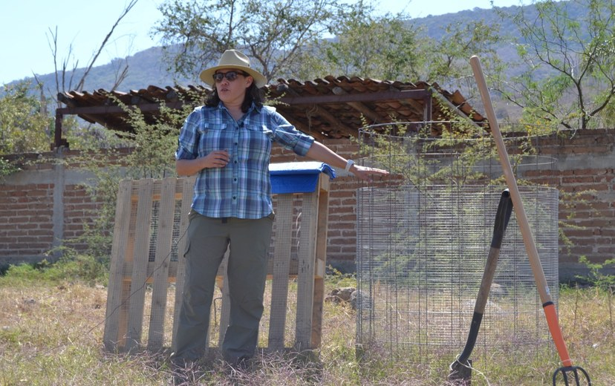
Loida Vasquez
Advanced Programs Lead & Mentor
[ADVICE LINE NEEDED]
BASED IN
TEACHING SINCE
[VERIFY]
[VERIFY]
BACKGROUND
KNOWN FOR
[VERIFY]
[VERIFY]
Notes:
Trading card: Loida Vasquez. Facts from the mentor bios collected on 30 Sep 2026 (soilfoodweb.com was blocked from this session); confirm every fact and the advice line with the mentor before posting.

Slide 4
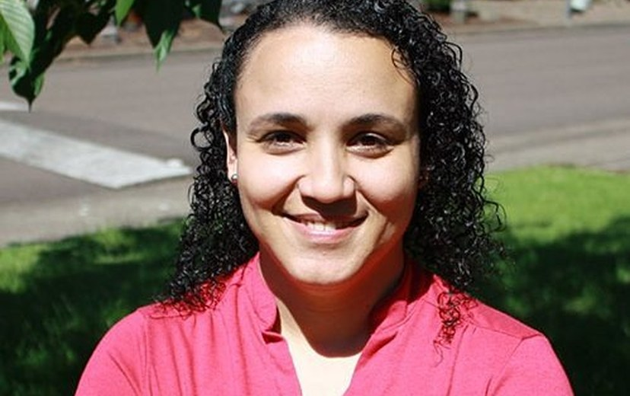
Dr. Carla Portugal
Science Lead & Mentor
“Bare soil erodes. Living roots and cover hold the aggregates together.”
BASED IN
TEACHING SINCE
Brazil [VERIFY]
2019
BACKGROUND
KNOWN FOR
PhD in Environmental Sciences, 20 years of environmental and farm consulting
[VERIFY]
Notes:
Trading card: Dr. Carla Portugal. Facts from the mentor bios collected on 30 Sep 2026 (soilfoodweb.com was blocked from this session); confirm every fact and the advice line with the mentor before posting. Carla's headshot is only 499 px; ask for a larger file.

Slide 5
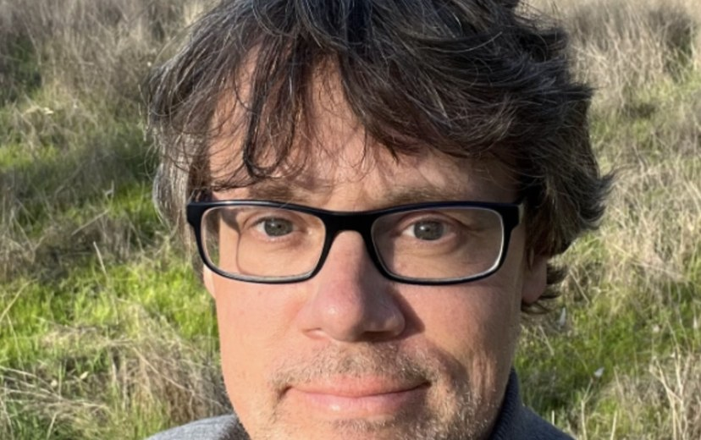
Wesley Sanders
AP Mentor
“Compost can look finished and still lack the biology you need. Check it under the microscope before you apply it.”
BASED IN
TEACHING SINCE
Sierra Nevada foothills, California
2020
BACKGROUND
KNOWN FOR
10 years as an agricultural journalist, then 10 years managing a farm
Foothill Biological Soil Health Services
Notes:
Trading card: Wesley Sanders. Facts from the mentor bios collected on 30 Sep 2026 (soilfoodweb.com was blocked from this session); confirm every fact and the advice line with the mentor before posting.

Slide 6
Casey Williams
AP Mentor
[ADVICE LINE NEEDED]
BASED IN
TEACHING SINCE
[VERIFY]
[VERIFY]
BACKGROUND
KNOWN FOR
[VERIFY]
[VERIFY]
Notes:
Trading card: Casey Williams. Facts from the mentor bios collected on 30 Sep 2026 (soilfoodweb.com was blocked from this session); confirm every fact and the advice line with the mentor before posting. [PHOTO NEEDED: Casey Williams, headshot]

Slide 7
Brian Daubenspeck
AP Mentor
[ADVICE LINE NEEDED]
BASED IN
TEACHING SINCE
[VERIFY]
[VERIFY]
BACKGROUND
KNOWN FOR
[VERIFY]
[VERIFY]
Notes:
Trading card: Brian Daubenspeck. Facts from the mentor bios collected on 30 Sep 2026 (soilfoodweb.com was blocked from this session); confirm every fact and the advice line with the mentor before posting. [PHOTO NEEDED: Brian Daubenspeck, headshot]

Slide 8
Isadora Schmidt
AP Mentor
[ADVICE LINE NEEDED]
BASED IN
TEACHING SINCE
[VERIFY]
[VERIFY]
BACKGROUND
KNOWN FOR
[VERIFY]
[VERIFY]
Notes:
Trading card: Isadora Schmidt. Facts from the mentor bios collected on 30 Sep 2026 (soilfoodweb.com was blocked from this session); confirm every fact and the advice line with the mentor before posting. [PHOTO NEEDED: Isadora Schmidt, headshot]

Slide 9
Aysen Ustunay
AP Mentor
[ADVICE LINE NEEDED]
BASED IN
TEACHING SINCE
[VERIFY]
[VERIFY]
BACKGROUND
KNOWN FOR
[VERIFY]
[VERIFY]
Notes:
Trading card: Aysen Ustunay. Facts from the mentor bios collected on 30 Sep 2026 (soilfoodweb.com was blocked from this session); confirm every fact and the advice line with the mentor before posting. [PHOTO NEEDED: Aysen Ustunay, headshot]

Slide 10
Dora Tkalec
AP Mentor
[ADVICE LINE NEEDED]
BASED IN
TEACHING SINCE
[VERIFY]
[VERIFY]
BACKGROUND
KNOWN FOR
[VERIFY]
[VERIFY]
Notes:
Trading card: Dora Tkalec. Facts from the mentor bios collected on 30 Sep 2026 (soilfoodweb.com was blocked from this session); confirm every fact and the advice line with the mentor before posting. [PHOTO NEEDED: Dora Tkalec, headshot]

Slide 11
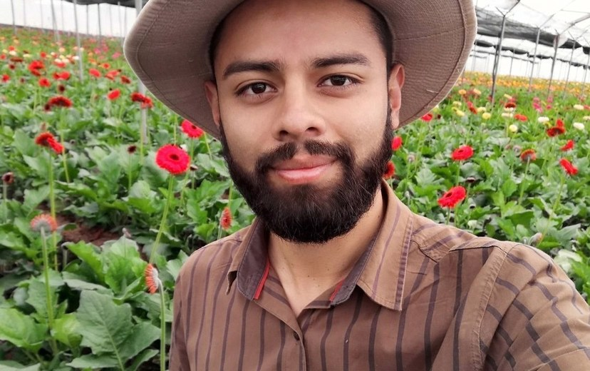
Gerald Ramirez
AP Mentor
“Extracts pull organisms off the compost into solution, so you can apply biology across a whole field.”
BASED IN
TEACHING SINCE
Costa Rica
[VERIFY]
BACKGROUND
KNOWN FOR
Agronomist, University of Costa Rica
[VERIFY]
Notes:
Trading card: Gerald Ramirez. Facts from the mentor bios collected on 30 Sep 2026 (soilfoodweb.com was blocked from this session); confirm every fact and the advice line with the mentor before posting. Bio also says 'Teaching the CLP and CTP courses' (left off: no acronyms in public text).

Slide 12
Elena Kalli
AP Admin
[ADVICE LINE NEEDED]
BASED IN
TEACHING SINCE
[VERIFY]
[VERIFY]
BACKGROUND
KNOWN FOR
[VERIFY]
[VERIFY]
Notes:
Trading card: Elena Kalli. Facts from the mentor bios collected on 30 Sep 2026 (soilfoodweb.com was blocked from this session); confirm every fact and the advice line with the mentor before posting. [PHOTO NEEDED: Elena Kalli, headshot]

Slide 13
Ib Borup Pederson
AP Mentor
[ADVICE LINE NEEDED]
BASED IN
TEACHING SINCE
[VERIFY]
[VERIFY]
BACKGROUND
KNOWN FOR
[VERIFY]
[VERIFY]
Notes:
Trading card: Ib Borup Pederson. Facts from the mentor bios collected on 30 Sep 2026 (soilfoodweb.com was blocked from this session); confirm every fact and the advice line with the mentor before posting. [PHOTO NEEDED: Ib Borup Pederson, headshot]

Slide 14
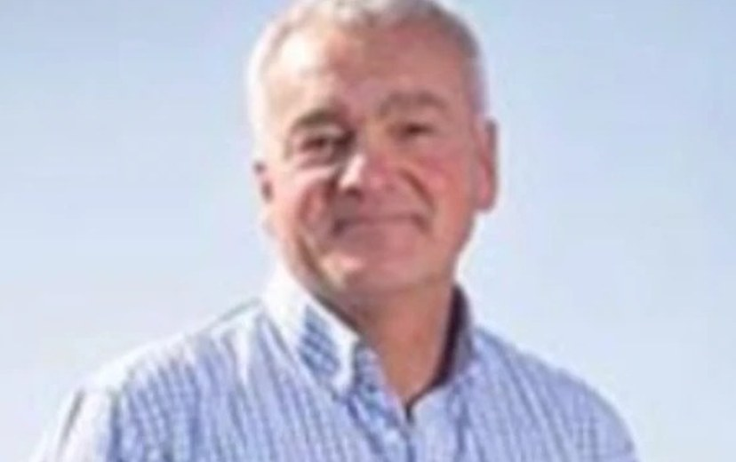
Nick Padwick
AP Mentor
“I make 750 tons of compost a year. Biology works at any scale.”
BASED IN
TEACHING SINCE
West Norfolk, England
[VERIFY]
BACKGROUND
KNOWN FOR
Farmers Weekly Farm Manager and Farmer of the Year, 2009
Managing Ken Hill Estate, home of Wild Ken Hill
Notes:
Trading card: Nick Padwick. Facts from the mentor bios collected on 30 Sep 2026 (soilfoodweb.com was blocked from this session); confirm every fact and the advice line with the mentor before posting.

Slide 15
Delvin Solkinson
Permaculture Lead Teacher
[ADVICE LINE NEEDED]
BASED IN
TEACHING SINCE
[VERIFY]
[VERIFY]
BACKGROUND
KNOWN FOR
[VERIFY]
[VERIFY]
Notes:
Trading card: Delvin Solkinson. Facts from the mentor bios collected on 30 Sep 2026 (soilfoodweb.com was blocked from this session); confirm every fact and the advice line with the mentor before posting. [PHOTO NEEDED: Delvin Solkinson, headshot]

Slide 16
Thank you to every mentor who teaches our students to see soil.
Notes:
Closing slide. Leaf frame built from existing cutouts.

