Slide 1
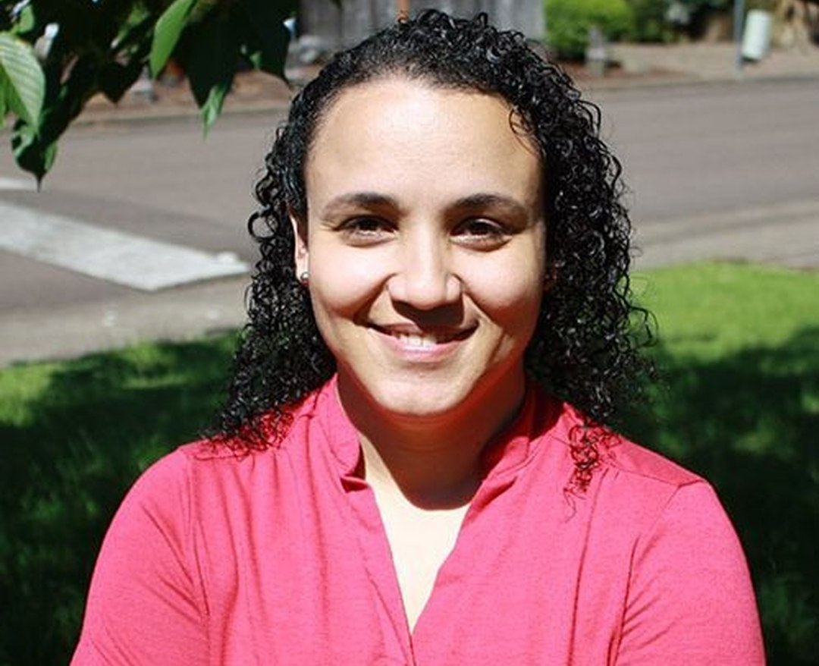
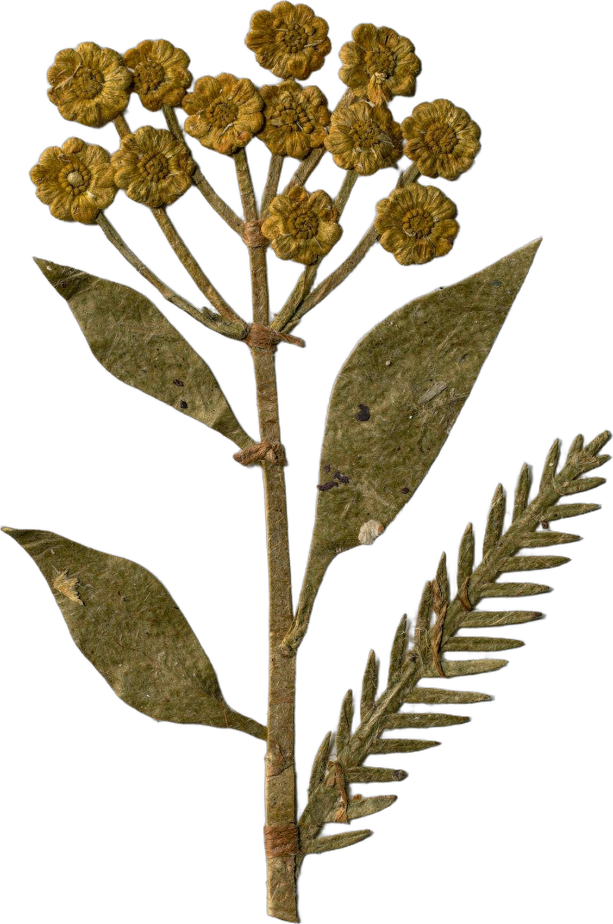

Meet our mentors
Dr. Carla Portugal
Science Lead & Mentor
Notes:
First 'Meet our mentors' post; posts 8 to 10 reuse this layout. No photo of Carla at a microscope in the library; this is her headshot (499 px, upscaled: ask for a larger file or a microscope photo) [PHOTO NEEDED: higher resolution].

