Slide 1

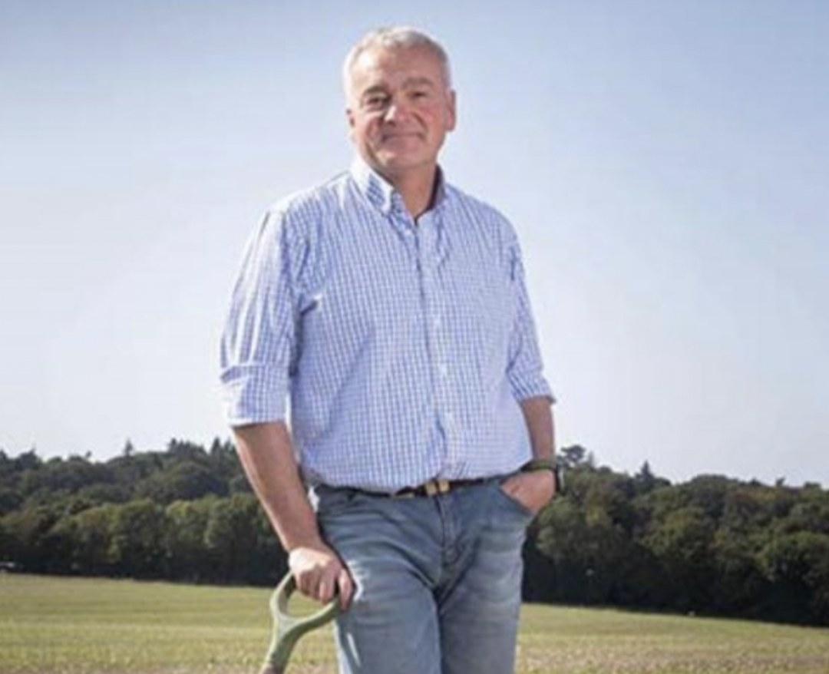

Meet our mentors
Nick Padwick
AP Mentor
Notes:
Photo: assets/mentors-teachers-day/Nick.png (Nick in a field with a spade). No photo with his windrows or compost turner in the library; the Drive photo from Wild Soils, Nov 2024, is the same small group shot as assets/photo/carla-nicks-son-nick-eri-wild-soils-event-11-2024.jpg.

