Slide 1

OCTOBER 5
Happy World Teachers' Day
Meet our eighteen mentors.
Swipe →
Notes:
Slide 1: bunting, balloons and stars (PowerPoint shapes), big logo. Mentor photos: Linnea's Drive folder (5 Oct 2026) and assets/mentors-teachers-day/; written consent per the folder README.

Slide 2

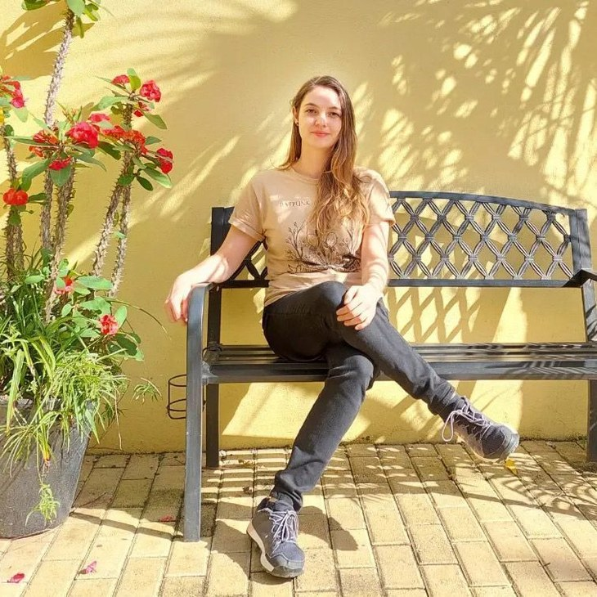
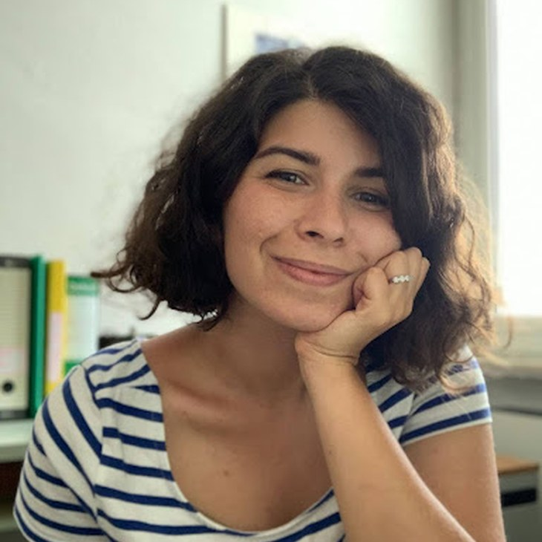
Ib Borup Pedersen
Farmer, SFW Consultant & Mentor
Laura Campos
SFW Mentor
Dr. Caterina Capri
SFW Mentor
Notes:
Mentors: Ib Borup Pedersen, Laura Campos, Caterina Capri. About lines: drafts from the team notes; confirm with each mentor (05-10-2026-mon-ig-teachers-day-mentors.md). Mentor photos: Linnea's Drive folder (5 Oct 2026) and assets/mentors-teachers-day/; written consent per the folder README.

Slide 3


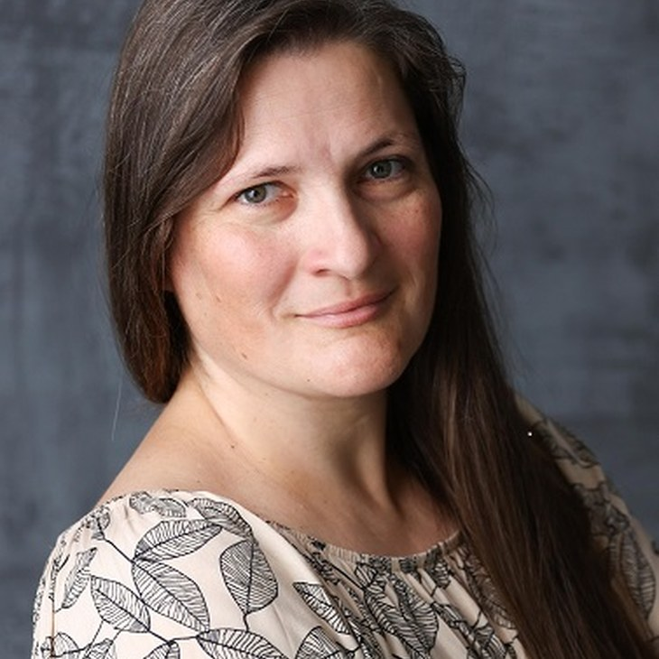
Brian Daubenspeck
SFW Consultant & Mentor
Elena Kalli
School Administration Officer
Dr. Nora Levay
SFW Mentor
Notes:
Mentors: Brian Daubenspeck, Elena Kalli, Nora Levay. About lines: drafts from the team notes; confirm with each mentor (05-10-2026-mon-ig-teachers-day-mentors.md). Mentor photos: Linnea's Drive folder (5 Oct 2026) and assets/mentors-teachers-day/; written consent per the folder README.

Slide 4


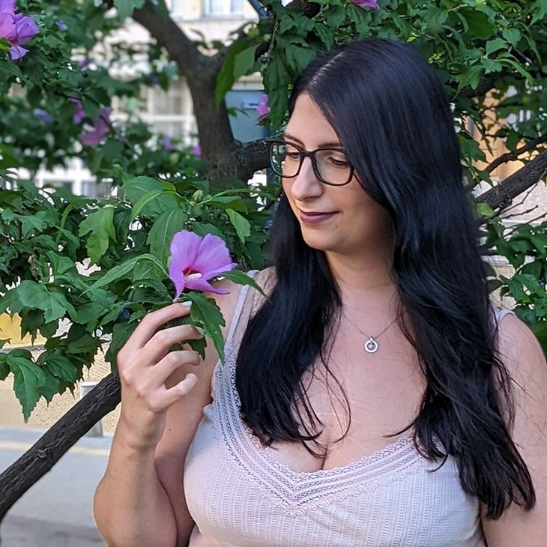
Nick Padwick
Farmer, SFW Consultant & Mentor
Dr. Carla Ribeiro Machado e Portugal
SFW Mentor
Dr. Elina Psara
SFW Mentor Team Lead
Notes:
Mentors: Nick Padwick, Carla Ribeiro Machado e Portugal, Elina Psara. About lines: drafts from the team notes; confirm with each mentor (05-10-2026-mon-ig-teachers-day-mentors.md). Mentor photos: Linnea's Drive folder (5 Oct 2026) and assets/mentors-teachers-day/; written consent per the folder README.

Slide 5



Gerald Ramírez
SFW Mentor
Wesley Sanders
SFW Consultant & Mentor
Isadora Schmidt
SFW Consultant & Mentor
Notes:
Mentors: Gerald Ramírez, Wesley Sanders, Isadora Schmidt. About lines: drafts from the team notes; confirm with each mentor (05-10-2026-mon-ig-teachers-day-mentors.md). Mentor photos: Linnea's Drive folder (5 Oct 2026) and assets/mentors-teachers-day/; written consent per the folder README.

Slide 6



Delvin Solkinson
SFW Permaculture Lead
Tommy Tepper
Instructor
Dora Tkalec
SFW Consultant & Mentor
Notes:
Mentors: Delvin Solkinson, Tommy Tepper, Dora Tkalec. About lines: drafts from the team notes; confirm with each mentor (05-10-2026-mon-ig-teachers-day-mentors.md). Mentor photos: Linnea's Drive folder (5 Oct 2026) and assets/mentors-teachers-day/; written consent per the folder README.

Slide 7



Ayşen Üstünay
SFW Consultant & Mentor
Loida Vasquez
Advanced Programs Lead
Casey Williams
SFW Consultant & Mentor
Notes:
Mentors: Ayşen Üstünay, Loida Vasquez, Casey Williams. About lines: drafts from the team notes; confirm with each mentor (05-10-2026-mon-ig-teachers-day-mentors.md). Mentor photos: Linnea's Drive folder (5 Oct 2026) and assets/mentors-teachers-day/; written consent per the folder README.

Slide 8


















Happy World Teachers' Day
Ib Borup Pedersen
Laura Campos
Caterina Capri
Brian Daubenspeck
Elena Kalli
Nora Levay
Nick Padwick
Carla Portugal
Elina Psara
Gerald Ramírez
Wesley Sanders
Isadora Schmidt
Delvin Solkinson
Tommy Tepper
Dora Tkalec
Ayşen Üstünay
Loida Vasquez
Casey Williams
Notes:
All fourteen in a grid, alphabetical. Mentor photos: Linnea's Drive folder (5 Oct 2026) and assets/mentors-teachers-day/; written consent per the folder README.

Slide 9
OCTOBER 5
Happy World Teachers' Day
soilfoodweb.com
Notes:
Closing: bunting, balloons and a big logo. Line to confirm with Linnea.

