Slide 1
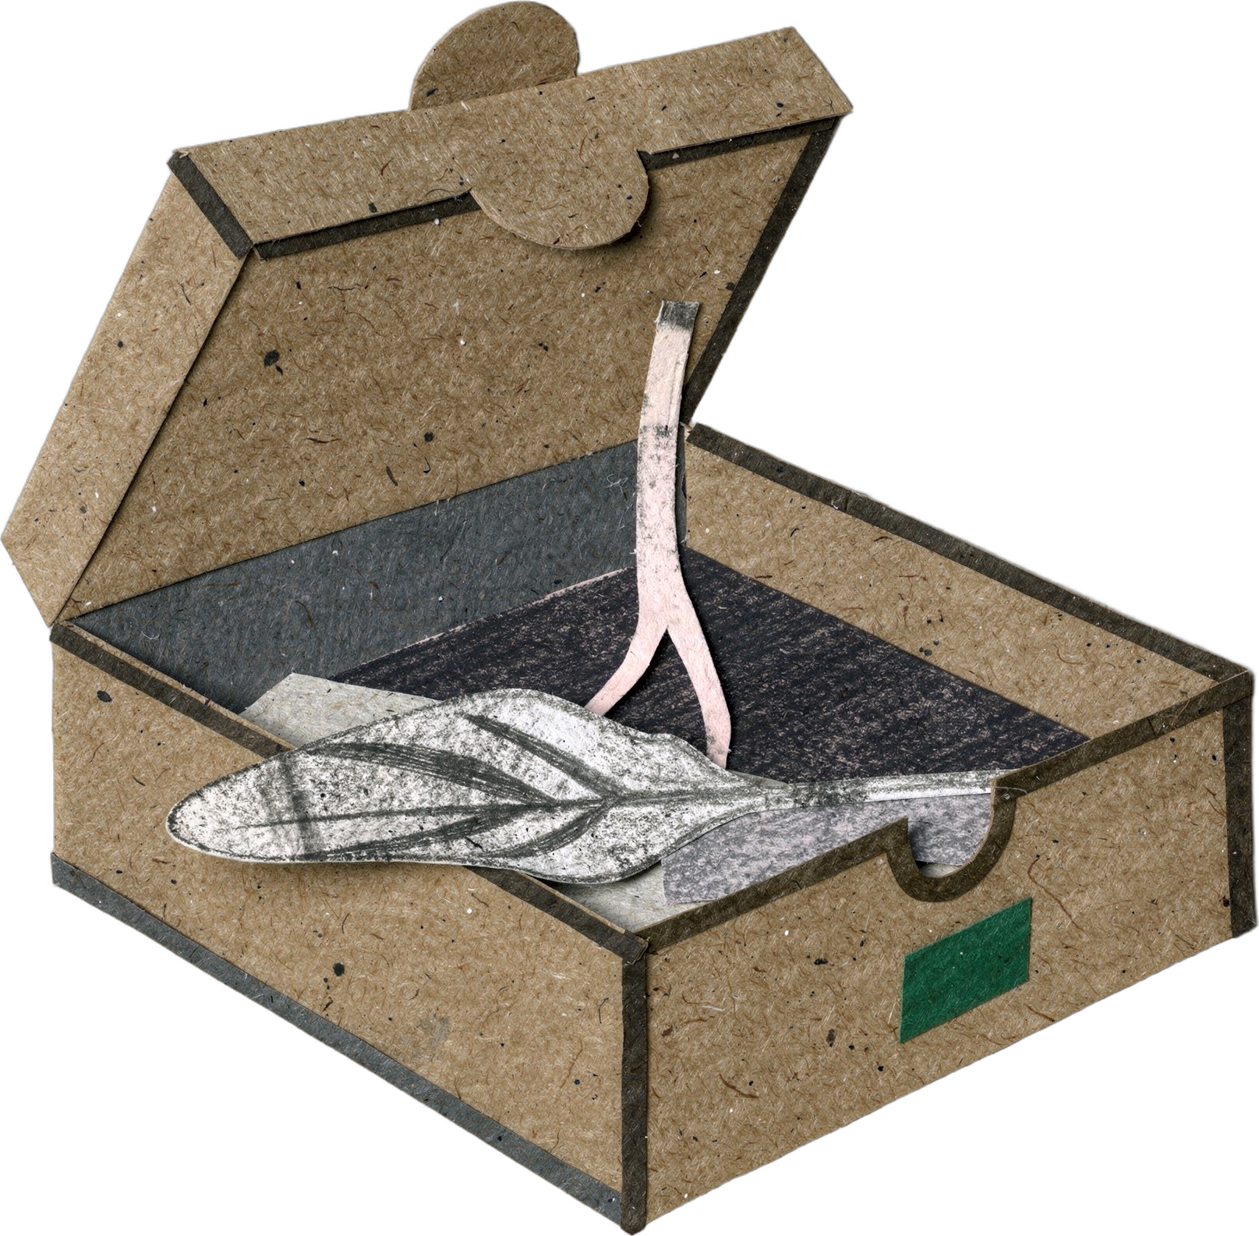

DR. ELAINE INGHAM · HOW TO BUILD GREAT SOIL
Your plant ordered pizza today. 🍕
Dr. Elaine Ingham, How to Build Great Soil, Part 1, 12:33 and 15:03; Clarholm 1985
Notes:
Template 3. Cover. Collage: pizza-box-root. Sources: Dr. Elaine Ingham, "How to Build Great Soil, Part 1", Diego Footer, 12:33: https://www.youtube.com/watch?v=ErMHR6Mc4Bk&t=753s; Dr. Elaine Ingham, "How to Build Great Soil, Part 1", Diego Footer, 15:03: https://www.youtube.com/watch?v=ErMHR6Mc4Bk&t=903s. Clarholm, "Interactions of bacteria, protozoa and plants leading to mineralization of soil nitrogen", Soil Biology and Biochemistry, 1985: https://scholar.google.com/scholar?q=Clarholm+1985+Interactions+of+bacteria+protozoa+and+plants+leading+to+mineralization+of+soil+nitrogen. Credit line for every quote: Dr. Elaine Ingham, "How to Build Great Soil, Part 1", Diego Footer. Short quotes with credit are fine; video clips and long excerpts need Evan to check with Diego first. Caption needs review by Allison (AI-generated by Linnea).

Slide 2
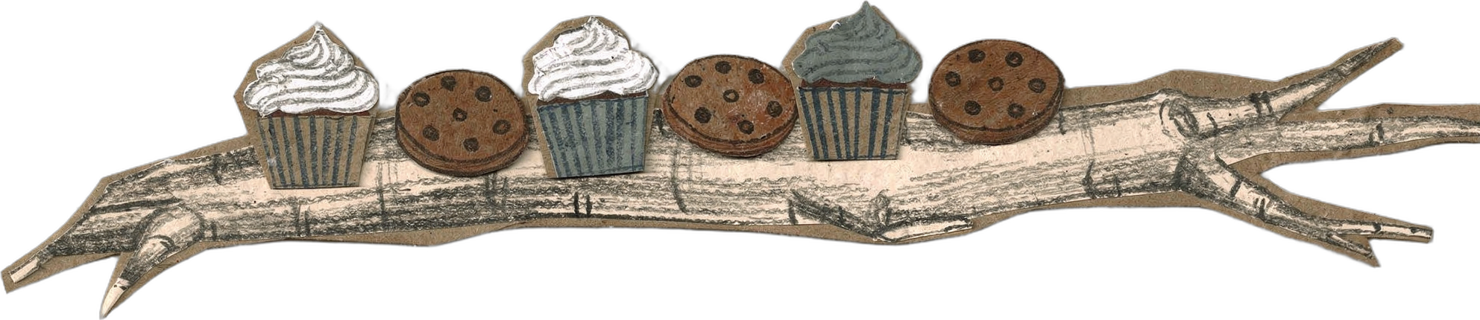
DR. ELAINE INGHAM · HOW TO BUILD GREAT SOIL
It pays with root exudates: mostly sugar, a little protein, a little carbohydrate. Dr. Elaine called them cakes and cookies.
Dr. Elaine Ingham, How to Build Great Soil, Part 1, 12:33 and 15:03; Clarholm 1985
soilfoodweb.com
Notes:
Template 3. Collage: cupcakes-cookies-root. Credit line for every quote: Dr. Elaine Ingham, "How to Build Great Soil, Part 1", Diego Footer. Short quotes with credit are fine; video clips and long excerpts need Evan to check with Diego first. Caption needs review by Allison (AI-generated by Linnea).

Slide 3

DR. ELAINE INGHAM · HOW TO BUILD GREAT SOIL
The recipe is the order. Each blend wakes the bacteria or fungi that make the enzymes for one nutrient: boron, molybdenum, zinc, phosphorus.
Dr. Elaine Ingham, How to Build Great Soil, Part 1, 12:33 and 15:03; Clarholm 1985
soilfoodweb.com
Notes:
Template 3. Library cutout: cute-bacterium-1. Credit line for every quote: Dr. Elaine Ingham, "How to Build Great Soil, Part 1", Diego Footer. Short quotes with credit are fine; video clips and long excerpts need Evan to check with Diego first. Caption needs review by Allison (AI-generated by Linnea).

Slide 4
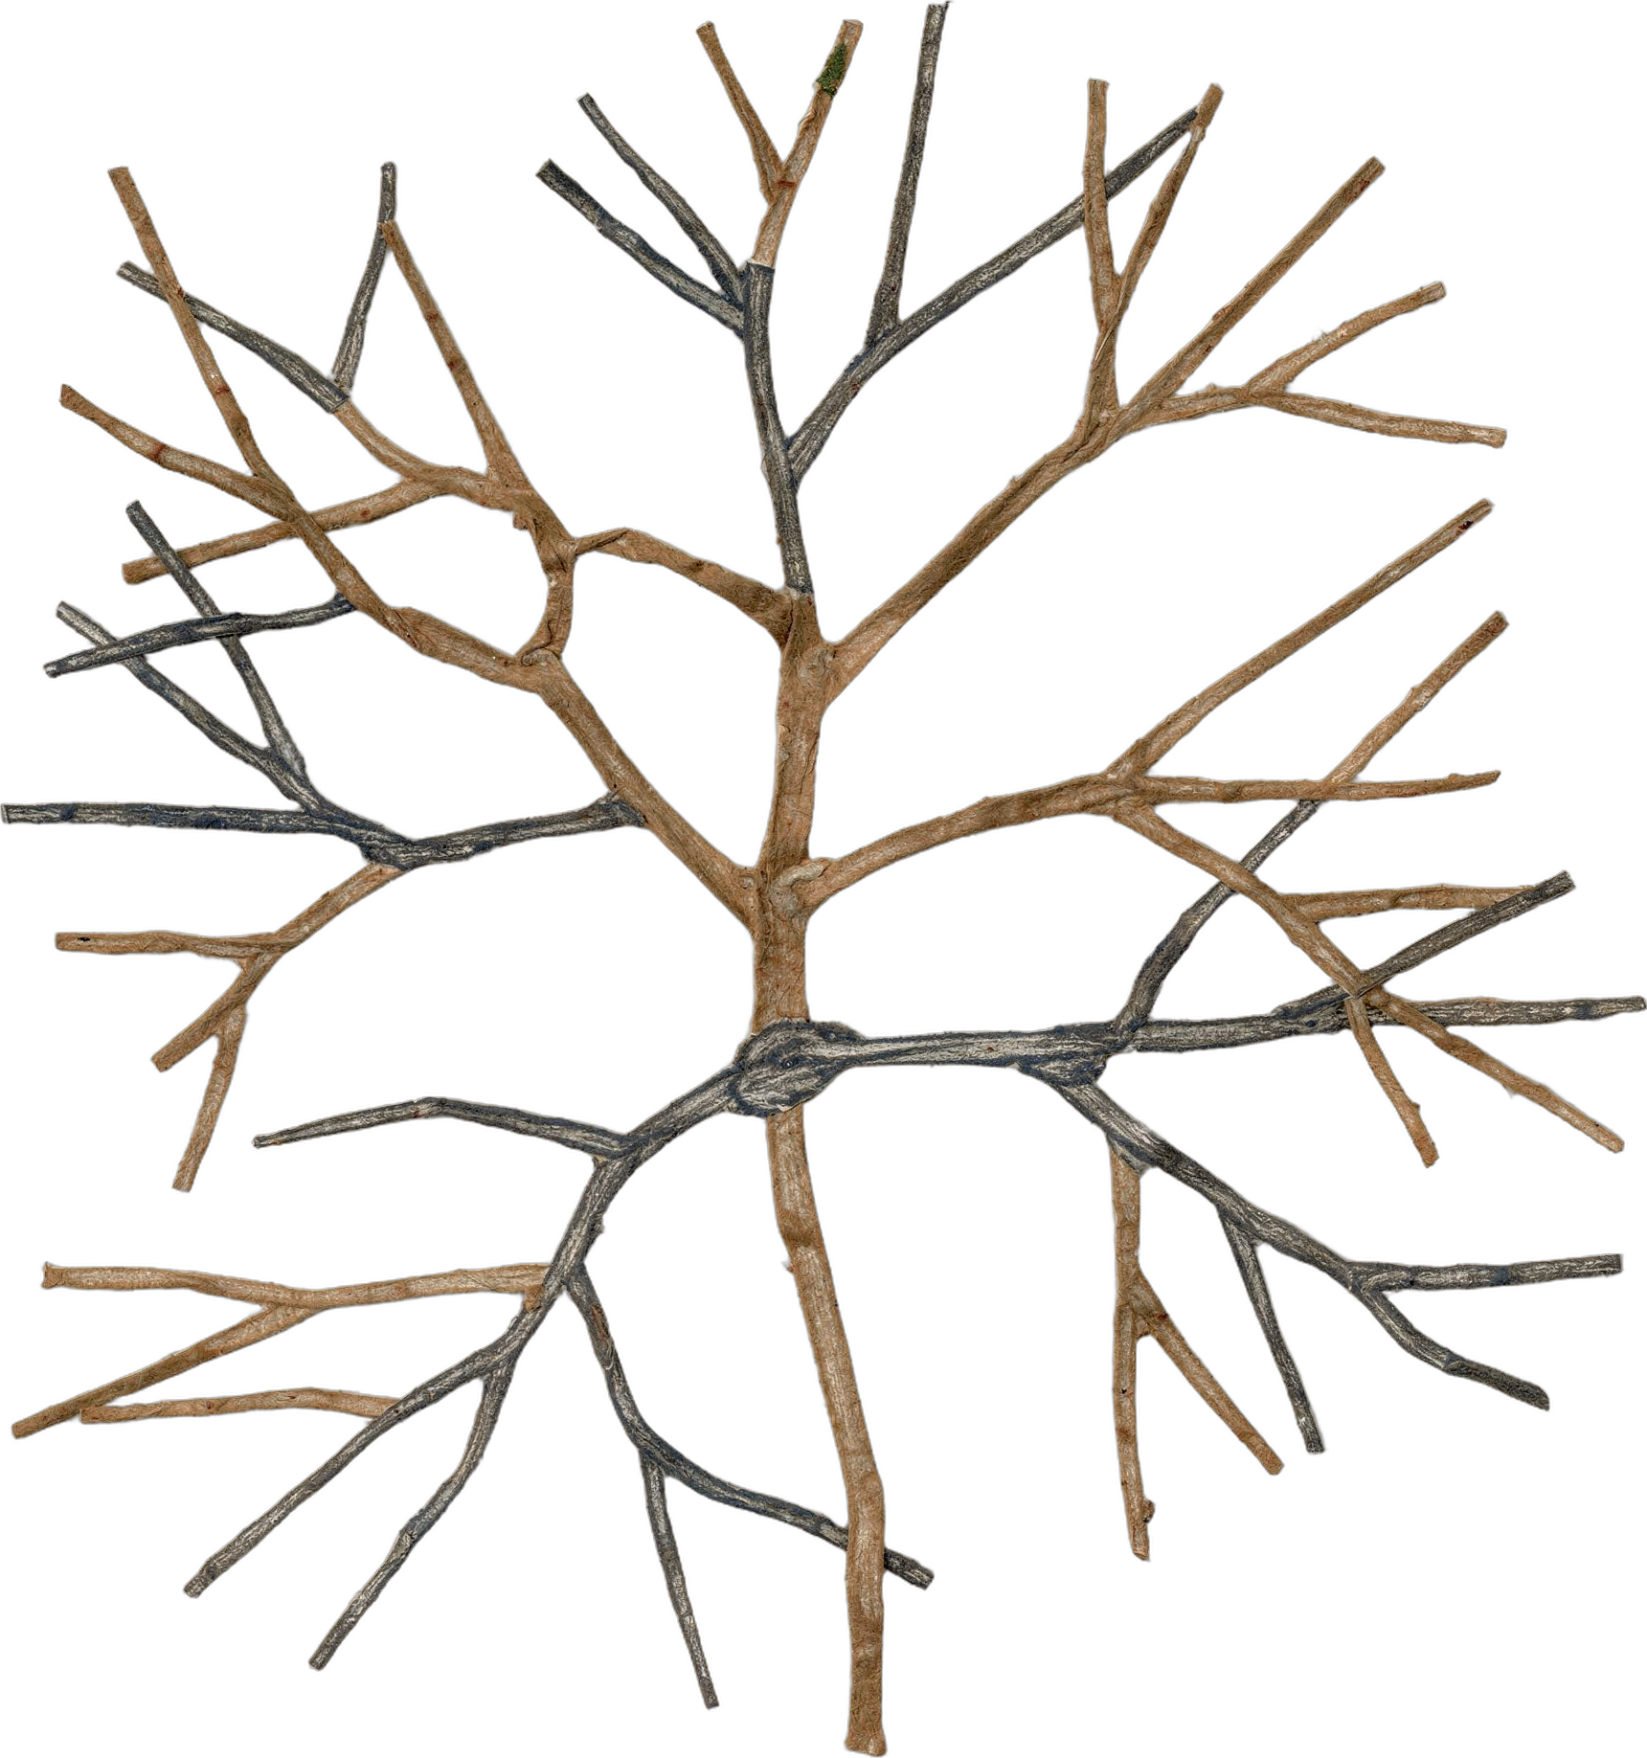
DR. ELAINE INGHAM · HOW TO BUILD GREAT SOIL
Those microbes pull the nutrients off sand, silt, clay and organic matter, and store them in their own bodies.
Dr. Elaine Ingham, How to Build Great Soil, Part 1, 12:33 and 15:03; Clarholm 1985
soilfoodweb.com
Notes:
Template 3. Library cutout: fungal-hyphae-1. Credit line for every quote: Dr. Elaine Ingham, "How to Build Great Soil, Part 1", Diego Footer. Short quotes with credit are fine; video clips and long excerpts need Evan to check with Diego first. Caption needs review by Allison (AI-generated by Linnea).

Slide 5
DR. ELAINE INGHAM · HOW TO BUILD GREAT SOIL
Delivery: protozoa and nematodes eat the microbes and release the extra nutrients at the root, in plant-available form.
PHOTO: assets/microscopy/flagellate.jpg
Dr. Elaine Ingham, How to Build Great Soil, Part 1, 12:33 and 15:03; Clarholm 1985
soilfoodweb.com
Notes:
Template 3. No flagellate in assets/microscopy/: placeholder until one is supplied (Wes). Credit line for every quote: Dr. Elaine Ingham, "How to Build Great Soil, Part 1", Diego Footer. Short quotes with credit are fine; video clips and long excerpts need Evan to check with Diego first. Caption needs review by Allison (AI-generated by Linnea).

Slide 6
DR. ELAINE INGHAM · HOW TO BUILD GREAT SOIL
Only the plant knows what it needs today. A soil lab report arrives two weeks later.
Dr. Elaine Ingham, How to Build Great Soil, Part 1, 12:33 and 15:03; Clarholm 1985
soilfoodweb.com
Notes:
Template 3. Type only. Credit line for every quote: Dr. Elaine Ingham, "How to Build Great Soil, Part 1", Diego Footer. Short quotes with credit are fine; video clips and long excerpts need Evan to check with Diego first. Caption needs review by Allison (AI-generated by Linnea).

Slide 7

“
Put the plant back in control of its own life.
Dr. Elaine Ingham
How to Build Great Soil, Part 1 · Diego Footer
How to Build Great Soil, Part 1, 16:32
Notes:
Template 1B quote, Legacy Purple (Dr. Elaine content). Quote at 16:32. Credit line for every quote: Dr. Elaine Ingham, "How to Build Great Soil, Part 1", Diego Footer. Short quotes with credit are fine; video clips and long excerpts need Evan to check with Diego first. Caption needs review by Allison (AI-generated by Linnea).

