Slide 1
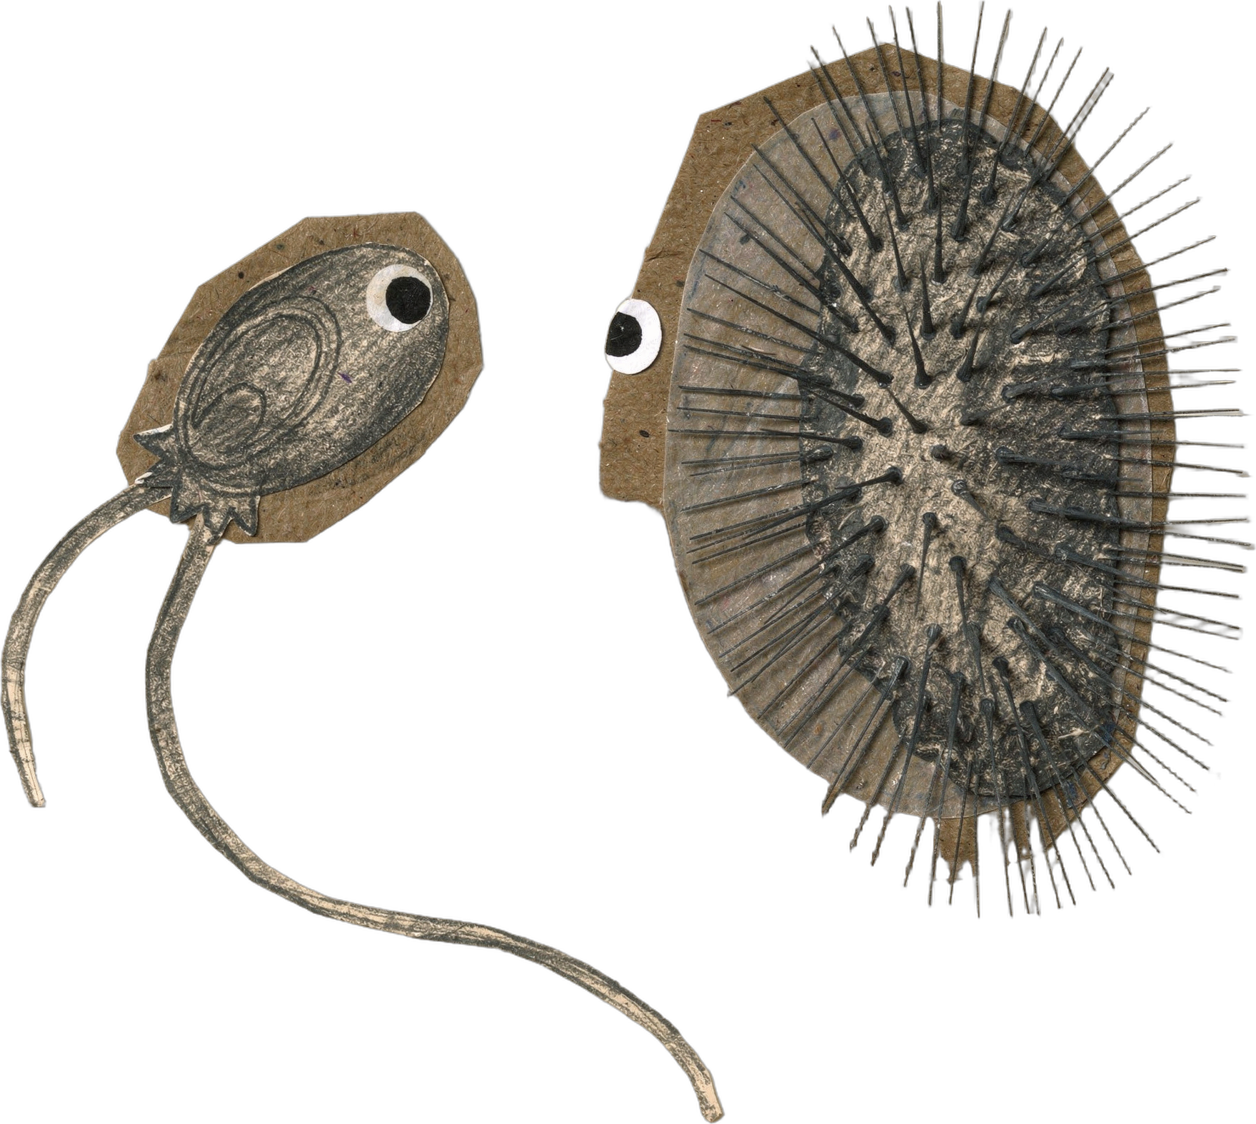

DR. ELAINE INGHAM · HOW TO BUILD GREAT SOIL
The oxygen gauge
Notes:
Template 6 reel cover. Collage: flagellate-ciliate. Sources: Dr. Elaine Ingham, "How to Build Great Soil, Part 1", Diego Footer, 19:28: https://www.youtube.com/watch?v=ErMHR6Mc4Bk&t=1168s. Ingham, Soil Biology Primer, USDA NRCS: https://scholar.google.com/scholar?q=Ingham+Soil+Biology+Primer+USDA+NRCS. Library footage and stills: amoeba: assets/video/sfw-amoeba-*.mp4, assets/gif/amoeba-*.gif, assets/microscopy/sfw-amoeba-still-*.jpg, amoeba-poster-1 to 3.jpg, cutout-2.png; testate amoeba: cutout-1.png, testate-amoeba-encysting-40x-*.jpg; ciliate: cutout-3.png, cutout-4.png (stalked ciliates); flagellate: none in the library (Wes). Credit line for every quote: Dr. Elaine Ingham, "How to Build Great Soil, Part 1", Diego Footer. Short quotes with credit are fine; video clips and long excerpts need Evan to check with Diego first. Caption needs review by Allison (AI-generated by Linnea).

Slide 2
“Is your compost running out of oxygen?”
Notes:
Template 6 caption card 1: 64 pt Montserrat Bold Cream, Deep Green outline, no background (export as PNG with transparency and lay over the footage). Credit line for every quote: Dr. Elaine Ingham, "How to Build Great Soil, Part 1", Diego Footer. Short quotes with credit are fine; video clips and long excerpts need Evan to check with Diego first. Caption needs review by Allison (AI-generated by Linnea).

Slide 3
“Flagellates and amoebae: oxygen is fine.”
Notes:
Template 6 caption card 2: 64 pt Montserrat Bold Cream, Deep Green outline, no background (export as PNG with transparency and lay over the footage). Credit line for every quote: Dr. Elaine Ingham, "How to Build Great Soil, Part 1", Diego Footer. Short quotes with credit are fine; video clips and long excerpts need Evan to check with Diego first. Caption needs review by Allison (AI-generated by Linnea).

Slide 4
“Ciliates waking up: oxygen is dropping.”
Notes:
Template 6 caption card 3: 64 pt Montserrat Bold Cream, Deep Green outline, no background (export as PNG with transparency and lay over the footage). Credit line for every quote: Dr. Elaine Ingham, "How to Build Great Soil, Part 1", Diego Footer. Short quotes with credit are fine; video clips and long excerpts need Evan to check with Diego first. Caption needs review by Allison (AI-generated by Linnea).

Slide 5
“More ciliates than flagellates? Turn the pile.”
Notes:
Template 6 caption card 4: 64 pt Montserrat Bold Cream, Deep Green outline, no background (export as PNG with transparency and lay over the footage). Credit line for every quote: Dr. Elaine Ingham, "How to Build Great Soil, Part 1", Diego Footer. Short quotes with credit are fine; video clips and long excerpts need Evan to check with Diego first. Caption needs review by Allison (AI-generated by Linnea).

