Slide 1
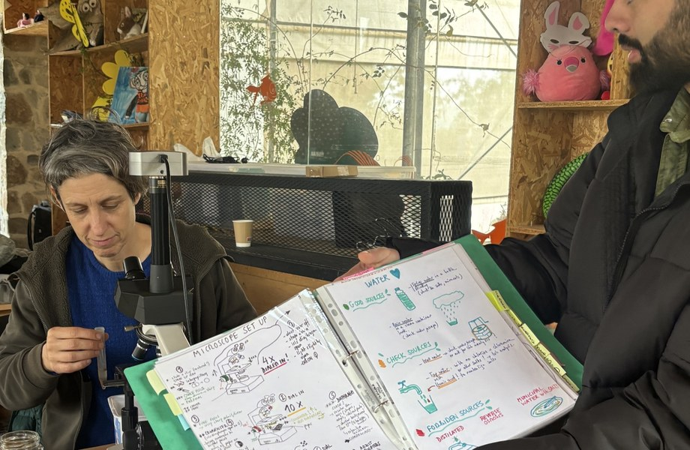

DR. ELAINE INGHAM · HOW TO BUILD GREAT SOIL
1.1 million people watched Dr. Elaine's soil masterclass. The question they ask most: which microscope?
Dr. Elaine Ingham, How to Build Great Soil, Part 1, 28:46; school.soilfoodweb.com
Notes:
Template 3. Photo: assets/photo/cy-classes-4.jpg (Foundation library), a class at microscopes; swap for a closer workshop photo of a student at a microscope if there is one. Sources: Dr. Elaine Ingham, "How to Build Great Soil, Part 1", Diego Footer, 28:46: https://www.youtube.com/watch?v=ErMHR6Mc4Bk&t=1726s. Course pages: https://school.soilfoodweb.com Credit line for every quote: Dr. Elaine Ingham, "How to Build Great Soil, Part 1", Diego Footer. Short quotes with credit are fine; video clips and long excerpts need Evan to check with Diego first. Caption needs review by Allison (AI-generated by Linnea).

Slide 2
DR. ELAINE INGHAM · HOW TO BUILD GREAT SOIL
At 29:03 she recommends a $350 microscope with objectives as good as Zeiss and a built-in camera.
Dr. Elaine Ingham, How to Build Great Soil, Part 1, 28:46; school.soilfoodweb.com
soilfoodweb.com
Notes:
Template 3. Type only. Credit line for every quote: Dr. Elaine Ingham, "How to Build Great Soil, Part 1", Diego Footer. Short quotes with credit are fine; video clips and long excerpts need Evan to check with Diego first. Caption needs review by Allison (AI-generated by Linnea).

Slide 3
DR. ELAINE INGHAM · HOW TO BUILD GREAT SOIL
What to look for today: [COPY: Wes].
PHOTO: Recommended microscope (from Wes)
Dr. Elaine Ingham, How to Build Great Soil, Part 1, 28:46; school.soilfoodweb.com
soilfoodweb.com
Notes:
Template 3. PHOTO placeholder: recommended microscope (from Wes). Credit line for every quote: Dr. Elaine Ingham, "How to Build Great Soil, Part 1", Diego Footer. Short quotes with credit are fine; video clips and long excerpts need Evan to check with Diego first. Caption needs review by Allison (AI-generated by Linnea).

Slide 4
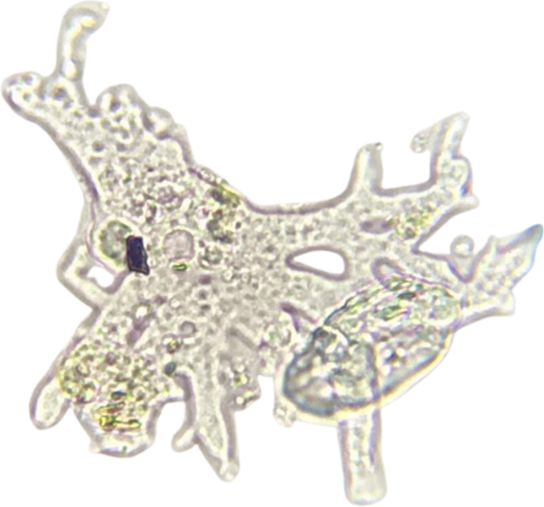
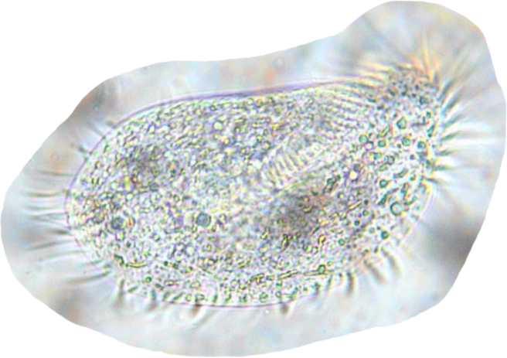
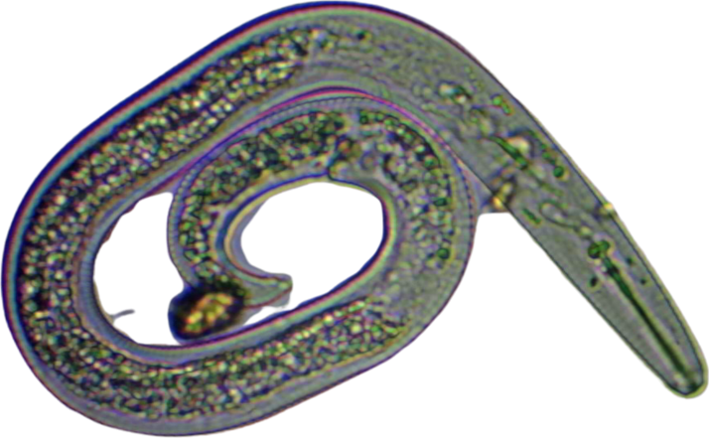
DR. ELAINE INGHAM · HOW TO BUILD GREAT SOIL
What you'll see: bacteria, fungal hyphae, flagellates, amoebae, ciliates and nematodes.
PHOTO:
bacteria
PHOTO:
fungal hyphae
PHOTO:
flagellate
Bacteria
Fungal hyphae
Flagellate
Amoeba
Ciliate
Nematode
Dr. Elaine Ingham, How to Build Great Soil, Part 1, 28:46; school.soilfoodweb.com
soilfoodweb.com
Notes:
Template 3: 2 x 3 grid of organisms, each labelled in 22 pt Source Sans 3. Bacteria, fungal hyphae and flagellate are not in assets/microscopy/: placeholders until supplied (Wes). Credit line for every quote: Dr. Elaine Ingham, "How to Build Great Soil, Part 1", Diego Footer. Short quotes with credit are fine; video clips and long excerpts need Evan to check with Diego first. Caption needs review by Allison (AI-generated by Linnea).

Slide 5
“
I can train you in one day how to use these microscopes.
Dr. Elaine Ingham
How to Build Great Soil, Part 1 · Diego Footer
How to Build Great Soil, Part 1, 28:52
soilfoodweb.com
Notes:
Template 1B quote, Legacy Purple (Dr. Elaine content). Quote at 28:52. Credit line for every quote: Dr. Elaine Ingham, "How to Build Great Soil, Part 1", Diego Footer. Short quotes with credit are fine; video clips and long excerpts need Evan to check with Diego first. Caption needs review by Allison (AI-generated by Linnea).

Slide 6
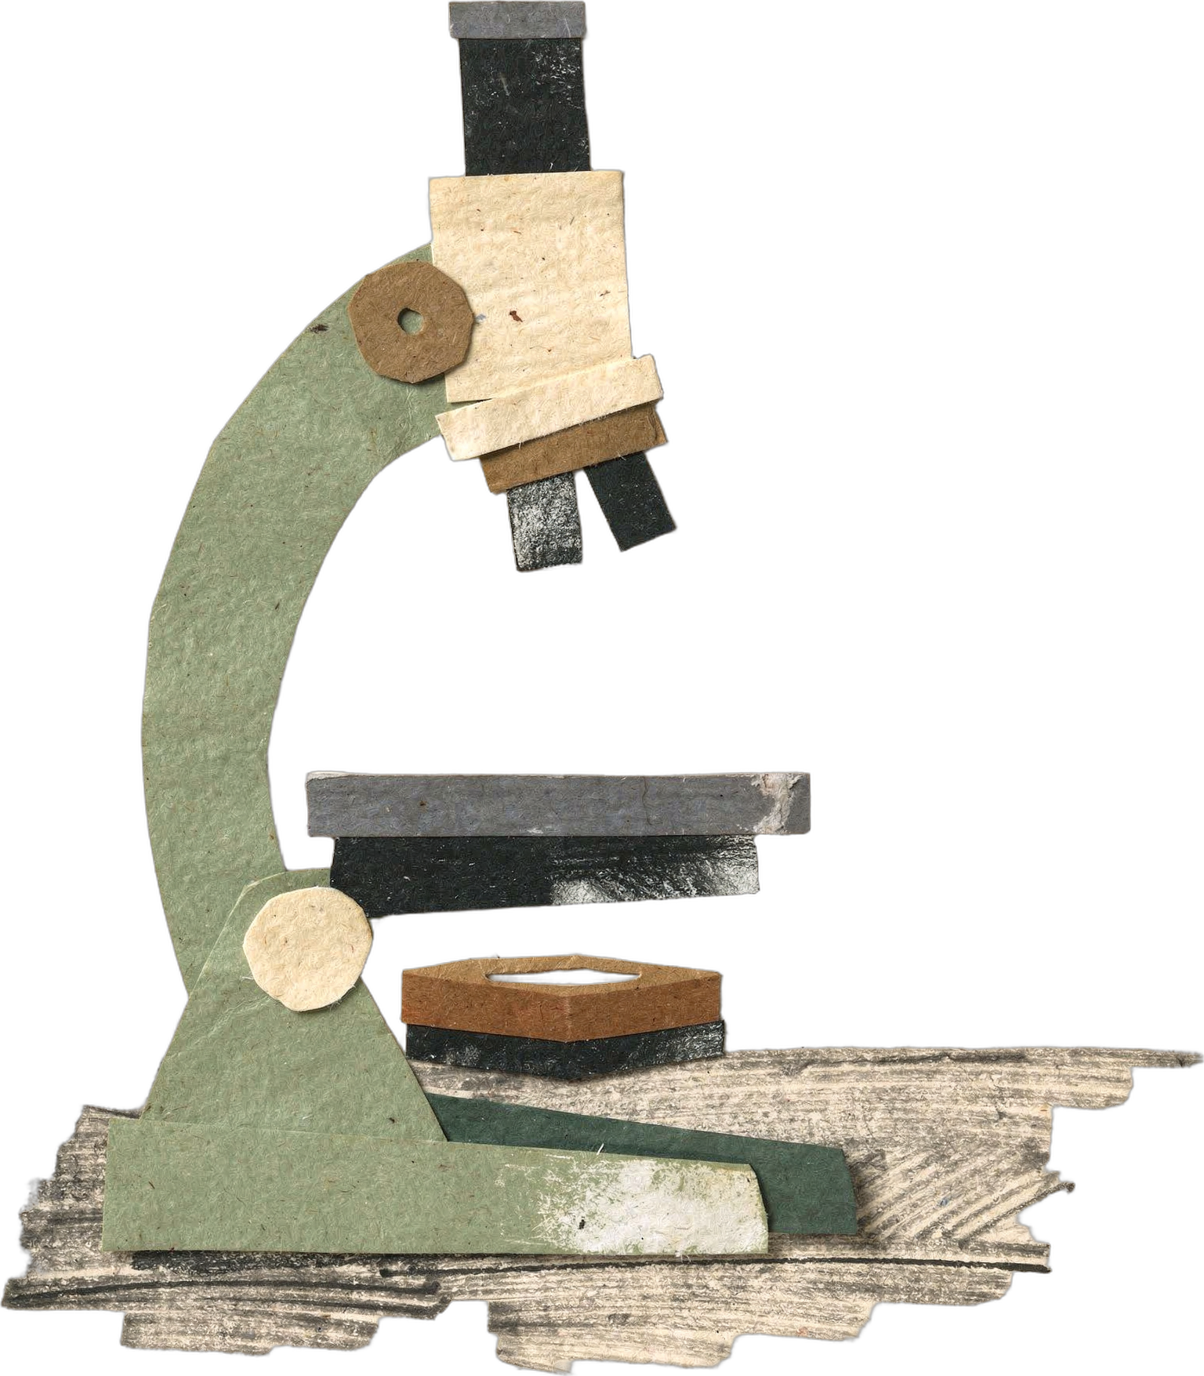
DR. ELAINE INGHAM · HOW TO BUILD GREAT SOIL
Learn soil microscopy in the Foundation Courses. Link in bio.
Dr. Elaine Ingham, How to Build Great Soil, Part 1, 28:46; school.soilfoodweb.com
Notes:
Template 3. Library cutout: microscope-paper-1. Link in bio: https://school.soilfoodweb.com Credit line for every quote: Dr. Elaine Ingham, "How to Build Great Soil, Part 1", Diego Footer. Short quotes with credit are fine; video clips and long excerpts need Evan to check with Diego first. Caption needs review by Allison (AI-generated by Linnea).

