Slide 1
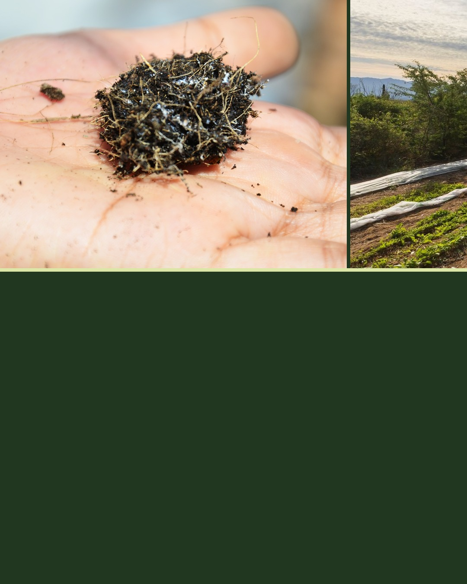

NEW STUDY
39%
more total carbon in the soil of the most regenerative farms.
Lundgren et al. 2026, Environ. Res.: Food Syst.
Notes:
Seamless 3-slide carousel, clean marketing style. Sources: Lundgren et al., Environmental Research: Food Systems, 2026, https://doi.org/10.1088/2976-601X/ae8f4e; Ecdysis Foundation press release, 17 September 2026, https://www.globenewswire.com/news-release/2026/09/17/3363925/0/en/regenerative-farming-outpaces-tech-based-carbon-capture-solutions-in-first-large-scale-systemic-study.html Photos (Foundation library, not 1000 Farms sites): hand-soil-roots-fungi.jpg, erc-rancho-cacachilas-agro.jpg (Rancho Cacachilas), handling-loose-soil.jpg.

Slide 2
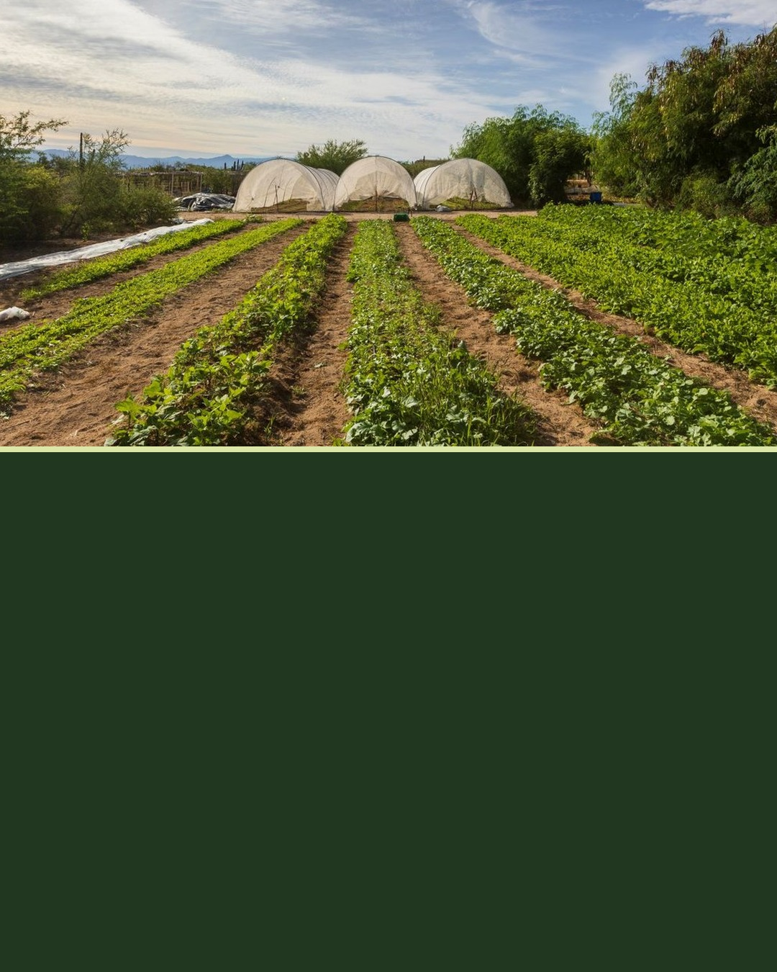
SAME FARMS, MORE LIFE
77%
more total fungi.
Soil microbes, insects, plants and birds were all more abundant.
soilfoodweb.com
Lundgren et al. 2026, Environ. Res.: Food Syst.
Notes:
Second slide. Sources: Lundgren et al., Environmental Research: Food Systems, 2026, https://doi.org/10.1088/2976-601X/ae8f4e; Ecdysis Foundation press release, 17 September 2026, https://www.globenewswire.com/news-release/2026/09/17/3363925/0/en/regenerative-farming-outpaces-tech-based-carbon-capture-solutions-in-first-large-scale-systemic-study.html

Slide 3
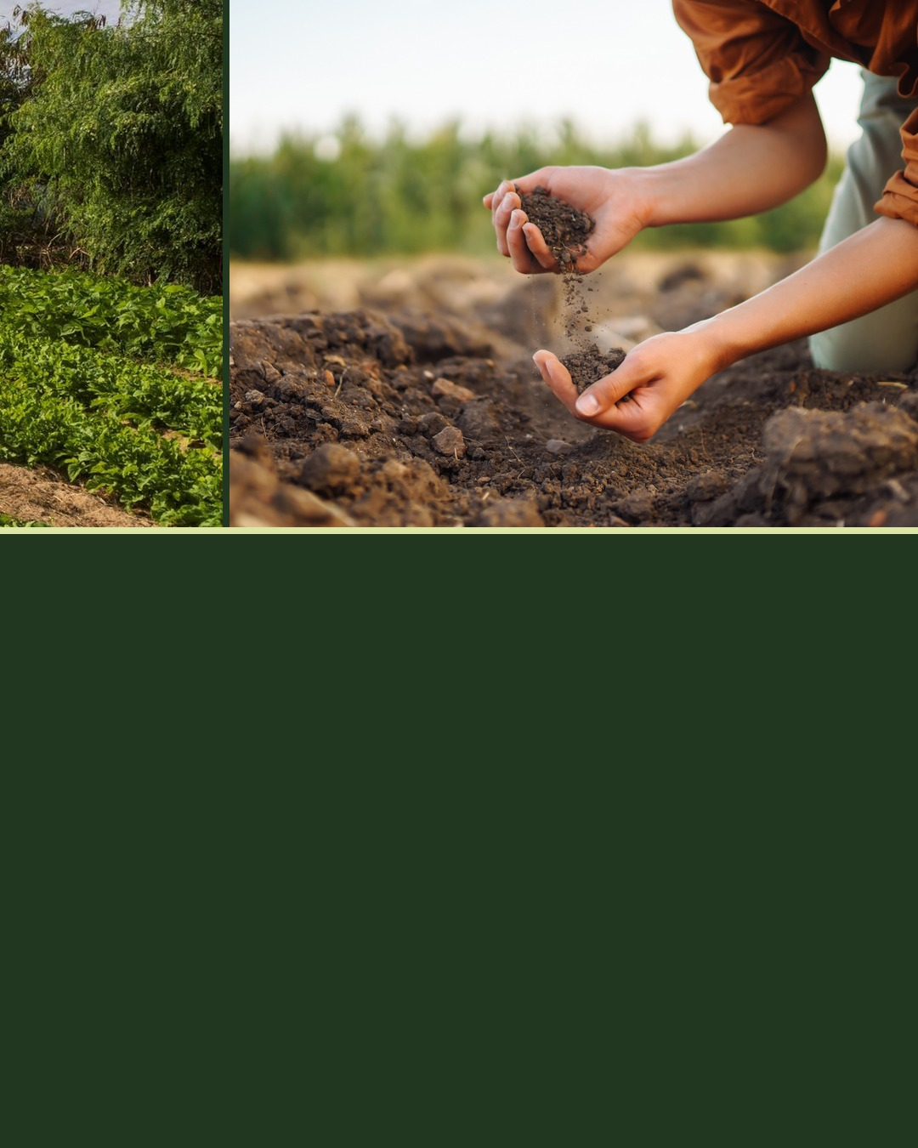
THE FINDING
One practice alone changed nothing.
Farms using just one regenerative practice looked the same as conventional farms. The outcomes came from the full system, living soil included.
Lundgren et al. 2026, Environ. Res.: Food Syst.
Notes:
Closing slide. Link for the caption: https://doi.org/10.1088/2976-601X/ae8f4e. Sources: Lundgren et al., Environmental Research: Food Systems, 2026, https://doi.org/10.1088/2976-601X/ae8f4e; Ecdysis Foundation press release, 17 September 2026, https://www.globenewswire.com/news-release/2026/09/17/3363925/0/en/regenerative-farming-outpaces-tech-based-carbon-capture-solutions-in-first-large-scale-systemic-study.html

