Slide 1



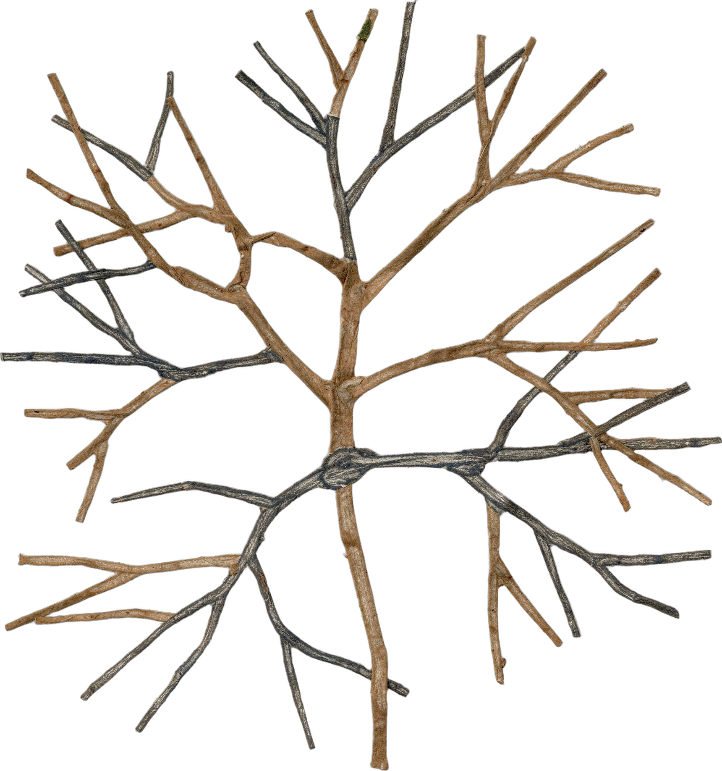
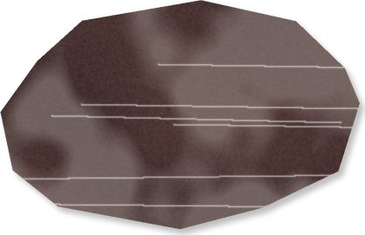

“A new study of working farms: the most regenerative farms stored 39% more carbon in their soil.”
Lundgren et al. 2026, Environ. Res.: Food Syst.
Notes:
Template 2A, scrapbook. Sources: Lundgren et al., Environmental Research: Food Systems, 2026, https://doi.org/10.1088/2976-601X/ae8f4e; Ecdysis Foundation press release, 17 September 2026, https://www.globenewswire.com/news-release/2026/09/17/3363925/0/en/regenerative-farming-outpaces-tech-based-carbon-capture-solutions-in-first-large-scale-systemic-study.html Field collage: stand-in from existing cutouts (ferns over torn-paper soil with the fungal-hyphae cutout) until field-cross-section is generated [COLLAGE NEEDED]. Stickers are drawn PowerPoint shapes (grouped, editable).

Slide 2
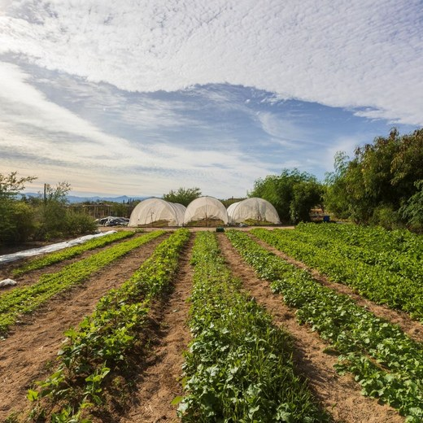
The 1000 Farms Initiative, led by Ecdysis Foundation,
measured farms across North America, from the most conventional to the most regenerative.
Foundation library
Lundgren et al. 2026, Environ. Res.: Food Syst.
Notes:
Photo: assets/photo/erc-rancho-cacachilas-agro.jpg (Foundation library). Stickers are drawn PowerPoint shapes (grouped, editable).

Slide 3
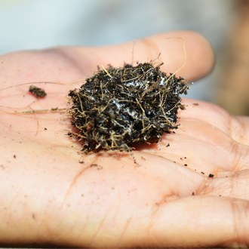
39%
more total soil carbon on the most regenerative farms.
Foundation library
Lundgren et al. 2026, Environ. Res.: Food Syst.
Notes:
Template 5 big number, scrapbook. Photo: assets/photo/hand-soil-roots-fungi.jpg (Foundation library). Stickers are drawn PowerPoint shapes (grouped, editable).

Slide 4
77%
more total fungi in regenerative soils.
Lundgren et al. 2026, Environ. Res.: Food Syst.
Notes:
Template 5 big number, scrapbook. Cutout: fungal-hyphae-1 (cut paper). Stickers are drawn PowerPoint shapes (grouped, editable).

Slide 5
More life everywhere: soil microbes, insects, plants and birds.
The more biodiversity, the more carbon stored.
Lundgren et al. 2026, Environ. Res.: Food Syst.
Notes:
Stickers: bacteria, beetle, wildflowers and a bird, one for each group in the sentence. Stickers are drawn PowerPoint shapes (grouped, editable).

Slide 6
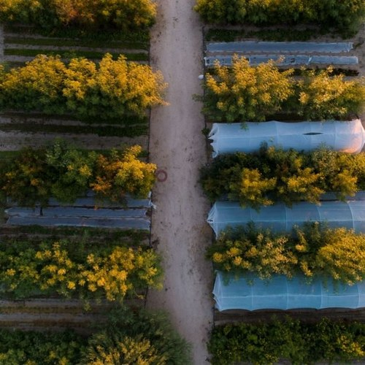
Regenerative yields matched national averages,
and net profit per acre was similar.
Foundation library
Lundgren et al. 2026, Environ. Res.: Food Syst.
Notes:
Photo: assets/photo/erc-rancho-cacachilas-agro8.jpg (Foundation library). Stickers are drawn PowerPoint shapes (grouped, editable).

Slide 7
One practice alone changed nothing.
Farms using a single regenerative practice looked like conventional farms. The whole system matters.
Lundgren et al. 2026, Environ. Res.: Food Syst.
Notes:
One lonely seedling on the left, the whole system (fungi, bacteria, beetle, flowers) on the right. Stickers are drawn PowerPoint shapes (grouped, editable).

Slide 8

Read the paper: Lundgren et al., Environmental Research: Food Systems, 2026.
[PAPER TITLE NEEDED]
Environmental Research: Food Systems
https://doi.org/10.1088/2976-601X/ae8f4e
Lundgren et al. 2026, Environ. Res.: Food Syst.
Notes:
Closing. Paper title: not reachable from this session (doi.org and the journal were blocked); fill in the exact title from the DOI page [PAPER TITLE NEEDED]. Stickers are drawn PowerPoint shapes (grouped, editable).

